Slide 1

Teaching Educators How To Integrate Tablet PC’s Into Their Classrooms
Presenter: Michael K. Nelson
University of Hawaii at Manoa
  College of Education
  Learning Design & Technology
  M.Ed. Graduate Student
Notes:
Aloha and welcome to my TCC presentation entitled “Teaching Educators How to Integrate Tablet PC’s Into Their Classrooms”. My name is Michael Nelson and I am graduate student in the Learning Design & Technology program with the College of Education at the University of Hawaii at Manoa.
I have also been a secondary mathematics teacher for the last 10 years. This presentation showcases my culminating project for my Masters of Education. I hope you enjoy the presentation, and I look forward to your questions at the end.

Slide 2
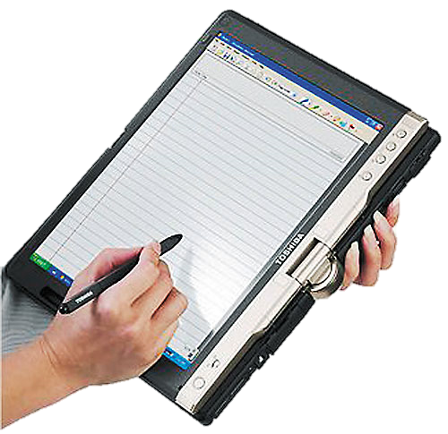
Polling Question
Are you familiar with the Tablet PC?
Notes:
Before I begin my presentation, I would like to ask the audience this question. Are familiar are you with the tablet PC? Using the icon in your participant window, click on the green check for yes or the red check for no.
Ok now I’m going get the results and post them
I see that poll shows that less than half of the responders are familiar with the Tablet PC. This presentation should help you
We see the poll shows about a 50/50 spilt of responders are familiar with the Tablet PC
We see that the poll shows a majority (more than 50%) of responders are familiar with the tablet PC.
That’s great! I hope presentation shares some new ideas about how the Tablet PC can be used.

Slide 3
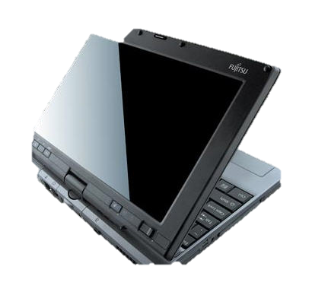
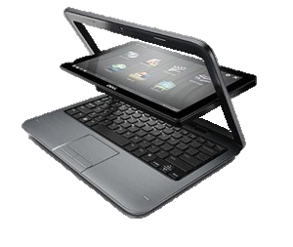
What is a Tablet PC?
A hybrid between a tablet and PC laptop
  Uses Stylus
  Most models have an integrated keyboard
  Performs all productivity tasks
    Internet
    Email
    Microsoft Office programs
Notes:
So what is a tablet PC? The tablet PC is essentially a hybrid between a tablet and a PC laptop. The key feature of the tablet PC is that you can use a stylus to handwrite directly on the screen as shown in the picture to the lower right. The tablet PC also has touch screen capabilities where the stylus can be used similar to a mouse, such as for selecting an icon or launching a program.
Most models of the tablet PC have an integrated keyboard as part of the standard hardware, as shown in the two pictures to the right. Also, many models allow the user to rotate the screen and lay it flat, so that the user can write on the screen, similar to writing on a paper notebook. The tablet PC can truly be an electronic notebook.
The tablet PC also includes all the computing that a laptop or desktop PC has. The user can perform all productivity tasks with the tablet PC, including accessing the internet, writing & sending emails, and working with Microsoft Office programs, such as Word or Excel.

Slide 4

Project Idea - Background
Educators are expected to integrate technology into their classrooms.
I wanted to improve my skills at integrating technology into my own classroom.
Notes:
Now that we have defined what the tablet PC is, I would to share some background about how I originated the idea. Through my teaching experience along with my studies and research at the University of Hawaii, I recognize that educators are being expected to improve their technology skills and integrate new technology into their classrooms. Many times teachers are expected to learn about this technology on their own and figure out ways on how this technology can be integrate into their classroom. I felt that by designing and educational website where I teach others about the features and ways the tablet PC can be integrated into a classroom, I would improve my skills and learn useful ways that this technology could be brought into my classroom.

Slide 5

Project Idea - Background
Researched technologies that would facilitate teaching mathematics – learned about tablet PC.
Tablet PC offers great promise for improving pedagogy.
    Handwrite mathematical symbols
    Hand-solve math problems.
    Annotate PowerPoint presentations with handwritten comments.
Notes:
I started researching different cutting-edge technologies that could potentially be integrated in a classroom to improve the learning experience. During my research, I discovered the tablet PC.
I thought it would be an excellent technology tool for any educator, but especially for a mathematics teacher. I envisioned a great fit for a math teacher. With a tablet PC, teachers could use the stylus to write numbers and mathematical symbols, such as PI or root signs, directly on the screen. Mathematical problems could be hand-solved with the electronic whiteboard. I found this particularly useful as PowerPoint presentations do not always lend themselves well to teaching and working through math solutions.
Lastly, for the PowerPoint presentations that a teacher does use, he or she can annotate the presentation with handwritten comments directly on the slide. Or solve additional problems in real time when students have question. I saw this as an excellent way to actively engage students and assist the teacher in emphasizing key lesson concepts.

Slide 6
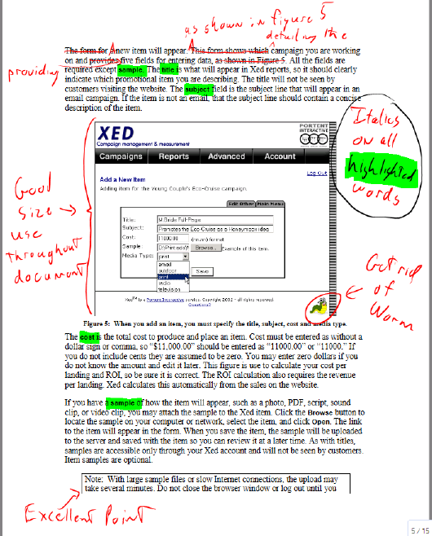
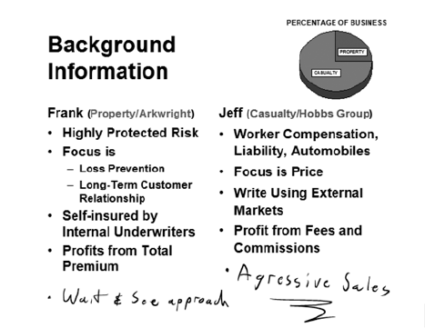
Examples of the Tablet PC in Action!
Notes:
Here are a few examples of how innovative features of the tablet PC would look like on documents. The picture on the left show the highlighting and ink feature that can be used to annotate a document.
The picture on the right is a PowerPoint presentation. Notice how the presenter annotated slide with his comments “Wait and See Approach” and “Aggressive Sales”, down at the bottom of the slide. This type of annotation would likely engaging the audience to a higher level. This type of annotation would be much more difficult to accomplish with a mouse. The stylus allows for real-time annotating.

Slide 7
Project Idea - Background
Create an instructional design website where educators could learn about the tablet PC’s innovative features.
Target Audience for Website
      Educators
      Deliver content through PowerPoint slides or writing on the whiteboard.
      Experienced with Microsoft Windows
      Motivated with integrating technology into their presentations
Notes:
After I learned about the key features of the tablet PC, I invested significant amount of time in mastering how to actually use the tablet PC features in a classroom. I also realized that as an educator, most teachers do not have a lot of free time to learn about new technology and how to integrate it into their classroom.
For this reason, I decided to create and easy step by step instructional design website where teachers could learn about the key features of the tablet PC.
My targeted as my audience was educators who tend to deliver their instructions content using PowerPoint slides or by writing on a whiteboard. They would be familiar with using computers and the basic knowledge of Microsoft Windows its functions and page set up. Ultimately, the audience would be interested and motivated to integrating technology into their classroom.

Slide 8


Problem Statement
The purpose of this instructional design project was to create an instructional website that educated teachers on the innovative features of tablet PC’s so they can ultimately use the knowledge to integrate tablets into their classrooms and positively impact their pedagogy.
Notes:
So with the idea of creating a website to teach teachers about the tablet PC, I crafted the following problem statement “The purpose of this instructional design project was to create an instructional website that educated teacher on the innovative features of tablet PC’s so they can ultimately use the knowledge to integrate tablets into their classrooms and positively impact their pedagogy.”

Slide 9

Goals and Objectives
Overall Goal: Educate and motivate teachers to integrate technology into their classrooms.
Primary Learning Objective: Educate teachers on the features of the tablet PC that will impact their teaching pedagogy.
Notes:
My overall goal was to educate and motivate teachers to integrate technology into their classrooms, My primary learning objective was to educate teachers on the features of the tablet PC that will impact their teaching pedagogy.

Slide 10
Instructional Design Website
The project consist of six modules:
Module 1: Discusses the differences between the Tablet, PC and Tablet PC
Module 2: Explains how to use the input panel. text and writing using the stylus
Module 3: Explains how to the operate the electronic ink features and whiteboard background
Notes:
My instructional website included a total of 6 learning modules.
Module 1 focusing on explaining the key fundamental differences between the tablet, a desktop or laptop PC, and the tablet PC. In Module 2, the Input Panel was introduced, and the website participant learns how to “type” text using the Key Pad and handwrite text using the writing pad and stylus. From there, Module 3 introduces the concept of the electronic whiteboard, and focuses on key features such as changing ink color and thickness, customizing the whiteboard background.

Slide 11
Instructional Design Website
Module 4: Explains how to annotate notes. Adding real time information to PowerPoints
Module 5: Explains how to record and file lessons to be viewed later
Module 6: Conclusion & Survey
Notes:
Module 4 I explained how to annotate electronic files, including Adobe Acrobat PDF files and PowerPoint presentations, and save them to be shared later
Module 5 I highlight the basic steps in recording a real-time audio and animations from a PowerPoint presentation. Then save it for later viewing by students or teachers.
Lastly, Module 6 concluded and reviewed the instructional modules and includes a post-questionnaire survey.

Slide 12
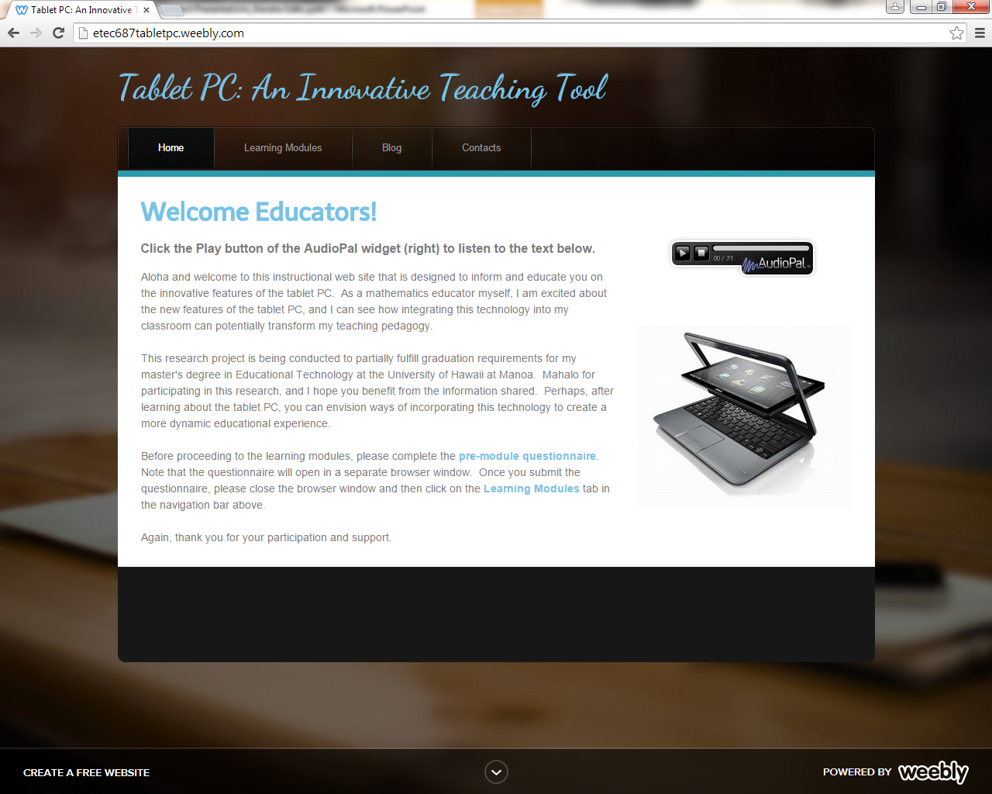
Notes:
This is the screen shot of the home page . This page welcomes the participants to the website. This page includes a widget (in the upper right corner) that is an audio of the text on the page.
The website was designed to have four tabs: Home page, Learning Modules, Blog, and Contacts. There is a link to the pre-questionnaire survey located in the 3rd paragraph of text.

Slide 13
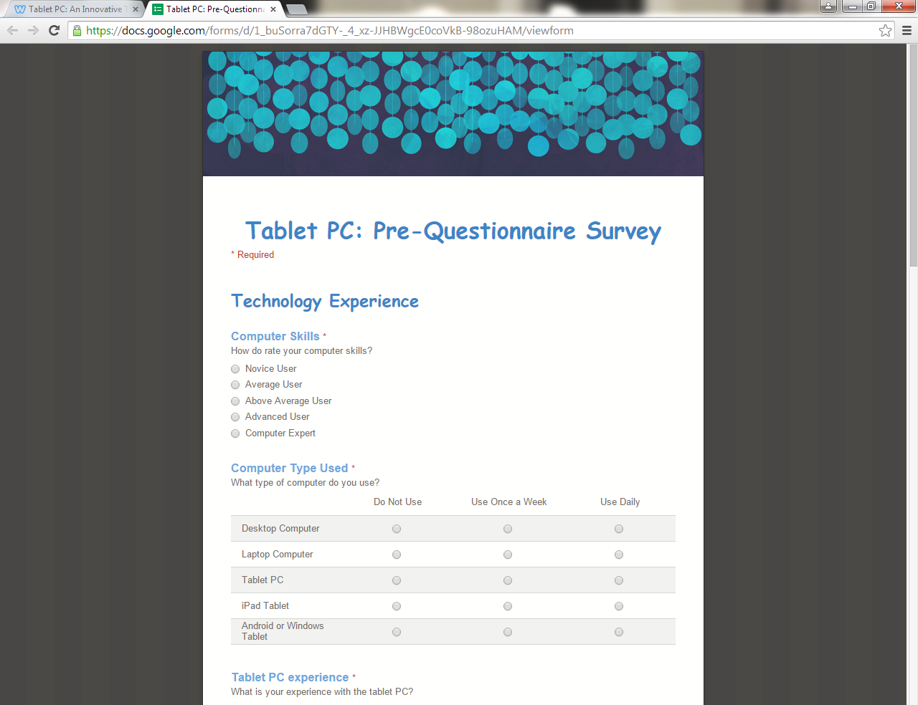
Pre-Questionnaire Survey
Developed using Google Forms
Contained variety of questions
    Technology Experience
    Computer Skills
    Computer Usage
    Technology Integration
Notes:
Here is a screen shot of the pre-questionnaire survey. This survey was created using Google forms. The pre-questionnaire survey asked the participants questions about their technology experience, computer usage, technology integration interest and plans, and computer usage to facilitate teacher pedagogy.
No personal or identifying questions were asked in the pre-questionnaire survey. Google forms collects the data and stores it into a spreadsheet. The participants’ identity remained completely anonymous through this process.

Slide 14
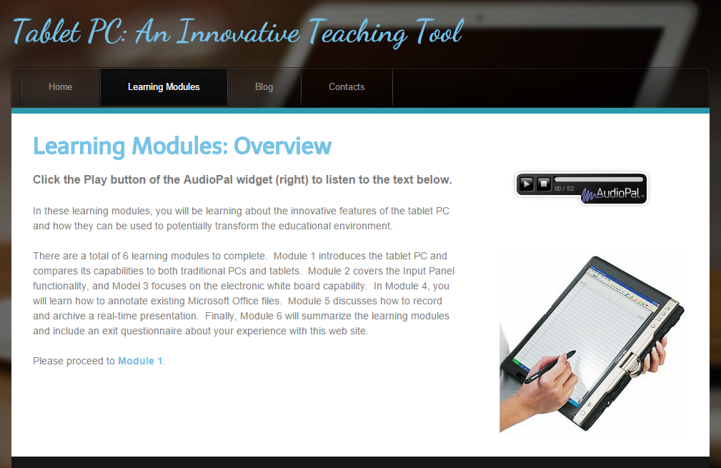
Notes:
This is the screen shot of the Learning Modules overview page. It is an introduction that discussing the structure of the learning modules and also provides information of what the participants will be learning as they complete the modules in my website. This page also offers the opportunity to listen to the text through audio by clicking on the autopal icon on the upper right.

Slide 15
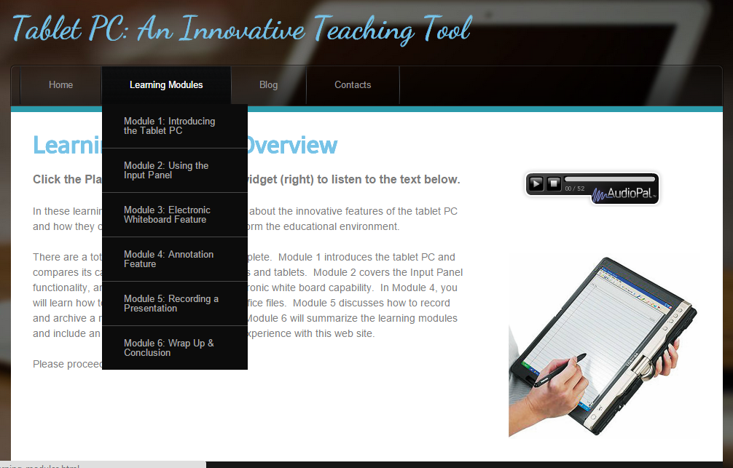
Notes:
Here is a screen shot of the learning modules dropdown menu. As you can see it shows all 6 instructional modules the participants can click on any module
to begin but I recommended to complete the modules in numerical order.

Slide 16
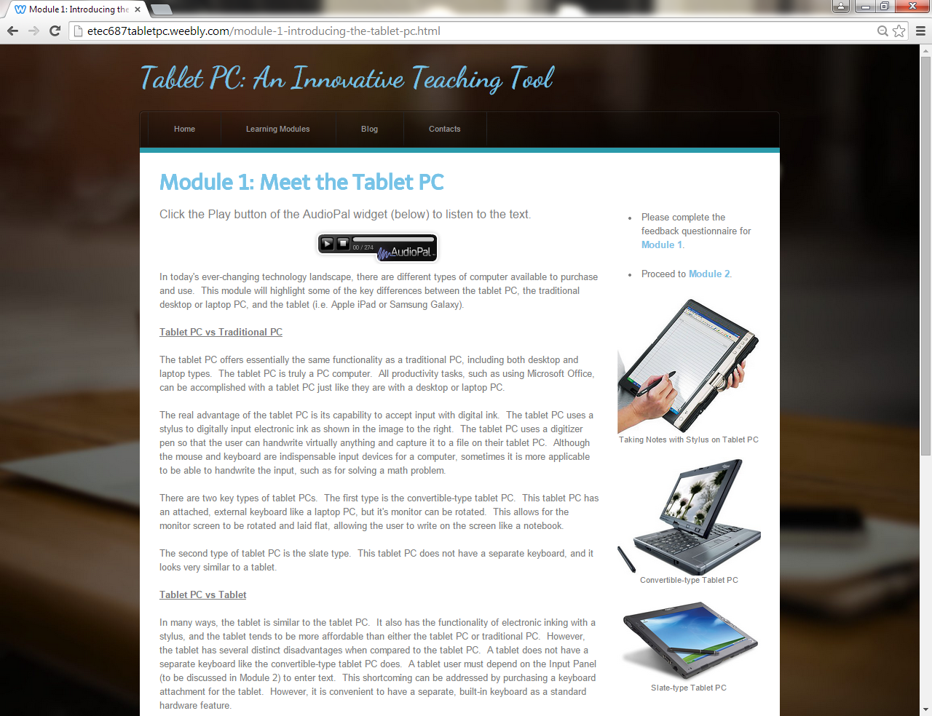
Notes:
Here is a screen shot of Module 1 which is my first learning module in my website. What I mean about that is it is the first module where the participants will question on the features taught. The main learning objective of this module is to teach the participant about the key differences and features of the tablet, PC, and tablet PC. I includes a link in upper right corner, The participant can click on this link after they have completed reading or listening to the information this link will take the participants directly to the feedback survey and when completed the survey. they can click on the module 2 link which will take them directly to Module 2.

Slide 17
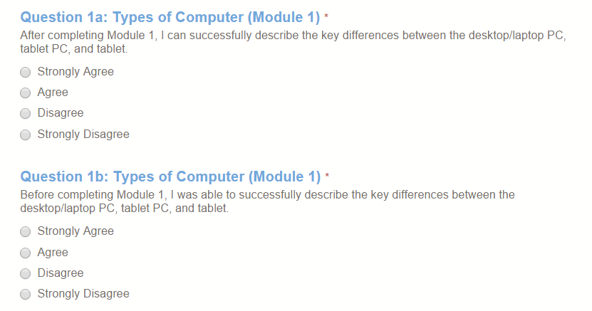
Module 1: Feedback Survey
Retrospective Questioning
Notes:
Here is a screen shot of the feedback survey for Module 1 . Like the pre-questionnaire survey, this survey was created using Google forms. The survey contains two sections. The 1st section is the Technology Experience section where the participants were asked feedback about achieving the learning objectives via retrospective questioning. Using a 4-point Likert scale, the retrospective question in this module asked the participant if he or she could describe the key differences between the tablet, PC, and tablet PC before and after taking the module (Questions 1a and 1b).
The 2nd section was a free response section where the participant could provide immediate, feedback on his or her experience with the module. The same format of retrospective questions and a free response question were utilized in Modules 2 to 5’s feedback surveys.

Slide 18
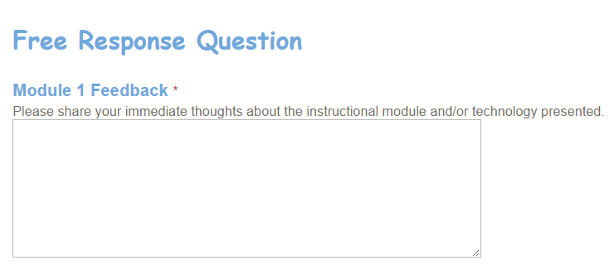
Module 1: Feedback Survey
Notes:
Here is a screen shot of the feedback survey for Module 1 . Like the pre-questionnaire survey, this survey was created using Google forms. The survey contains two sections. The 1st section is the Technology Experience section where the participants were asked feedback about achieving the learning objectives via retrospective questioning. Using a 4-point Likert scale, the retrospective question in this module asked the participant if he or she could describe the key differences between the tablet, PC, and tablet PC before and after taking the module (Questions 1a and 1b).
The 2nd section was a free response section where the participant could provide immediate, feedback on his or her experience with the module. The same format of retrospective questions and a free response question were utilized in Modules 2 to 5’s feedback surveys.

Slide 19
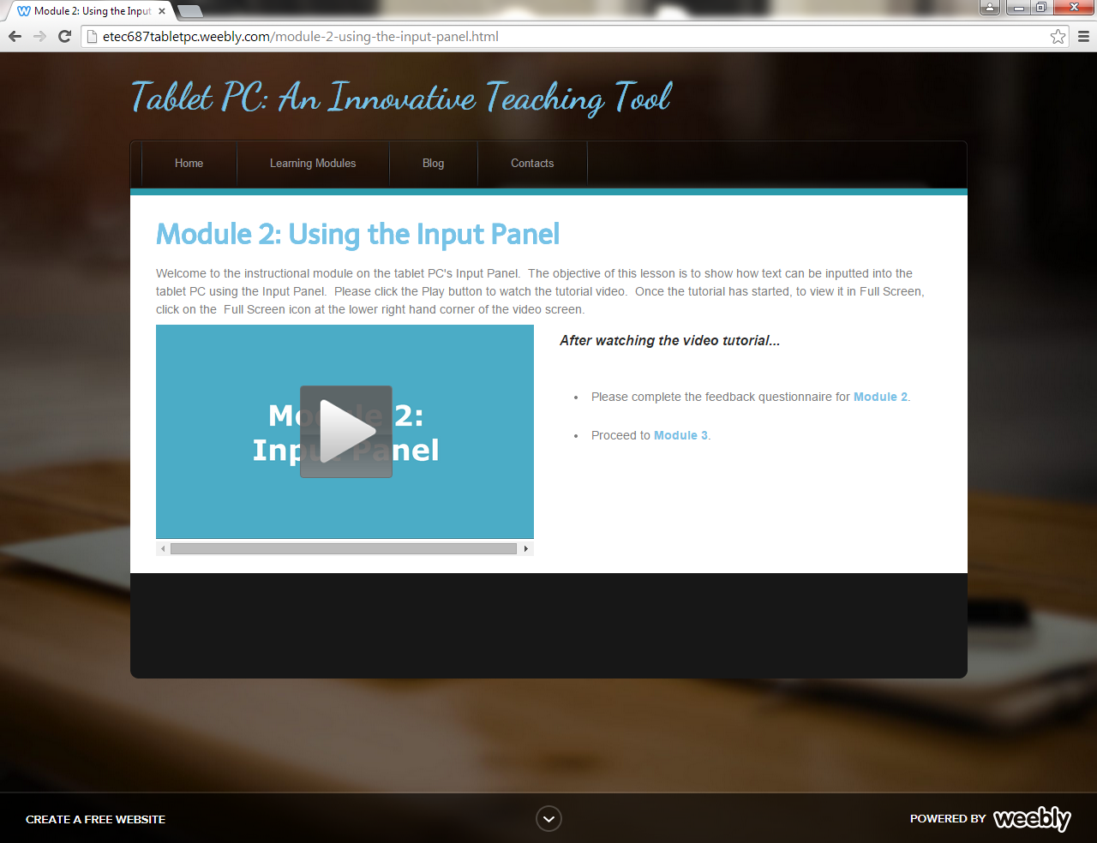
Notes:
Here is a screen shot of module two. In this module I used video and audio to deliver the instructional content. The content in this module talks about how the stylus can be used to input text on to powerpoint slides. I showed two ways of doing this, one was using the key pad icon which is like an electronic key board and the stylus is used to tap on each letter. The other was using the writing pad and the stylus was used to write directly on the screen to enter the text. Again I included links that will take the participants directly to the feedback questionnaire and when they have completed it they can click on the next modules link. I included these links on the modules that included a feedback questionnaire to make navigation easy and quick.

Slide 20
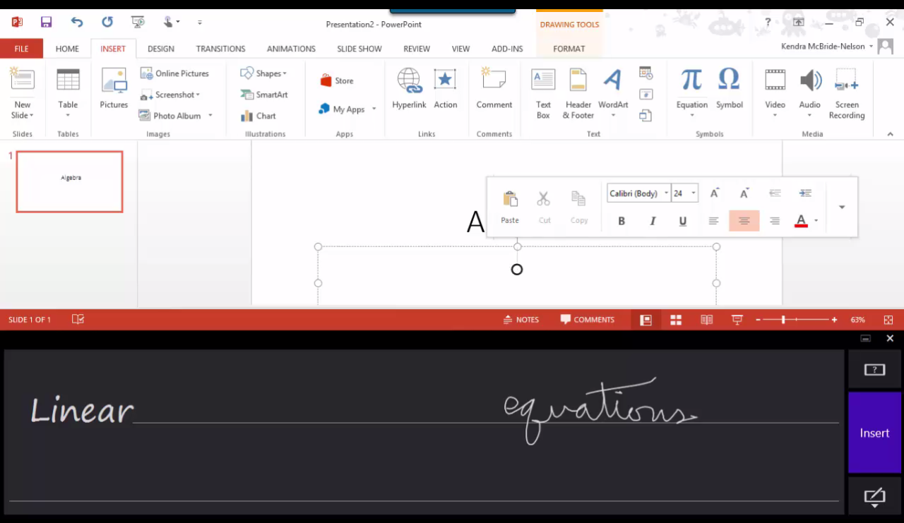
Notes:
Here is a screen shot of part of my lesson in module 2 in this shot I’m teaching how to uses the writing pad. The neat thing about the writing pad is that text can be written in print or cursive and the software is very accurate when determining the correct text when it is written in cursive. The text can be checked here on the left for accuracy before being placed on to the slide. I personally liked writing in cursive rather than using the key pad because it was much quicker when placing large amounts of text on to the slide.

Slide 21
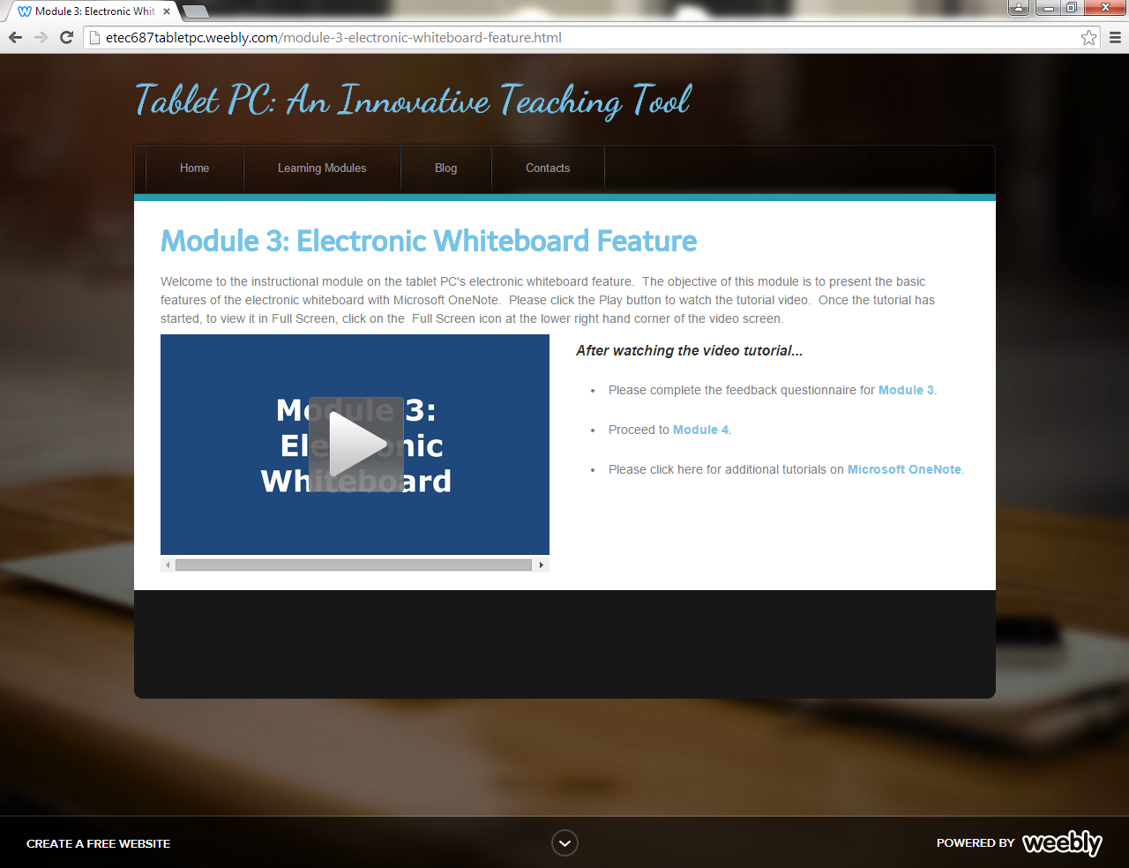
Notes:
This is a screen shot of module 3’s page. This tutorial shows how to use Microsoft OneNote as an electronic whiteboard. The module focuses on how to use the ink features, including changing ink color and thickness, as well as how to manipulate the background of the whiteboard. I used audio and video to deliver the learning content.

Slide 22
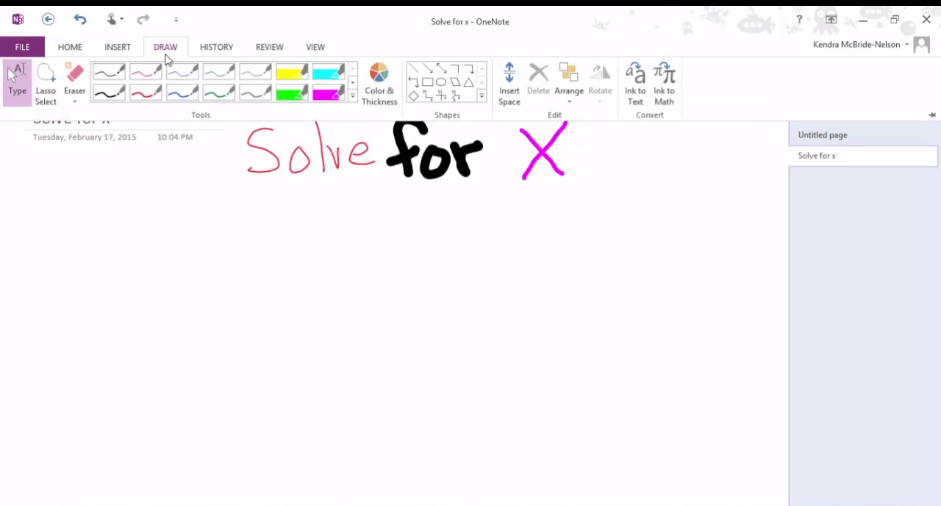
Notes:
Here is a screen shot from the tutorial of the use of different ink colors and thicknesses. The icons at the top allow the user to choose the color & thickness, or even the highlighter if needed using the stylus. This feature is great for math teacher who want to show examples of math procedures used to complete problems. In this example the stylus was used to write the text directly on the screen like a whiteboard.

Slide 23
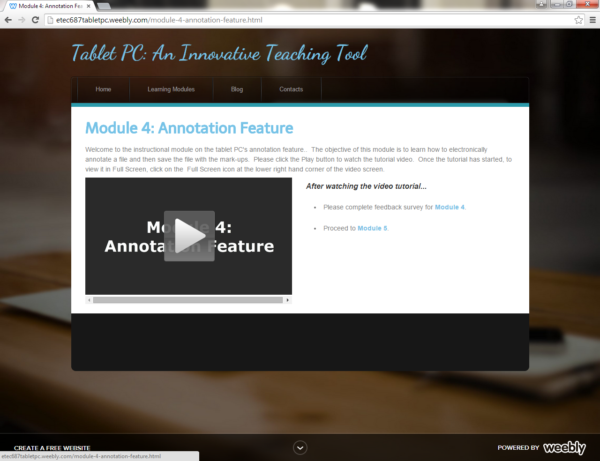
Notes:
This is a screenshot of module 4 page. This tutorial educates the user on how to electronically annotate a file using the tablet PC. module talked about the annotation features of the tablet PC. In this module participants were required to open a file using powerpoint and annotate the file then save it to view latter by student.

Slide 24
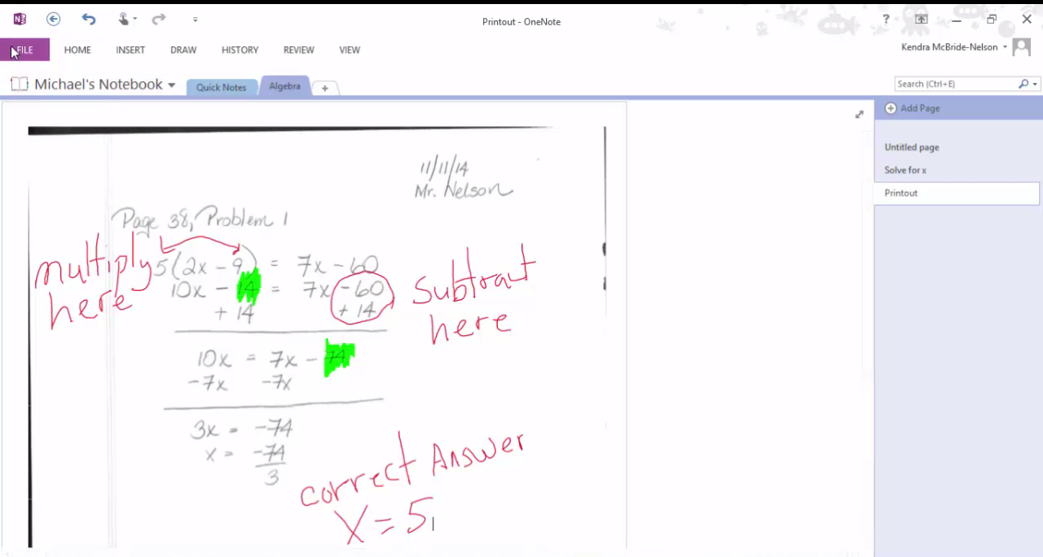
Notes:
Here is a screen shot of module 4’s lesson. In this tutorial, Microsoft OneNote in used to order to be electronically annotated. As you can see here annotations have been added to the document in both red ink and highliteing..
This feature is very useful for teachers because they show the corrections directly on the students work that has been scanned and emailed to the teacher. by the teacher. Annotations can be made then shared with the class or shared with the individual student. This feature can also allow students who will be absent for long periods of time to send their work electronically to their teacher who can make correction and give feedback then send that information back to the student.

Slide 25
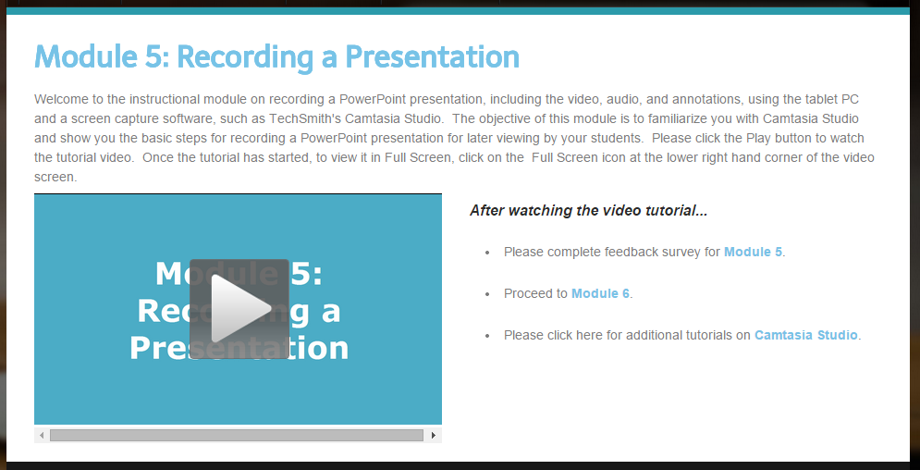
Notes:
Here is module 5’s page. This module details the necessary steps to record the real-time audio and animations of a powerpoint presentation and archive it so it can be viewed later by the students or the teacher. I also covered how the saved presentation can be embedded into a class website. This was the most difficult module to create. In this module I had to use Snagit, which allowed me to capture the exact steps I was doing in Camtasia Studio in order to record a PowerPoint presentation. Specifically, I was able to record and show the participants how to open Camtasia Studio and then Microsoft Powerpoint in order to record their powerpoint lesson. Designing and learning how to do this was one of my biggest challenges.

Slide 26
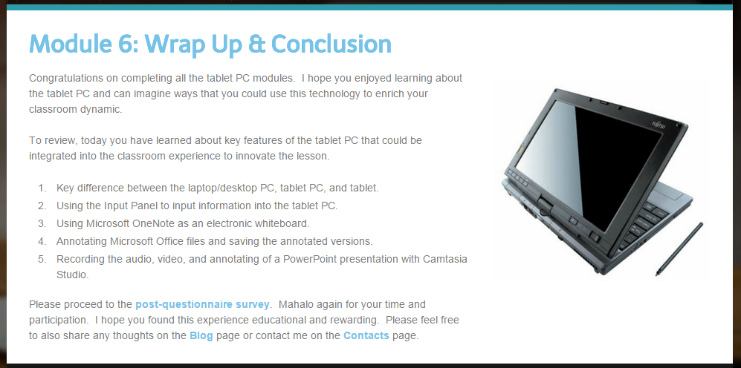
Notes:
This is a screen shot of the final module, Module 6. This is not a learning module, but rather it is a summary of the key concepts covered in the website. I also felt that this was good place to thank my participants for there time and energy in completing the learning modules. I also included a link that took the participants to final questionnaire.

Slide 27
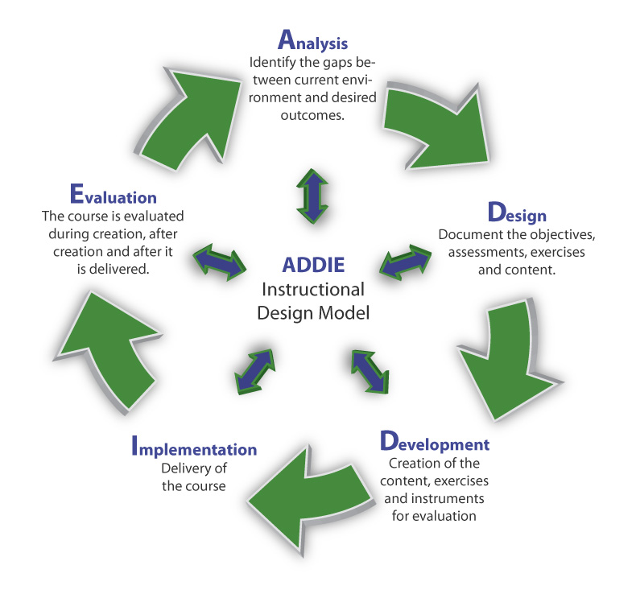
Project Development
ADDIE process was core of my project development.
Development process was cyclical.
The building of the website went through multiple iterations.
Notes:
Now that I have shown you my instructional design website, I want to spend some time sharing with you how I developed my project.
At the core of the my instructional design project was the ADDIE process.
Originally only created learning modules that focused on tablet PC features.
I used the ADDIE model in designing this website. It helped me to keep structure and organization as I completed this project. During the Analyzing phase I determined my target audience, What I wanted to teach them, and what my delivery method would be. I then designed my learning objectives and assessment methods. Developing the learning modules was time consuming and frustrating. I had to learn and test many different types of software to determine which ones would create an easy to navigate and understand learning modules. My implementation did not go as planned and some of the participants completed the modules without using a Tablet PC and were unable to practice using the features during the lessons. Formative evaluations were used for each module to improve navigation abilities and understanding of content, Summative assessment were used to determine that all the links worked and feedback could be collected. The ADDIE process helped me complete my project and be thorough with the design of each module.

Slide 28

Project Development
Used Weebly as my platform to build my website
Variety of Web 2.0 tools & software programs
  Audio Recordings
      SoundCloud & AudioPal
  Video Recordings
      Screencast-O-Matic
      Camtasia Studio & Snagit
  Participant Surveys
      Google Forms
Notes:
Now that I have shown you my instructional design website, I want to spend some time sharing with you how I developed my project.
First, I decided to use Weebly as my platform to build my ID website. I chose Weebly for several reasons: 1) It is a free Web 2.0 tool, 2) It is simple, user-friendly, and intuitive to use and 3) I had built up some expertise with Weebly in my previous LTEC classes.
For my ID website, I also used a myriad of other Web 2.0 tools. For audio recordings in the website, I initially selected SoundCloud but in my final version of the website, I used AudioPal. For creating the video tutorials, I initially chose Screencast-o-matic because it as a free Web 2.0 tool, and it appeared to be robust enough to create quality video tutorials. However, I soon learned that even the upgraded, paid version of Screencast-o-matic lacked the flexibility that I needed to edit and produce a quality video. Also, there was a “bug” or incompatibility between my tablet PC and Screencast-o-matic that I will discuss in greater detail during the Challenges portion of my presentation. So for the final version of my ID website, I used Camtasia Studio to record and produce all my video tutorials.
Lastly, for my project participants to evaluate and provide feedback on the website, I designed and built the surveys using Google Forms. There were several things that I particularly liked about Google Forms. 1) It’s also a free Web 2.0 tool, 2) It’s part of the Google docs suite of tools, and I gained a lot of experience with Google Docs during the LTEC program, 3) It was pretty easy to build a survey, publish it, and then create a link to it for quick access, and 4) Google Forms captures all the survey responses in a spreadsheet that updates as additional participants submit responses.

Slide 29
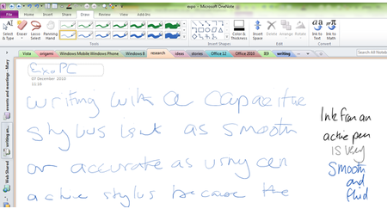
Obstacles during Development
Digitizer Pen vs. Capacitive Stylus
Notes:
When I purchased my tablet PC, I was under the impression that I would be able to write with the stylus almost like I would write with a ballpoint pen. I soon learned that my handwriting looked like I was writing with a crayon rather than a pencil or ballpoint pen. After some extensive research, I realized that my tablet PC was not equipped with a digitizer pen like most tablet PC’s are. Instead my Dell XPS 12 2-in-1 Ultrabook™ was equipped with Touch Screen technology and can only utilize a capacitive stylus. As you see in the screenshot, the handwriting to the left is written with a capacitive stylus, and it appears “crayon-like” while the handwriting on the right is written with a digitizer pen, and it appears “ballpoint pen-like”.

Slide 30
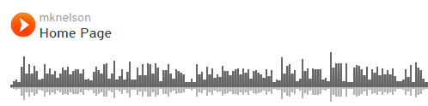


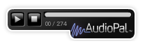
Obstacles during Development
Audio Recordings
Notes:
When I recorded the audio for my ID website, I originally used the free Web tool, SoundCloud. I had no problems recording with SoundCloud, and I was pleased with the audio quality. However, when I embedded the audio as an object on the web page, it appeared as shown above. I didn’t like that my user ID, track name, or the audio bars were displayed. I also found that the audio didn’t consistently stop playing when paused.
So I decided to look for another audio recording tool. I found AudioPal. I would upload the MP3 recording and then AudioPal would provide me the HTML code to embed the object on the web page. I really like the AudioPal widgets as shown. They are sleek, compact, and have distinct Play and Stop buttons.
Even though AudioPal quickly allowed me to embed audio, it was a little challenging to get the audio into MP3 format. As a work-around, I recorded the audio with Sound Recorder, which saves the file in WMA format. From there, I used convert.com to change the audio files from WMA to MP3 format.

Slide 31
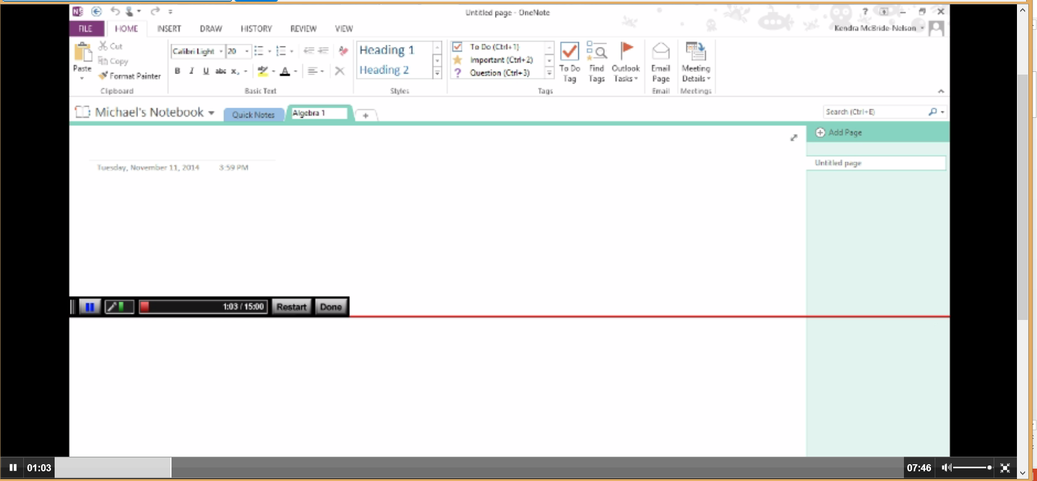
Obstacles during Development
Video Recordings
Screencast-O-Matic recording bar appears in the video recording
Notes:
When I was creating my video tutorials for my ID project, I originally chose Screencast-O-Matic because it was a free Web 2.0 tool that seemed easy to use and have robust functionality. When I recorded the tutorial for Module 2 (Input Panel), Screencast-O-Matic’s recording control bar became stuck in the middle of the recording area. When I produced the video, the recording bar did not disappear and it looked as shown in the screen shot. Sceencast-O-Matic lacked features to easily edit the video recording and produce a more professional product.
I knew that TechSmith’s Camtasia Studio was a superior software for recording videos. I purchased software licenses for Camtasia Studio and also Snagit. It was challenging to learn another software product and re-record the videos; however, Camtasia Studio and Snagit yielded a much more superior, professional recordings.

Slide 32


Obstacles during Development
Recording of Modules
Scripting easy-to-follow screencasts to make learning features simple for participants.
Notes:
I was surprised at how many times I had to record my tutorials, modifying the script each time to make it understandable for the participants. It was also very time consuming to edit the recordings in Camtasia Studio and produce them as finished video recordings.

Slide 33
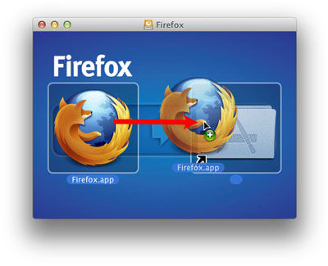

Obstacles during Development
OS/Browser Incompatibility

Slide 34
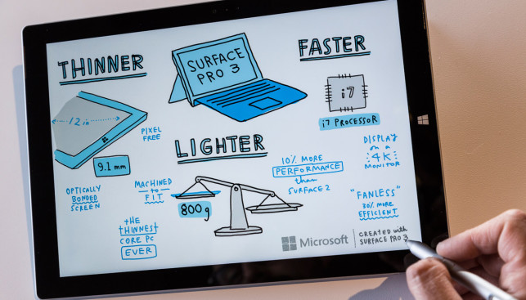
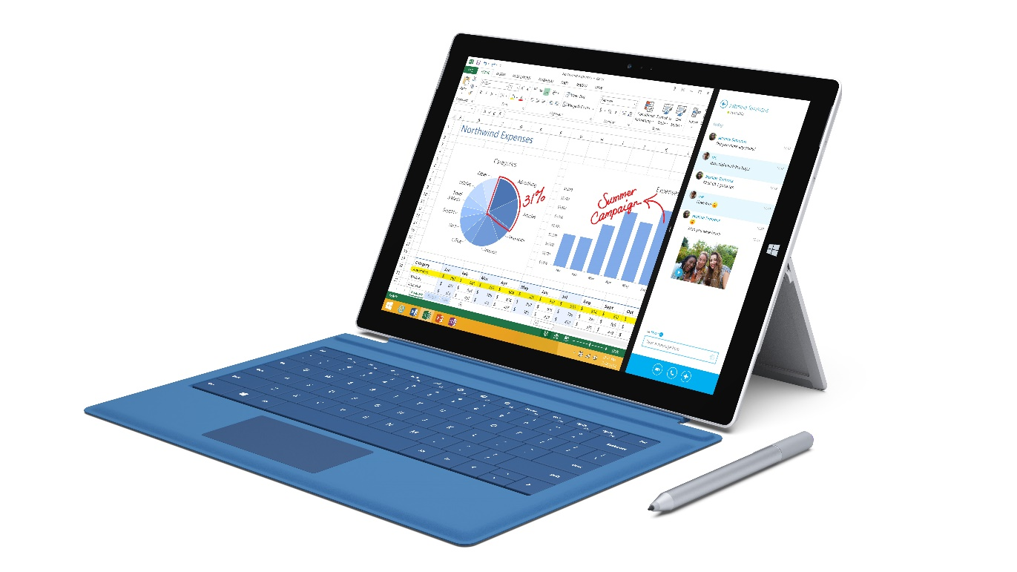
New Technology: Microsoft Surface Pro 3
Notes:
The Microsoft Surface Pro 3 integrates all the best features of the tablet PC, the personal computer, and the tablet into one. The Surface Pro 3 has digitizer pen technology and as you can see from the photo on the left, the level of detail

Slide 35

Project Accomplishments
Created the website I envisioned
Became proficient tablet PC.
Increased Weebly website development experience.
Gained more skills with Web 2.0 tools.
  SoundCloud
  Screencast-O-Matic
  Google Forms
Successfully produced videos with Camtasia Studio & Snagit.
http://etec687tabletpc.weebly.com

Slide 36
A Special Thank You…
My critical friends, Madeline and Davina
Fellow LTEC classmates
Professors
My wife, Kendra McBride-Nelson
Notes:
I would like to express my appreciation and thanks. First, I would like to thank my critical friends, Madeline Giscombe and Davina Pangelinan. They have offered me invaluable feedback throughout this last year.
Second, I would like to thank my fellow cohorts. It has been great to get to know you over the last several years, and I have learned so much from you all during this program.
Third, I would like to thank my professors, especially my advisor, Dr. Catherin Fulford, for their guidance and patience. I know that working with someone who was a technology challenged as me required extra time, flexibility, and effot.
Lastly, I would like to extend a special mahalo to my wife, Kendra. Blah blah blah!

Slide 37


Questions?
Thank You
for your time…
Notes:
I appreciate your interest and time during my TCC presentation. Does anyone have any questions about my project?
If there are no further questions, mahalo again! Aloha!

