Slide 1

Self-Splitting of Liquid-Metal Nodes

Slide 2
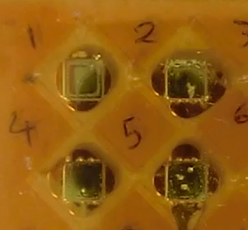
1 cm

Slide 3
Electrically Merging Liquid-Metal Nodes

Slide 4
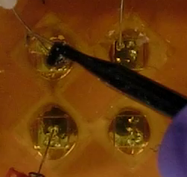
1 cm

