Slide 1

OSN Fall Invitational Conference 2012 Kaua‘i Community College
Student Ethnobotany Experiments

Slide 2
10:15am-11:00am
Expanse of student ethnobotany experiments
Value of Individual experiments
  Hands-on activity
Value of Group experiments
  Hands-on activity
Group discussion

Slide 3
There can always be more time with all experiments
Make the most of the time
that you have with students

Slide 4
Supplies
Paper
Pen

Slide 5
Expanse of Student Ethnobotany Experiments
LIMITLESS
Utilize ethnobotanical methodology
Utilize personal, local knowledge
Utilize the entire room
Utilize outdoors

Slide 6
Individual experiment
Pen, paper
People still depend of plants for survival.
(Prance et al., 2007)
Record on paper a plant you identify with.

Slide 7
Record on paper a plant you identify with:
  What is the name of the plant.
    Common/local/native, scientific name
  What is important about this plant.
  Why is this plant important.
  Why do you identify with this plant.

Slide 8
Hold that thought…please ☺

Slide 9
Group experiment
Pen, group, packet

Slide 10
Group experiment
BOT105: Plants as Symbols of Religion, Power and Economics
(adpated from UHM Fall BOT:1052011)

Slide 11
Task: Break into Groups 3-5
Time allotment: 1 minute
Symbols of Religion, Power and Economics
will come from references of:
Local significance
National significance
International significance

Slide 12
Group Task
2 minutes
Introduce your name.
Introduce where your are from.
Introduce your plant, why do you identify with this plant.
5 minutes (20 seconds per symbol, 12 symbol)
Identify the Plant.
Identify the Significance to religion, power, economics.
Identify the target Audience.
2 minutes
1. As a group discuss the meaning of each slide in the packet as related to religion, power, economics.

Slide 13
BOT105: Plants as Symbols of Religion, Power and Economics
Adapted from UH-Manoa
BOT105: Introduction to Ethnobotany

Slide 14


Slide 15


Slide 16


Slide 17


Slide 18
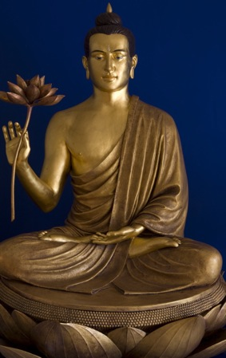

Slide 19
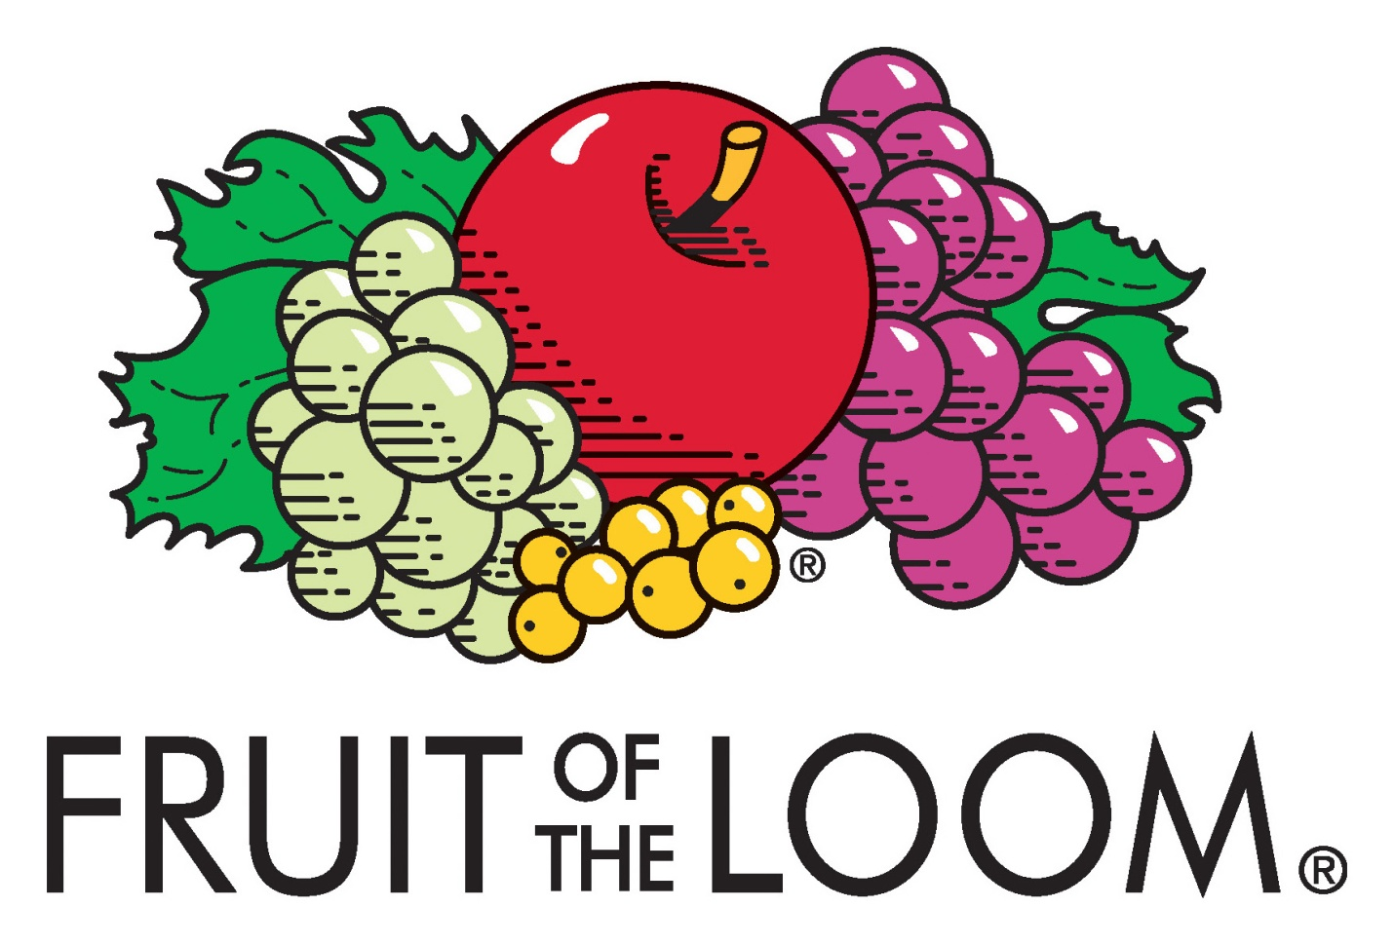

Slide 20


Slide 21


Slide 22


Slide 23


Slide 24


Slide 25


Slide 26
Group Task
2 minutes
Introduce yourselves.
Name your group.
5 minutes (20 seconds per symbol, 15 symbol)
Identify the Plant.
Identify the Significance to religion, power, economics.
Identify the target Audience.
2 minutes
1. As a group discuss the meaning of each slide in the packet as related to religion, power, economics.

Slide 28
Marijuana, Cannabis sp.
Medical use
Patient’s in need of Medical Marijuana

Slide 30
Evergreen coniferous tree
Is associated with Christmas time where an angel or star is placed at the top of the tree, representing the host of angels or the Star of Bethlehem from the Nativity
Christians

Slide 32
Hops, Humulus lupulus.
Authenticity logo has been specially developed to communicate and reinforce the brand’s brewing quality, heritage and authenticity. Its primary application area is direct beer related items.
Beer drinkers

Slide 34
Apple Computers, Malus sp.
The bite symbolized knowledge (in the bible the apple was the fruit of the tree of knowledge) and the bite could also be pronounced "byte", a reference to computer technology.
General Techies

Slide 36
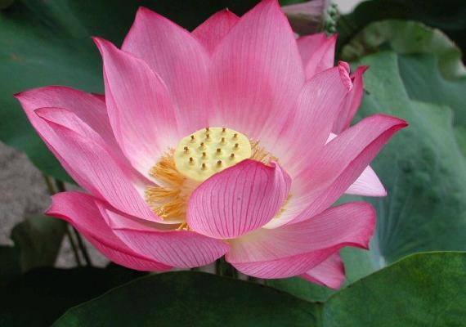
Lotus (Nelumbo nucifera)
The lotus flower is a potent symbol that grows strong and beautiful from the murkiest depths, metaphor for enlightenment.
Buddhists

Slide 38
Apple, green grapes, currants and purple grapes
Fruit of the Loom— a name that bears resemblance to the phrase “fruit of the womb”, an expression meaning "children", which can be traced back to use in the Bible (Psalm 127:3).
Children to senior citizens…one of the most recognizable trademarks in the world

Slide 40
Olive, Olea europaea
the olive leaf as a symbol of abundance, glory and peace - were used to crown the victors of friendly games and bloody wars.
Flag of the United Nations can be used by the personnel and material of UN Peacekeeping missions as a protective sign prevent attacks during an armed conflict.

Slide 42

Hibiscus, Hibiscus sp.
Pualani (Flower of the Sky), which profiles an Island girl with a flower in her hair against a red hibiscus.
"Pualani is more than an abstract image, she's a persona. She's not representative of any one individual. We each identify with her in different ways.“- Hattie Dixon, Senior Director of Advertising and Promotions at Hawaiian

Slide 44
Olive leaves, Olea europaea
The olive branches signify peace between the Turks and Greeks. The map on the flag is a copper-orange colour, symbolizing the large deposits of copper ore on the island (chiefly in the form of chalcopyrite, which is yellow in color), from which it may have received its name.
Flag of Cyprus

Slide 46
Fruit hat, banana, pineapples
the first company to brand the banana back in 1944, when we introduced Miss Chiquita. Her catchy jingle taught consumers about Chiquita bananas and how to store them.
consumers of banana

Slide 48
Taro, Colocasia esculenta
“It’s no accident that American Savings Bank’s symbol is the kalo or taro plant. We chose it to remind us of our dedication to the healthy growth of our communities, and the uniquely beautiful place we all call home.”
Residents of Hawaii

Slide 50
Prickly pear cactus
The story goes that the Aztecs received a vision or a sign from “Huitzilopochtli” through one of their many “gods” that told them they would know where to build their central city or “zocolo”, the empire of Tenochtitlan” ("Place of the Prickly Pear Cactus") when they saw what is today depicted on the Mexican Flag. They were told that when they saw a [Mexican] Eagle perched on a Nopal cactus with a serpent (rattle snake) in its talon, located on an island, this is where they should begin to build their permanent city. They supposedly did encounter this on an island in the middle of a lake (Lake Anáhuac) now known today as México City.
Flag of Mexico

Slide 51
Group Discussion
Group Experiment

Slide 52
Revisit Individual experiment
  Record on paper a plant you identify with:
  Common/local/native, scientific name
  What is the name of the plant.
  What is important about this plant.
  Why is this plant important.
  Why do you identify with this plant.
  1 minute

Slide 53
Group Discussion
Individual experiment

Slide 54
10:15am-11:00am
10:15-10:17am
  Expanse of student ethnobotany experiments
10:18-10:20am
  Value of Individual experiments
    hands-on activity
10:20-10:50am
  Value of Group experiments
    Hand-on activity
10:51-11:00am
  Group discussion

Slide 55
Classroom Planning
Slide number | Activity | Time (min) | (am/pm)
1-5 | Introduction | 3 | 10:18am
6-7 | Individual experiment | 2 | 10:20am
8-10 | Group experiment introduction | 1 | 10:21am
11 | Group break out | 1 | 10:22am
12 | Group introductions | 2 | 10:24am
13-25 | Symbols of plants: religion, power, economics | 5 | 10:29am
26 | Group breakout discussion | 2 | 10:31am
27-50 | Symbols of plants: answers | 10 | 10:41am
51 | Larger group discussion | 5 | 10:46am
52 | Revisit individual experiment | 2 | 10:48am
53 | Final group discussion | 10 | 10:58am

Slide 56
MAHALO
Open Science Network for Ethnobiology
National Science Foundation
Botanical Research Institute of Texas
University of Hawaii at Manoa, Botany Department, Ethnobotany Track
Kamehameha Schools- Imi Naauao
Native Hawaiian Science Engineering Mentorship Program

