Slide 1

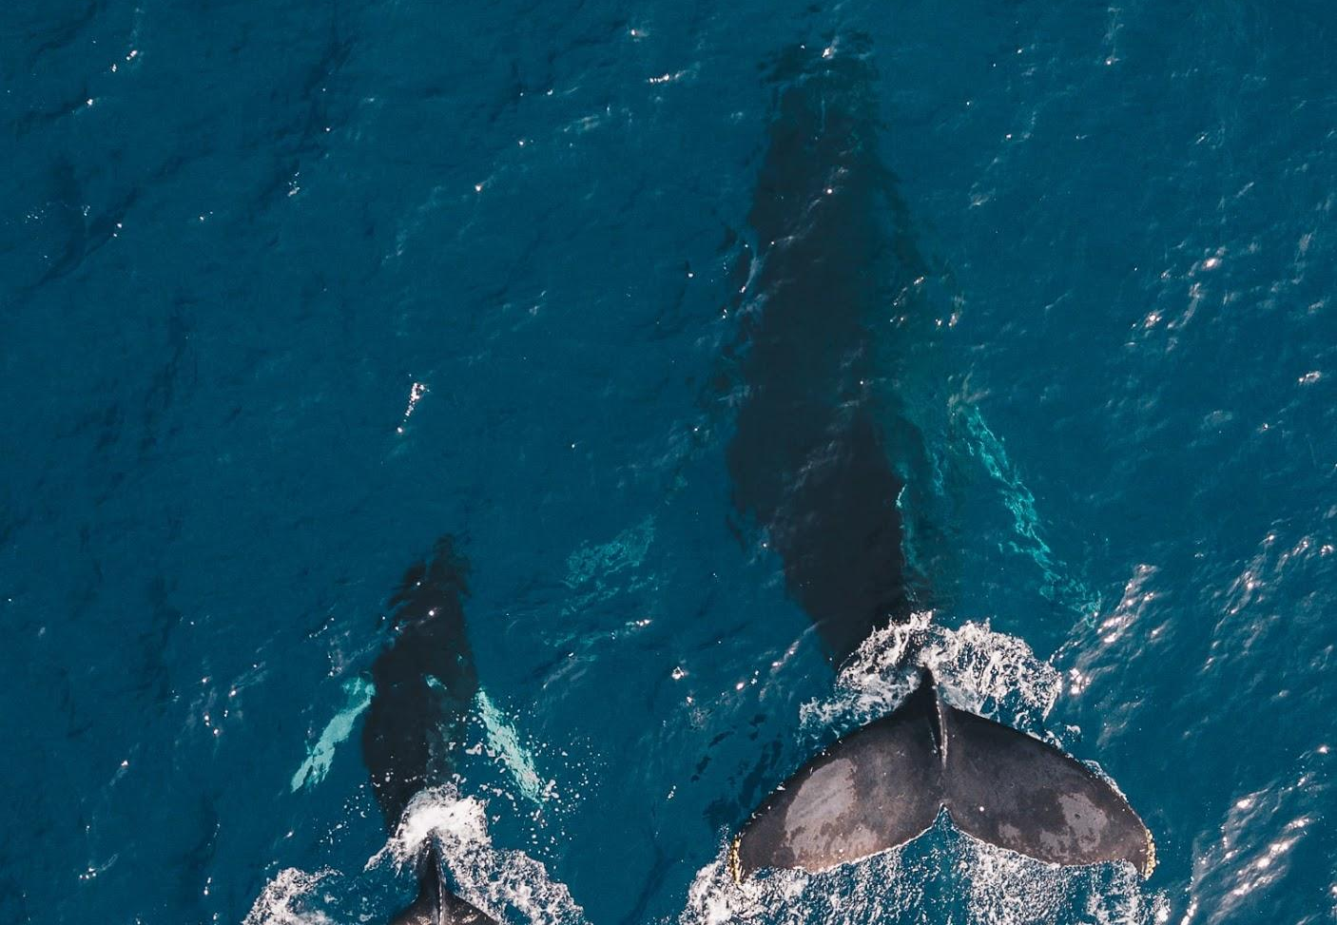

(Re) Learning Waihoʻoluʻu
An Online Module on Hawaiian Color Theory
Kūʻiʻolani Cotchay
University of Hawaiʻi at Mānoa
Learning Design & Technology
Spring 2020

Slide 2

Agenda
Introduction
Development
Design
Implementation
Results
Discussion

Slide 3
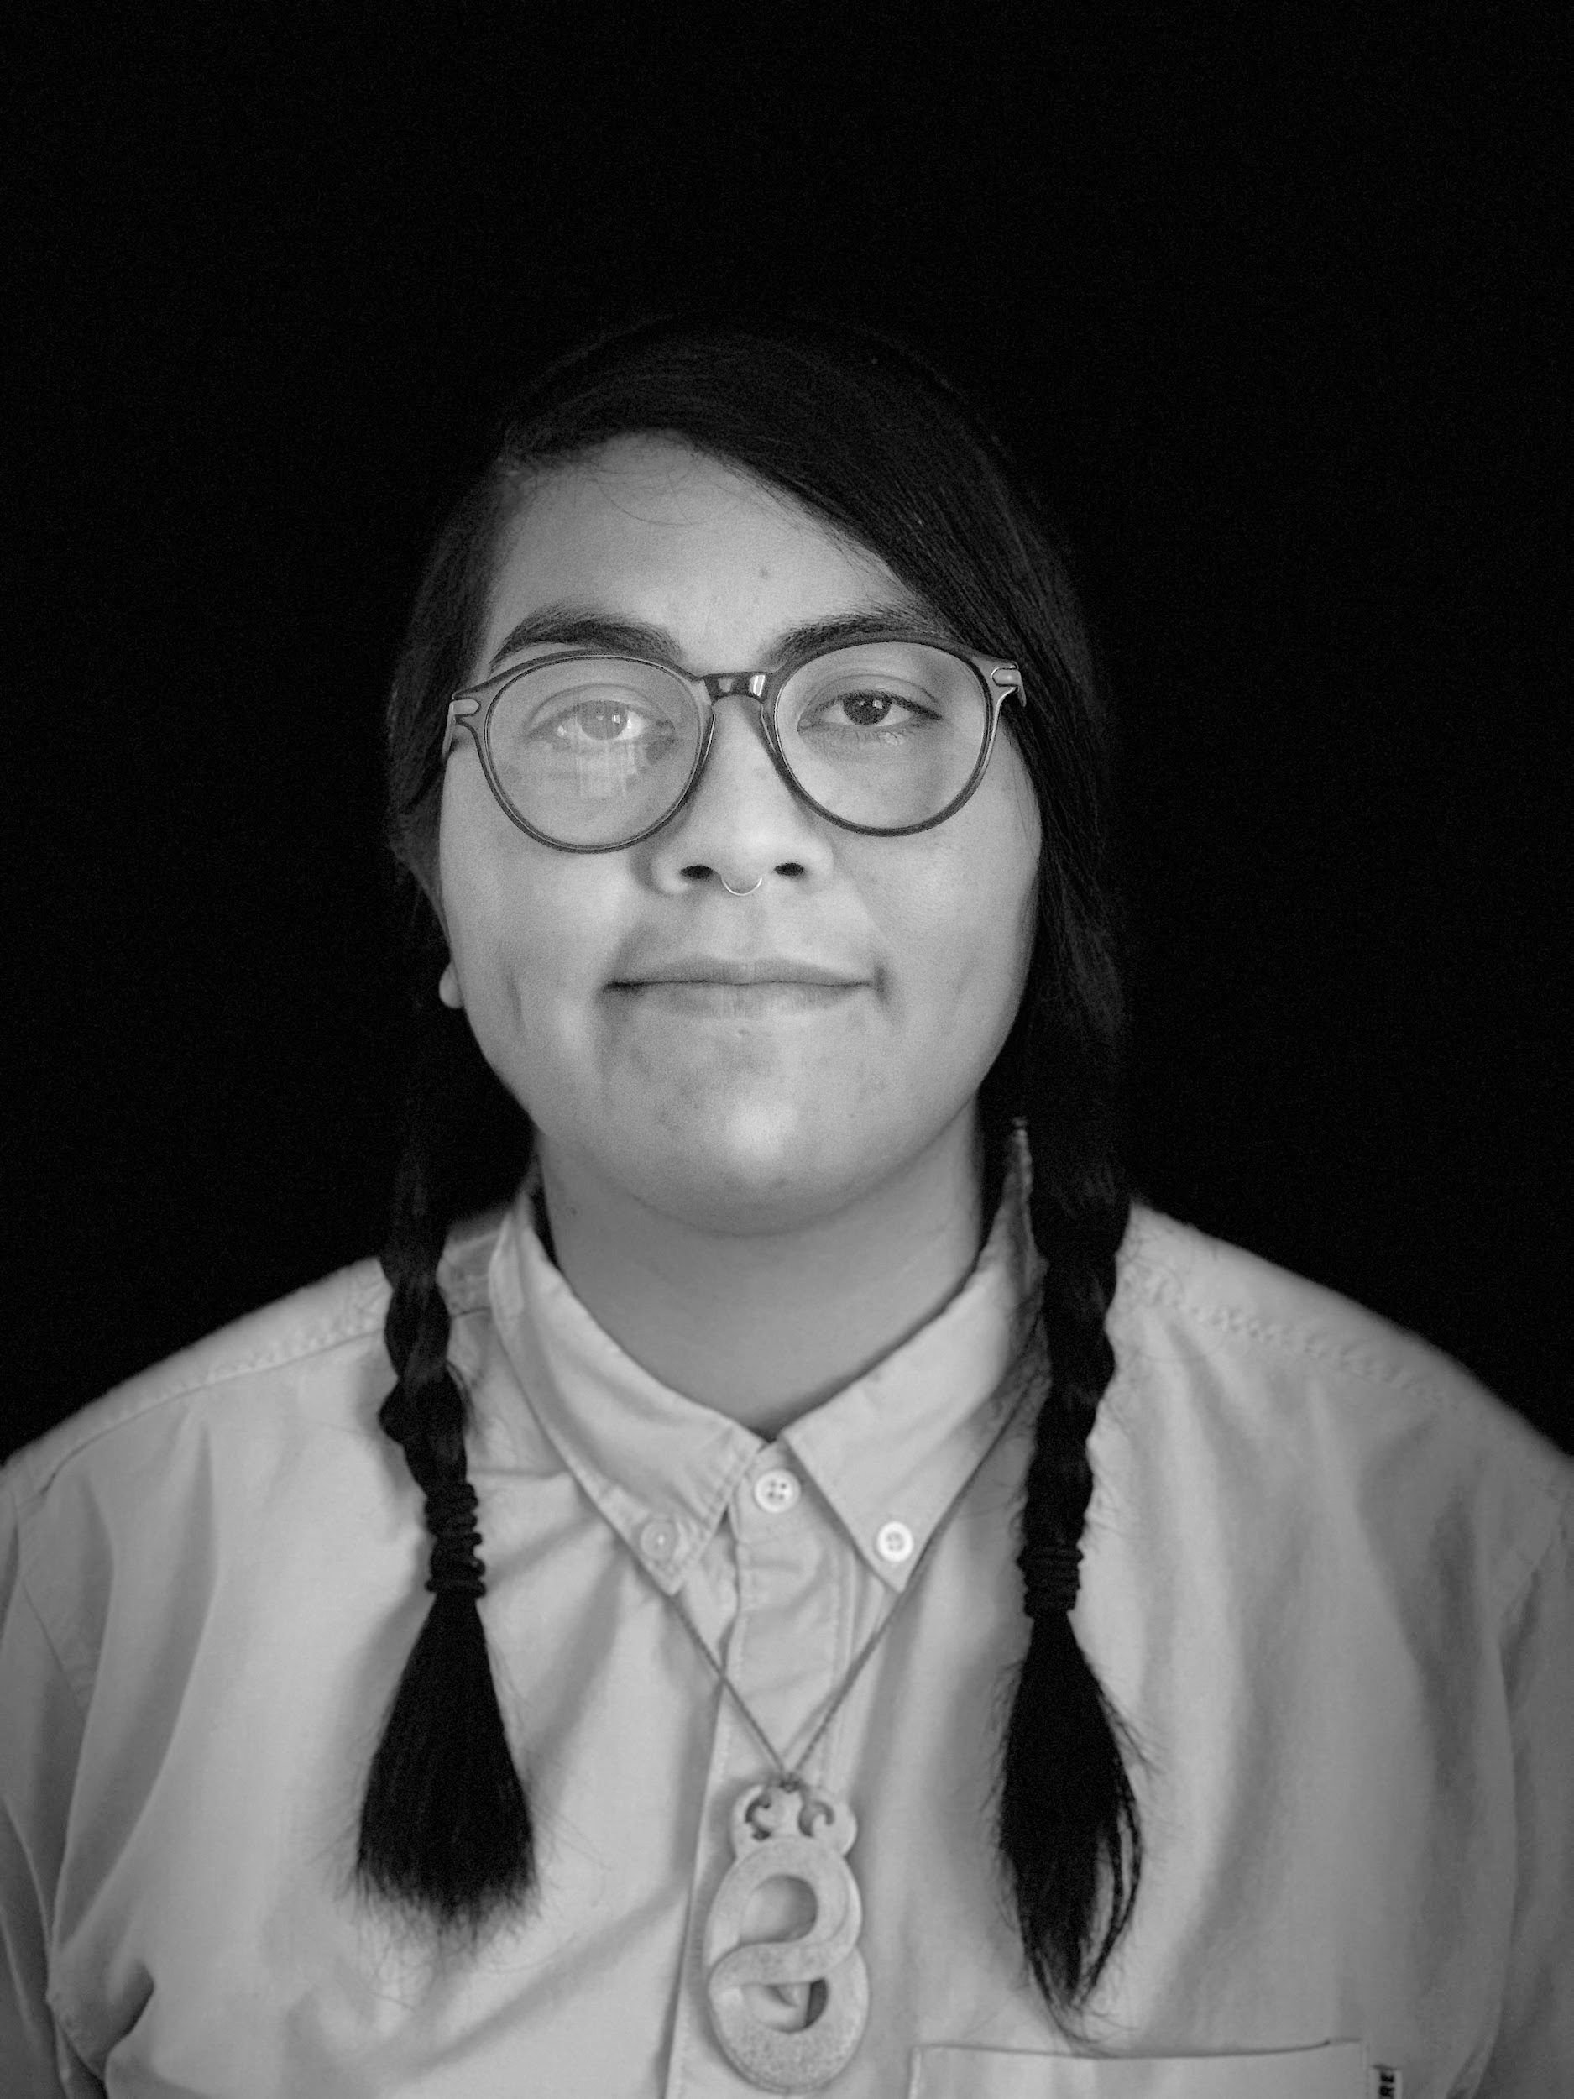
Introduction
Kūʻiʻolani Cotchay
Mākaha, Oʻahu, Hawaiʻi
BA Hawaiian Studies
M Ed Learning Design & Technology Candidate
Favorite Waihoʻoluʻu: Uli

Slide 4
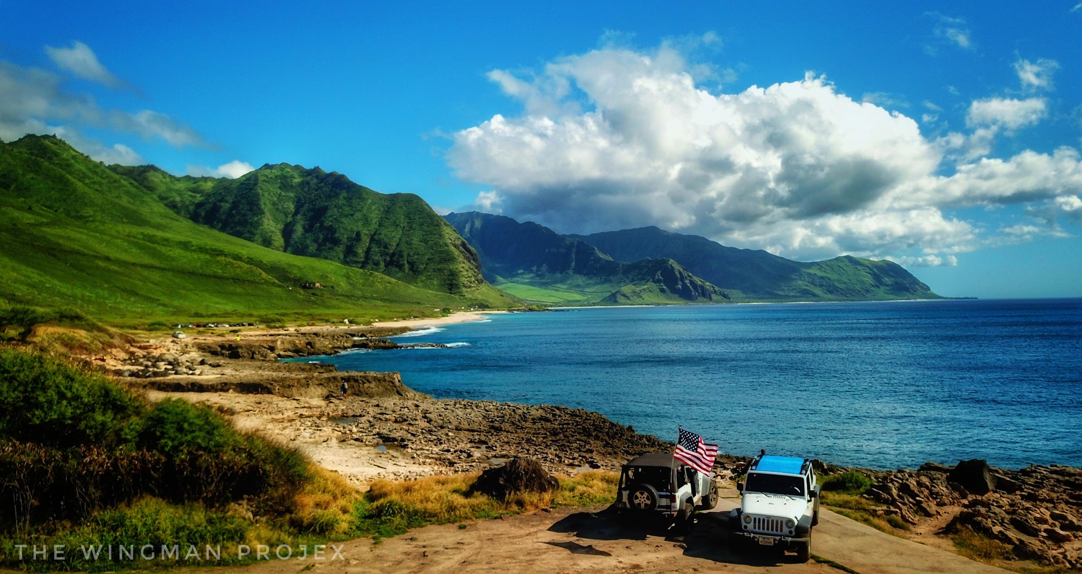
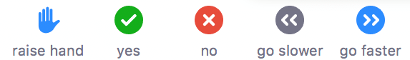
Introduction: Yokohama’s/Yok’s (Beach)

Slide 5
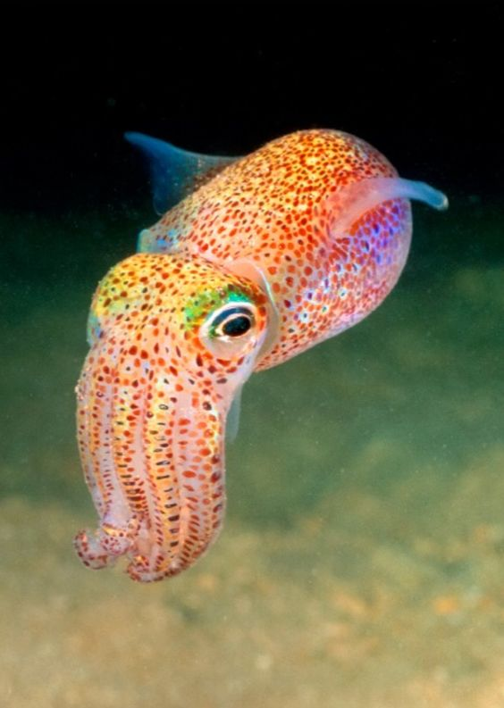

Introduction: Keawaʻula
Color
  Place
  Time
  Communication
“ʻUla” = “Red”
“Awa” = “Bay”
Hawaiian Bobtail Squid
Color
  Place
  Time
  Communication
ʻULA

Slide 6

Introduction: Background
University of Hawaiʻi at Mānoa
Undergraduate Hawaiian Studies majors struggle to perceive and interpret color in traditional ways.
Current challenges:
Limited instruction
Centers on Western color perspectives
Lack of accessible resources
  Literature and technology
Minimal technology use

Slide 7

Development: Intervention
Online module on Hawaiian color theory
One-hour lesson
Asynchronous
Engaging
  Colorful
  Multimedia
Center Hawaiian education practices
Learning Assessment

Slide 8

Development: Research
Purpose Statement:
The purpose of this project is to evaluate the impact of an online Hawaiian color theory module on undergraduate Hawaiian studies majors' perceptions and interpretation of color from a traditional perspective.
Research Questions:
How does an online module about Hawaiian color theory impact undergraduate Hawaiian studies majors':
Perception?
Interpretation?

Slide 9
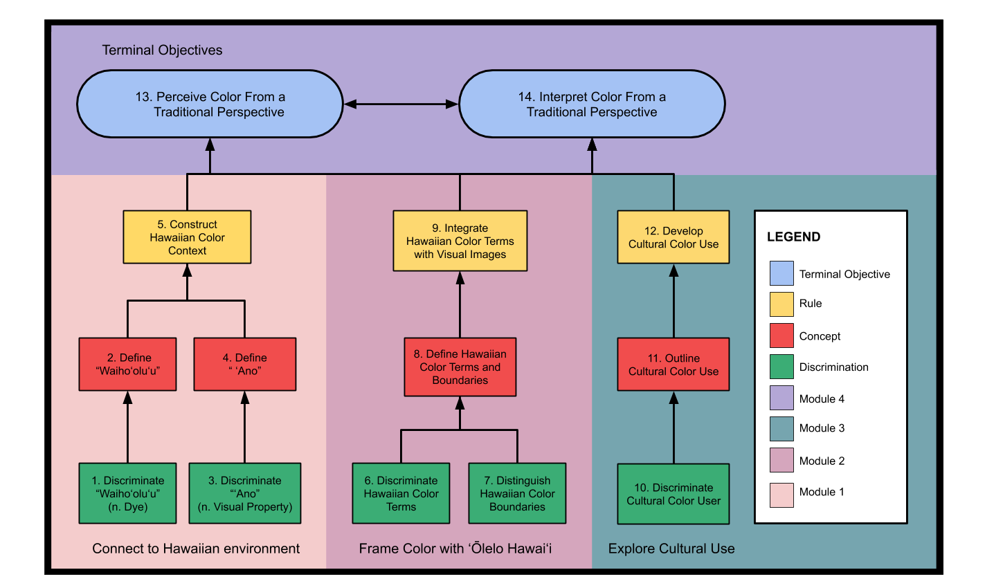

Design: Instruction
Hierarchy Chart
Literature Review
Performance Objectives
4 Clusters
Understandings of Color:
Environment
Language
Culture

Slide 10
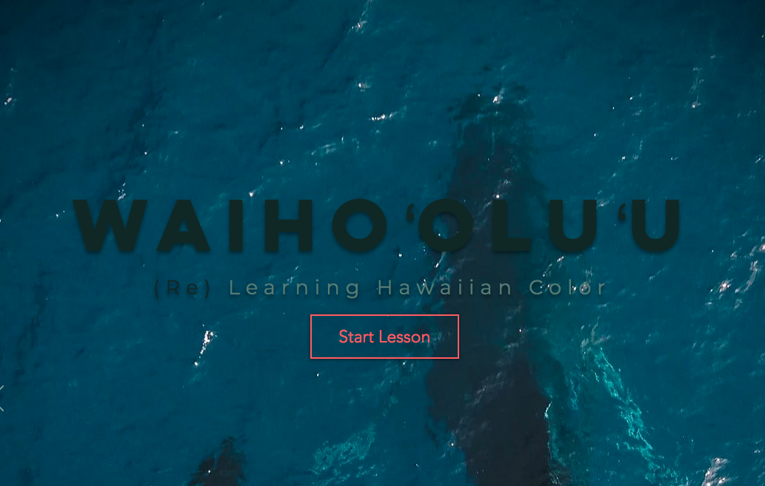
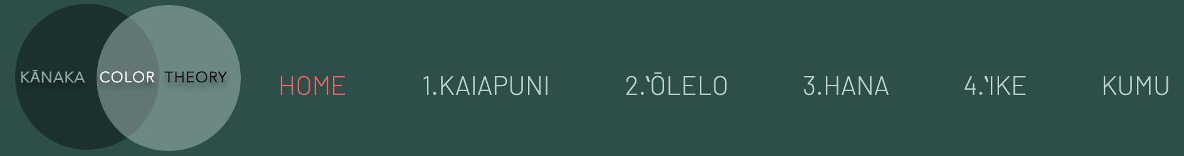
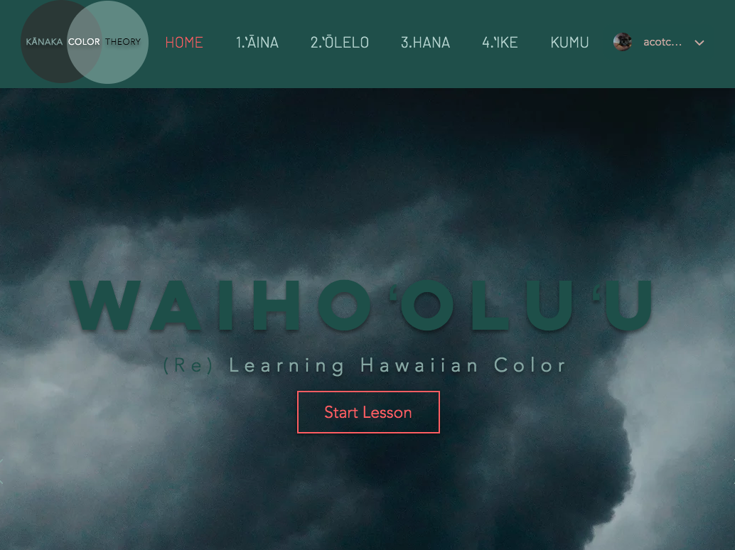
Design: Homepage

Slide 11
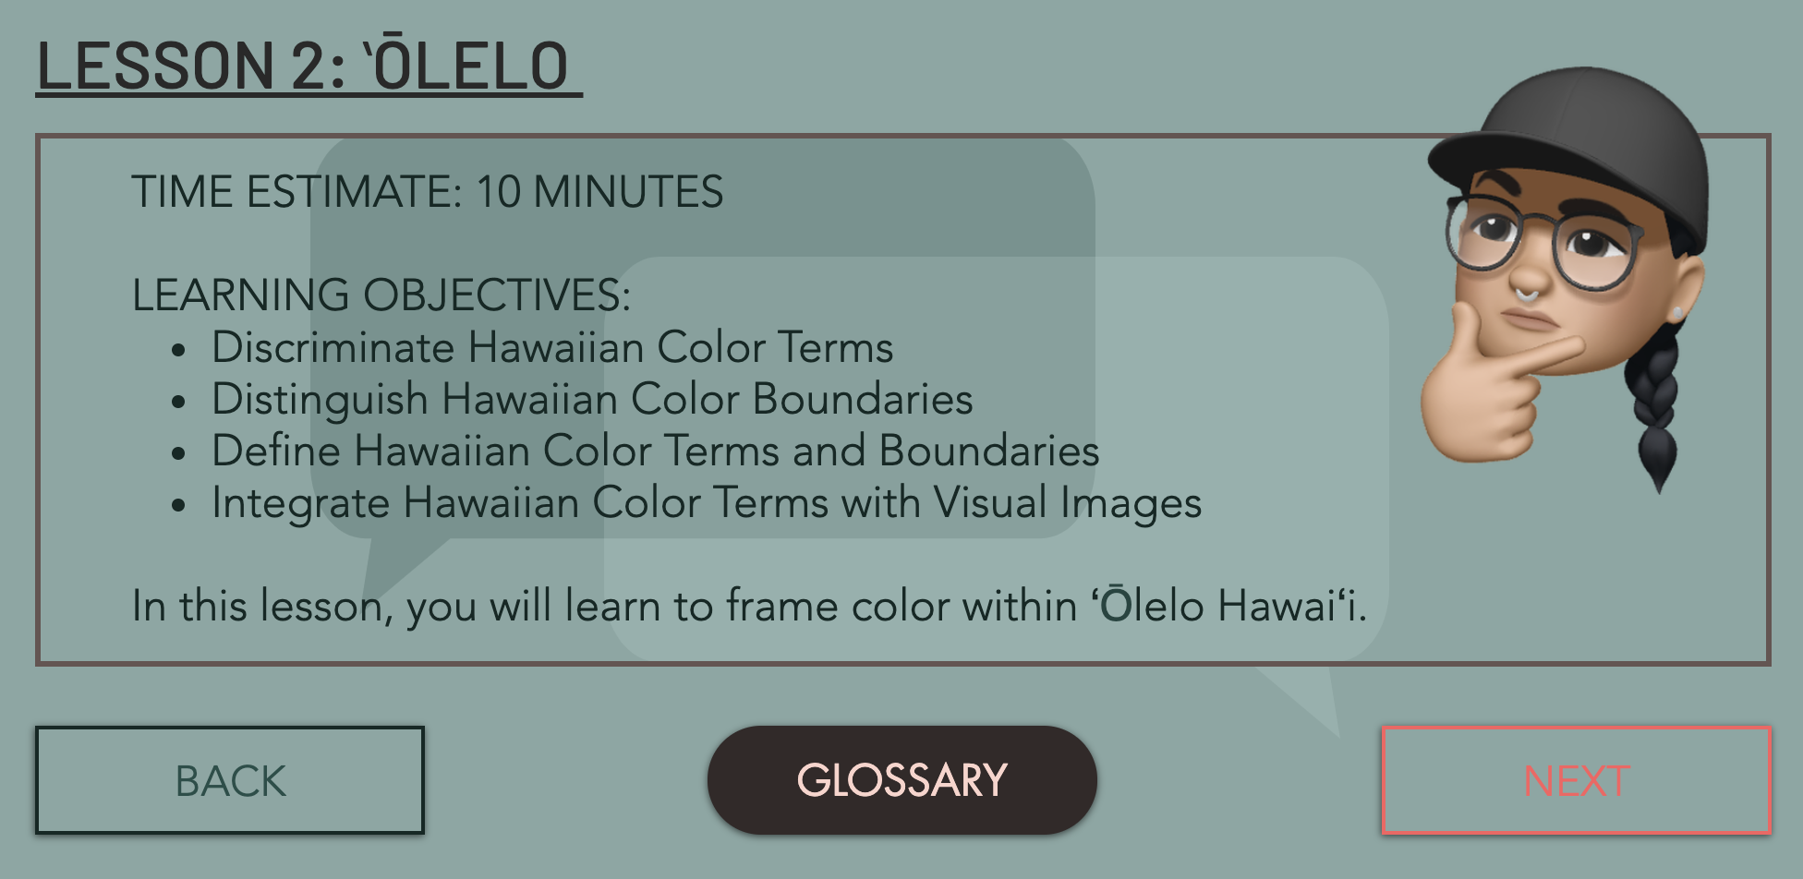
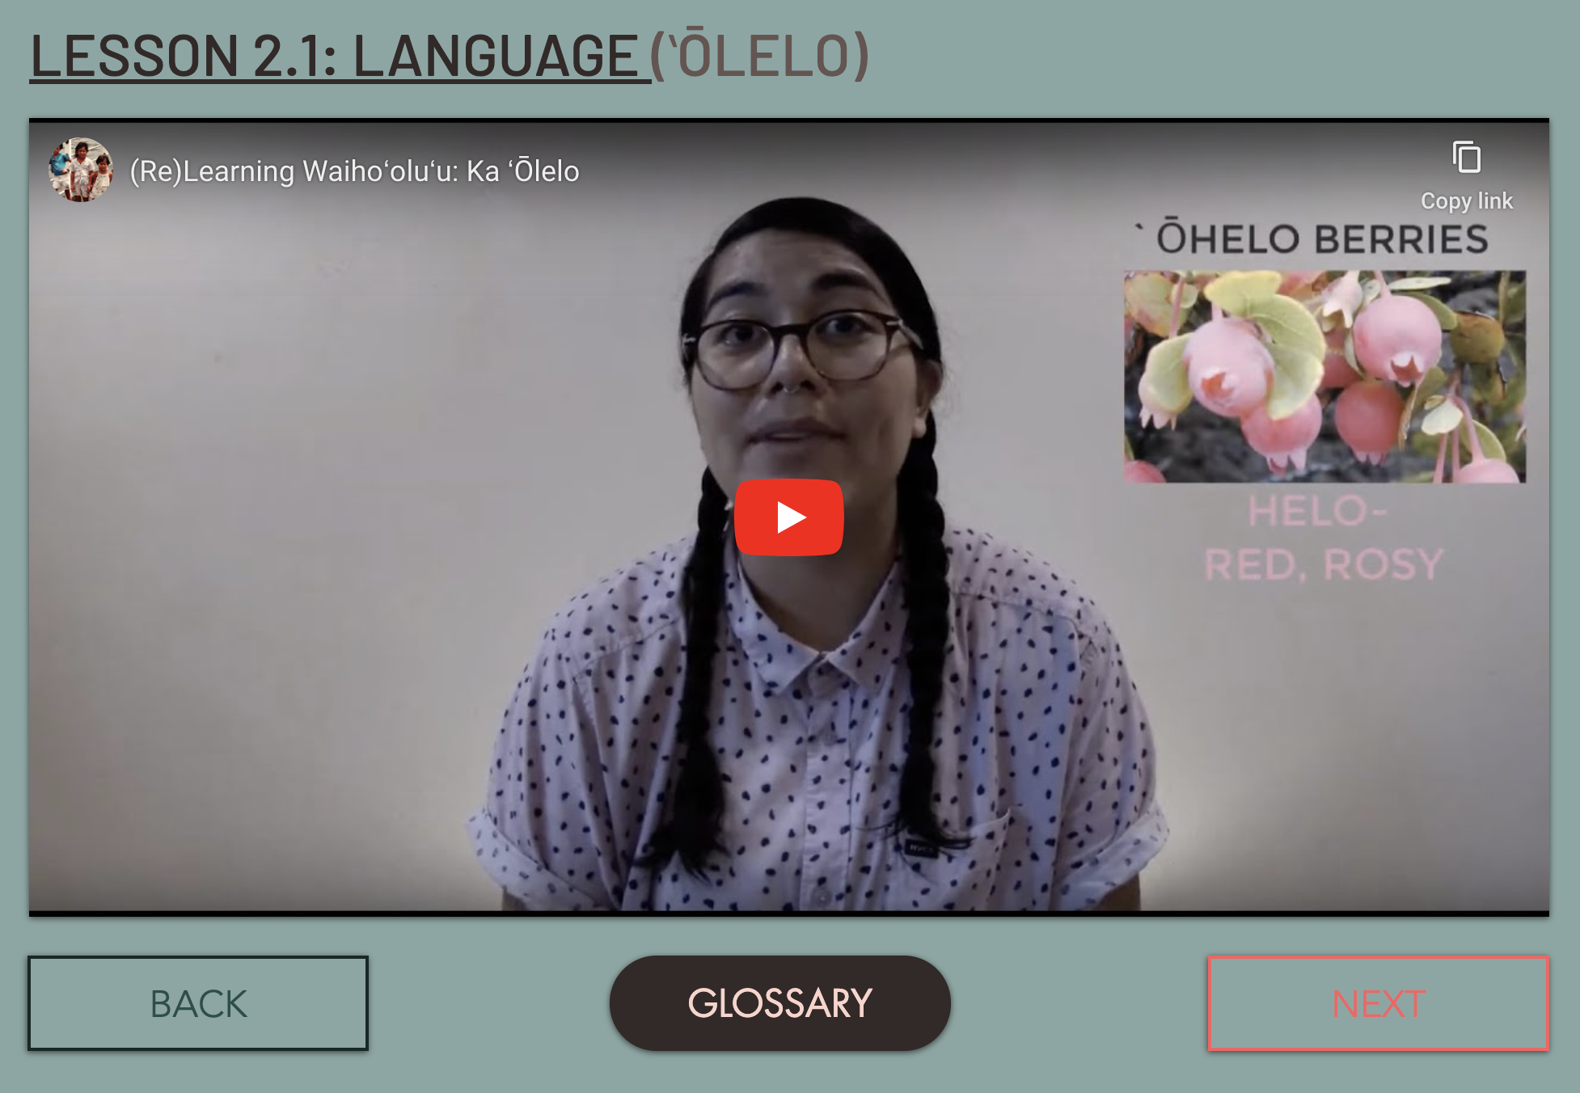
Design: Lessons

Slide 12
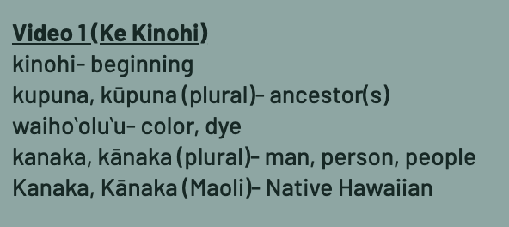

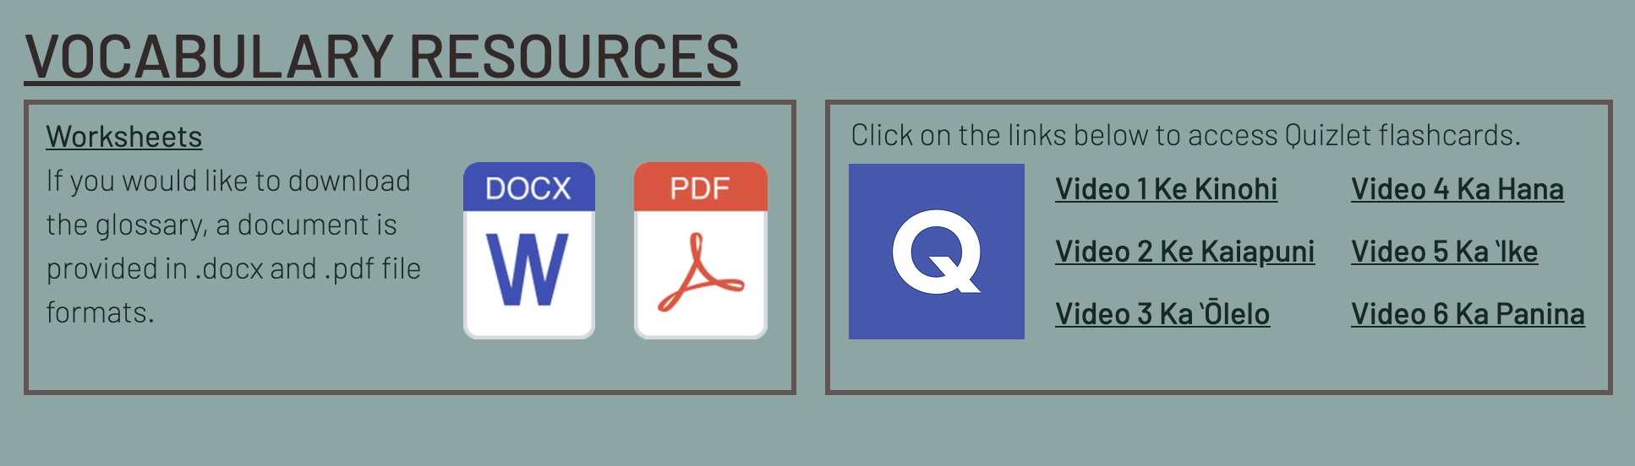
Design: Learner Support
Glossary
  Printable Worksheets
  Quizlet Flashcards
Embedded Hawaiian Dictionaries Website
ULI

Slide 13
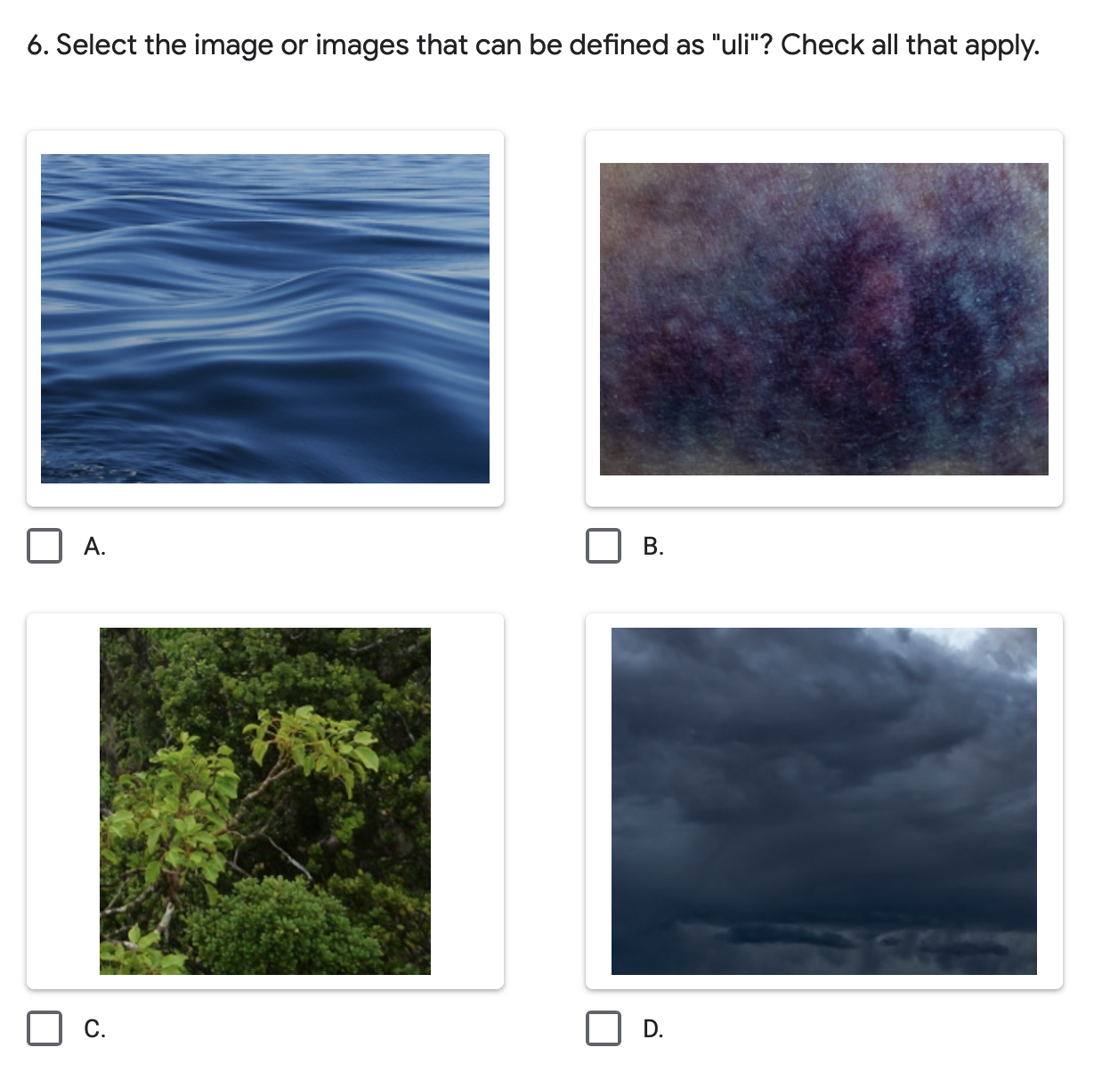
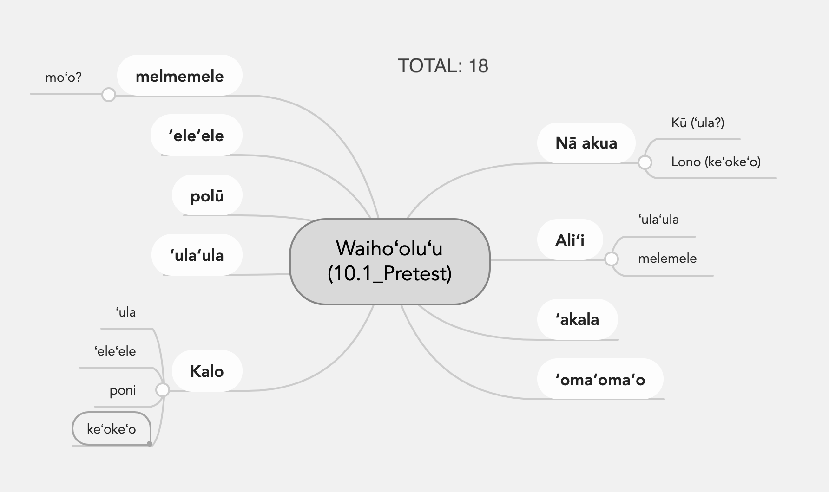
Design: Assessment
Part 1: Standardized
Part 2: Concept Map

Slide 14
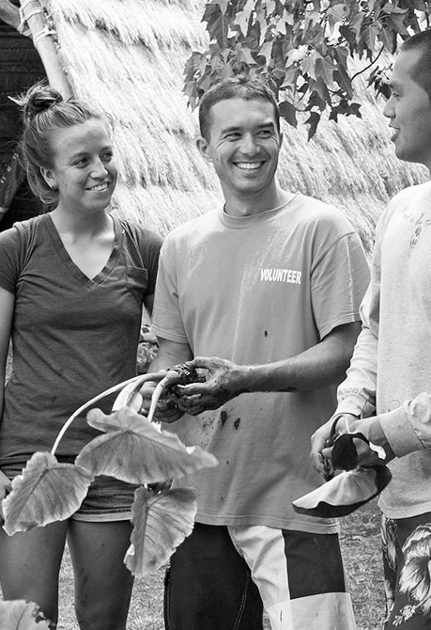
Implementation: Participants
Round 1
  2 non-students
  Usability
Round 2
  1 Hawaiian Language Tutor
  1 Hawaiian Studies Instructor
Round 3
  10 Undergraduate Hawaiian Studies Majors
  8 Native Hawaiians, 2 Non-Hawaiians
  Most have 2+ years of Hawaiian Language
  Online and face to face sessions
  1-on-1 and group sessions

Slide 15
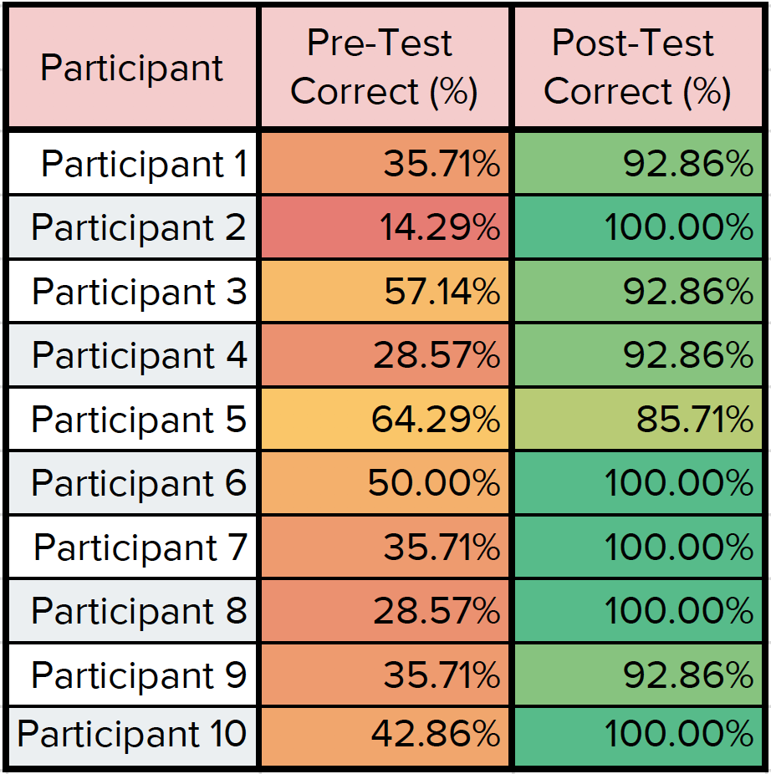
Results: Standardized Assessment
Higher Scores
Glossary
Took Notes
Online
Lower Scores
Face to face
  Casual
Advanced Hawaiian Language

Slide 16
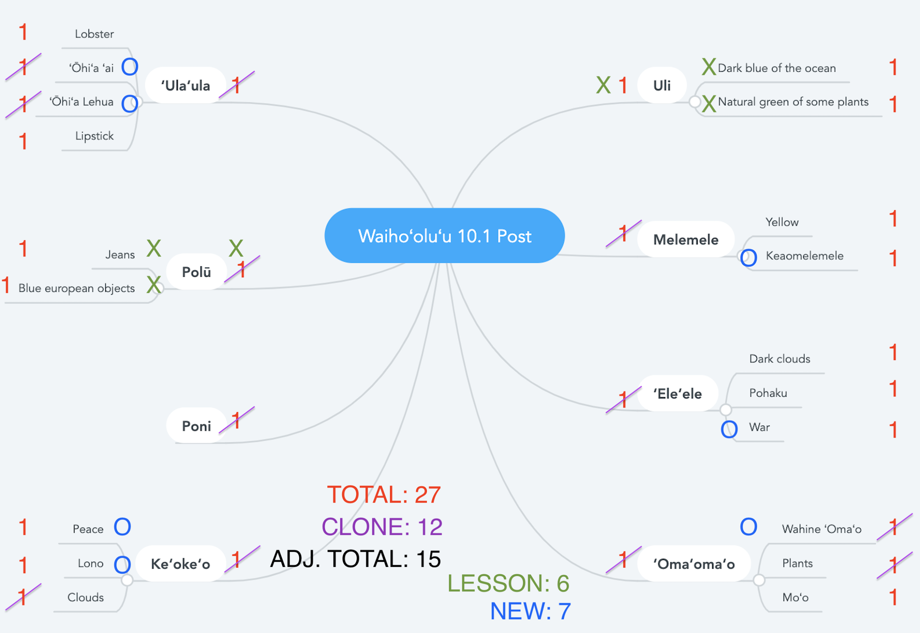
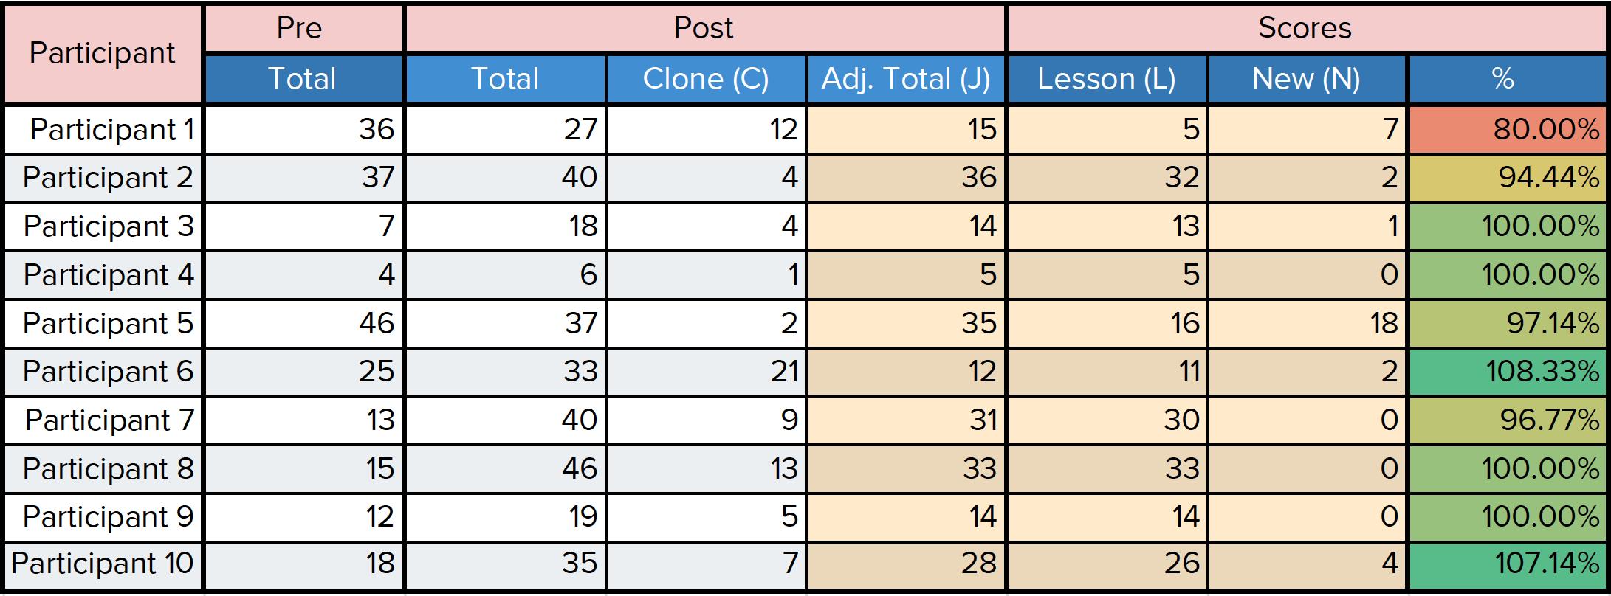
Results: Concept Map Assessment
KEY:
C = Clone (repeat from pre-test)
J = Adjusted post-test total
L = Likely from lesson
N = New connections, connecting to external knowledge, or taught me something new

Slide 17
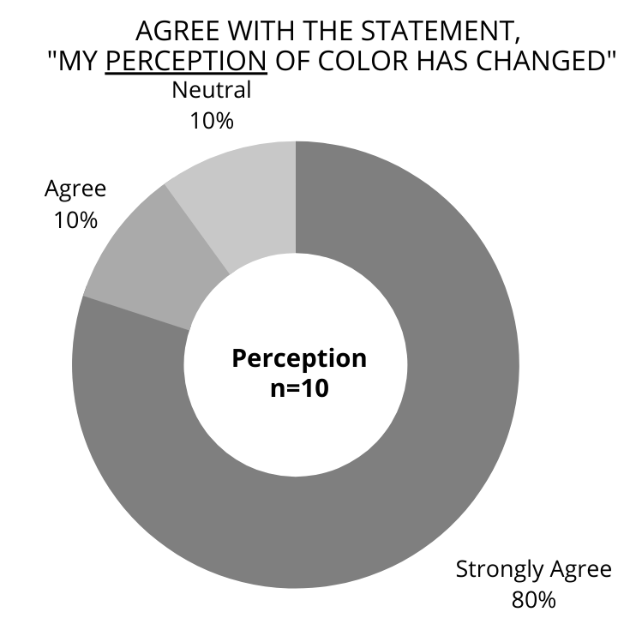
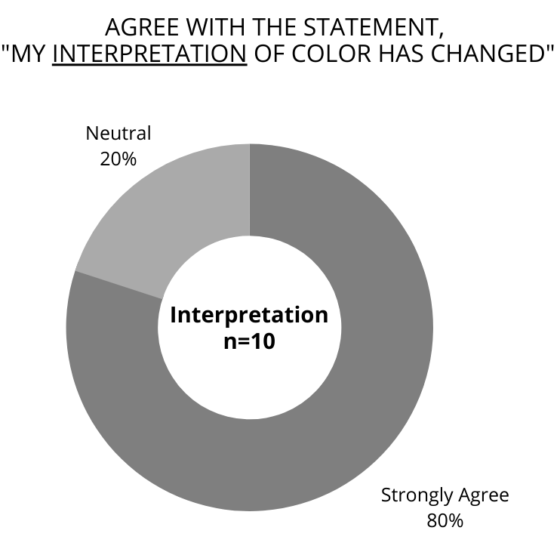
Results: Post Survey

Slide 18
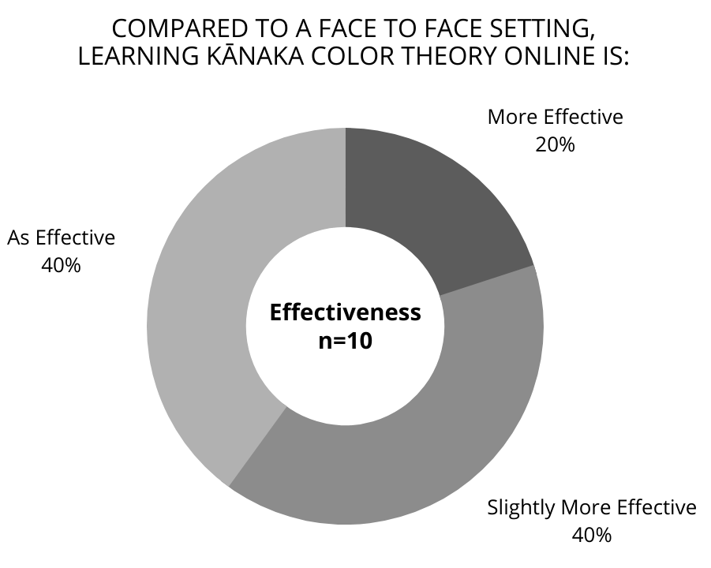
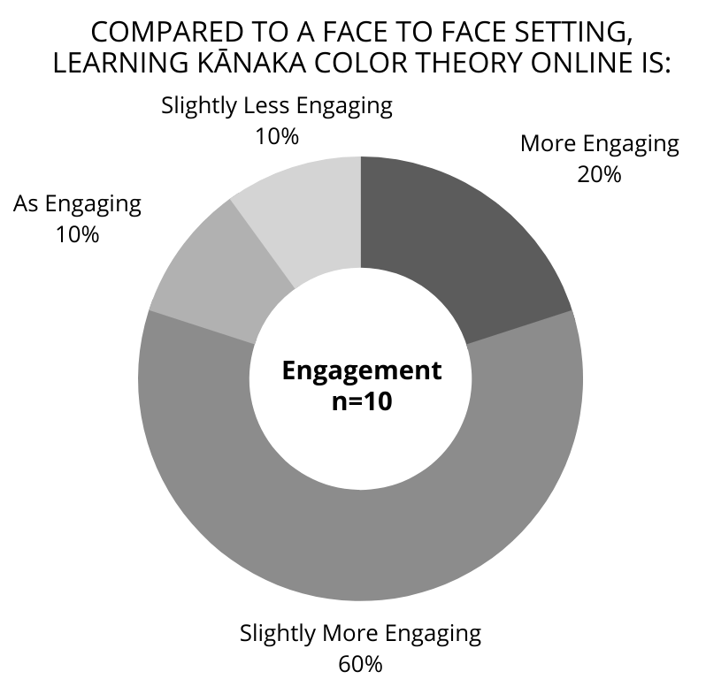
Results: Post Survey (continued)

Slide 19

Results: Summary
Confirmed demand for:
  Further development of Hawaiian Color Theory
  More sources on Hawaiian Color Theory
  Online learning
    Change in attitudes!
An online module on Hawaiian color theory:
  changes perception and interpretation of color and
  centers understandings of color in traditional perspectives.

Slide 20

Discussion
Challenges:
Underdeveloped Hawaiian Color Theory
Authentic Assessment in short time period
Diverse range in learners
Makawalu (honoring multiplicity)
Strengths:
Relationships
Aʻo aku, aʻo mai (Learning, 2 way direction)

Slide 21
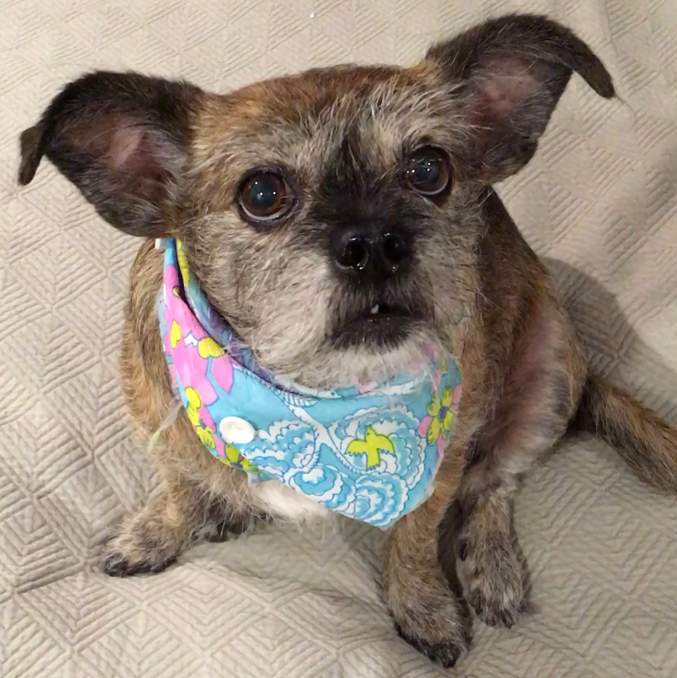
Discussion (continued)
Share results with Hawaiian Studies
Share with indigenous instructional designers
Continue developing Hawaiian Color Theory
  Semester class
  Workshop series
  Expand audience (K-12)
Mahalo to:
  My family
  LTEC, Critical Friends
  Hawaiʻinuiākea
  My dog, Rosie

Slide 22
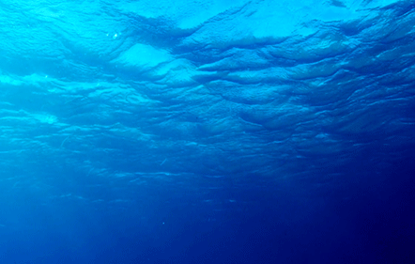



Slide 23
References
Aissa, D. (n.d.). White Tiger [photograph]. Retrieved from https://unsplash.com/photos/Pe1Ol9oLc4o
Coleman, J. (2018). Ocean Background Underwater [graphic interchange format]. Retrieved from http://www.lowgif.com/view.html
Computer Laptop (clipart). (n.d.). Retrieved from https://www.clipart.email/download/9124822.html
Delorme, C. M. (2018). Quilting a journey: decolonizing instructional design. AlterNative, 14(2), 164-172. https://doi.org/10.1177/117718011876
Dick, W. O., Carey, L. O., & Carey, J. O. (2009). The systematic design of instruction (7th ed.). Boston: Pearson.
Dukes, W. (2012). Double Rainbow Sunset [photograph]. Retrieved from https://www.flickr.com/photos/20connectedbreaths/7946950374/in/photostream/
Hawaiʻinuiākea School of Hawaiian Knowledge (n.d.). Untitled [photograph]. Retrieved from https://www.facebook.com/hshkuhm/photos/a.499935306753160/499935310086493/?type=1&theater
Mayer, R. (2014). Cognitive Theory of Multimedia Learning. In R. Mayer (Ed.), The Cambridge Handbook of Multimedia Learning (Cambridge Handbooks in Psychology, pp. 43-71). Cambridge: Cambridge University Press. doi:10.1017/CBO9781139547369.005
Perrine, D. (n.d). Hawaiian Bobtail Squid [photograph]. Retrieved November from https://oceanconservancy.org/blog/2019/07/02/bobtail-squid-might-cutest-thing-ocean/
Pozzi, G. (n.d). Mother + Calf [photograph]. Retrieved from https://unsplash.com/photos/PO0UHx-5mHo
Silvestre, R. (n.d.). Taro plant - Folha de Inhame [photograph]. Retrieved from https://unsplash.com/photos/8Y-aaZ8fYmk
University of Hawaiʻi at Mānoa (n.d). Untitled [photograph]. Retrieved from https://manoa.hawaii.edu/wasc/aloha-aina/
Wingman Projex (n.d). Keawaula [photograph]. Retrieved from https://www.reddit.com/r/drones/comments/az9w6j/keawaula_beach_hawaii/

