Slide 1

DEPOSITORY LIBRARY CONFERENCE 2022
What Does the Green Dot Mean?
Documenting Your Collection’s History
Gwen Sinclair, Claudene Sproles, Angela Kent

Slide 2
OUTLINE
Library History
Depository History
Collection Development
Technical Services
Public Services
Automation
People
Case Study: Kentucky GODORT
Case Study: Texas State Library
Today's Presentation

Slide 3

Why document?
  Succession planning - preserve institutional memory
  Systems analysis
  Explain peculiarities of the catalog and other systems
  Evaluate policies and procedures
  Prepare for transitions

Slide 4
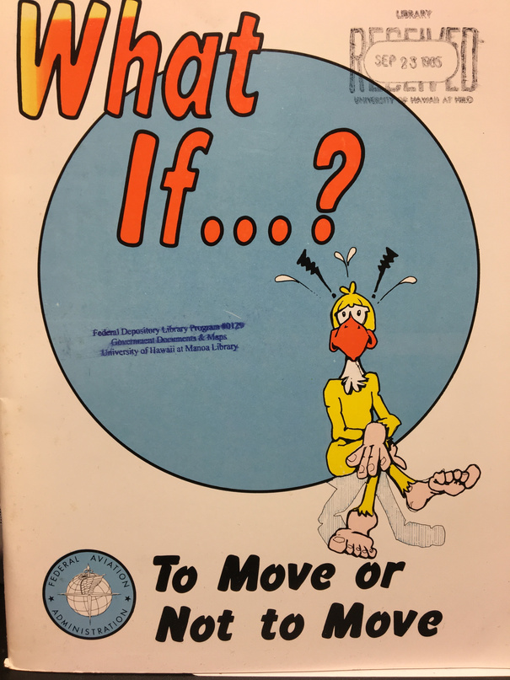
  When was the library established?
  Main emphasis/purpose
  Locations/moves
  Disasters
Library History
Faewool Camera Shop | 2020

Slide 5
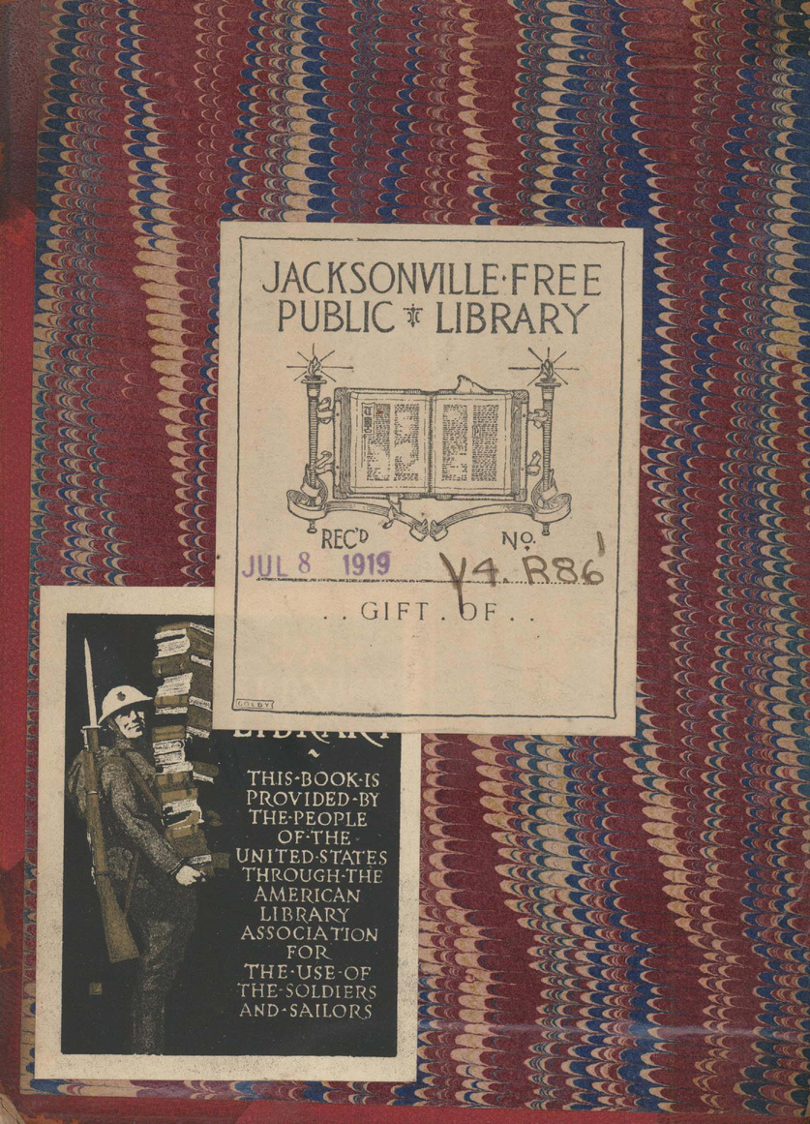
Depository History
  When was the depository established?
  Separate or integrated?
  Major changes in status/designation
  SuDocs or other classification scheme?

Slide 6
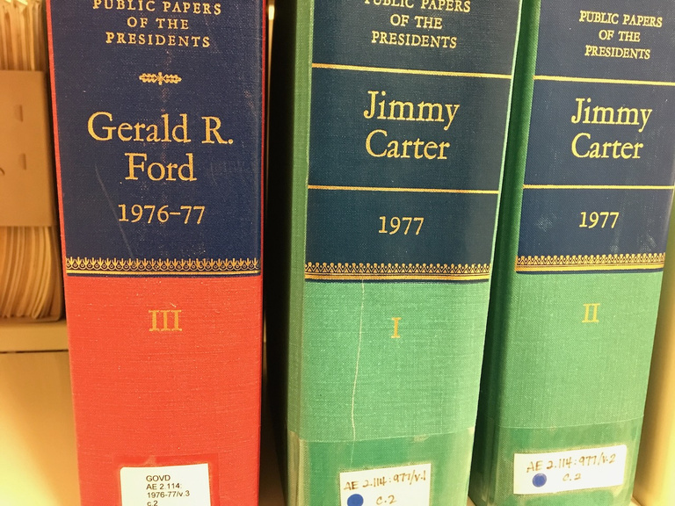
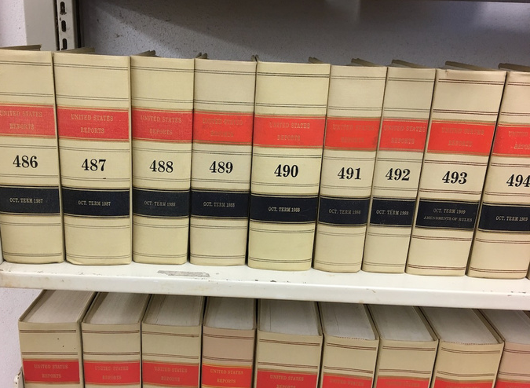
Partnerships
Preservation steward
Print selector
Digitization
Digital deposit

Slide 7
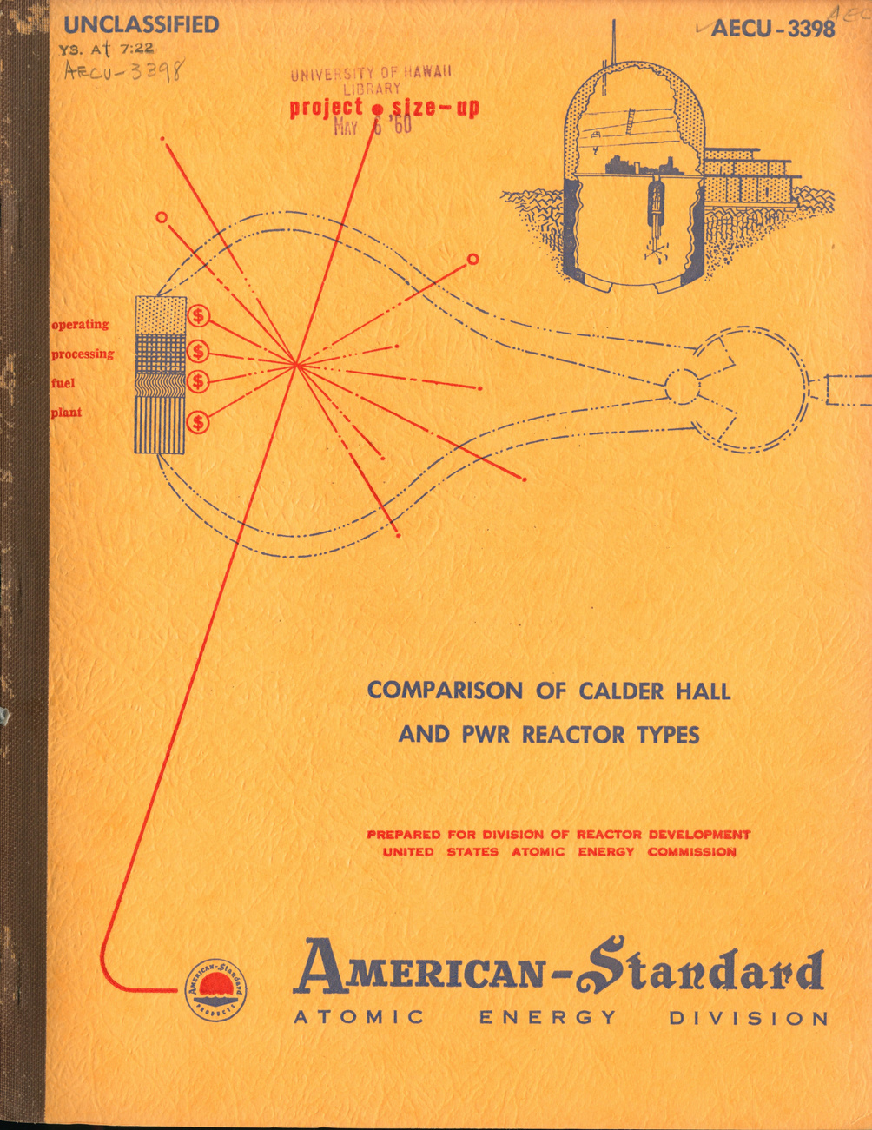
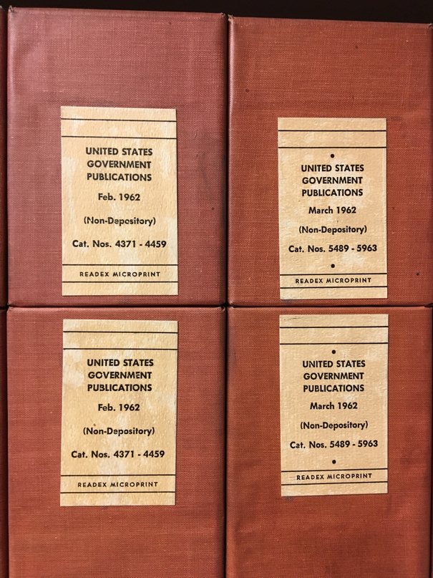
Collection Development
  Collection strength
  Selection percentage
  Other depository systems, e.g., Atomic Energy Commission (AEC) or Army Map Service (AMS)
  Documents Expediting Project
  Major microform sets
  Virtual depository
  Commercial publications

Slide 8
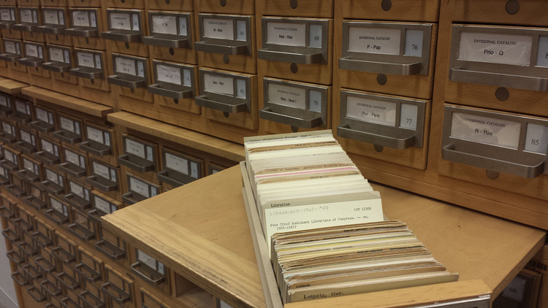
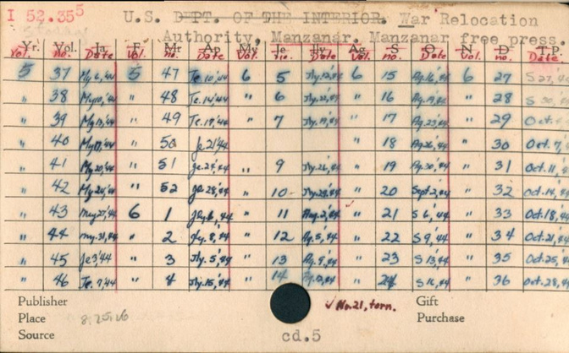
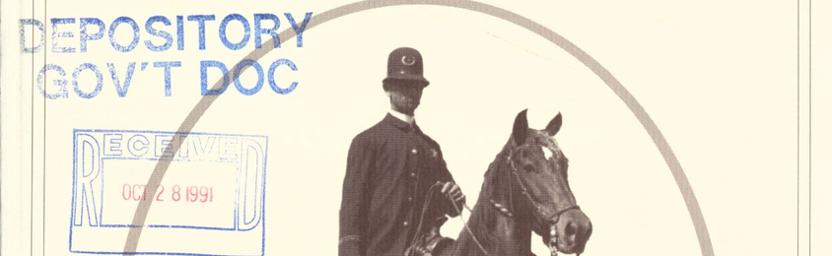
Events
Technical Services
  Shelflist/card catalog/database
  Serials check-in
  Marking
  Binding

Slide 9
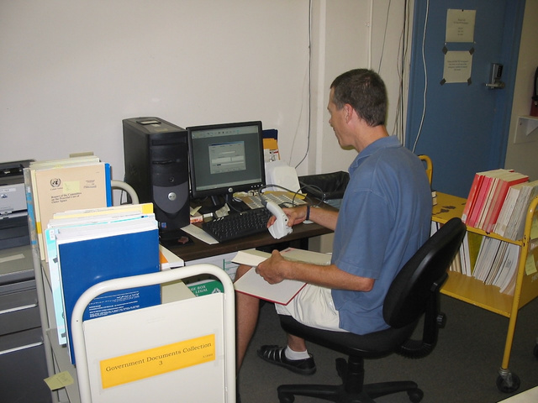
Automation
  When did the library start using an online catalog?
  Were gov docs included in retrocon?
  Barcoding
  Use of vendor- or GPO-supplied records

Slide 10
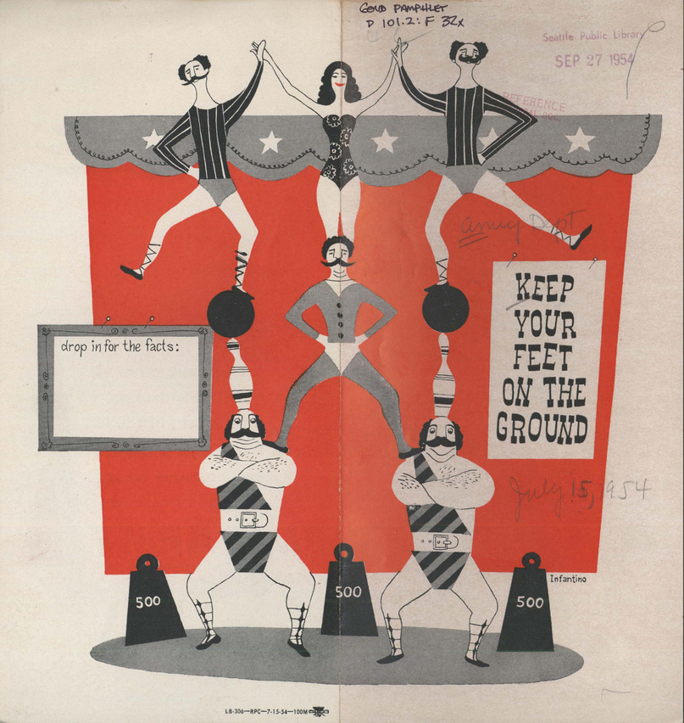
Circulation
  Circulating or Library Use Only
  Loan period for gov docs
  Pamphlets
  Maps
  Diskettes/CDs/DVDs

Slide 11
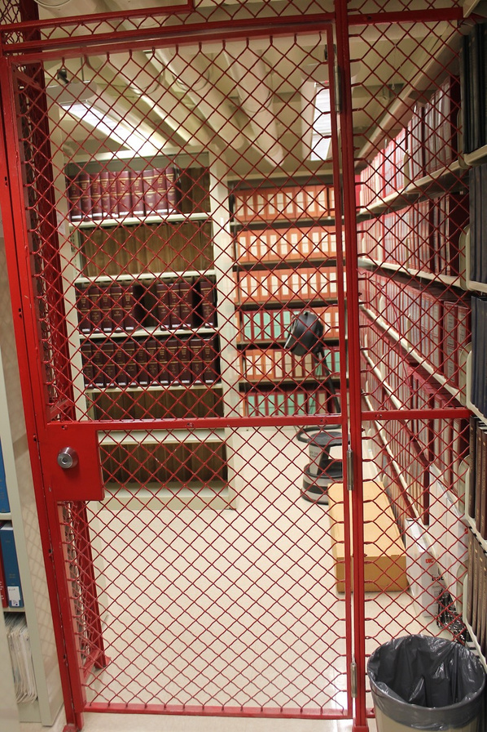
Events
Shelving
  Open/closed stacks
  Selective housing agreements
  Off-site storage
  Transfers to main collection
  Multiple locations

Slide 12
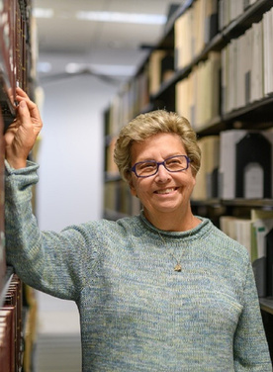




Who Were They?
TSLAC
Kentucky GODORT
UHM Library
Sue Troyan
26 years
FLDP Coordinator
Regional
Gov Docs librarians Mabel, Eleanor, Verna, and Virginia
Sandee McAninch University of Kentucky

Slide 13
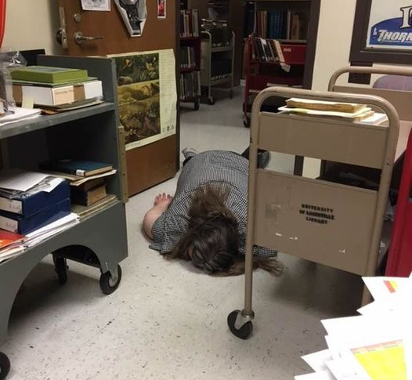
Claudene Sproles
Head, Collection Management
Depository Librarian
University of Louisville
caspro01@louisville.edu
Notes:
1. My history with UofL and the state of record keeping and the depository when I arrived.
2. No one knew where any of the records of the depository were. Everything had to be recreated
3. there was no "succession planning" when I arrived.
written procedures were sparse and out of date
4. things not done to depository standards. the catalogers were wiping the 086 field
So my first steps when I took over the depository-
*. Get procedures in order
*. create a Written collection development policy
*. create disaster plan
*** I Visited the regional librarian and invited her to visit- to learn of procedures in the state and to have her review our depository

Slide 14
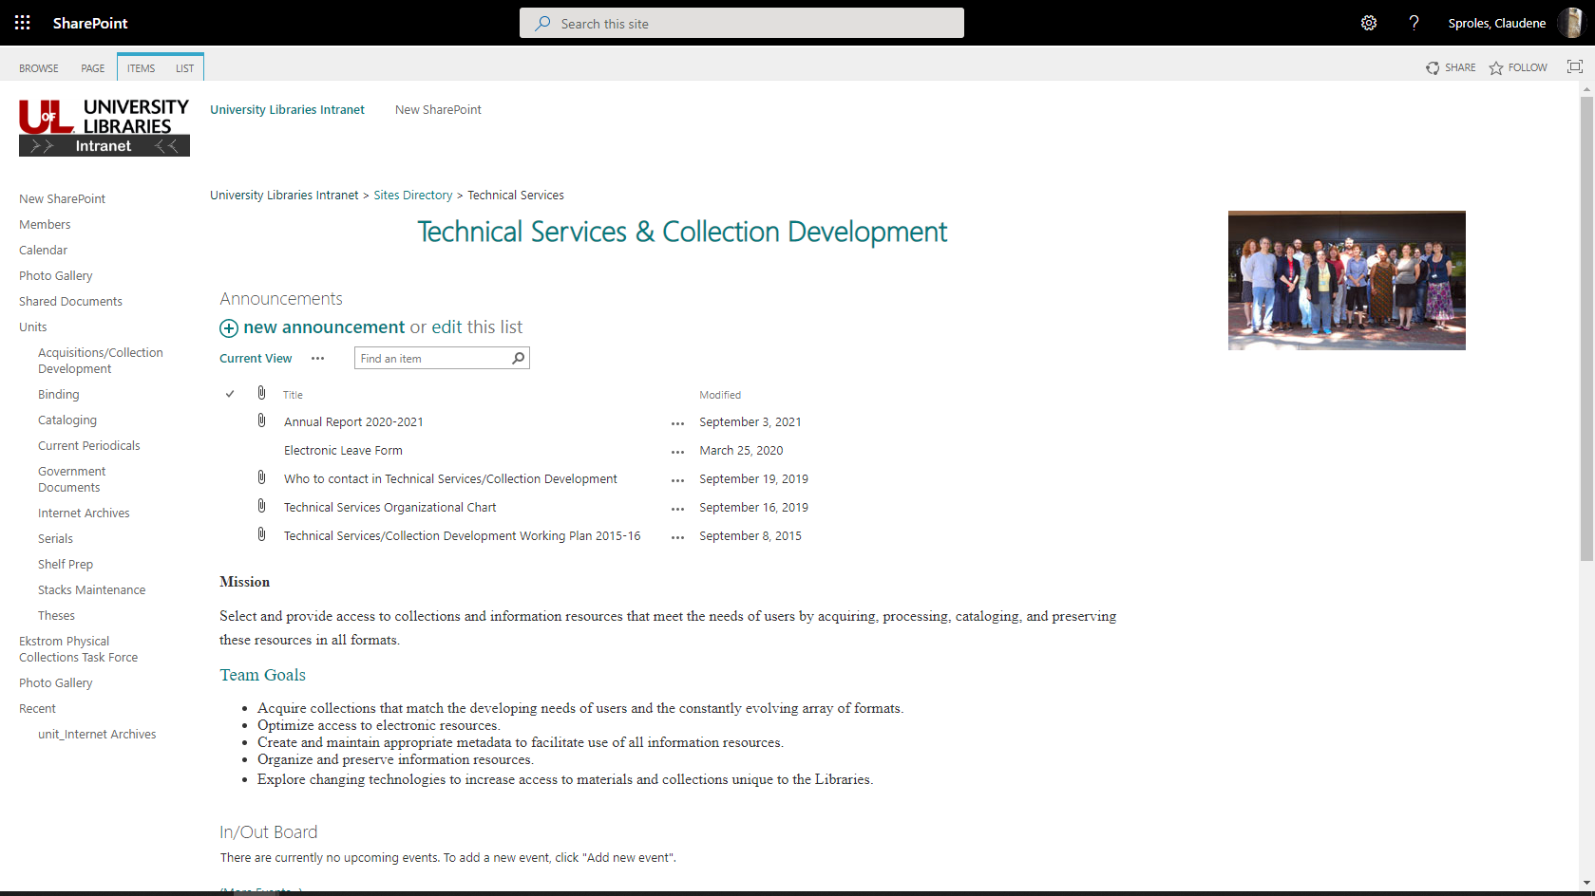

Notes:
2. Implementation and use of SharePoint.
The government documents duties are shared between Collection Management and Technical Services.
As the depository librarian, I am in charge of documents, but Tech Services does the cataloging.
I wanted to move policies and procedures to a neutral location that would allow broad access
\
Several options for this, such as wikis and libguides, but SharePoint is free to us and we already have access. Some of this material was originally in shared drives, but we were encouraged to move to SharePoint.

Slide 15
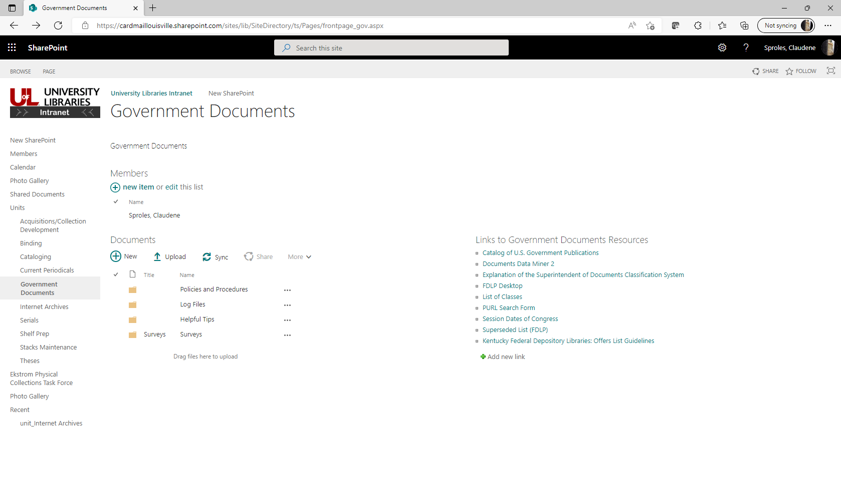

Slide 16
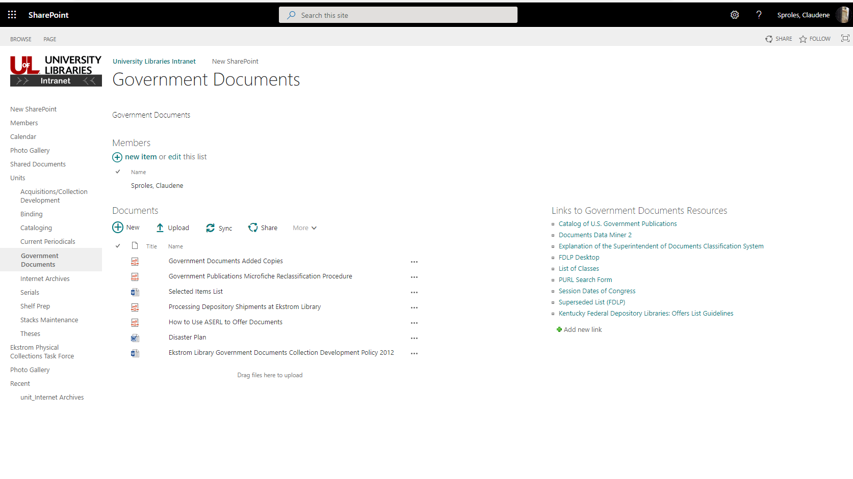
Notes:
All current policies and procedures in one place. Come here for most up-to-date procedure

Slide 17
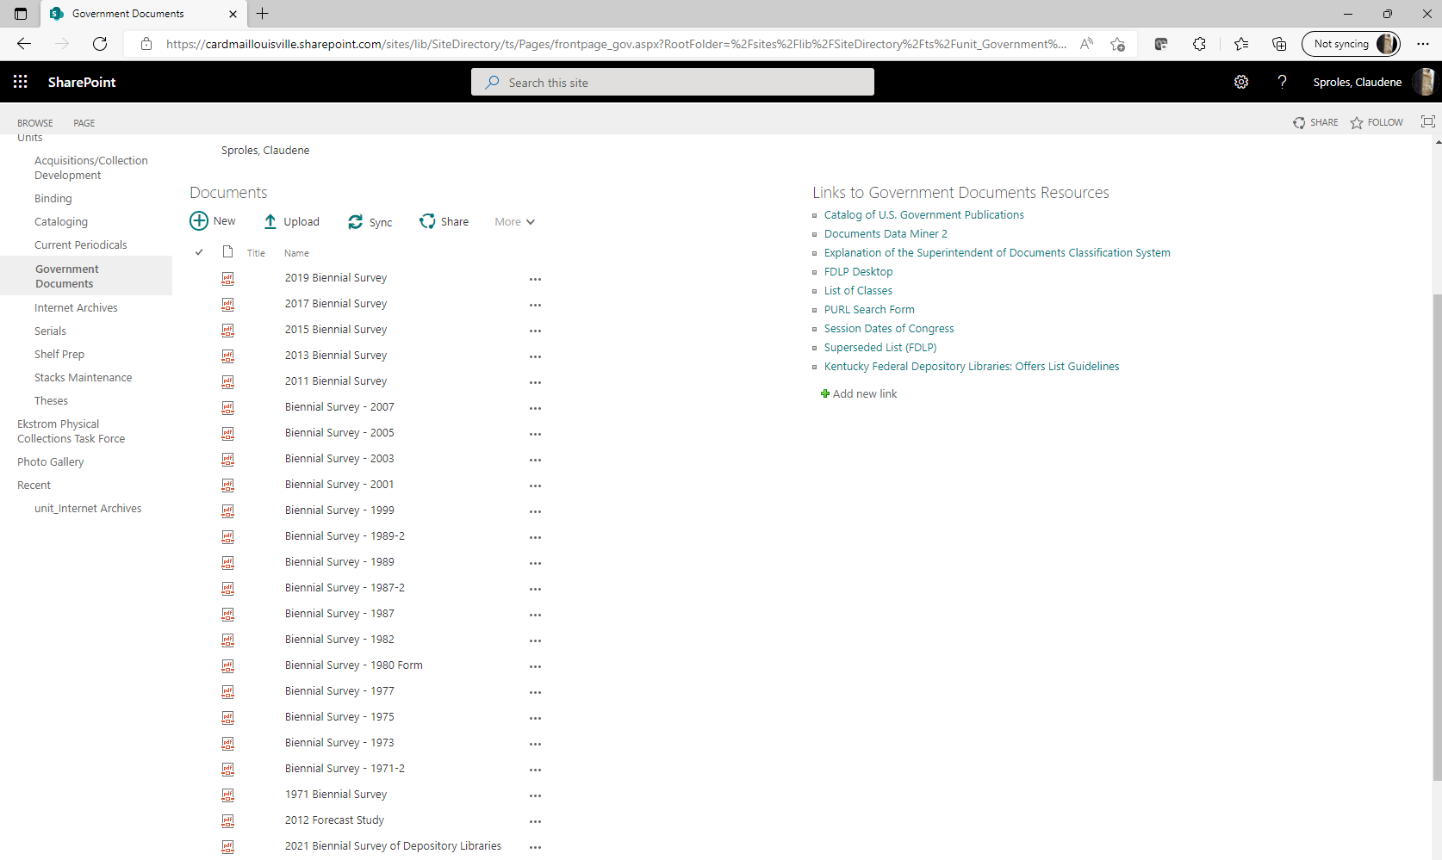

Slide 18
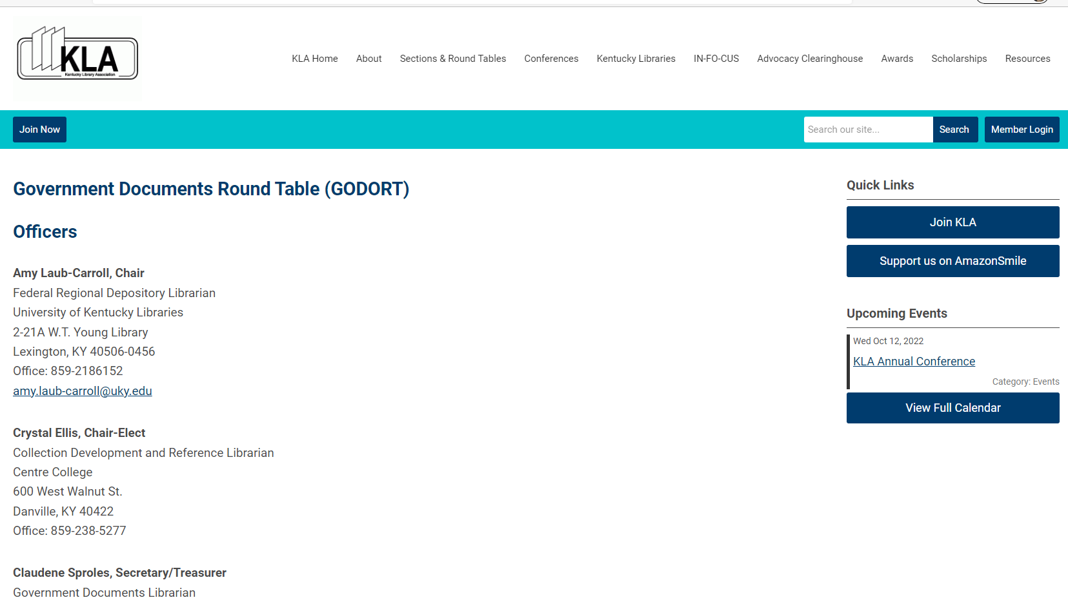
Notes:
Importance of State Professional Organizations
*educational opportunities
*networking- group of colleagues to call on for advice
*advocacy- stronger voice on a state level
*develop leadership skills
*mentoring

Slide 19
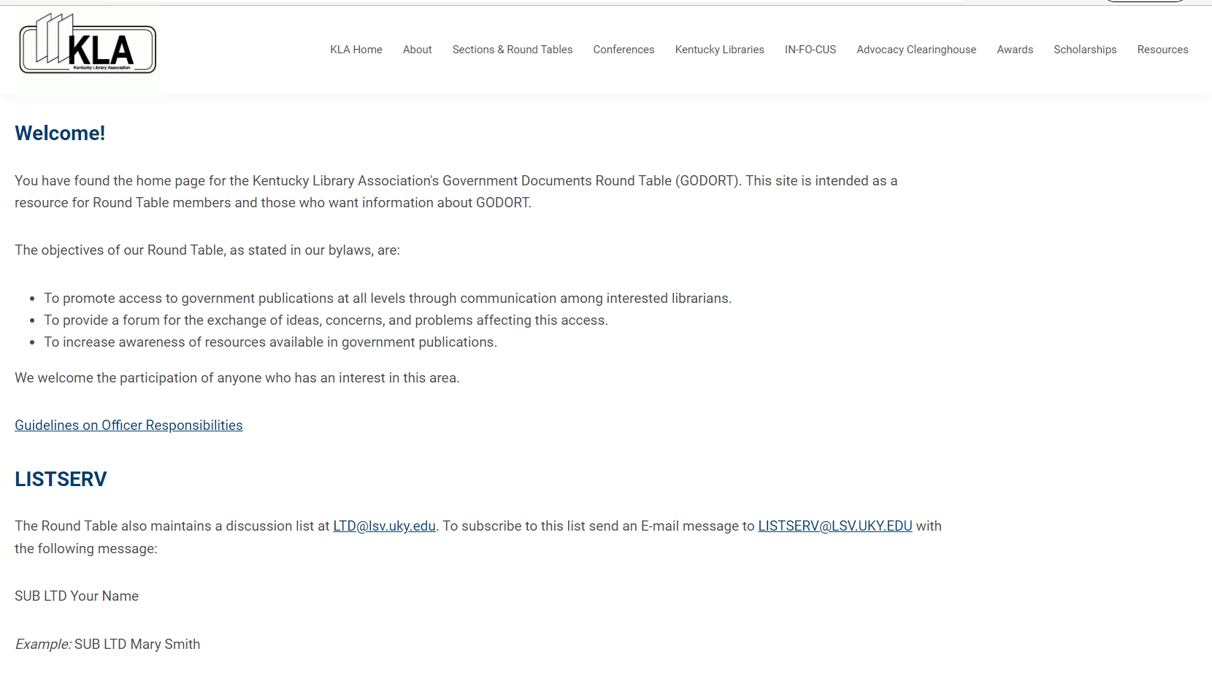

Slide 20
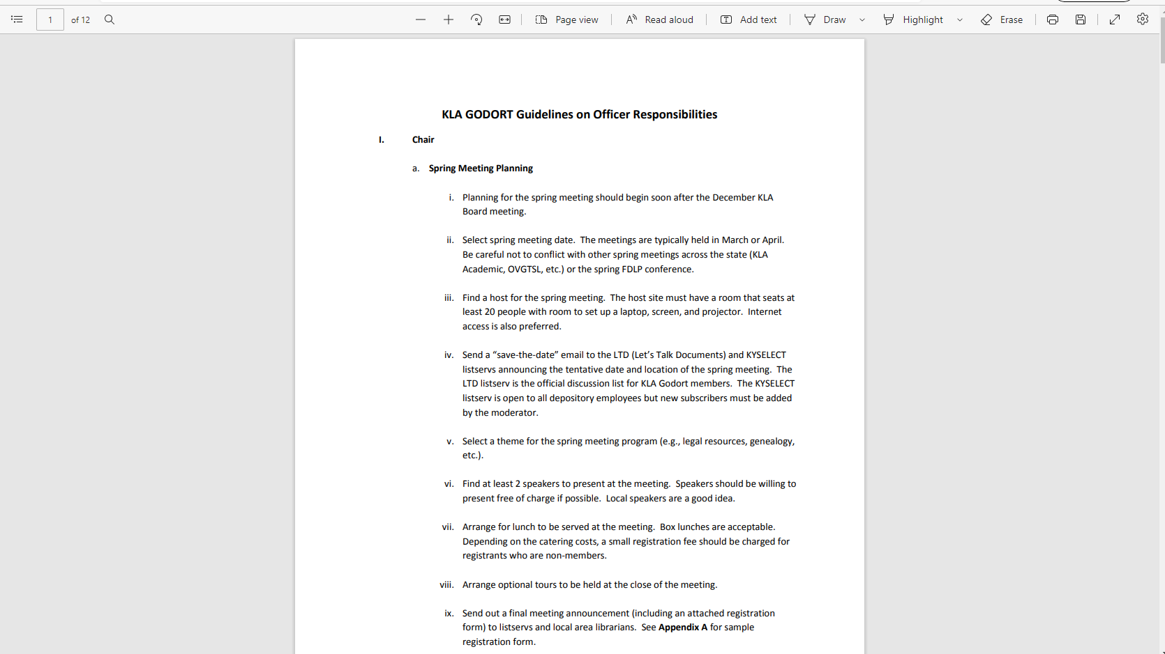

Slide 21
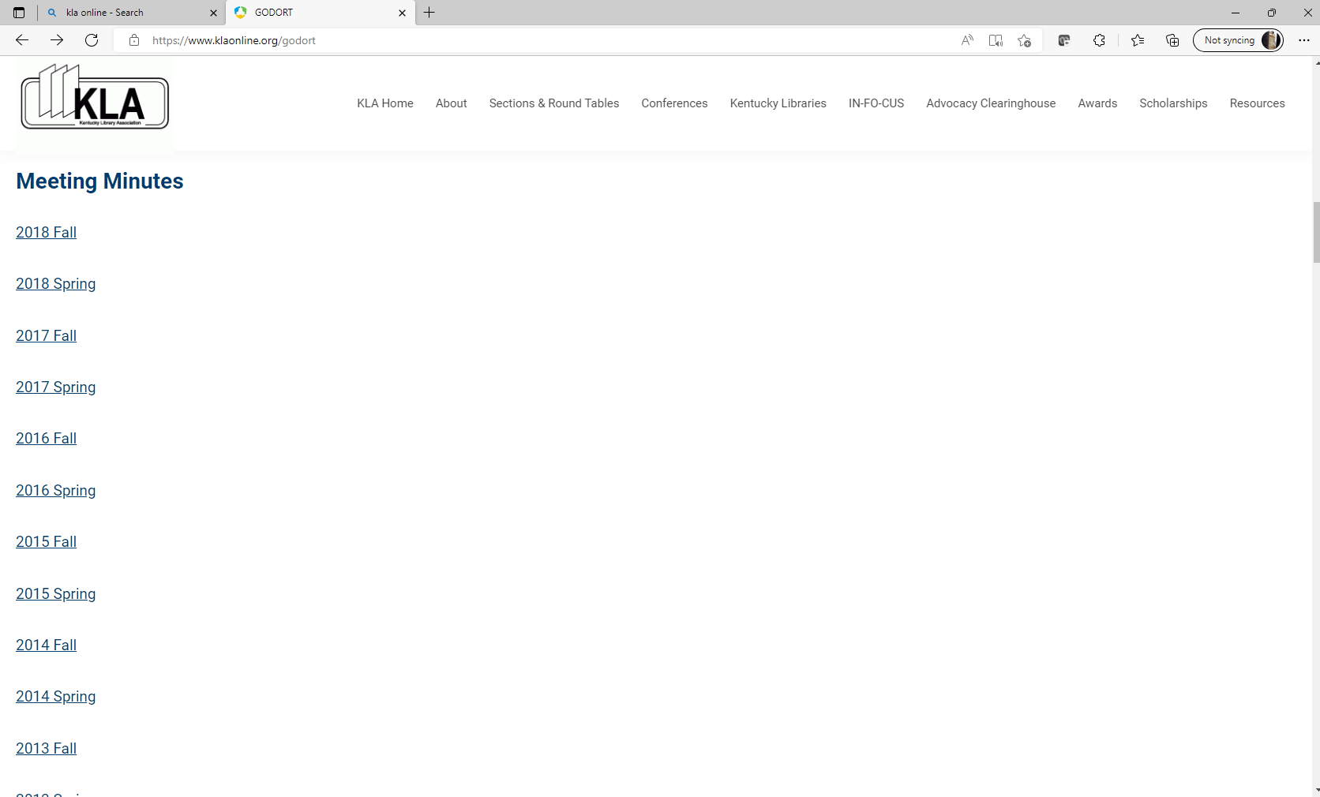

Slide 22
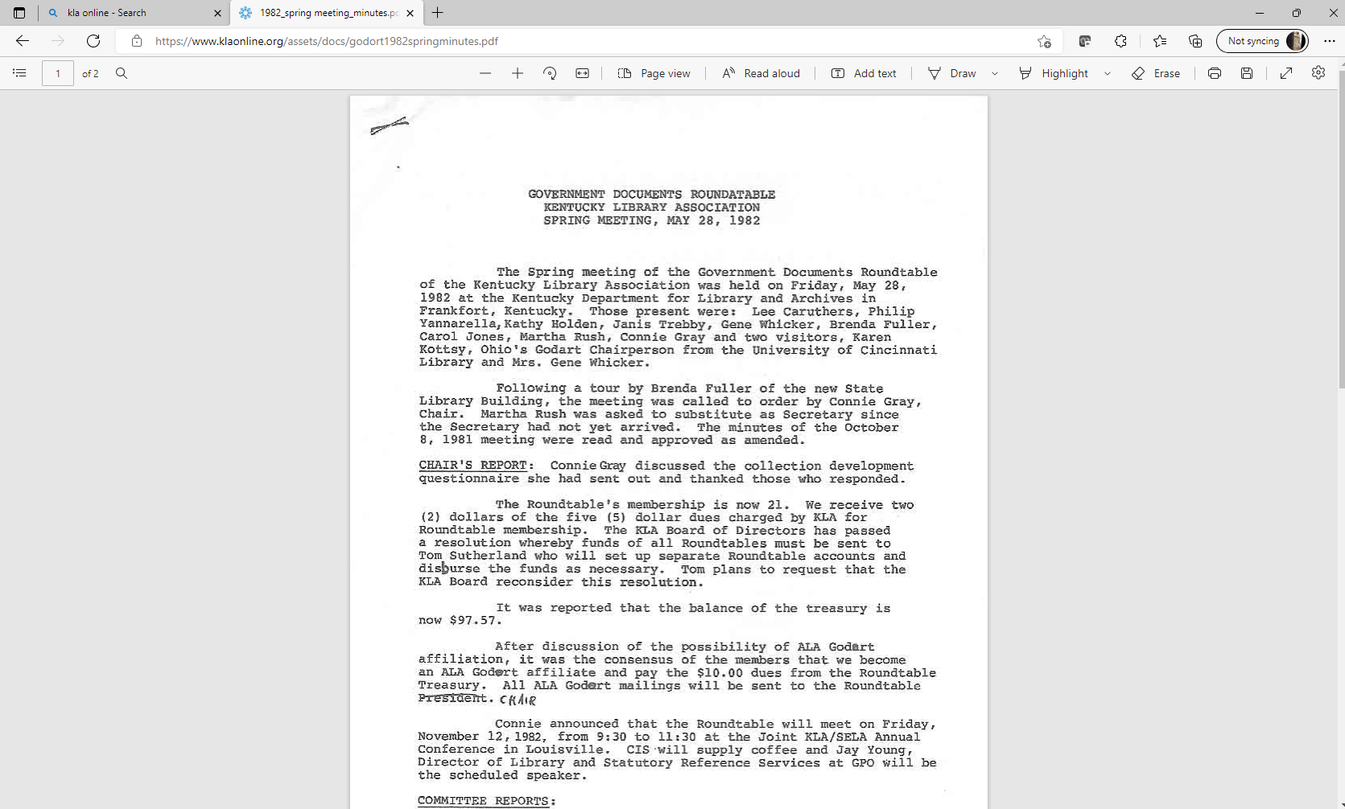

Slide 23
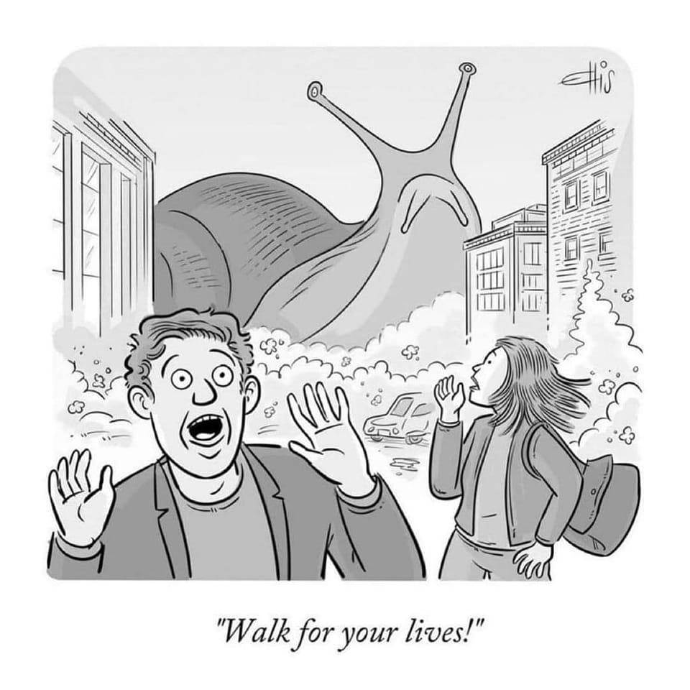

Slide 24
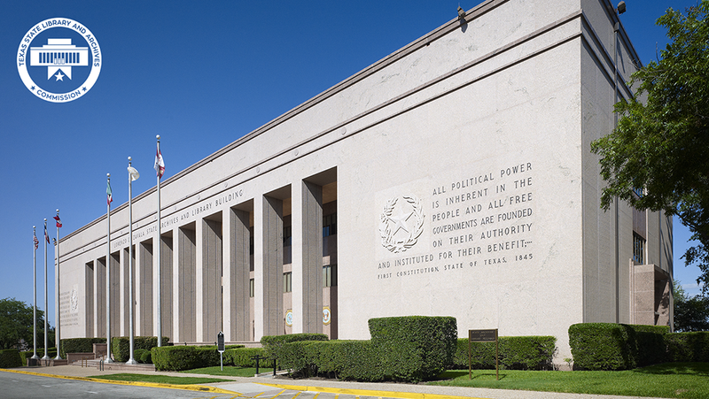
Case Study
Library History
  Established: circa 1845
  Purpose: state archives
  Location/move: state capitol grounds; quonset hut; reno (2008); off-site storage
  Disaster: n/a. Supports libraries across a flood-prone, hurricane-prone state

Slide 25
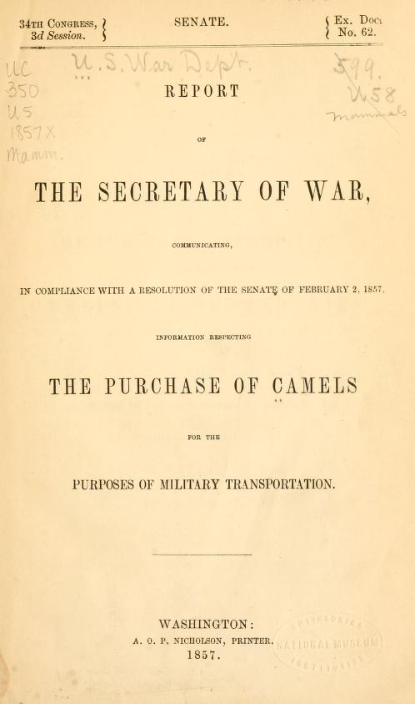
Depository History
  Est.: unknown
  Separate Fed Docs
  Co-Regional (trad.)
  Closed stacks
  SuDocs classification
  State Library & Archives (single, standalone agency
  State pubs and Fed docs repository
  Full-time Conservator
  No partnerships
Tip!
  Connect to main colls. & mission
  Include in collection development policy

Slide 26
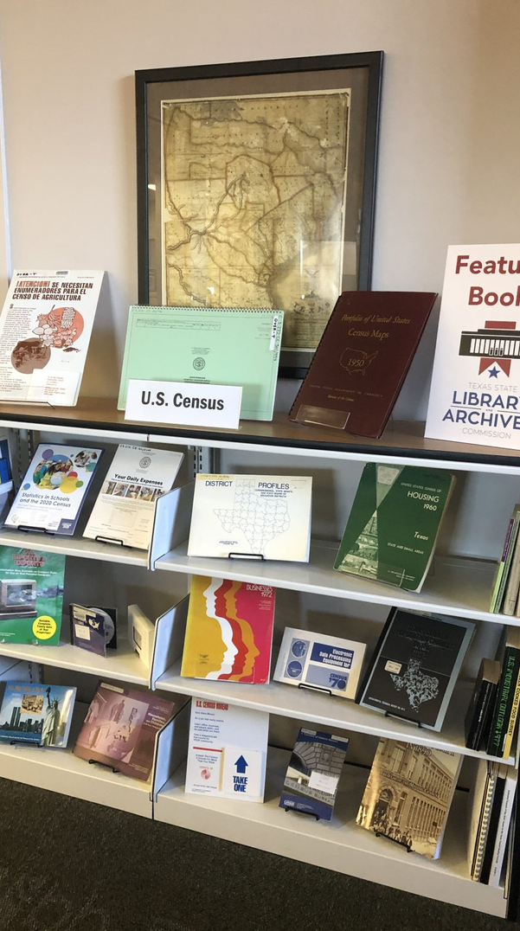
Collection Development
  Strength: Regional depository, print (no plans to reduce or remove)
  Selection percentage: ~95%
  Other depository systems: state publications
Tip!
  Book displays (even if non-circ)
  Feature in social media
  Incorporate into larger exhibits

Slide 27
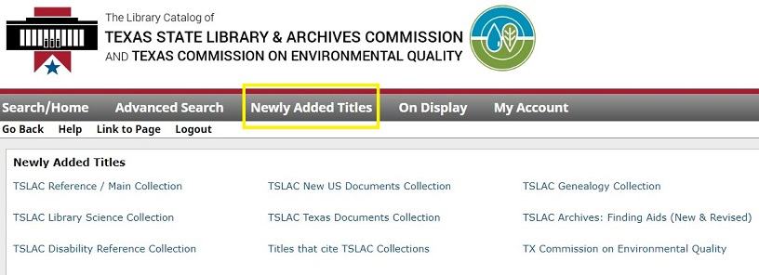
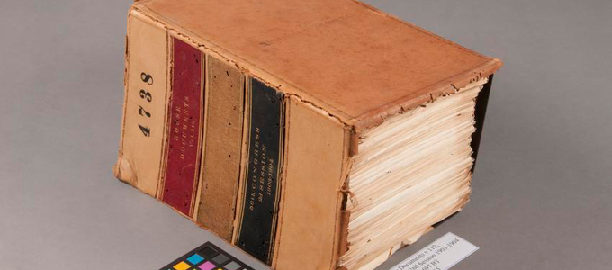
Events
Technical Services
  Shelf list: lost during renovation
  Rely on ILS catalog record ingest
  Rely on browsing (librarians) in closed stacks
Tip!
  Document decisions (exceptions, house rules)
  Meet regularly with Cataloging
  Use ILS note functions heavily
Automation
  Limited
  In-house digitization: no

Slide 28
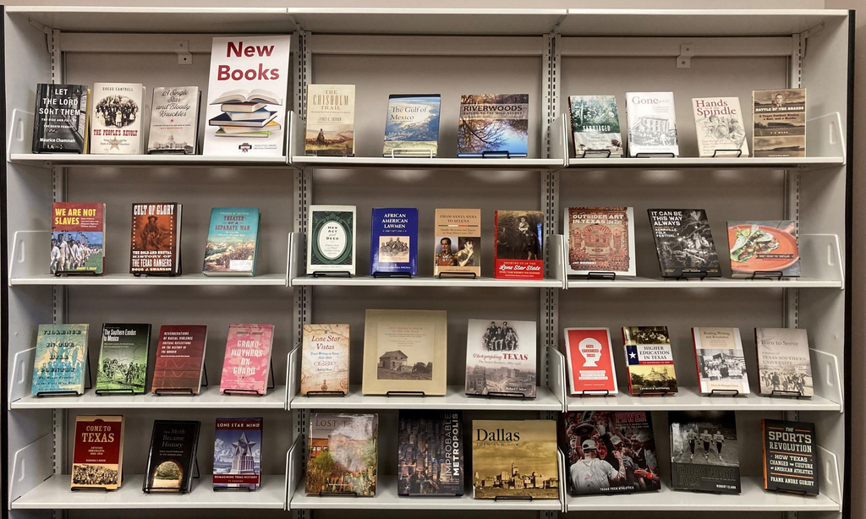
Circulation
  Non-circulating collection
  ILL? yes (both hardcopy and scans)
Tip!
  Have a USD Collection Development Policy
  Refer to FDLP libs first

Slide 29
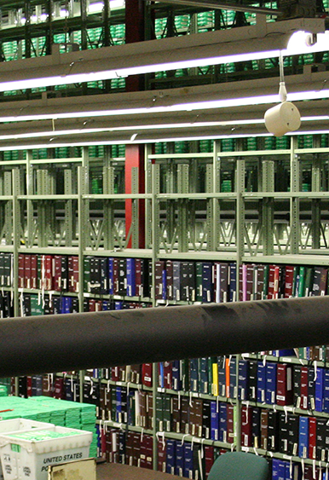
Events
Shelving
  Closed stacks
  Dedicated stacks floor
  (new!) Off-site storage
Tip!
  Use Out Markers
  Use Wayfinders

Slide 30
GWEN SINCLAIR
gsinclai@hawaii.edu
Thank you!
CLAUDENE SPROLES
caspro01@louisville.edu
ANGELA KENT
ajakent@icloud.com

