Slide 1
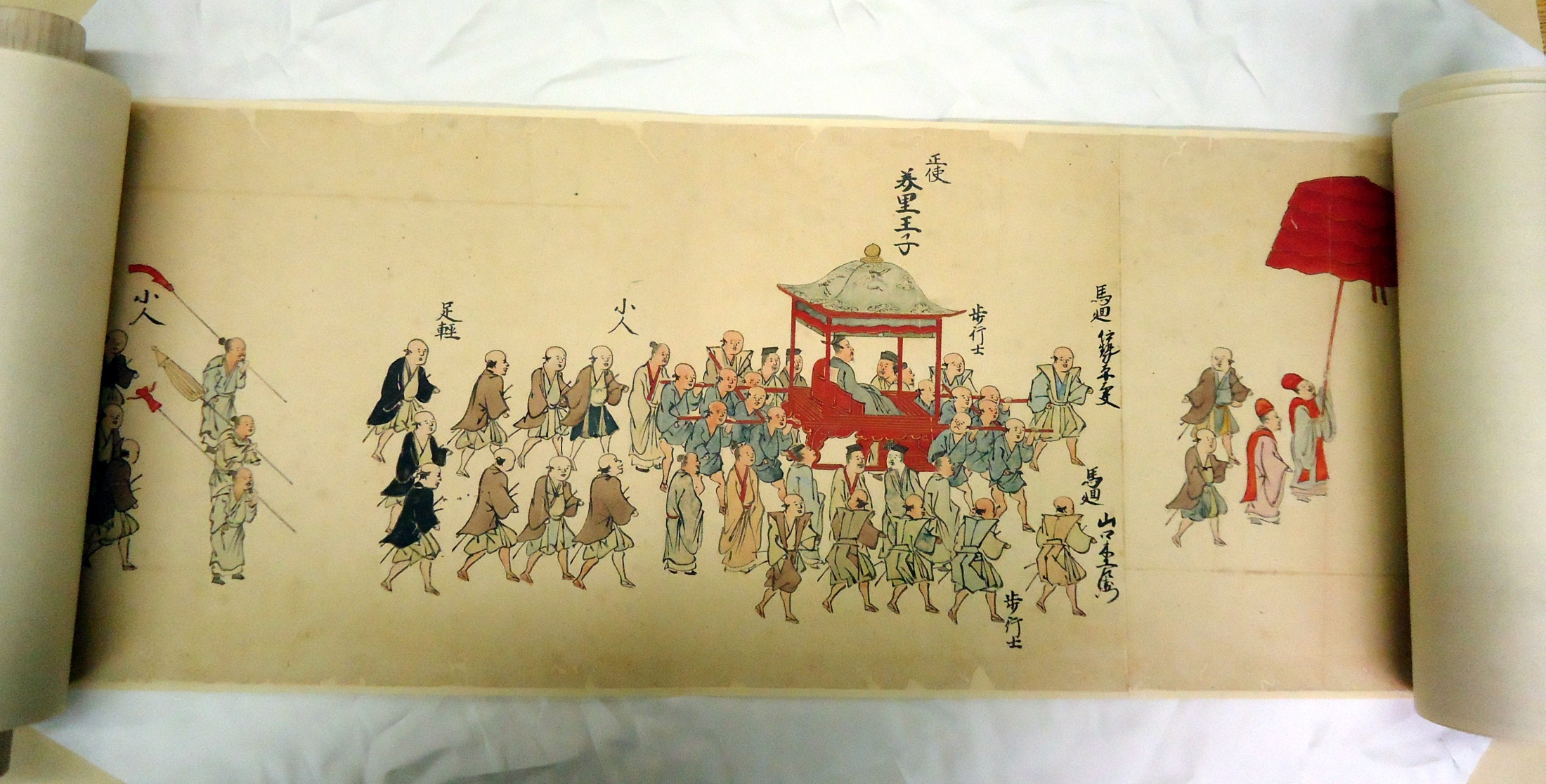
Ryukyuan Embassy Processions: A 1710 Edo Nobori Scroll from the Sakamaki/Hawley Collection
Travis Seifman
Univ. of California, Santa Barbara

Slide 2
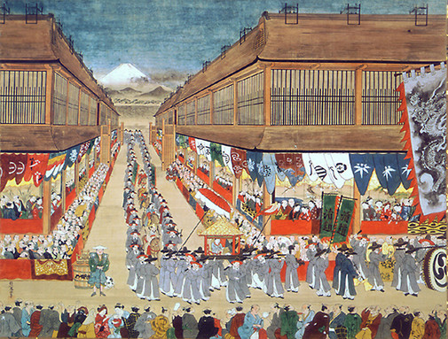
Chôsenjin uki-e
Hanegawa Tôei
c. 1748
ink & colors on paper

Slide 3

“Procession of Ryukyuans Enroute to Edo Castle”
Unknown artist 1710
Ink and colors on paper
First of two scrolls 27 x 1,975 cm
Sakamaki/Hawley Collection,
Univ. of Hawaiʻi at Mānoa Library
琉球人登城之行列
作者不明
１７１０年
紙本着色
二巻の第一
ハワイ大学図書館所蔵

Slide 4
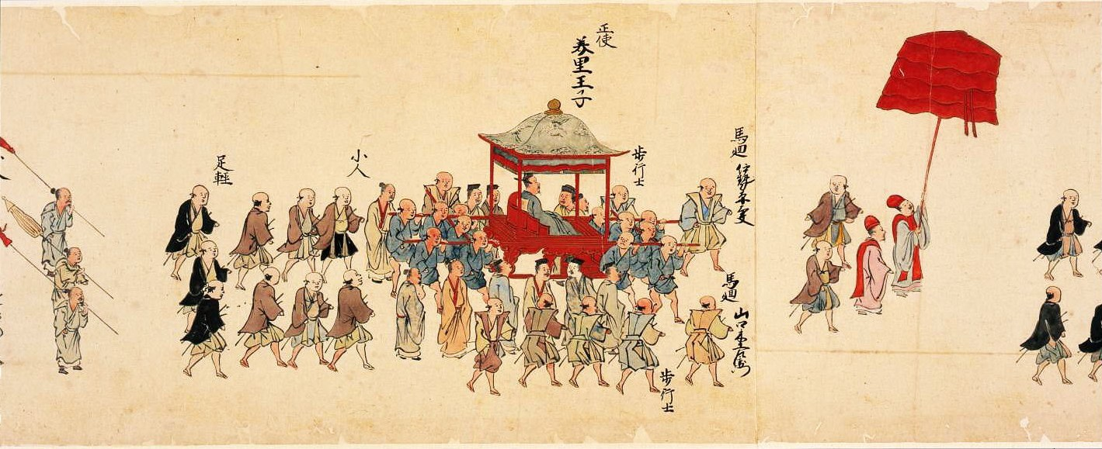
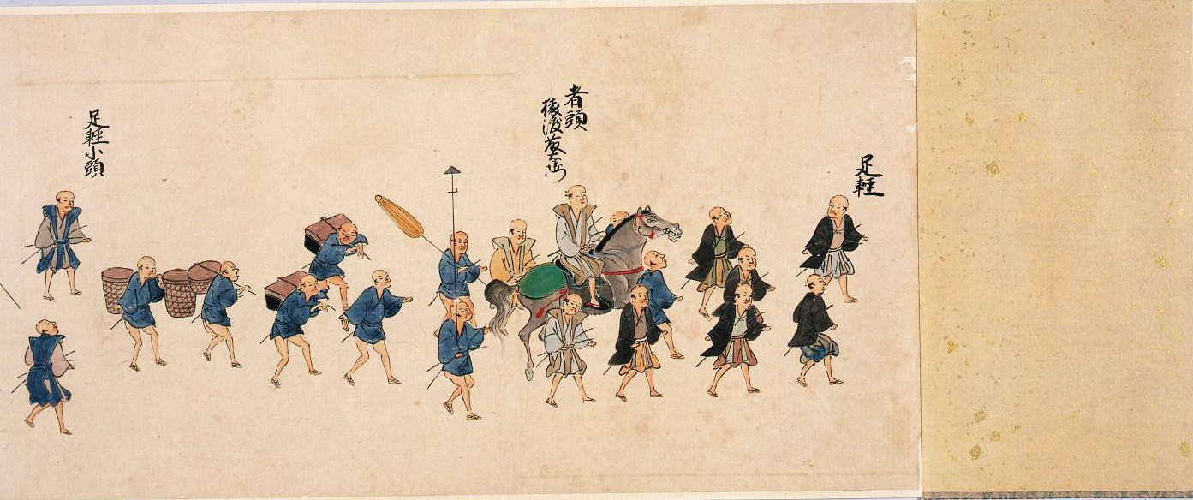
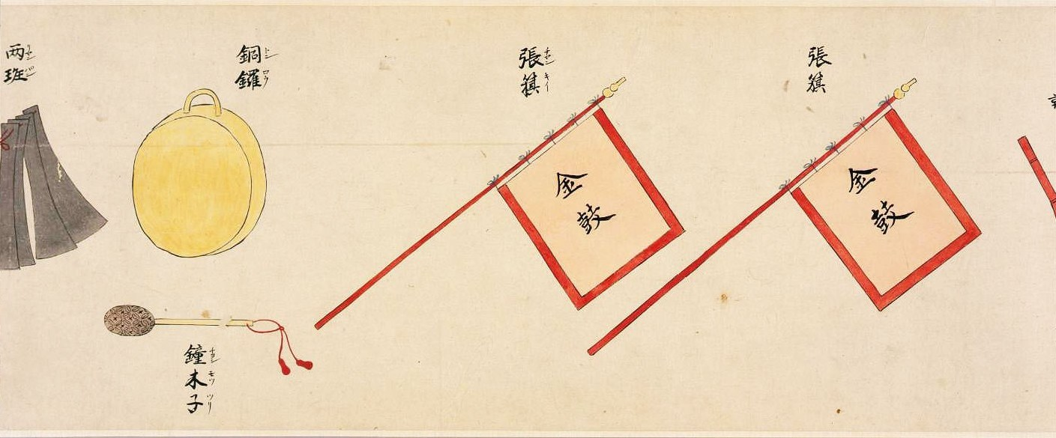
“Procession of Ryukyuans Enroute to Edo Castle” 1710
First scroll: Ryukyuan procession
Second scroll:
Procession of Satsuma samurai
and, images of Ryukyuan musical instruments and banners

Slide 5
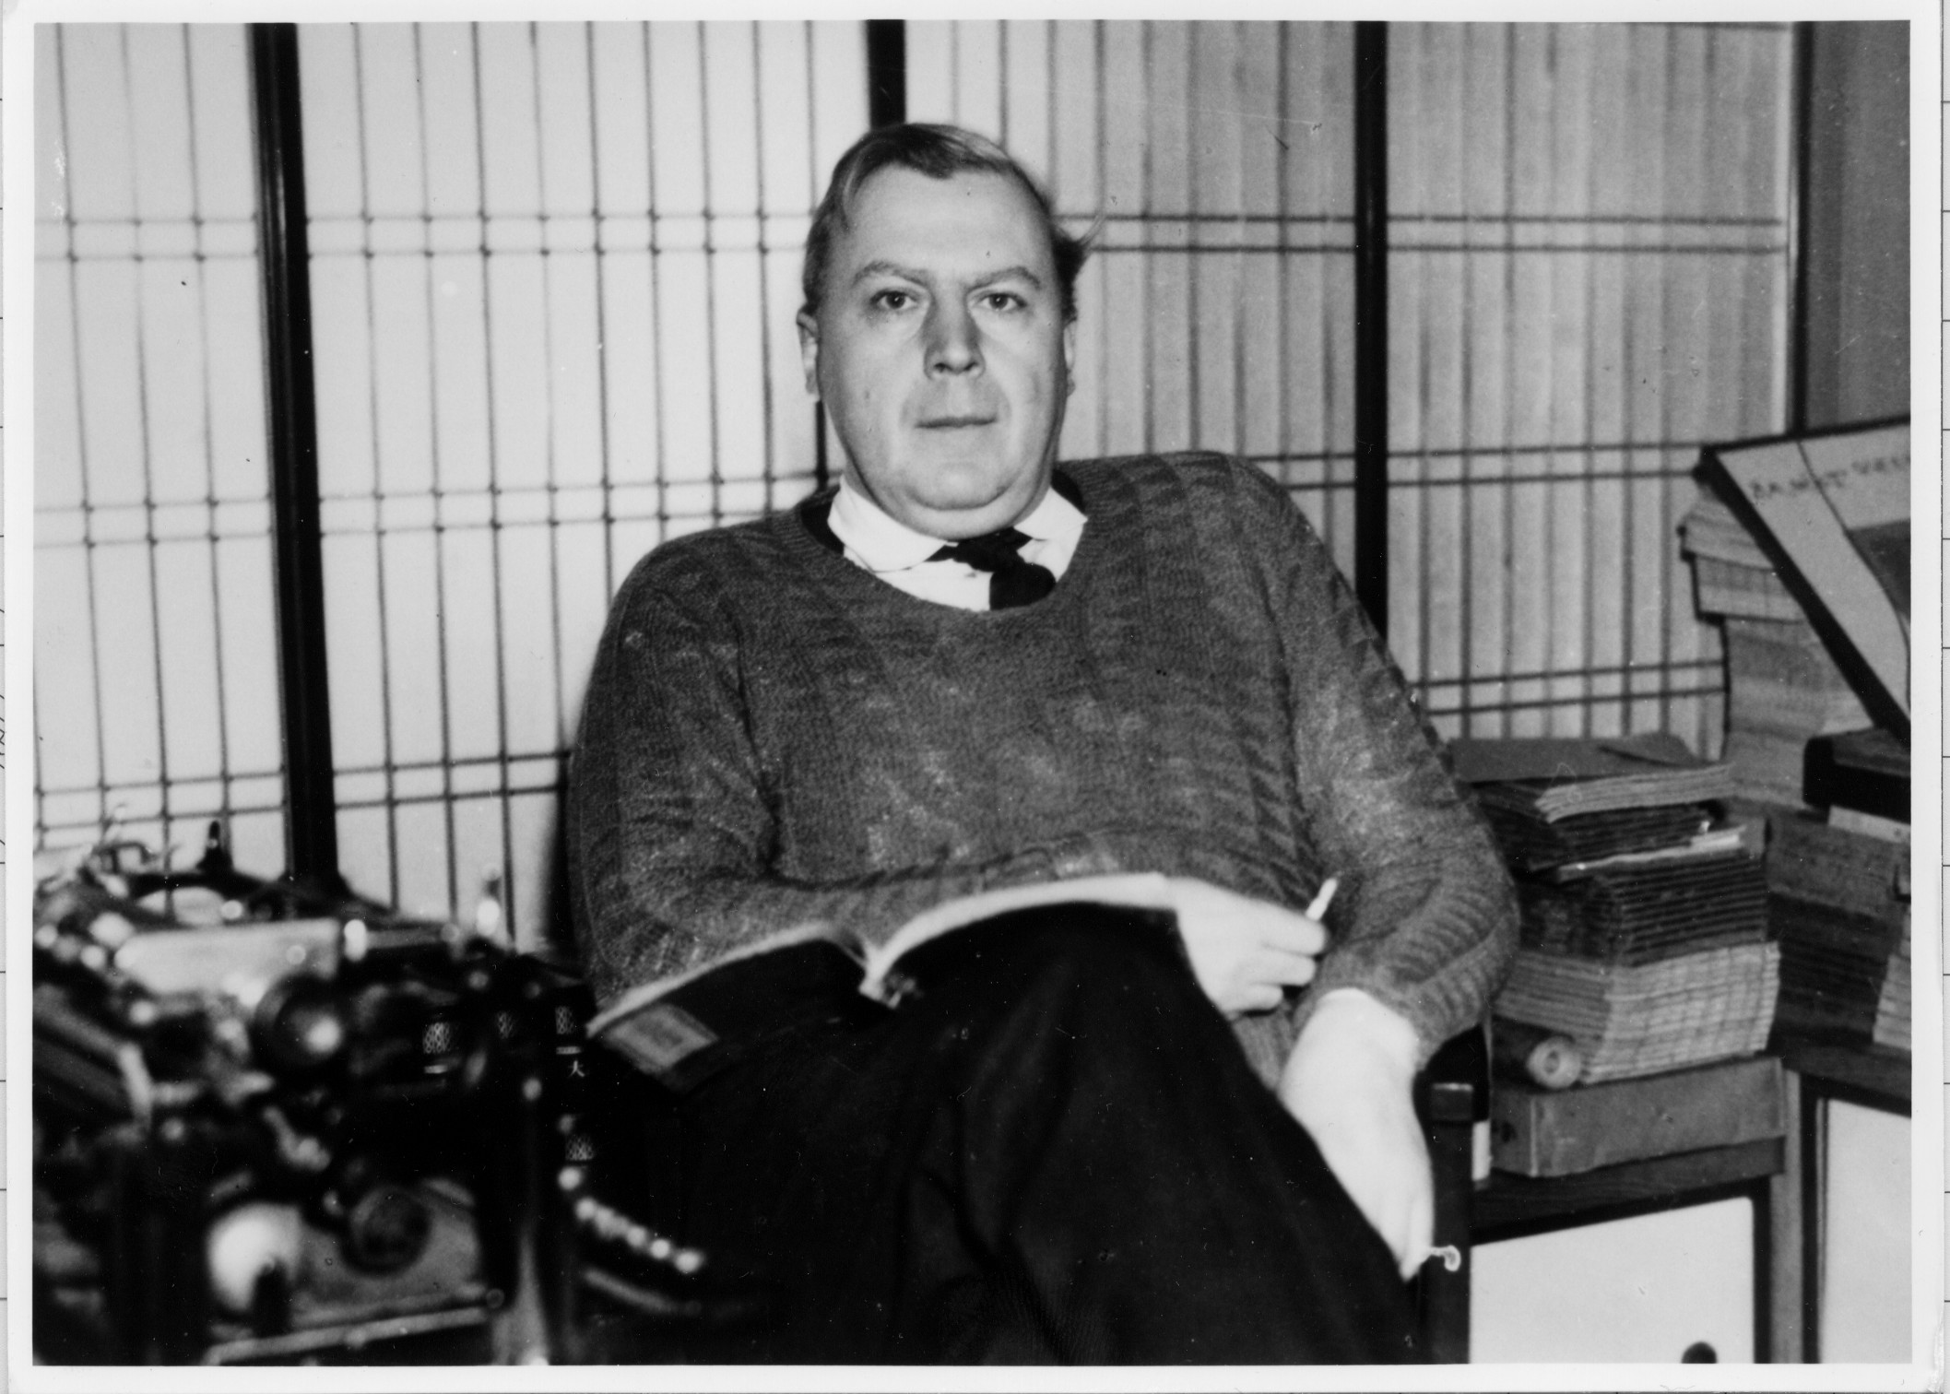
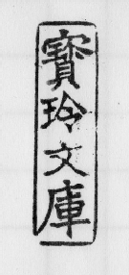
Frank Hawley (1906-61), British book collector and East Asia expert
*Following Hawley’s death in 1961, the University of Hawaiʻi obtained his collection of Okinawa-related materials
*Below left: Mr. Hawley’s seal, reading 「宝玲文庫」 (“Hōrei bunko”) meaning “Hawley Collection”

Slide 6
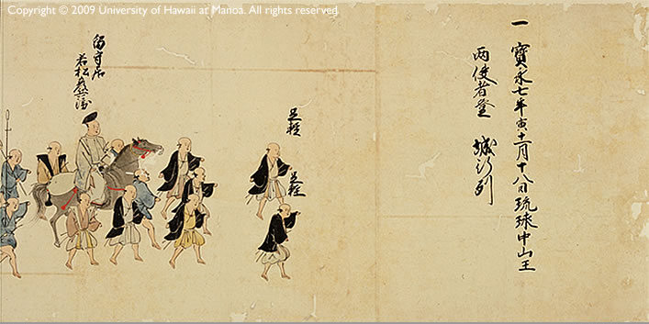
Inscription: 宝永七年寅十一月十八日琉球中山王 両使者登城之列
7th year of Hōei [1710], 11th month, 18th day
Procession of both ambassadors of the King of Chūzan Ryūkyū up to the castle

Slide 7
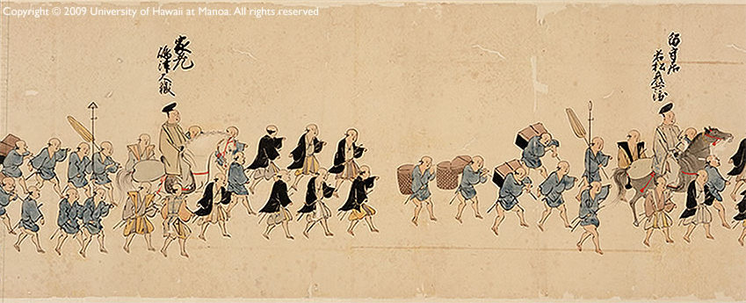
家老 島津大徹
House Elder (karô)
Shimazu Daitetsu
留守居 若松彦兵衛
Edo-based domain official (rusui) Wakamatsu Hikobee

Slide 8
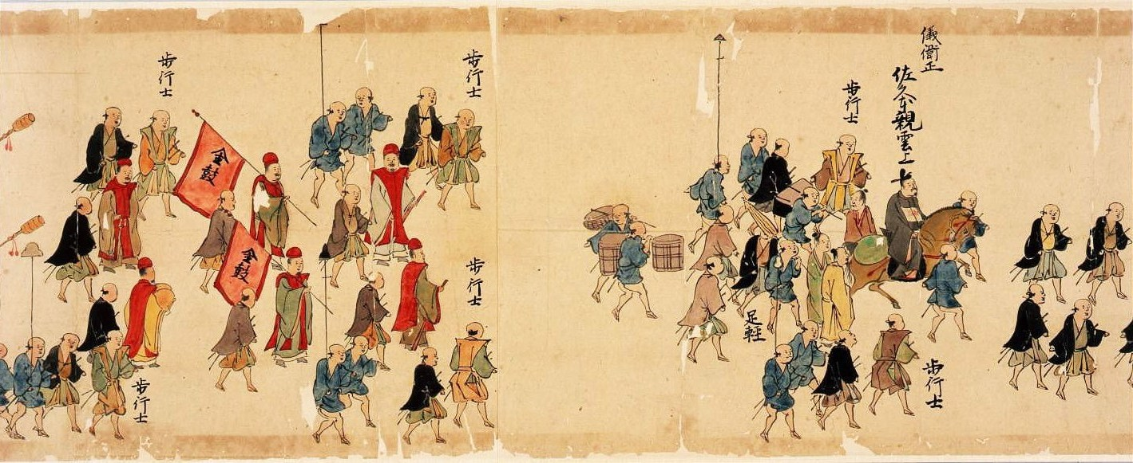
歩行士
hokôshi / kachishi
“samurai accompanying on foot”
「金鼓」の旗
“golden drum” banners
佐久本親雲上
Sakumoto peechin
儀衛正 gieisei
Head of street musicians

Slide 9
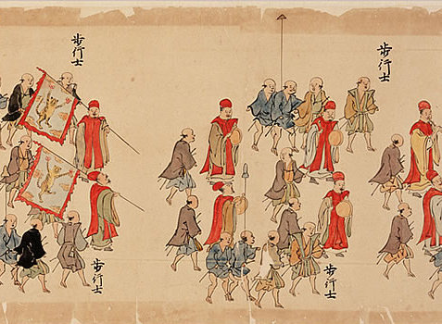
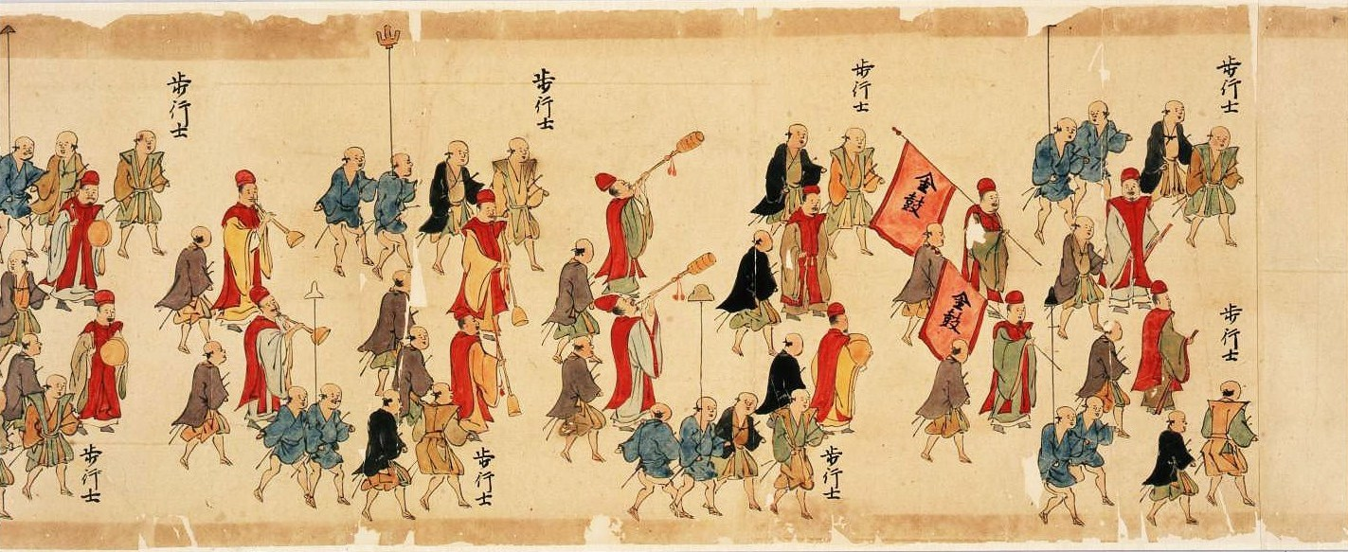
Tiger banners Street musicians
playing drums, gongs, and woodwinds
「金鼓」の旗
“golden drum” banners

Slide 10
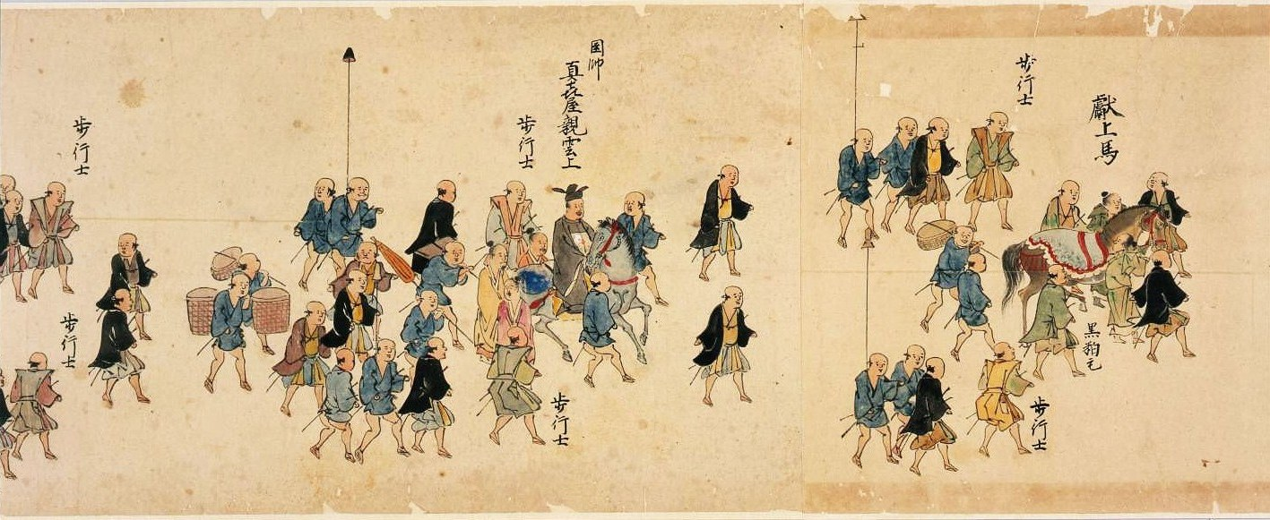
真喜屋親雲上
Makiya peechin
圉師 gyōshi
Head groom / horse steward
献上馬 kenjōba
horse to be presented
[as a gift / as tribute]

Slide 11
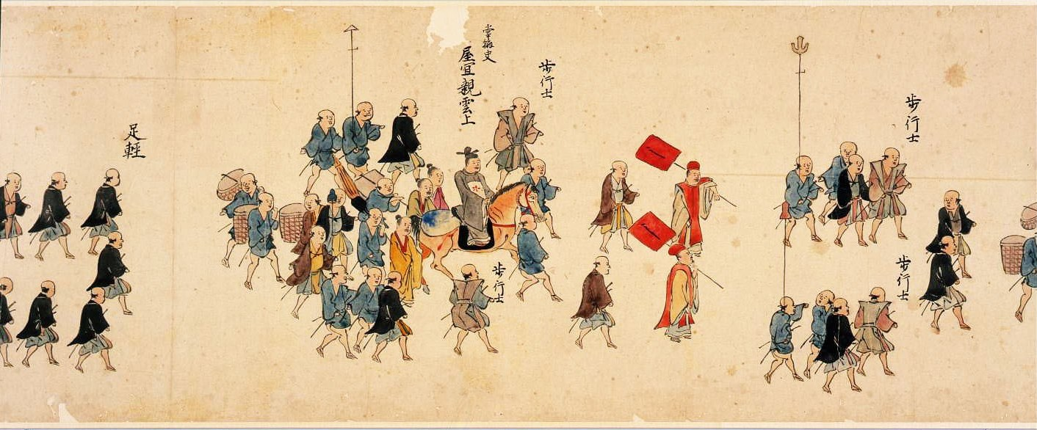
屋宜親雲上
Yagi peechin
掌翰史 shokanshi
Secretary

Slide 12
美里王子 Misato ōji
Prince Misato
正使 seishi
Lead Envoy/Ambassador
慶賀使 keikashi
“Congratulatory Mission,” congratulating the new Shogun for his succession to that position

Slide 13
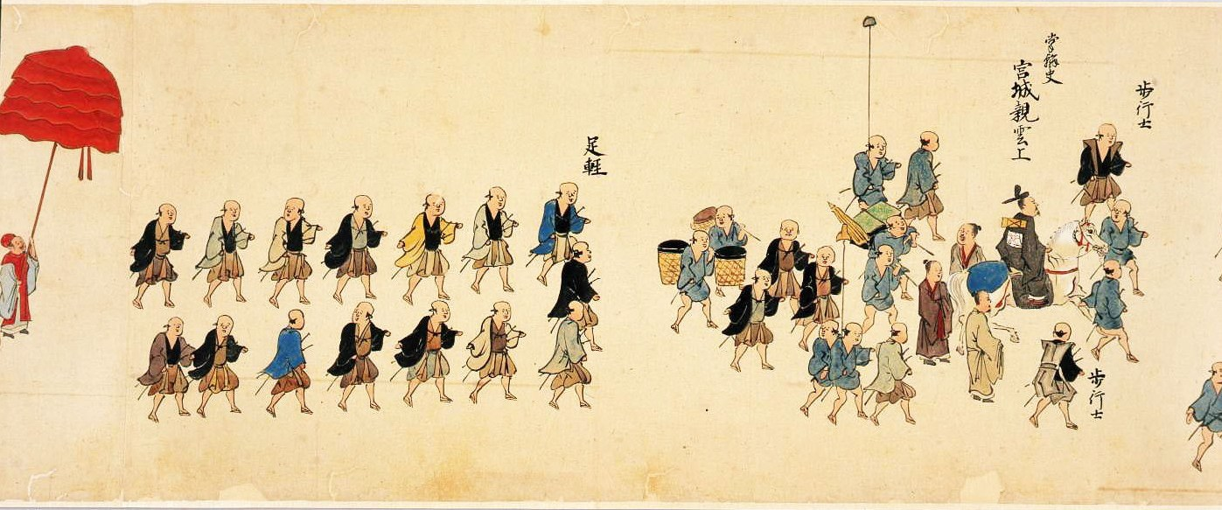
宮城親雲上
Miyagusuku peechin
掌翰史 shokanshi
Secretary

Slide 14
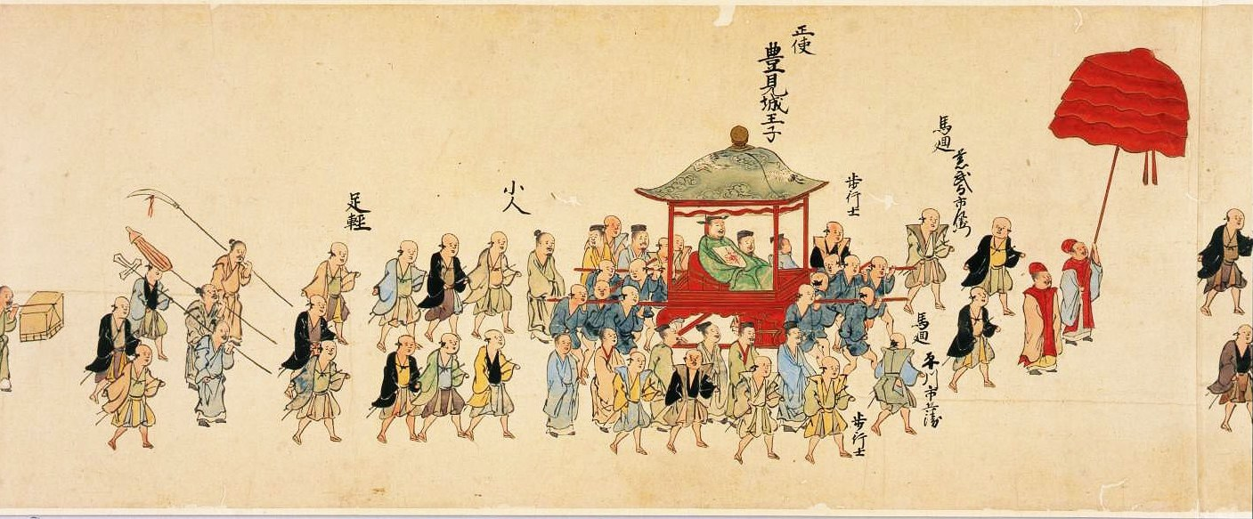
豊見城王子 Tomigusuku ōji
Prince Tomigusuku
正使 seishi
Lead Ambassador
謝恩使 shaonshi
“Gratitude Mission,” expressing thanks for shogunal recognition of the new King of Ryūkyū

Slide 15
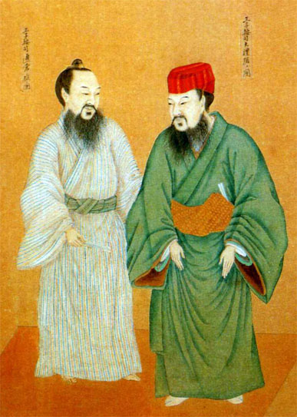
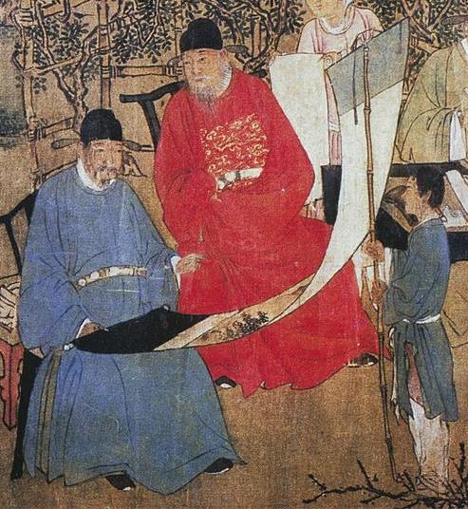
Painting of an anji and an ōji
王子按司大礼服並通常服着装図
19th c., Anonymous Ryukyuan painter
Tokyo National Museum
東京国立博物館
Ming scholar-bureaucrats viewing a painting
1437
Xie Huan 謝環

Slide 16
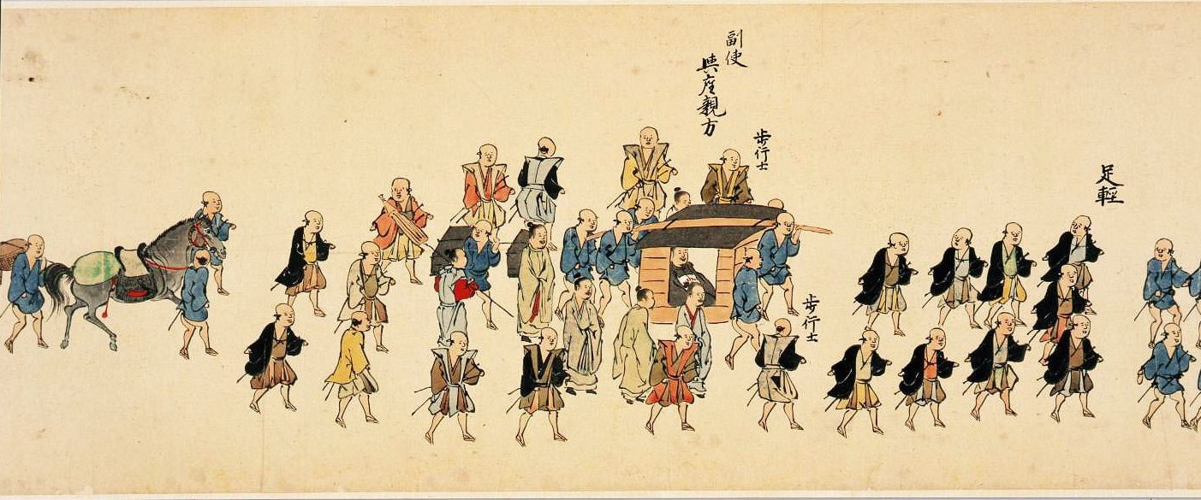
与座親方
Yoza ueekata
副使
Vice-Ambassador (Deputy Envoy)

Slide 17
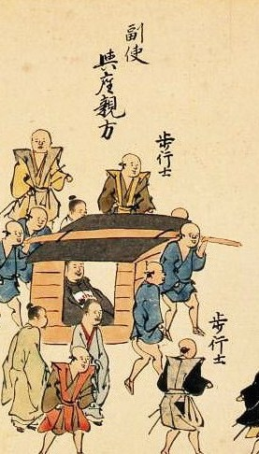
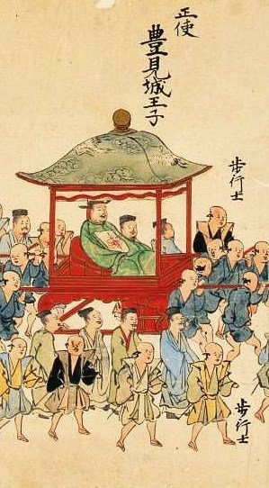
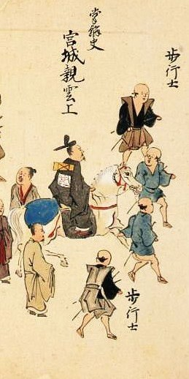
Vice-Envoy Yoza ueekata
in a Japanese-style palanquin
副使与座親方
Lead Envoy Prince Tomigusuku
in a Chinese-style palanquin
正使豊見城王子
Secretary Miyagusuku peechin, on horseback
掌翰史宮城親雲上

Slide 18
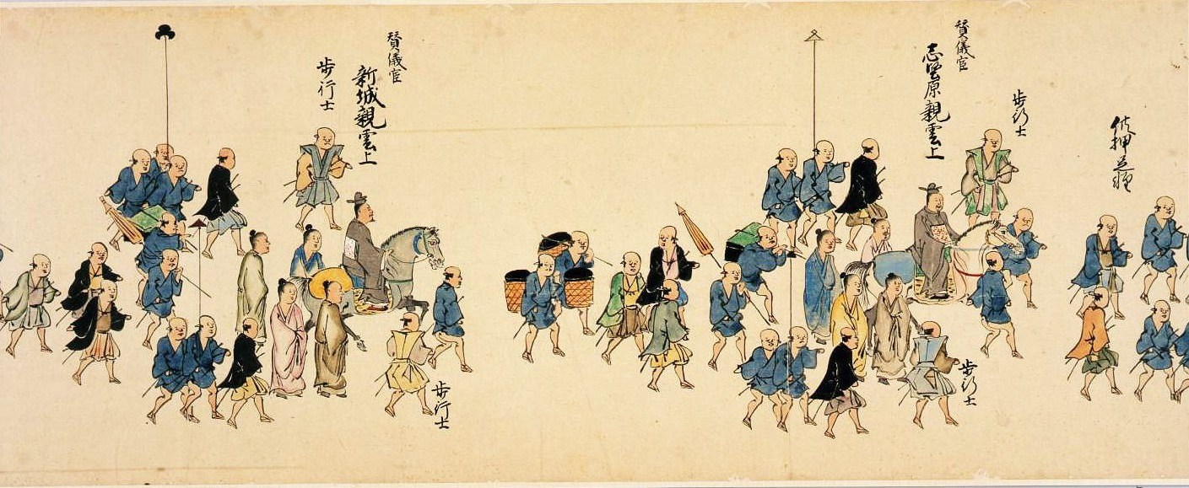
新城親雲上
Aragusuku peechin
賛儀官
Sangikan
志堅原親雲上
Shikenbaru peechin
賛儀官
Sangikan

Slide 19
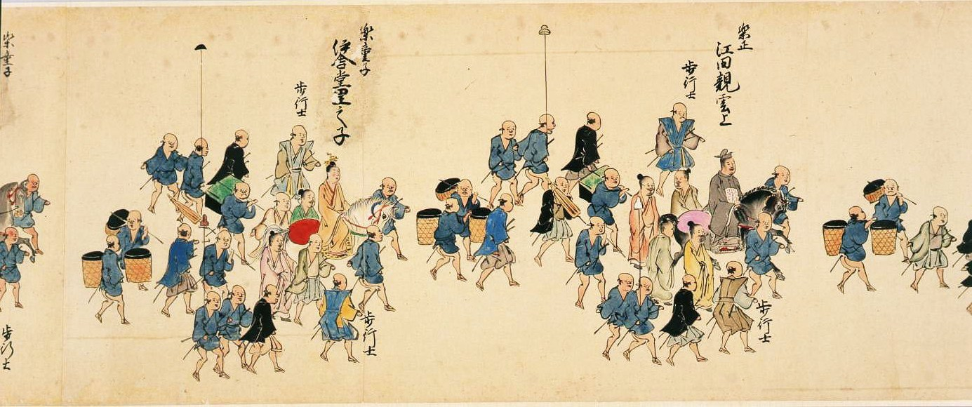
伊舎堂里之子
Ishadô satunushi
楽童子
gakudôji
江田親雲上
Eda peechin
楽正
gakusei

Slide 20
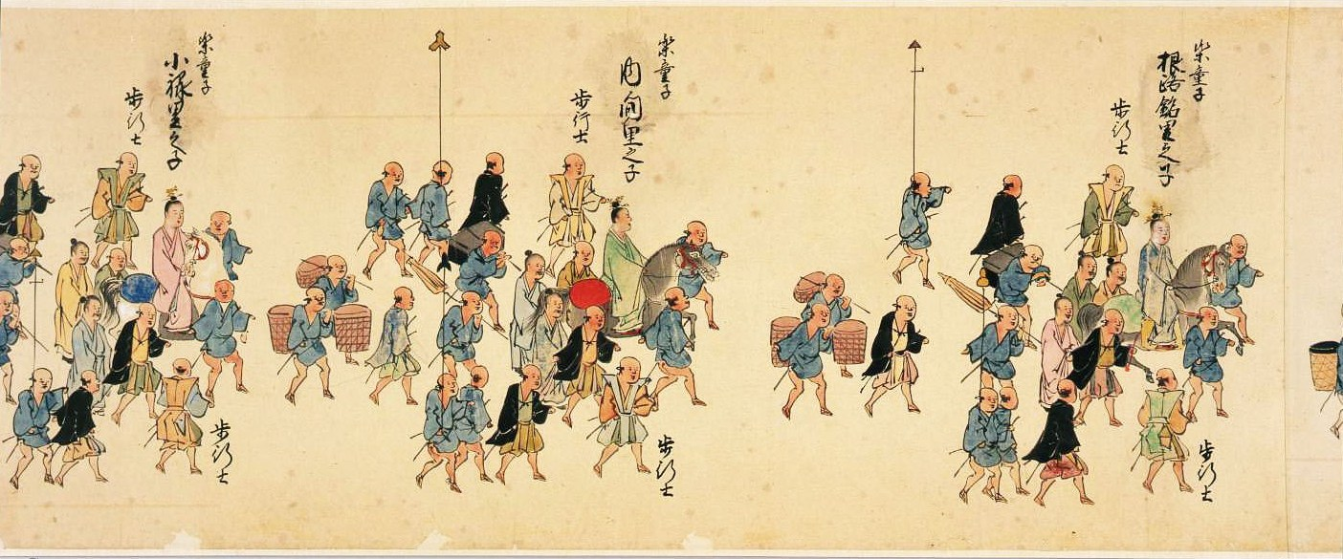
楽童子
gakudôji
小禄里之子
Uruku (Oroku) satunushi
楽童子
gakudôji
根路銘里之子
Nirumi satunushi

Slide 21
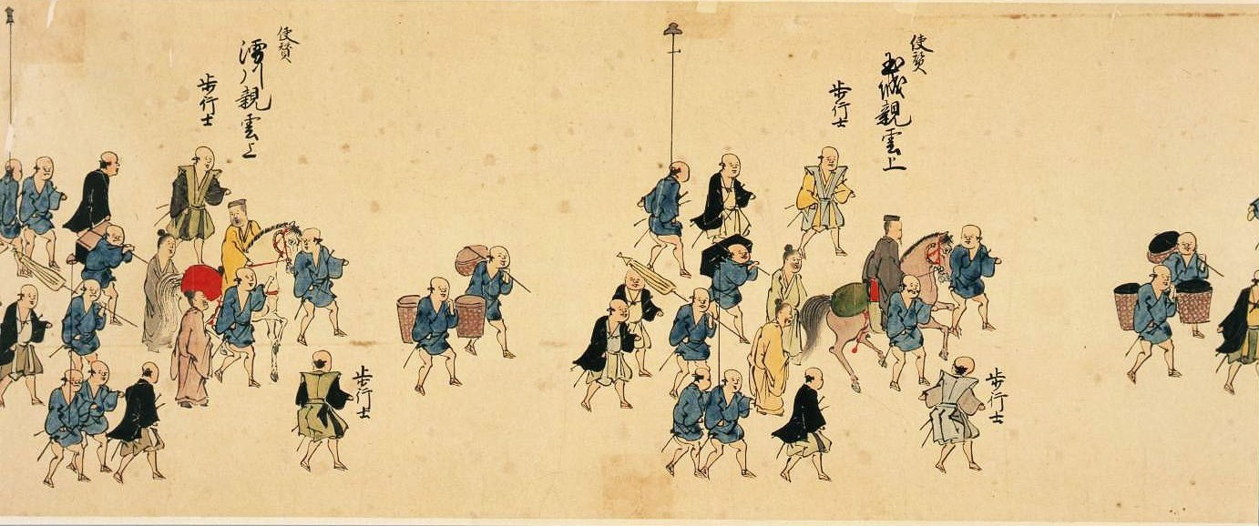
玉城親雲上 （玉城朝薫）
Tamagusuku peechin
(Tamagusuku Chôkun)
使賛 shisan
Chief Aide to the Lead & Vice Envoys

Slide 22
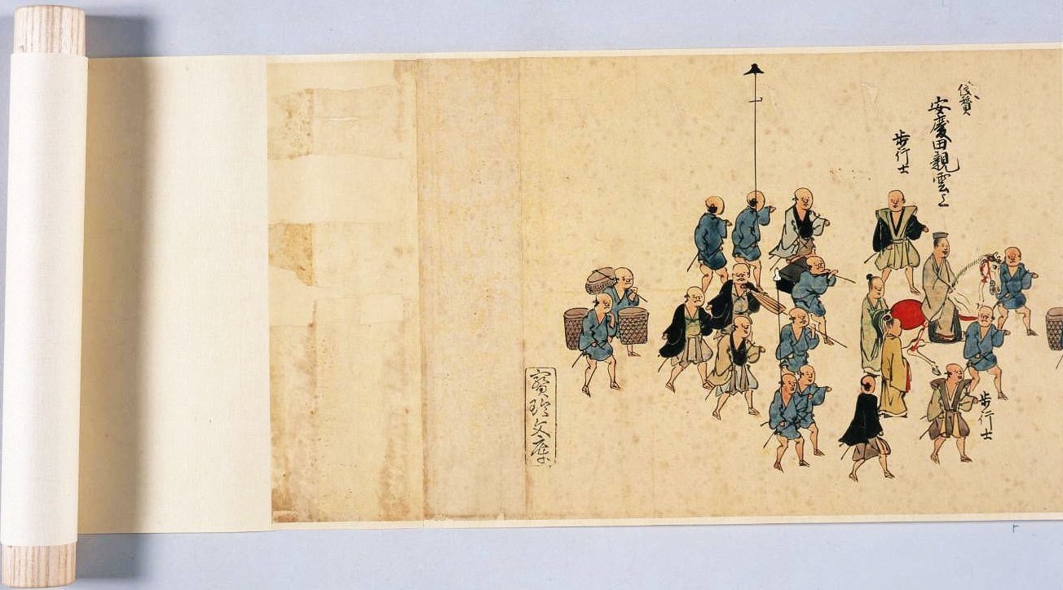

Slide 23
Ryukyuan Embassy Processions: A 1710 Edo Nobori Scroll from the Sakamaki/Hawley Collection
Travis Seifman
Univ. of California, Santa Barbara

