Slide 1

Using Social Tools As a New Instructional Approach
Jayneen Kehaulani Souza
University of Hawaii at Manoa
jayneenk@hawaii.edu

Slide 2
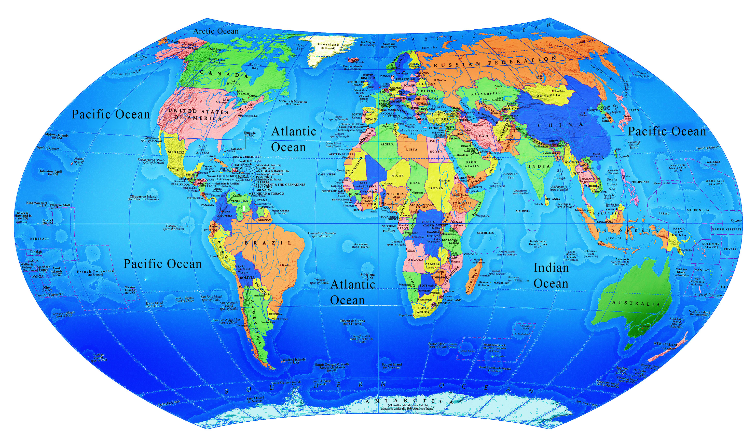
Where are you?

Slide 3
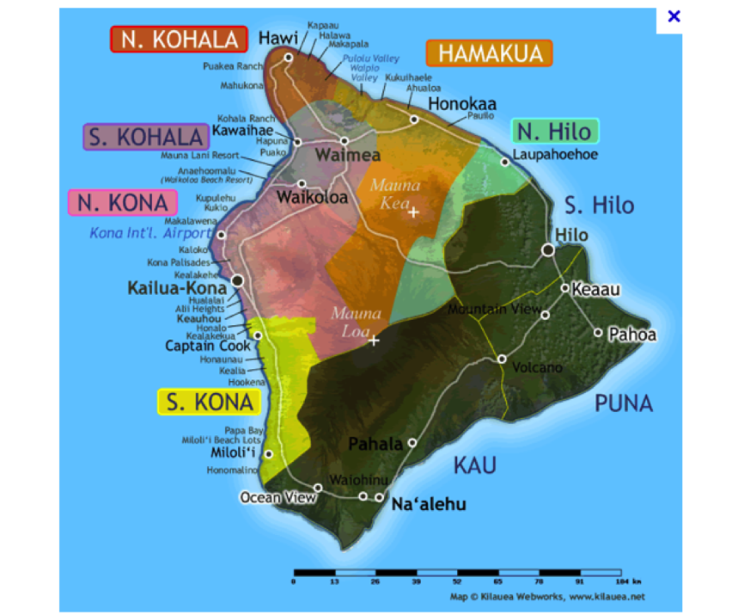

Here I am
High School Mathematics Teacher
Educational Technology
Notes:
I am a graduate student in the Master’s of Education in Educational Technology at the University of Hawai`i at Mānoa.
Been a teacher for 13 years
Currently an ETEC student and soon to graduate at the university in the educational technology program and in my final semester

Slide 4

Poll
Do you think visual learning tools play an important role in the 21st century mathematics classroom?
Notes:
Do you think “Visual tools play an important role in communicating mathematical ideas and supporting the process of reflection”
A mind map is a visual, non-linear way to capture the relationship between thoughts and ideas. There is a lot of mind mapping software out there,
Mind maps, prezi, powerpoint

Slide 5

Poll
Do you think visual learning tools play an important role in the 21st century mathematics classroom?
Yes
No
Notes:
Do you think “Visual tools play an important role in communicating mathematical ideas and supporting the process of reflection”
A mind map is a visual, non-linear way to capture the relationship between thoughts and ideas. There is a lot of mind mapping software out there,
Mind maps, prezi, powerpoint

Slide 6
Research
Visual Learning
According to author, Patty Kohler,
“research clearly indicates that brain activity is enhanced when we use and teach our students to represent information in a visual way” (Kohler, 2009, p.1).
Notes:
What is visual thinking and visual learning?
Visual thinking is a learning style where the learner better understands and retains information when ideas, words and concepts are associated with images.
Research tells us that the majority of students in a regular classroom need to see information in order to learn it.
Some common visual learning strategies include creating graphic organizers, diagramming, mind mapping, outlining and more.

Slide 7

Research
Visual Learning
According to author, Patty Kohler,
“research clearly indicates that brain activity is enhanced when we use and teach our students to represent information in a visual way” (Kohler, 2009, p.1).
Notes:
What is visual thinking and visual learning?
Visual thinking is a learning style where the learner better understands and retains information when ideas, words and concepts are associated with images. Research tells us that the majority of students in a regular classroom need to see information in order to learn it. Some common visual learning strategies include creating graphic organizers, diagramming, mind mapping, outlining and more.

Slide 8
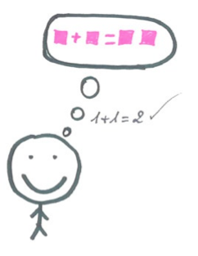
Research
Visual Learning
According to author, Patty Kohler,
“research clearly indicates that brain activity is enhanced when we use and teach our students to represent information in a visual way” (Kohler, 2009, p.1).
Notes:
What is visual thinking and visual learning?
Visual thinking is a learning style where the learner better understands and retains information when ideas, words and concepts are associated with images. Research tells us that the majority of students in a regular classroom need to see information in order to learn it. Some common visual learning strategies include creating graphic organizers, diagramming, mind mapping, outlining and more.

Slide 9

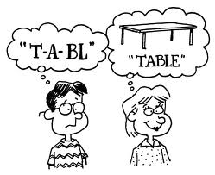
Research
Visual Learning & Technology
How can visual thinking and technology enhance student learning?
Notes:
Through innovative uses of technology, multimedia software and other online resources, educators can make available an environment that seeks to motivate, cultivate, and meet the needs of the 21st century learner (Belderrain, 2006).
How can my students build knowledge and content using visual thinking and technology?
Problem Solving using 21st century skills that are applicable to all content areas and build an online culture of learning?

Slide 10
Research
Visual Learning & Technology
How can visual thinking and technology enhance student learning?
Literature suggests using mind-tools in education. Mind-tools are cognitive tools, such as selected computer programs, that stimulate learning and thinking in students .
Notes:
Through innovative uses of technology, multimedia software and other online resources, educators can make available an environment that seeks to motivate, cultivate, and meet the needs of the 21st century learner (Belderrain, 2006).
How can my students build knowledge and content using visual thinking and technology?
Problem Solving using 21st century skills that are applicable to all content areas and build an online culture of learning?

Slide 11
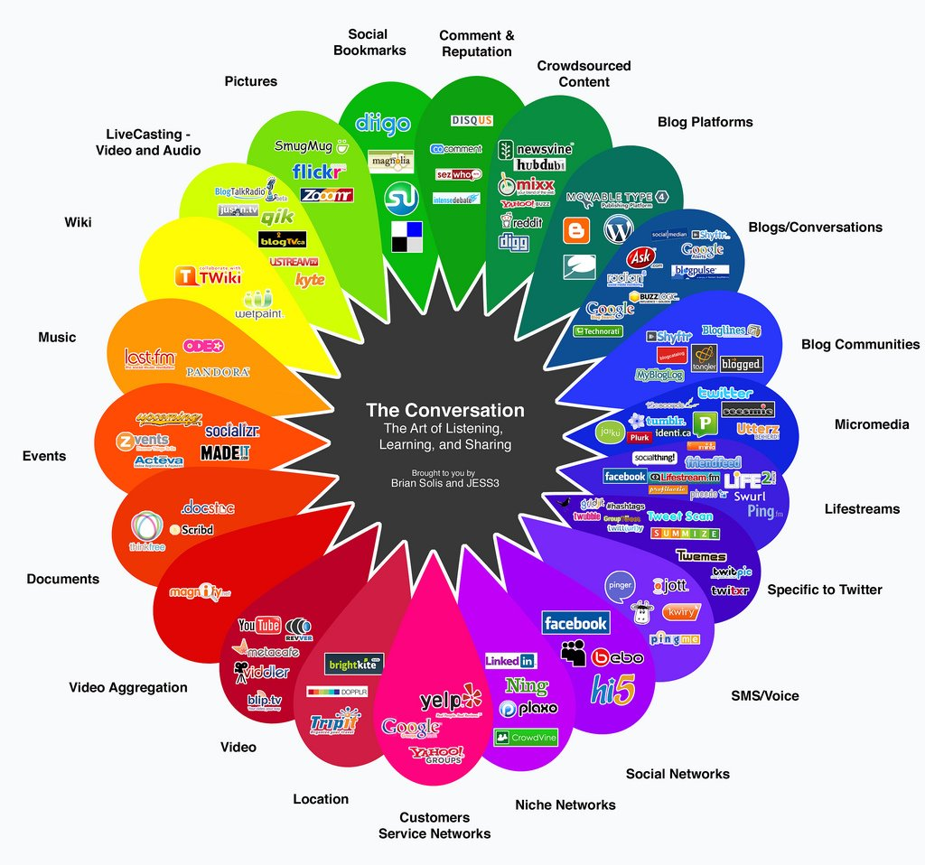
Notes:
Action Reasearch

Slide 12

Mindtools and Technology
Notes:
What are social mindtools? And, how can these tools enhance visual learning in combination with technology?

Slide 13

Mindtools and Technology
Notes:
What are social mindtools? And, how can these tools enhance visual learning in combination with technology?

Slide 14

Mindtools and Technology
Notes:
What are social mindtools? And, how can these tools enhance visual learning in combination with technology?

Slide 15
What are Social Mindtools?
Social
Notes:
What are social mindtools? And, how can these tools enhance visual learning in combination with technology?

Slide 16
What are Social Mindtools?
Social
Mindtools
Notes:
What are social mindtools? And, how can these tools enhance visual learning in combination with technology?

Slide 17
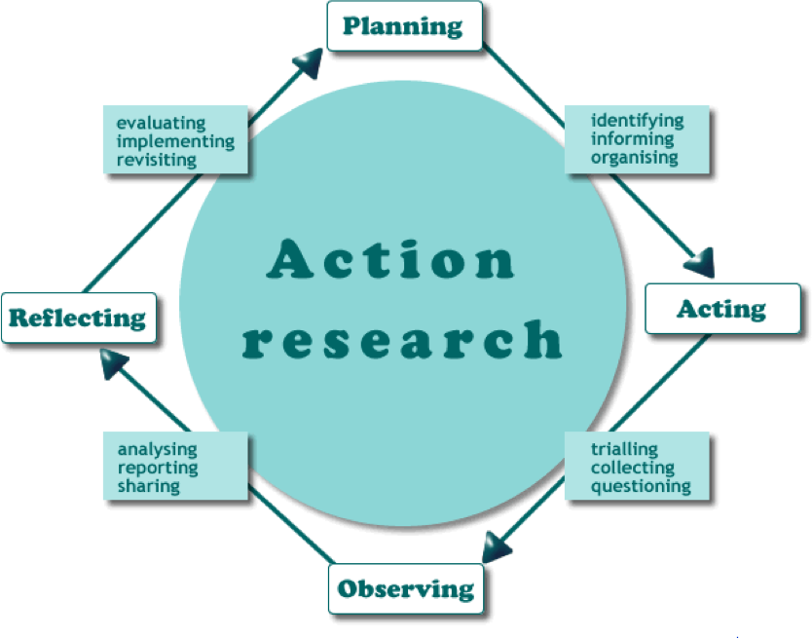
Action Research Project
    Purpose statement

Slide 18

Action Research Project
    Purpose statement: To evaluate the effectiveness of using a visual learning Web 2.0 tool, Webspiration Classroom to foster collaboration among ninth and tenth grade geometry students

Slide 19

What is Webspiration Classroom?
Do you know what
is?
Yes
No

Slide 20
What is Webspiration?
Visual Thinking Tool
Online
Anytime
Anywhere
Social Mindtool
Synchronous
Dynamic Diagramming
Web 2.0 Tool
Notes:
Webspiration Classroom™ is the online diagramming, graphic organizer, mind mapping and outlining tool for writing, brainstorming and collaboration, designed specifically to meet the needs of students, educators and schools.
The visual thinking and learning tools in Webspiration Classroom provide students with support to improve their writing, while giving them the tools they need to evaluate, synthesize and retain information across the curriculum. Webspiration Classroom teaches students how to develop their ideas, from the brainstorming stage all the way through to an organized, polished project.

Slide 21

Social Mindtools
Improve Writing and Thinking Skills
Teach and reinforce writing
Anytime
Anywhere

Slide 22

Social Mindtools
Improve Writing and Thinking Skills
Teach and reinforce writing
Improve visual and critical thinking skills
Anytime
Anywhere

Slide 23

Social Mindtools
Improve Writing and Thinking Skills
Teach and reinforce writing
Improve visual and critical thinking skills
Engage students in collaborative learning
Optimize student-teacher interaction
Anytime
Anywhere

Slide 24
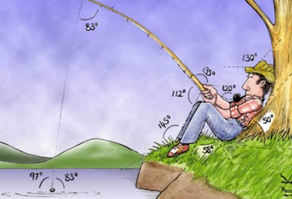
Multi-media Presentation
Real Life Applications
Collaborative Groups
Explore via the Internet
Notes:
Right Triangles and Trigonometry

Slide 25
Guiding Questions

Slide 26
Guiding Questions
What are the student’s attitudes towards Webspiration as a likeable tool?
Likeability

Slide 27
Guiding Questions
What are the student’s attitudes towards Webspiration as a likeable tool?
What are the student’s attitudes towards using Webspiration as an effective Web 2.0 tool to foster collaboration?
Usability
Likeability

Slide 28
Guiding Questions
What are the student’s attitudes towards Webspiration as a likeable tool?
What are the student’s attitudes towards using Webspiration as an effective Web 2.0 tool to foster collaboration?
Will the students’ perceive Webspiration as a tool they would continue to use in other content areas?
Usability
Likeability
Desire to repeat

Slide 29

Foster Collaboration?
Webspiration

Slide 30


Participants
19 participants
9th and 10t grade high school students
General education classroom
1 teacher and 1 educational assistant

Slide 31

Instructional Materials
One-to-one Laptop Program (Mac Air)
Software (Inspiration, Microsoft Office, Geometers Sketchpad, Garage Band, etc.)
ITD Resources, Technology Learning Modules

Slide 32
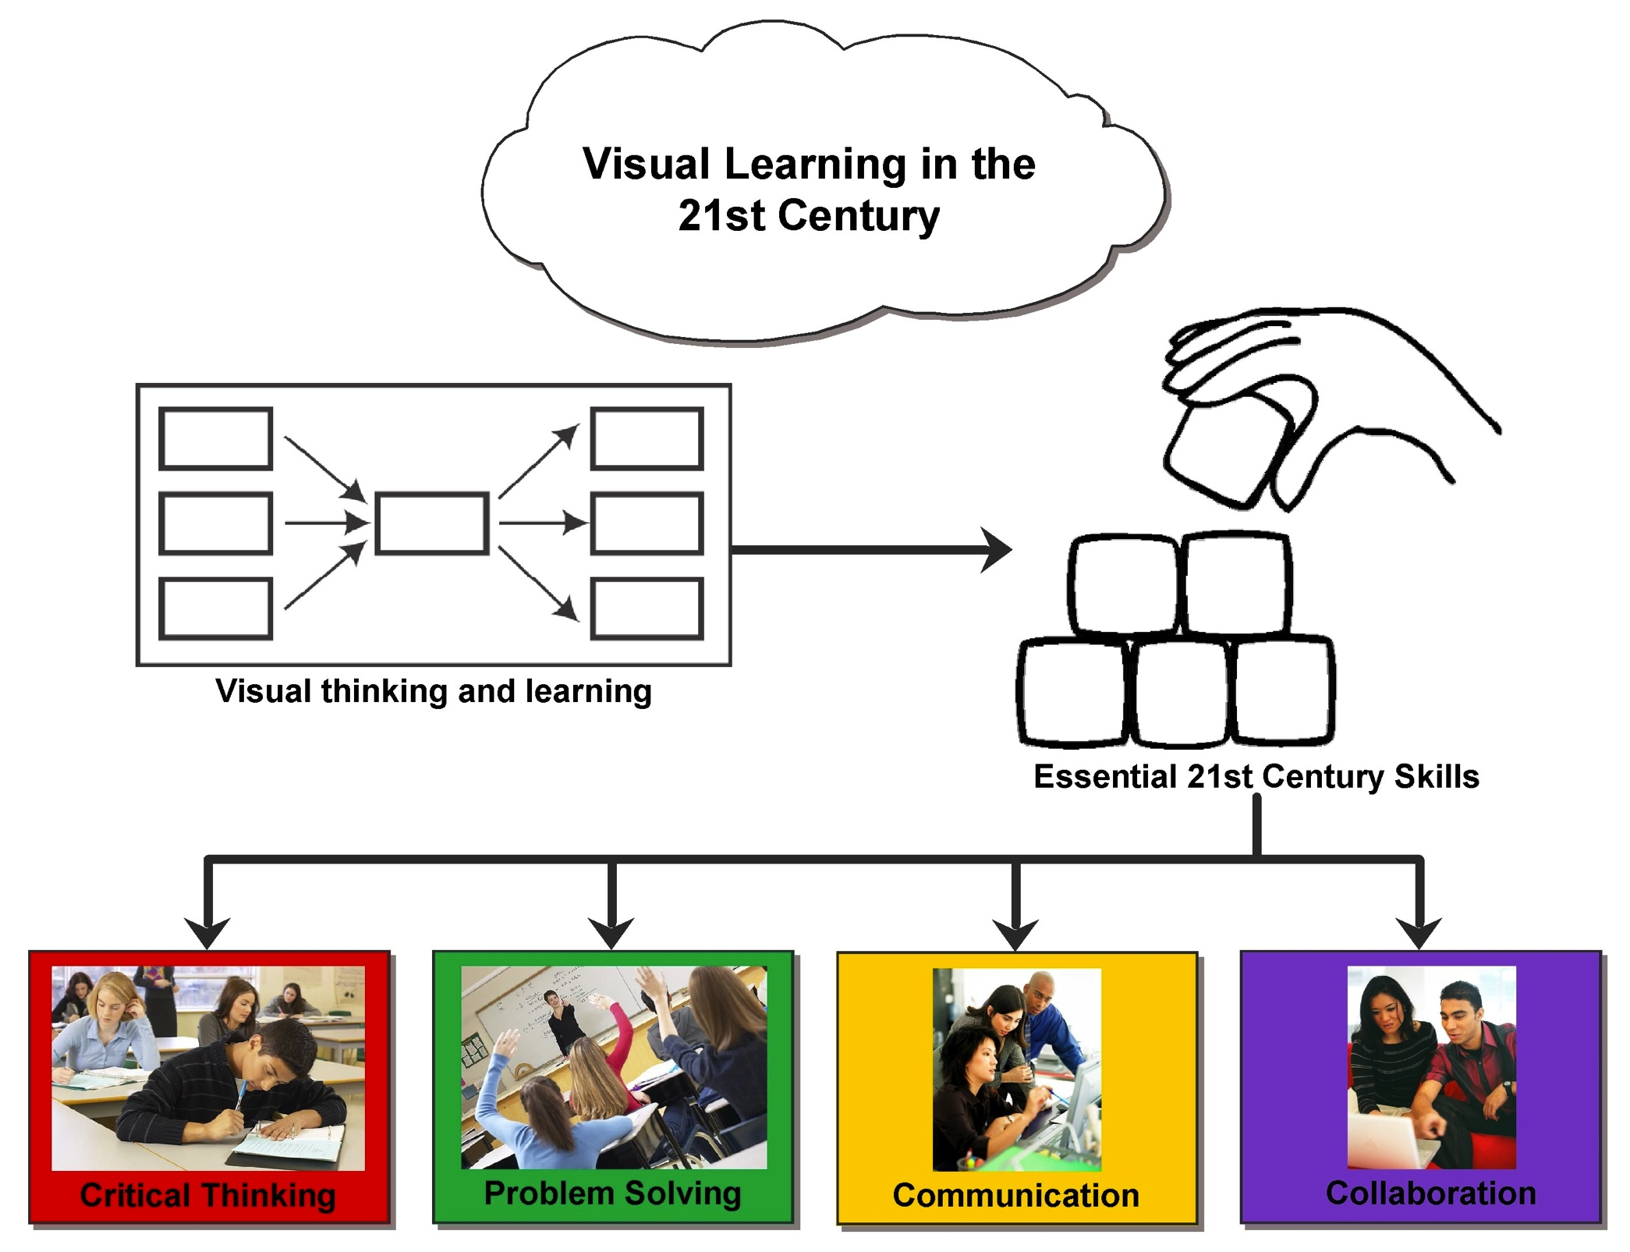


Notes:
How can I find an effective platform that will engage the learner

Slide 33
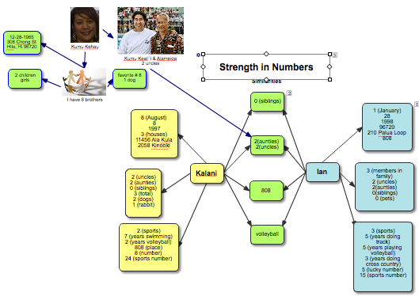
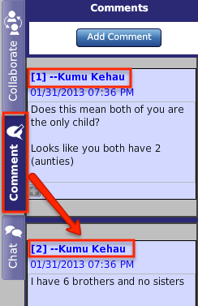
Building an Online Community

Slide 34
Likeability
Likeability

Slide 35
Likeability
Usability
Likeability

Slide 36
Likeability
Usability
Desire to repeat
Likeability

Slide 37
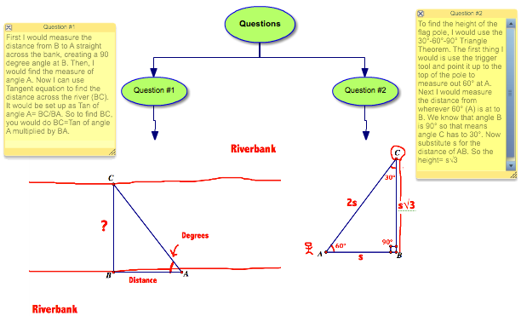
Designer of Knowledge
Student 2
Student 1

Slide 38
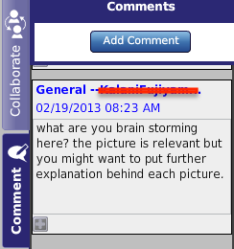
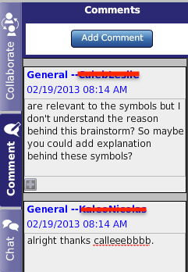
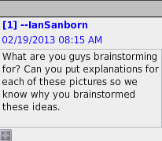
Peer Review
Student 2
Student 1

Slide 39
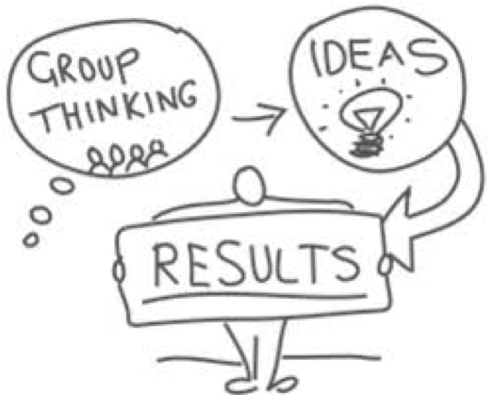
Likeability
Notes:
peer interaction
Diagrams, Webs, MindMaps
Synchronous peer review
Online electronic environment
access anytime anywhere
No synchronous group editing

Slide 40
Likeability
“You can take control of everything. You can make a diagram so its easier to see and look at. Also you can add pictures and words”
Notes:
peer interaction
Diagrams, Webs, MindMaps
Synchronous peer review
Online electronic environment
access anytime anywhere
No synchronous group editing

Slide 41
Likeability
“I like how we can all collaborate our ideas together wherever we are as long as we have access”
“You can take control of everything. You can make a diagram so its easier to see and look at. Also you can add pictures and words”
Notes:
peer interaction
Diagrams, Webs, MindMaps
Synchronous peer review
Online electronic environment
access anytime anywhere
No synchronous group editing

Slide 42
Likeability
“I like that you can have a group. I don't like that it’s hard to use because you can't go on all at once”
“I like how we can all collaborate our ideas together wherever we are as long as we have access”
“You can take control of everything. You can make a diagram so its easier to see and look at. Also you can add pictures and words”
Notes:
peer interaction
Diagrams, Webs, MindMaps
Synchronous peer review
Online electronic environment
access anytime anywhere
No synchronous group editing

Slide 43

Likeability
Standing in Line
Notes:
These digital natives demand real-time instantaneous results.

Slide 44
Likeability
No
No
No
No
No
No
Standing in Line
Notes:
These digital natives demand real-time instantaneous results.

Slide 45
Likeability
No
No
No
No
No
No
No Standing in Line
Notes:
These digital natives demand real-time instantaneous results.

Slide 46
Usability

Slide 47
Usability
No Drag & Drop!

Slide 48
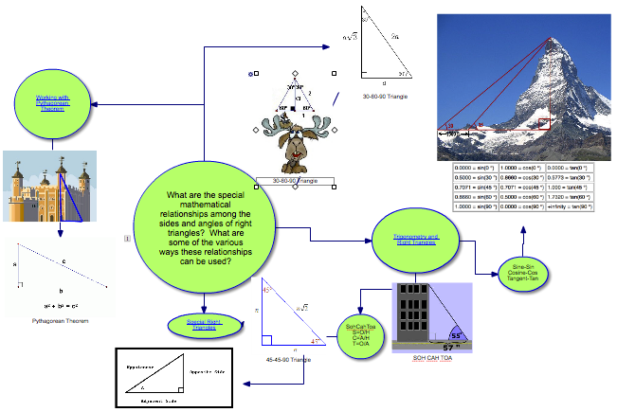

Slide 50
How did it feel to use diagramming and mindmapping to show your understanding of math concepts?

Slide 51
How did it feel to use diagramming and mindmapping to show your understanding of math concepts?
It was okay, I like how when I put things down my thoughts came out more organized and my notes were a little easier to follow

Slide 52
How did it feel to use diagramming and mindmapping to show your understanding of math concepts?
It was okay, I like how when I put things down my thoughts came out more organized and my notes were a little easier to follow
58%
Students felt that diagramming and webbing was easier to understand because their thoughts, ideas and information were organized “all on one thing” and “all in one place”

Slide 53

Usability
I like that you can chat with other people and add comments, like in Google Docs.
You couldnʻt really communicate your ideas that well because only one person can work at a time and other people can only comment or chat.
-
+
Chat & Comment Features

Slide 54
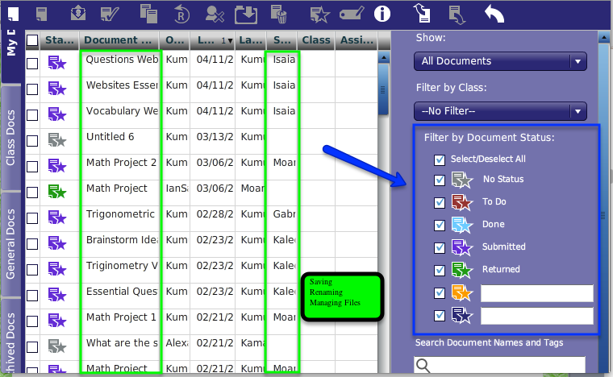
What were the challenges you faced using Webspiration?
File Sharing Naming Files Posting Assignment Locating Files

Slide 55
What were the challenges you faced using Webspiration?
47%
Webspiration was confusing because there were so many steps when trying to open, share, and turn in documents.
File Sharing Naming Files Posting Assignment Locating Files

Slide 56
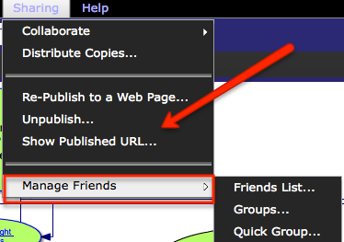
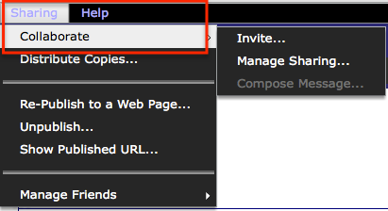
What were the challenges you faced using Webspiration?
Technology Challenges

Slide 57
What were the challenges you faced using Webspiration?
Technology Challenges

Slide 58
What were the challenges you faced using Webspiration?
52%
Webspiration was difficult and complicated to use because multiple people weren’t able to edit at the same time. It was such a big hassle when collaborating with group members.
Technology Challenges

Slide 59

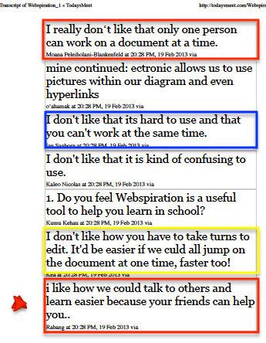
Open Ended Questions
Whole Group Discussion
Backchanneling Microblogging
Notes:
Constructive feedback
Questions
What do you like most about Webspiration?
What do you like the least about Webspiration?
Do you think Webspiration is a useful tool to help you learn in school?

Slide 60

Attitudinal Survey Results

Slide 61
Attitudinal Survey Results
58% diagramming and webbing was easier to understand

Slide 62
Attitudinal Survey Results
52% Difficult and complicated to use because multiple people weren’t able to edit at the same time.
58% diagramming and webbing was easier to understand

Slide 63
Attitudinal Survey Results
52% Difficult and complicated to use because multiple people weren’t able to edit at the same time.
58% Ideas and information were organized “all on one thing” and “all in one place”
58% diagramming and webbing was easier to understand

Slide 64

How could Webspiration be used for other school subjects?
Webspiration

Slide 65
How could Webspiration be used for other school subjects?
Webspiration
I think that Webspiration is a very good tool to use in an English class. To plan an essay, do a rough draft, and to do an outline.

Slide 66
How could Webspiration be used for other school subjects?
Webspiration
It could be used for many subjects if you are a visual learner and need to communicate ideas to partners in a way that is easy for you to manage and is easily processed
I think that Webspiration is a very good tool to use in an English class. To plan an essay, do a rough draft, and to do an outline.

Slide 67
How could Webspiration be used for other school subjects?
I think it could be used in any other class to help with group projects. I also think that it could help with outlining and brainstorming for speeches or essays.
Webspiration
It could be used for many subjects if you are a visual learner and need to communicate ideas to partners in a way that is easy for you to manage and is easily processed
I think that Webspiration is a very good tool to use in an English class. To plan an essay, do a rough draft, and to do an outline.

Slide 68
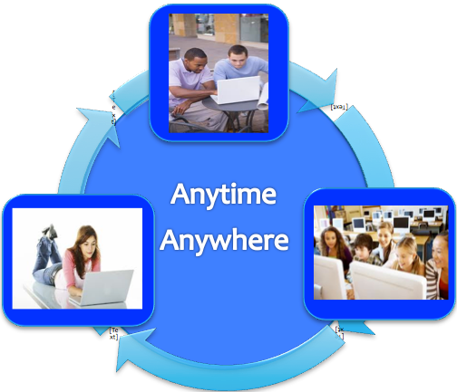
Webspiration
Implications

Slide 69
Webspiration
Implications
Measuring tool
Webspriation ineffective in fostering collaboration
Instantaneous real-time group editing

Slide 70
Webspiration
Implications
Measuring tool
Webspriation ineffective in fostering collaboration
Instantaneous real-time group editing
More time in class
Build Online Community
Ease of Usability

Slide 71
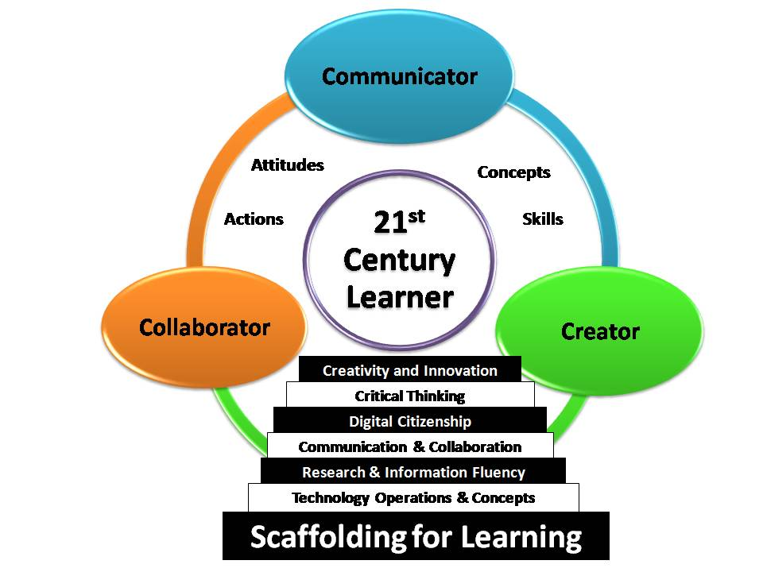
Visual Thinking & Technology

Slide 72
Visual Thinking & Technology
Validation of Study

Slide 73
Visual Thinking & Technology
Validation of Study
Proven Learning Method
Differentiation
Independent, organize, meaningful context

Slide 74

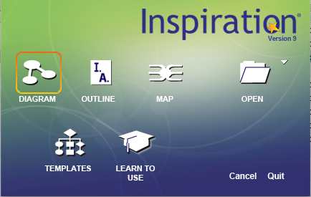
Conclusion
Recommended
Features

Slide 75
Conclusion
Recommend
Features
30% of my students are currently using Inspiration in other content areas.

Slide 76
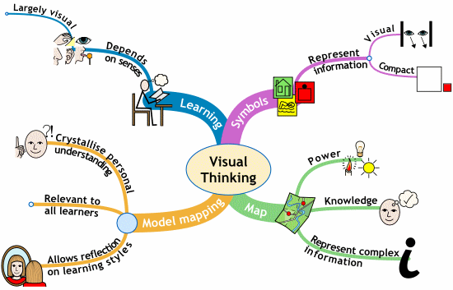
Conclusion

Slide 77
Conclusion
Visual Thinking – Effective

Slide 78
Conclusion
Visual Thinking – Effective
Limitations in real-time group editing.

Slide 79
Conclusion
Visual Thinking – Effective
Limitations in real-time group editing.
A Need for Social Mindtools

Slide 80

Mahalo
Question Time……….

