Slide 1
Developing iBooks
A Case Study Teaching Gram-stain Analysis
Notes:
Aloha, and welcome to my presentation. I really appreciate everyone's attendance, and I hope this will prove to be a valuable experience for everyone.
I am here to talk about my project “Developing iBooks” - A case study teaching gram-stain analysis.

Slide 2

Jonathan Kevan

Slide 3
Jonathan Kevan
Nursing Department UHM

Slide 4
Jonathan Kevan
Nursing Department UHM
  Educational Technologist

Slide 5
Jonathan Kevan
Nursing Department UHM
  Educational Technologist
  Information Technology

Slide 6
Jonathan Kevan
Nursing Department UHM
  Educational Technologist
  Information Technology
  Instructional Design

Slide 7
Jonathan Kevan
Nursing Department UHM
  Educational Technologist
  Information Technology
  Instructional Design
M.Ed - Education Technology

Slide 8
The project

Slide 9

Learning Objectives

Slide 10
Learning Objectives

Slide 11
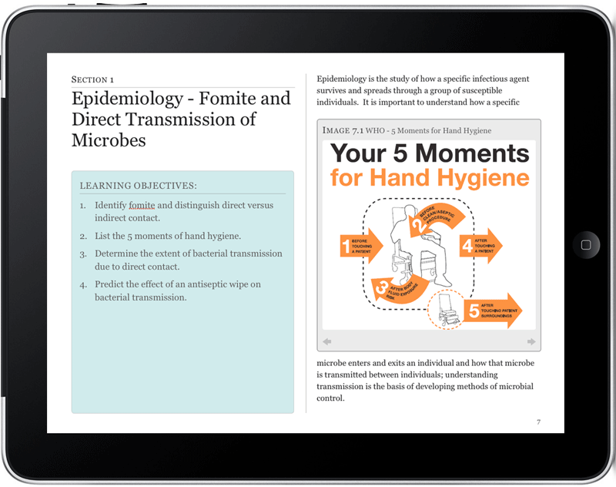
Learning Objectives
iBook

Slide 12
Learning Objectives
iBook
?

Slide 13
The story…
The purpose of this instructional design project was to design, develop, and evaluate an iBook to inform development decisions for instructional designers.

Slide 14
What’s an iBook?

Slide 15
What’s an iBook?
Electronic book

Slide 16
What’s an iBook?
Electronic book
Multimedia

Slide 17
What’s an iBook?
Electronic book
Multimedia
  Text and images

Slide 18
What’s an iBook?
Electronic book
Multimedia
  Text and images
  Video, audio, 3D, assessment items

Slide 19
What’s an iBook?
Electronic book
Multimedia
  Text and images
  Video, audio, 3D, assessment items
Custom functionality through HTML5

Slide 20
What’s an iBook?
Electronic book
Multimedia
  Text and images
  Video, audio, 3D, assessment items
Custom functionality through HTML5
Proprietary format (Apple)

Slide 21
What’s an iBook?
Electronic book
Multimedia
  Text and images
  Video, audio, 3D, assessment items
Custom functionality through HTML5
Proprietary format (Apple)
Create with iBooks Author (free)

Slide 22
What’s an iBook?
Electronic book
Multimedia
  Text and images
  Video, audio, 3D, assessment items
Custom functionality through HTML5
Proprietary format (Apple)
Create with iBooks Author (free)
iPads only

Slide 23
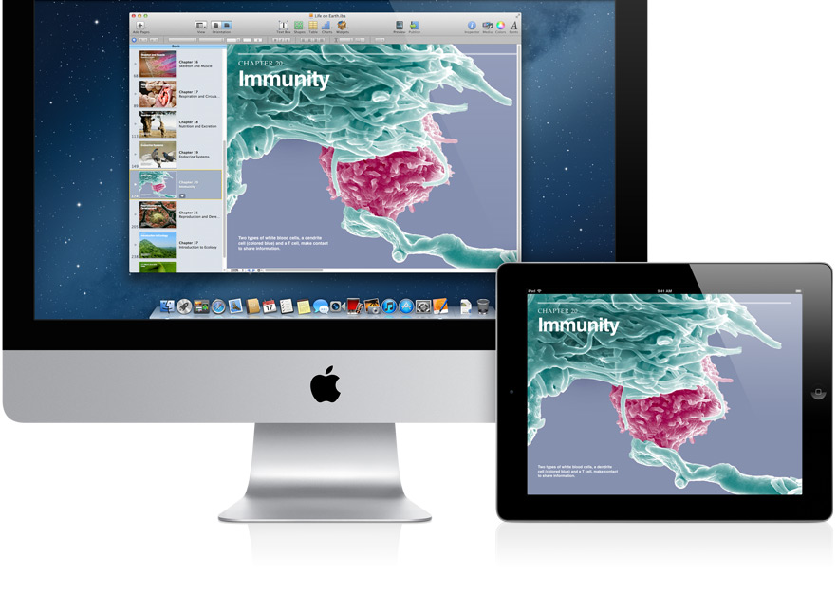
iBooks Author
iBooks

Slide 24
The agenda
Notes:
How the idea for this project came to fruition
Then I will go run through the project steps one at a time.
Analysis & Exploration will cover the topic of the iBook, why I selected it. Spoiler alert, it’s on Gram-stains ☺. No worries if you aren’t familiar with this particular topic.. I will give you a 30 second crash course.
Design & Development will cover visual examples of how the iBook followed select learning theories
Evaluation and Reflection will cover the results from participants and what was learned towards the end of conceptualizing an iBook framework for development.

Slide 25
The agenda
Where it all began
Notes:
How the idea for this project came to fruition
Then I will go run through the project steps one at a time.
Analysis & Exploration will cover the topic of the iBook, why I selected it. Spoiler alert, it’s on Gram-stains ☺. No worries if you aren’t familiar with this particular topic.. I will give you a 30 second crash course.
Design & Development will cover visual examples of how the iBook followed select learning theories
Evaluation and Reflection will cover the results from participants and what was learned towards the end of conceptualizing an iBook framework for development.

Slide 26
The agenda
Where it all began
Project steps
Notes:
How the idea for this project came to fruition
Then I will go run through the project steps one at a time.
Analysis & Exploration will cover the topic of the iBook, why I selected it. Spoiler alert, it’s on Gram-stains ☺. No worries if you aren’t familiar with this particular topic.. I will give you a 30 second crash course.
Design & Development will cover visual examples of how the iBook followed select learning theories
Evaluation and Reflection will cover the results from participants and what was learned towards the end of conceptualizing an iBook framework for development.

Slide 27
The agenda
Where it all began
Project steps
  Topic selection
Notes:
How the idea for this project came to fruition
Then I will go run through the project steps one at a time.
Analysis & Exploration will cover the topic of the iBook, why I selected it. Spoiler alert, it’s on Gram-stains ☺. No worries if you aren’t familiar with this particular topic.. I will give you a 30 second crash course.
Design & Development will cover visual examples of how the iBook followed select learning theories
Evaluation and Reflection will cover the results from participants and what was learned towards the end of conceptualizing an iBook framework for development.

Slide 28
The agenda
Where it all began
Project steps
  Topic selection
  Design theory
Notes:
How the idea for this project came to fruition
Then I will go run through the project steps one at a time.
Analysis & Exploration will cover the topic of the iBook, why I selected it. Spoiler alert, it’s on Gram-stains ☺. No worries if you aren’t familiar with this particular topic.. I will give you a 30 second crash course.
Design & Development will cover visual examples of how the iBook followed select learning theories
Evaluation and Reflection will cover the results from participants and what was learned towards the end of conceptualizing an iBook framework for development.

Slide 29
The agenda
Where it all began
Project steps
  Topic selection
  Design theory
  iBook Development
Notes:
How the idea for this project came to fruition
Then I will go run through the project steps one at a time.
Analysis & Exploration will cover the topic of the iBook, why I selected it. Spoiler alert, it’s on Gram-stains ☺. No worries if you aren’t familiar with this particular topic.. I will give you a 30 second crash course.
Design & Development will cover visual examples of how the iBook followed select learning theories
Evaluation and Reflection will cover the results from participants and what was learned towards the end of conceptualizing an iBook framework for development.

Slide 30
The agenda
Where it all began
Project steps
  Topic selection
  Design theory
  iBook Development
Data collection in iBooks
Notes:
How the idea for this project came to fruition
Then I will go run through the project steps one at a time.
Analysis & Exploration will cover the topic of the iBook, why I selected it. Spoiler alert, it’s on Gram-stains ☺. No worries if you aren’t familiar with this particular topic.. I will give you a 30 second crash course.
Design & Development will cover visual examples of how the iBook followed select learning theories
Evaluation and Reflection will cover the results from participants and what was learned towards the end of conceptualizing an iBook framework for development.

Slide 31
The agenda
Where it all began
Project steps
  Topic selection
  Design theory
  iBook Development
Data collection in iBooks
Results
Notes:
How the idea for this project came to fruition
Then I will go run through the project steps one at a time.
Analysis & Exploration will cover the topic of the iBook, why I selected it. Spoiler alert, it’s on Gram-stains ☺. No worries if you aren’t familiar with this particular topic.. I will give you a 30 second crash course.
Design & Development will cover visual examples of how the iBook followed select learning theories
Evaluation and Reflection will cover the results from participants and what was learned towards the end of conceptualizing an iBook framework for development.

Slide 32
The agenda
Where it all began
Project steps
  Topic selection
  Design theory
  iBook Development
Data collection in iBooks
Results
Implications
Notes:
How the idea for this project came to fruition
Then I will go run through the project steps one at a time.
Analysis & Exploration will cover the topic of the iBook, why I selected it. Spoiler alert, it’s on Gram-stains ☺. No worries if you aren’t familiar with this particular topic.. I will give you a 30 second crash course.
Design & Development will cover visual examples of how the iBook followed select learning theories
Evaluation and Reflection will cover the results from participants and what was learned towards the end of conceptualizing an iBook framework for development.

Slide 33
Where it all began…
Notes:
http://sites.uci.edu/imeded/2012/11/30/medical-microbiology-ibook-replaces-traditional-lab-manual/
Mary Frances Ypma-Wong, Ph.D.
Educational Technology Facilitator
Julie Youm, PhD
Research Coordinator
Warren Wiechmann, M.D., MBA
Faculty Director,
Instructional Technologies Group

Slide 34
Where it all began…
Few spare hours
Notes:
http://sites.uci.edu/imeded/2012/11/30/medical-microbiology-ibook-replaces-traditional-lab-manual/
Mary Frances Ypma-Wong, Ph.D.
Educational Technology Facilitator
Julie Youm, PhD
Research Coordinator
Warren Wiechmann, M.D., MBA
Faculty Director,
Instructional Technologies Group

Slide 35
Where it all began…
Few spare hours
Interested in eBooks
Notes:
http://sites.uci.edu/imeded/2012/11/30/medical-microbiology-ibook-replaces-traditional-lab-manual/
Mary Frances Ypma-Wong, Ph.D.
Educational Technology Facilitator
Julie Youm, PhD
Research Coordinator
Warren Wiechmann, M.D., MBA
Faculty Director,
Instructional Technologies Group

Slide 36


Where it all began…
Few spare hours
Interested in eBooks
Notes:
http://sites.uci.edu/imeded/2012/11/30/medical-microbiology-ibook-replaces-traditional-lab-manual/
Mary Frances Ypma-Wong, Ph.D.
Educational Technology Facilitator
Julie Youm, PhD
Research Coordinator
Warren Wiechmann, M.D., MBA
Faculty Director,
Instructional Technologies Group

Slide 37
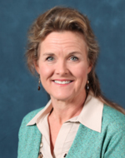
Where it all began…
Few spare hours
Interested in eBooks
Mary Frances Ypma-Wong, Ph.D.
University of California Irvine
Medical School
Notes:
http://sites.uci.edu/imeded/2012/11/30/medical-microbiology-ibook-replaces-traditional-lab-manual/
Mary Frances Ypma-Wong, Ph.D.
Educational Technology Facilitator
Julie Youm, PhD
Research Coordinator
Warren Wiechmann, M.D., MBA
Faculty Director,
Instructional Technologies Group

Slide 38

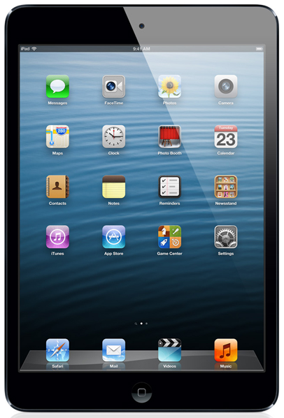
Paper lab manual iBook
Not to scale…

Slide 39
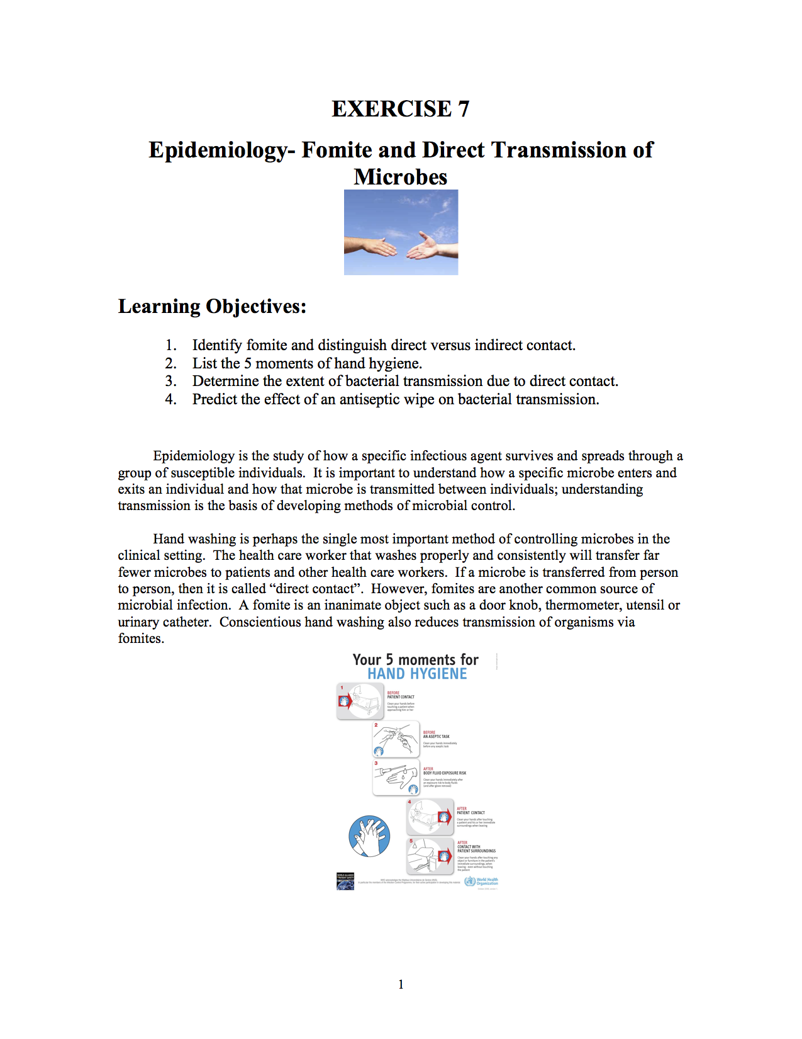

Slide 40
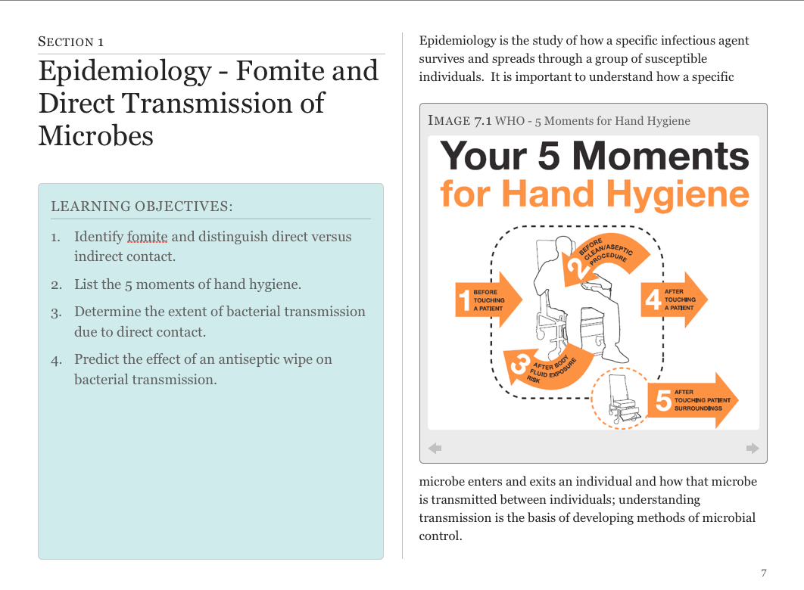

Slide 41
Paper
iBook

Slide 42
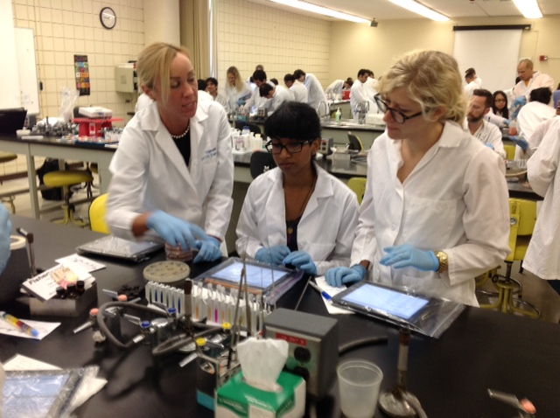

Slide 43
Now what?

Slide 44
Now what?
That was copy/paste exercise

Slide 45
Now what?
That was copy/paste exercise
How do I…

Slide 46
Now what?
That was copy/paste exercise
How do I…
    Take advantage of iBook features

Slide 47
Now what?
That was copy/paste exercise
How do I…
    Take advantage of iBook features
    Design from scratch

Slide 48
Now what?
That was copy/paste exercise
How do I…
    Take advantage of iBook features
    Design from scratch
No iBook literature existed

Slide 49
The topic

Slide 50
The topic
Let’s start w/ Gram-stain

Slide 51
The topic
Let’s start w/ Gram-stain
  Identification of bacteria by dying (coloring).

Slide 52
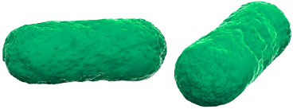
The topic
Let’s start w/ Gram-stain
  Identification of bacteria by dying (coloring)

Slide 53
The topic
Let’s start w/ Gram-stain
  Identification of bacteria by dying (coloring)

Slide 54
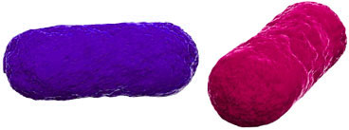
The topic
Let’s start w/ Gram-stain
  Identification of bacteria by dying (coloring)

Slide 55
The topic
Let’s start w/ Gram-stain
  Identification of bacteria by dying (coloring)
  Very visual in nature

Slide 56
The topic
Let’s start w/ Gram-stain
  Identification of bacteria by dying (coloring)
  Very visual in nature
  Physical (lab work) vs. Analysis (microscope)

Slide 57
The topic
Let’s start w/ Gram-stain
  Identification of bacteria by dying (coloring)
  Very visual in nature
  Physical (lab work) vs. Analysis (microscope)
  Could be done before the lab started

Slide 58
The topic
Let’s start w/ Gram-stain
  Identification of bacteria by dying (coloring)
  Very visual in nature
  Physical (lab work) vs. Analysis (microscope)
  Could be done before the lab started
  Added: Shape & Arrangement

Slide 59
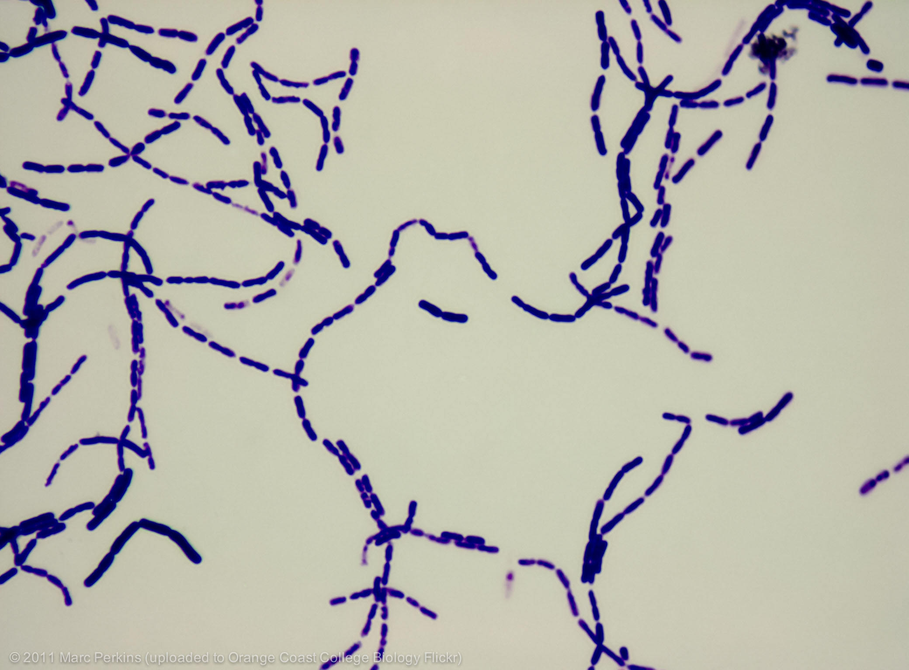
Notes:
Thank to Marc Perkins at Orange County College

Slide 60
Theories

Slide 61
Theories
  First Principles of Instruction – Dr. M. David Merrill

Slide 62
Theories
  First Principles of Instruction – Dr. M. David Merrill
    Broadly accepted instructional design principles

Slide 63
Theories
  First Principles of Instruction – Dr. M. David Merrill
    Broadly accepted instructional design principles
    Structure for organizing content

Slide 64
Theories
  First Principles of Instruction – Dr. M. David Merrill
    Broadly accepted instructional design principles
    Structure for organizing content
  Multimedia Design Theory – Dr. Richard Mayer

Slide 65
Theories
  First Principles of Instruction – Dr. M. David Merrill
    Broadly accepted instructional design principles
    Structure for organizing content
  Multimedia Design Theory – Dr. Richard Mayer
    Design for maximum cognitive impact

Slide 66
Theories
  First Principles of Instruction – Dr. M. David Merrill
    Broadly accepted instructional design principles
    Structure for organizing content
  Multimedia Design Theory – Dr. Richard Mayer
    Design for maximum cognitive impact
  iOS design guidelines

Slide 67
Theories
  First Principles of Instruction – Dr. M. David Merrill
    Broadly accepted instructional design principles
    Structure for organizing content
  Multimedia Design Theory – Dr. Richard Mayer
    Design for maximum cognitive impact
  iOS design guidelines
    Aesthetics - size, color, relative placement

Slide 68
Theories
  First Principles of Instruction – Dr. M. David Merrill
    Broadly accepted instructional design principles
    Structure for organizing content
  Multimedia Design Theory – Dr. Richard Mayer
    Design for maximum cognitive impact
  iOS design guidelines
    Aesthetics - size, color, relative placement
    Touch navigation

Slide 69
Design & construction
Intro to iBooks
Notes:
Add another slide w/ an example of different identifications

Slide 70
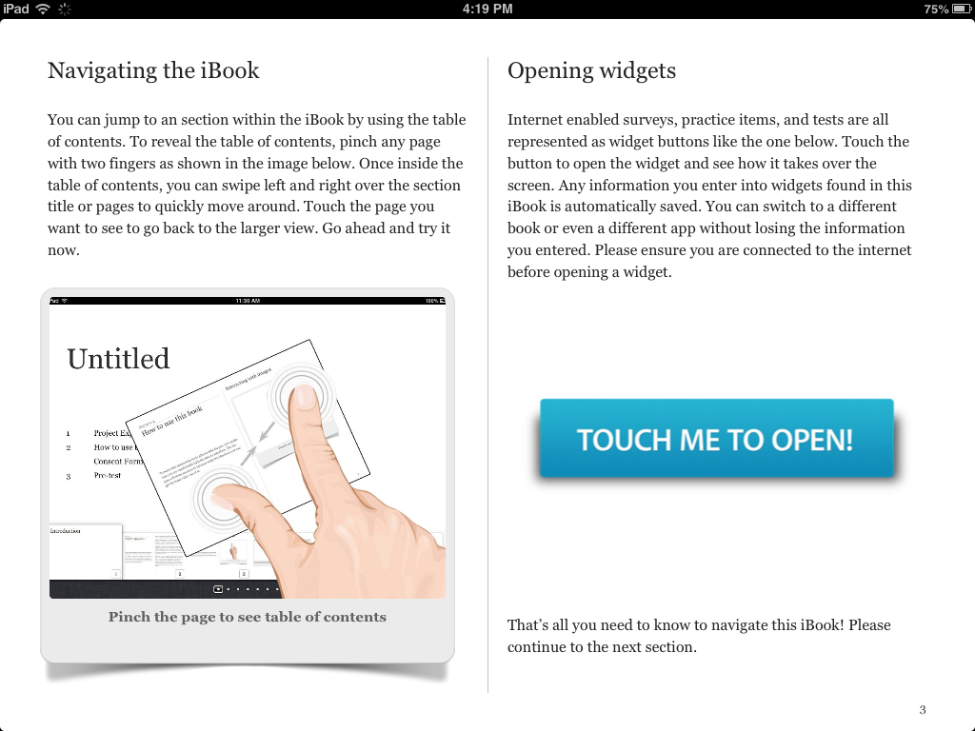
Intro to iBooks

Slide 71
Intro to iBooks

Slide 72
Intro to iBooks

Slide 73
Design & construction
Intro to iBooks
Gram-stain results
Notes:
Add another slide w/ an example of different identifications

Slide 74
Design & construction
Intro to iBooks
Gram-stain results
  Positive (purple), Negative (pink/red)
Notes:
Add another slide w/ an example of different identifications

Slide 75
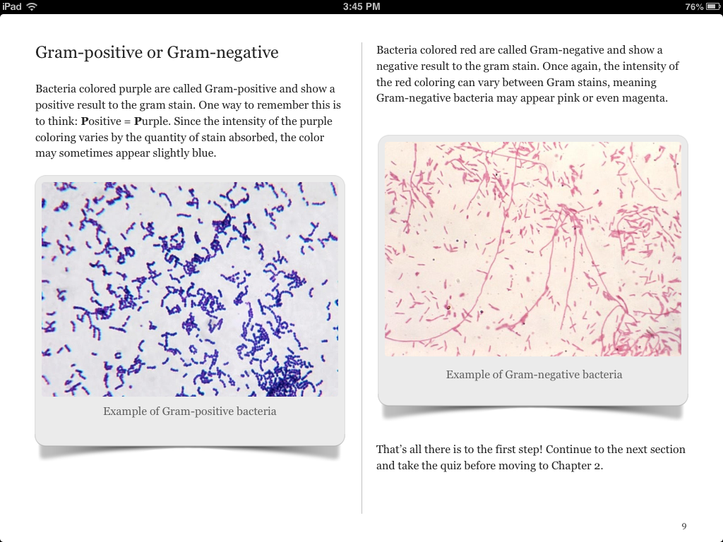
Gram-stain results

Slide 76
Gram-stain results
Notes:
Really focused on trying to keep visual examples near each other when they were to be compared.

Slide 77
Design & construction
Intro to iBooks
Gram-stain results
  Positive (purple), Negative (pink/red)
Bacterial shape
Notes:
Add another slide w/ an example of different identifications

Slide 78
Design & construction
Intro to iBooks
Gram-stain results
  Positive (purple), Negative (pink/red)
Bacterial shape
  Spherical (cocci), Rod (bacilli)
Notes:
Add another slide w/ an example of different identifications

Slide 79
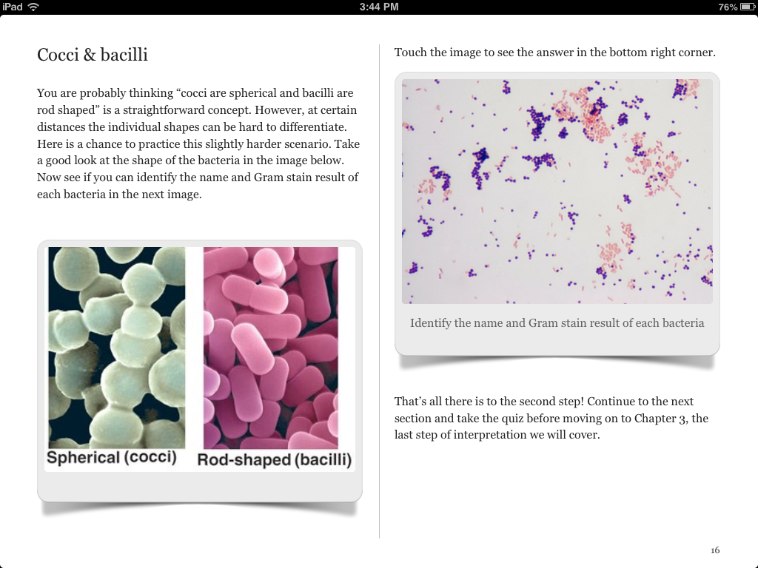
Bacterial shape

Slide 80
Bacterial shape

Slide 81
Bacterial shape
Notes:
Once again, keeping visual examples of the bacterial shapes near each other for comparison.
Had both zoomed in to better conceptualize the shapes, and had an image that would be the types the student would analyze with them next to each other.
Also having them identify the gram stain and bacteria shape as practice.

Slide 82
Design & construction
Intro to iBooks
Gram-stain results
  Positive (purple), Negative (pink/red)
Bacterial shape
  Spherical (cocci), Rod (bacilli)
Identifying arrangement
Notes:
Add another slide w/ an example of different identifications

Slide 83
Design & construction
Intro to iBooks
Gram-stain results
  Positive (purple), Negative (pink/red)
Bacterial shape
  Spherical (cocci), Rod (bacilli)
Identifying arrangement
  Pair (diplo), Line (strepto), Bunch (staphylo)
Notes:
Add another slide w/ an example of different identifications

Slide 84
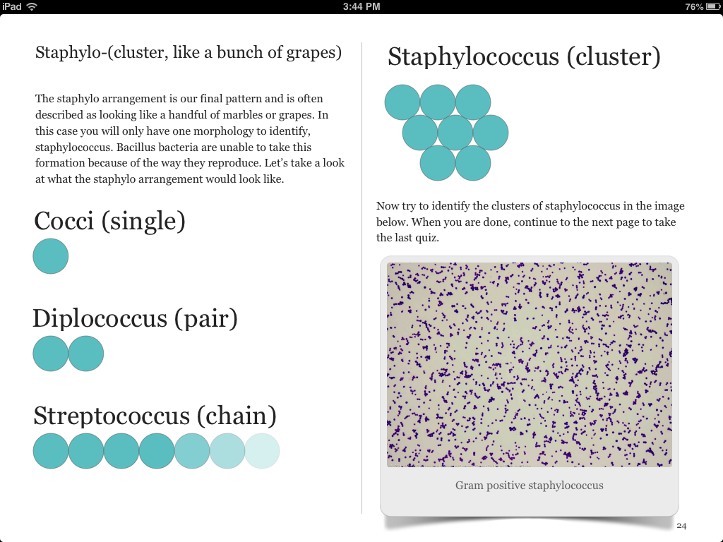
Identifying arrangement
Notes:
All the elements I discussed before…
This is one of the last slides in the showing arrangement..

Slide 85
Identifying arrangement
Notes:
All the elements I discussed before…
This is one of the last slides in the showing arrangement..

Slide 86
Identifying arrangement
Notes:
All the elements I discussed before…
This is one of the last slides in the showing arrangement..

Slide 87
Identifying arrangement
Notes:
All the elements I discussed before…
This is one of the last slides in the showing arrangement..

Slide 88
Identifying arrangement
Notes:
All the elements I discussed before…
This is one of the last slides in the showing arrangement..

Slide 89
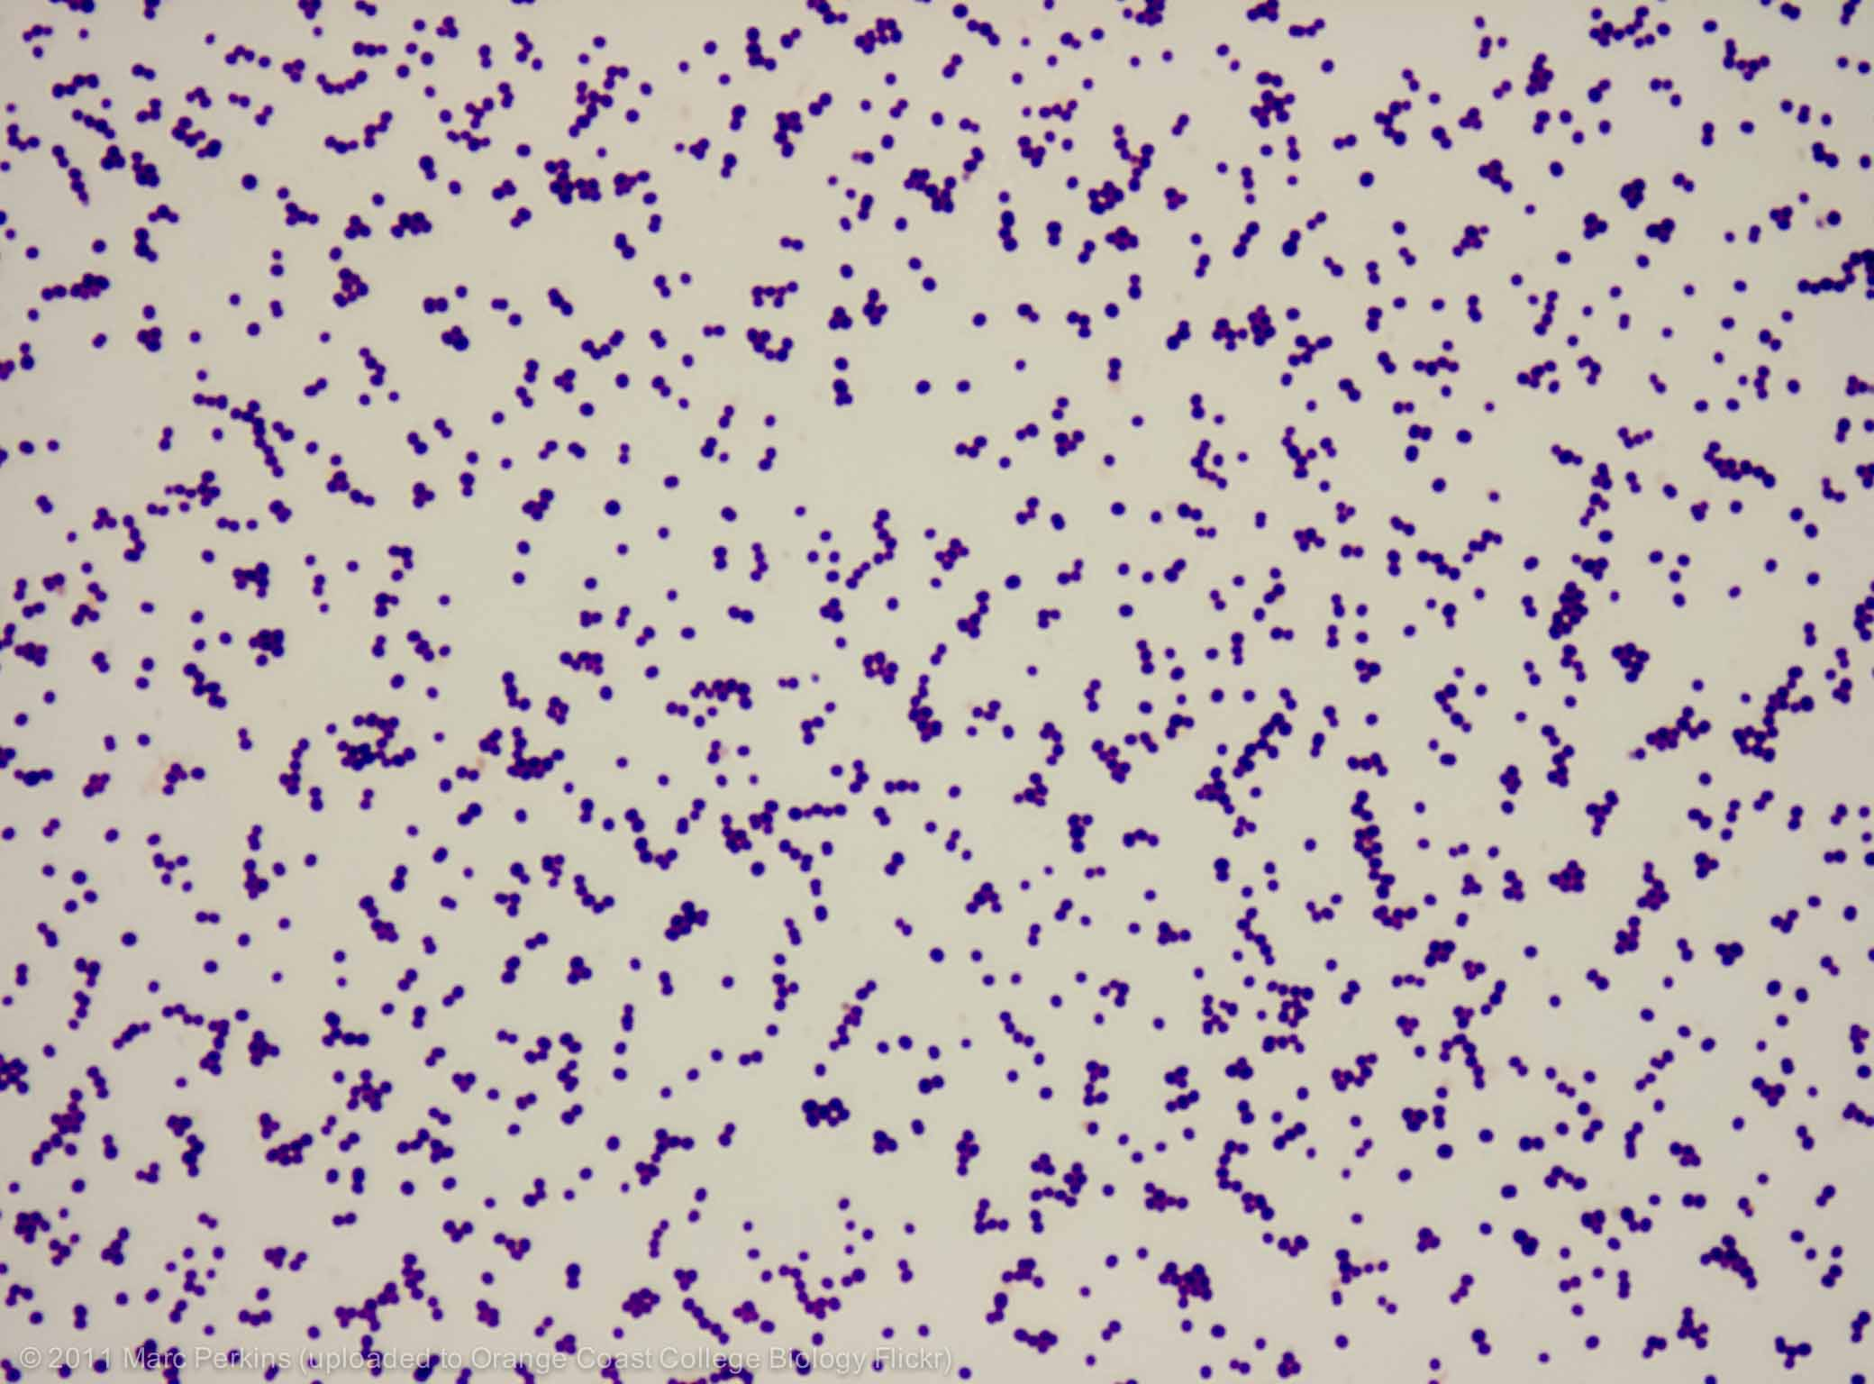

Slide 90
Data collection
Learning assessment (n=20)

Slide 91
Data collection
Learning assessment (n=20)
  Pre test
  3 embedded tests
  Post test

Slide 92
Data collection
Learning assessment (n=20)
  Pre test
  3 embedded tests
  Post test
Surveys (n=19)

Slide 93
Data Collection
Learning assessment (n=20)
  Pre test
  3 embedded tests
  Post test
Surveys (n=19)
  Pre survey
    Experience with Apple (products and comfort navigating)
    Experience with iBooks
    Confidence with Gram-stain analysis

Slide 94
Data Collection
Learning assessment (n=20)
  Pre test
  3 embedded tests
  Post test
Surveys (n=19)
  Pre survey
    Experience with Apple (products and comfort navigating)
    Experience with iBooks
    Confidence with Gram-stain analysis
  Post survey
    Reassess confidence
    Open-ended questions (problems/comments)

Slide 95
Data Collection
Learning assessment (n=20)
  Pre test
  3 embedded tests
  Post test
Surveys (n=19)
  Pre survey
    Experience with Apple (products and comfort navigating)
    Experience with iBooks
    Confidence with Gram-stain analysis
  Post survey
    Reassess confidence
    Open-ended questions (problems/comments)
Participants = adult learners (nurses? IDs? F&F?)

Slide 96
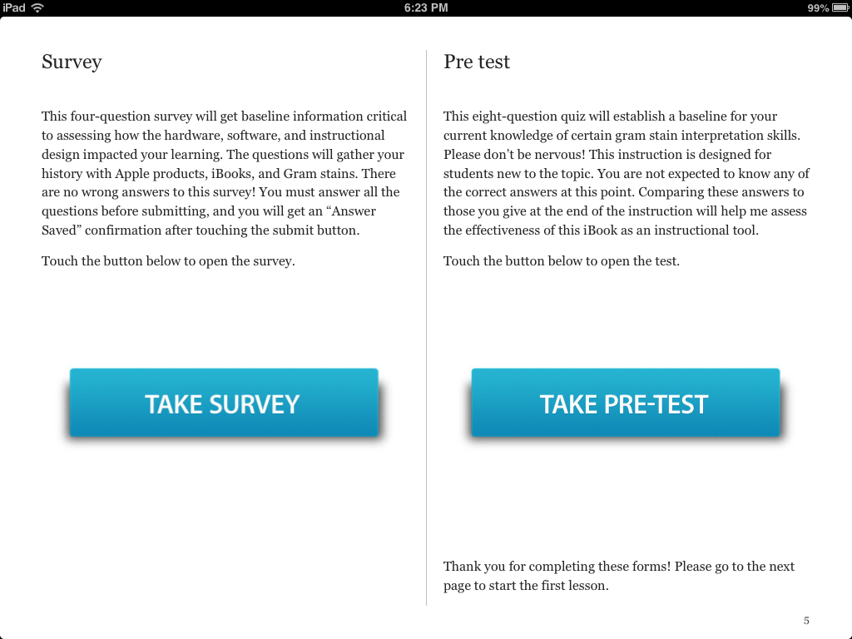

Slide 98
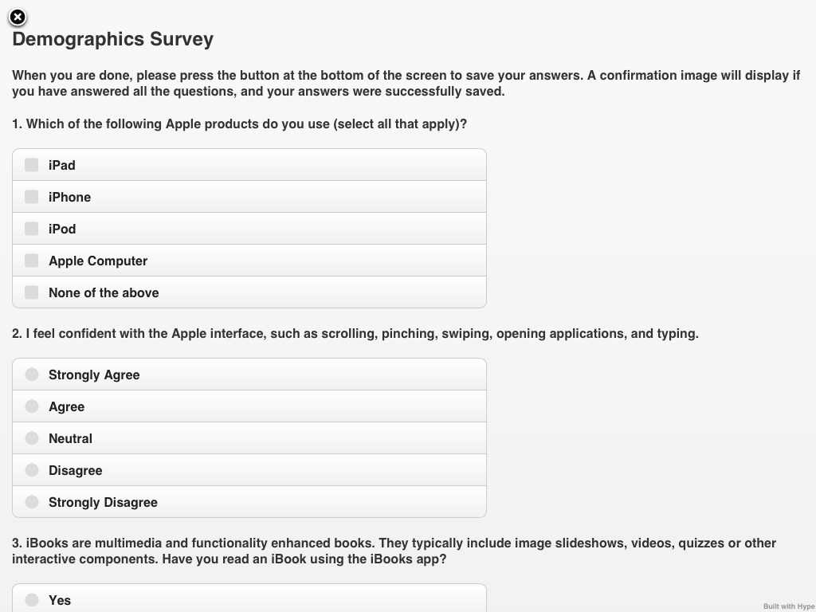

Slide 99



Data collection
Collected anonymously from iBook (if consenting)
iPad -> Google doc spreadsheet -> Graph

Slide 100
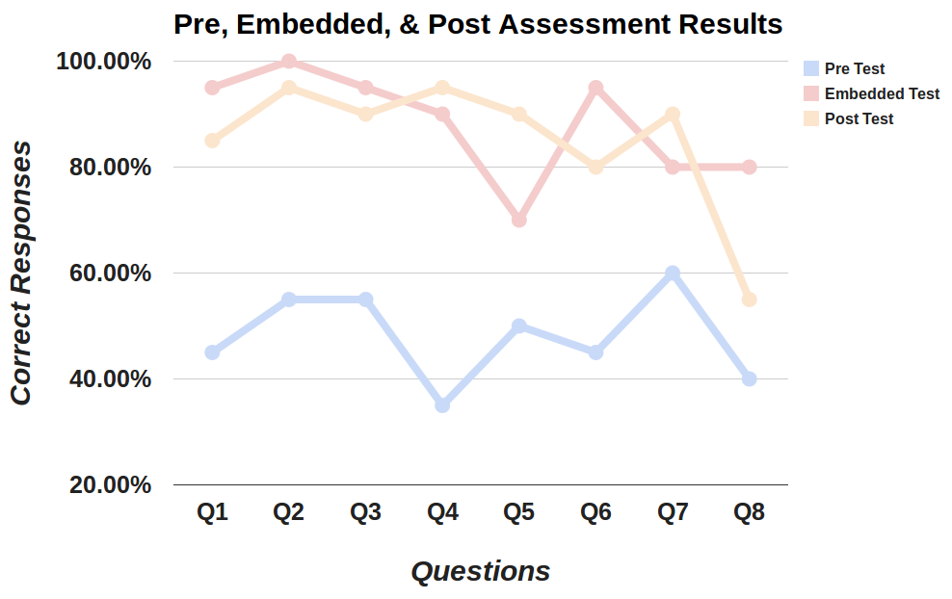
Results – Everyone learned! (n=20)

Slide 101
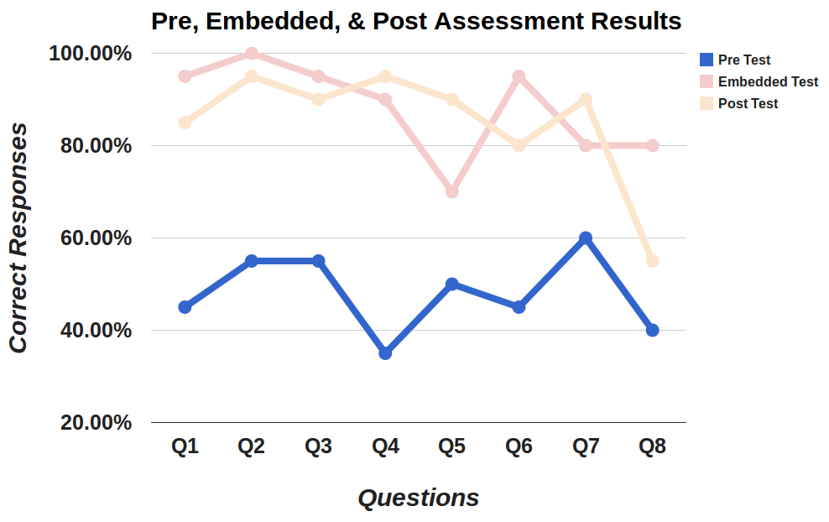
Results – Everyone learned! (n=20)

Slide 102
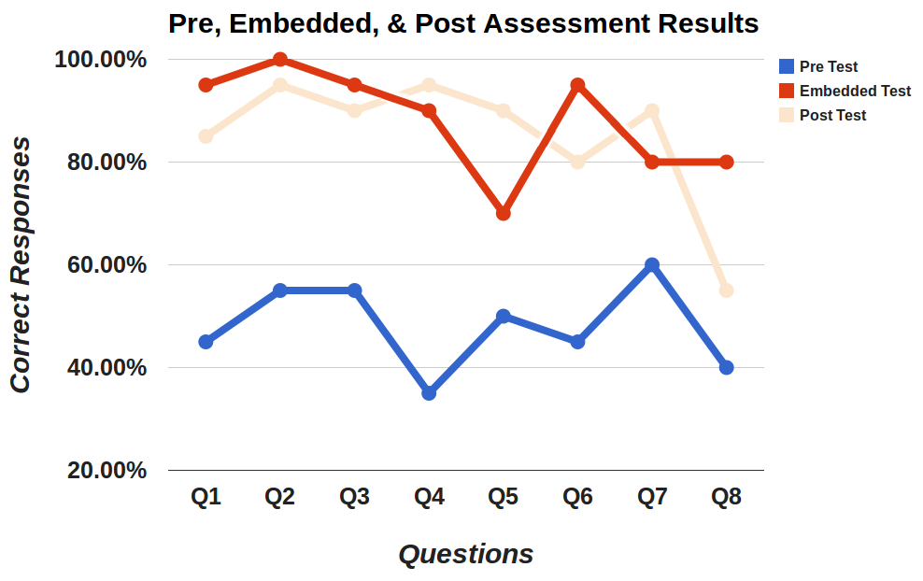
Results – Everyone learned! (n=20)

Slide 103

Results – Everyone learned! (n=20)

Slide 104
Results – Everyone learned! (n=20)
?

Slide 105
Interpret the following Gram stain.

Slide 106
Interpret the following Gram stain.
Two most common selections (out of 4 options)

Slide 107
Interpret the following Gram stain.
Two most common selections (out of 4 options)
a. The stain shows Gram-positive staphylococcus
c. The stain shows Gram-positive streptococcus

Slide 108
Interpret the following Gram stain.
Two most common selections (out of 4 options)
a. The stain shows Gram-positive staphylococcus
c. The stain shows Gram-positive streptococcus

Slide 109
Interpret the following Gram stain.
Responses
Two most common selections (out of 4 options)
a. The stain shows Gram-positive staphylococcus
c. The stain shows Gram-positive streptococcus
11/20
9/20

Slide 110

Interpret the following Gram stain.
Responses
Two most common selections (out of 4 options)
a. The stain shows Gram-positive staphylococcus
c. The stain shows Gram-positive streptococcus
11/20
9/20

Slide 117
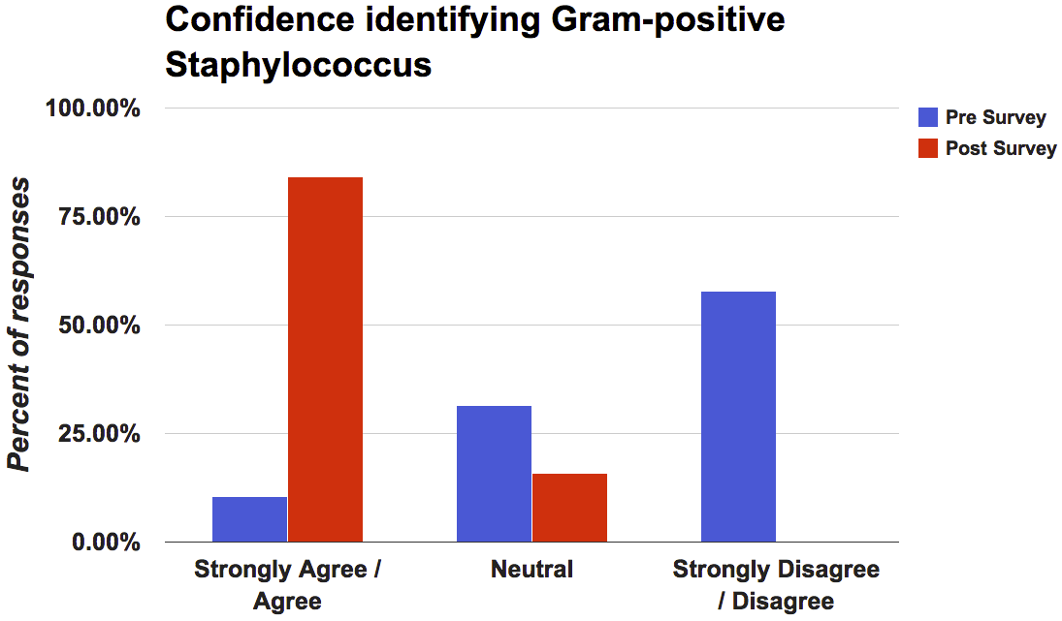
Results
Notes:
Have exact percentages available

Slide 118
Results
11%
Notes:
Have exact percentages available

Slide 119
Results
84%
11%
Notes:
Have exact percentages available

Slide 120
Implications
Theories worked well
  iOS Guidelines
  Mayer’s Multimedia Principles
  Merrill’s First Principles of Instruction
Notes:
All the theories worked well.
Apple experience of the people who commented on navigation problems.

Slide 121
Implications
Theories worked well
  iOS Guidelines
  Mayer’s Multimedia Principles
  Merrill’s First Principles of Instruction
Need guidelines for media quality/structure
Notes:
All the theories worked well.
Apple experience of the people who commented on navigation problems.

Slide 122
Implications
Theories worked well
  iOS Guidelines
  Mayer’s Multimedia Principles
  Merrill’s First Principles of Instruction
Need guidelines for media quality/structure
  Resolution (image >= res of media)
Notes:
All the theories worked well.
Apple experience of the people who commented on navigation problems.

Slide 123
Implications
Theories worked well
  iOS Guidelines
  Mayer’s Multimedia Principles
  Merrill’s First Principles of Instruction
Need guidelines for media quality/structure
  Resolution (image >= res of media)
  Free of distracting elements
Notes:
All the theories worked well.
Apple experience of the people who commented on navigation problems.

Slide 124
Next steps
Expand on content

Slide 125
Next steps
Expand on content
Integrate with a microbiology class

Slide 126
Next steps
Expand on content
Integrate with a microbiology class
Add an additional theory (social?)

Slide 127


Questions?
Jonathan Kevan
jkevan@hawaii.edu
@jmkevan
To download
1) Download iBooks App (free)
2) Into Safari: http://bit.ly/14hWl5r
3) Wait… 33 MB
4) When done, select “Open in iBooks”

