Slide 1
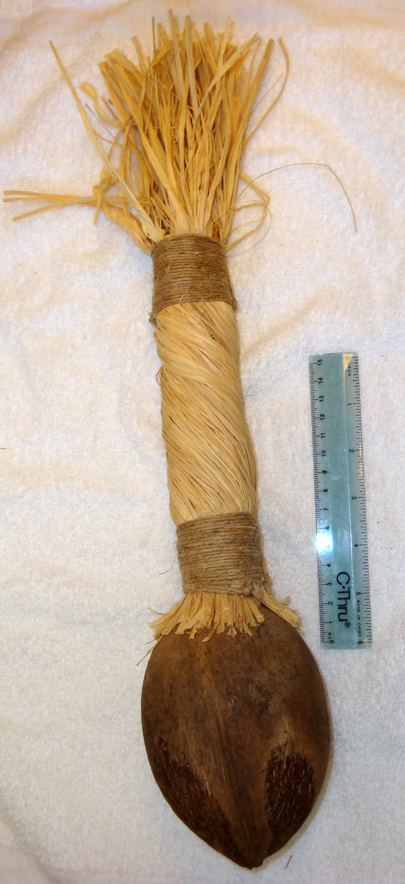
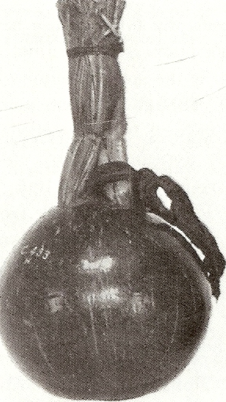
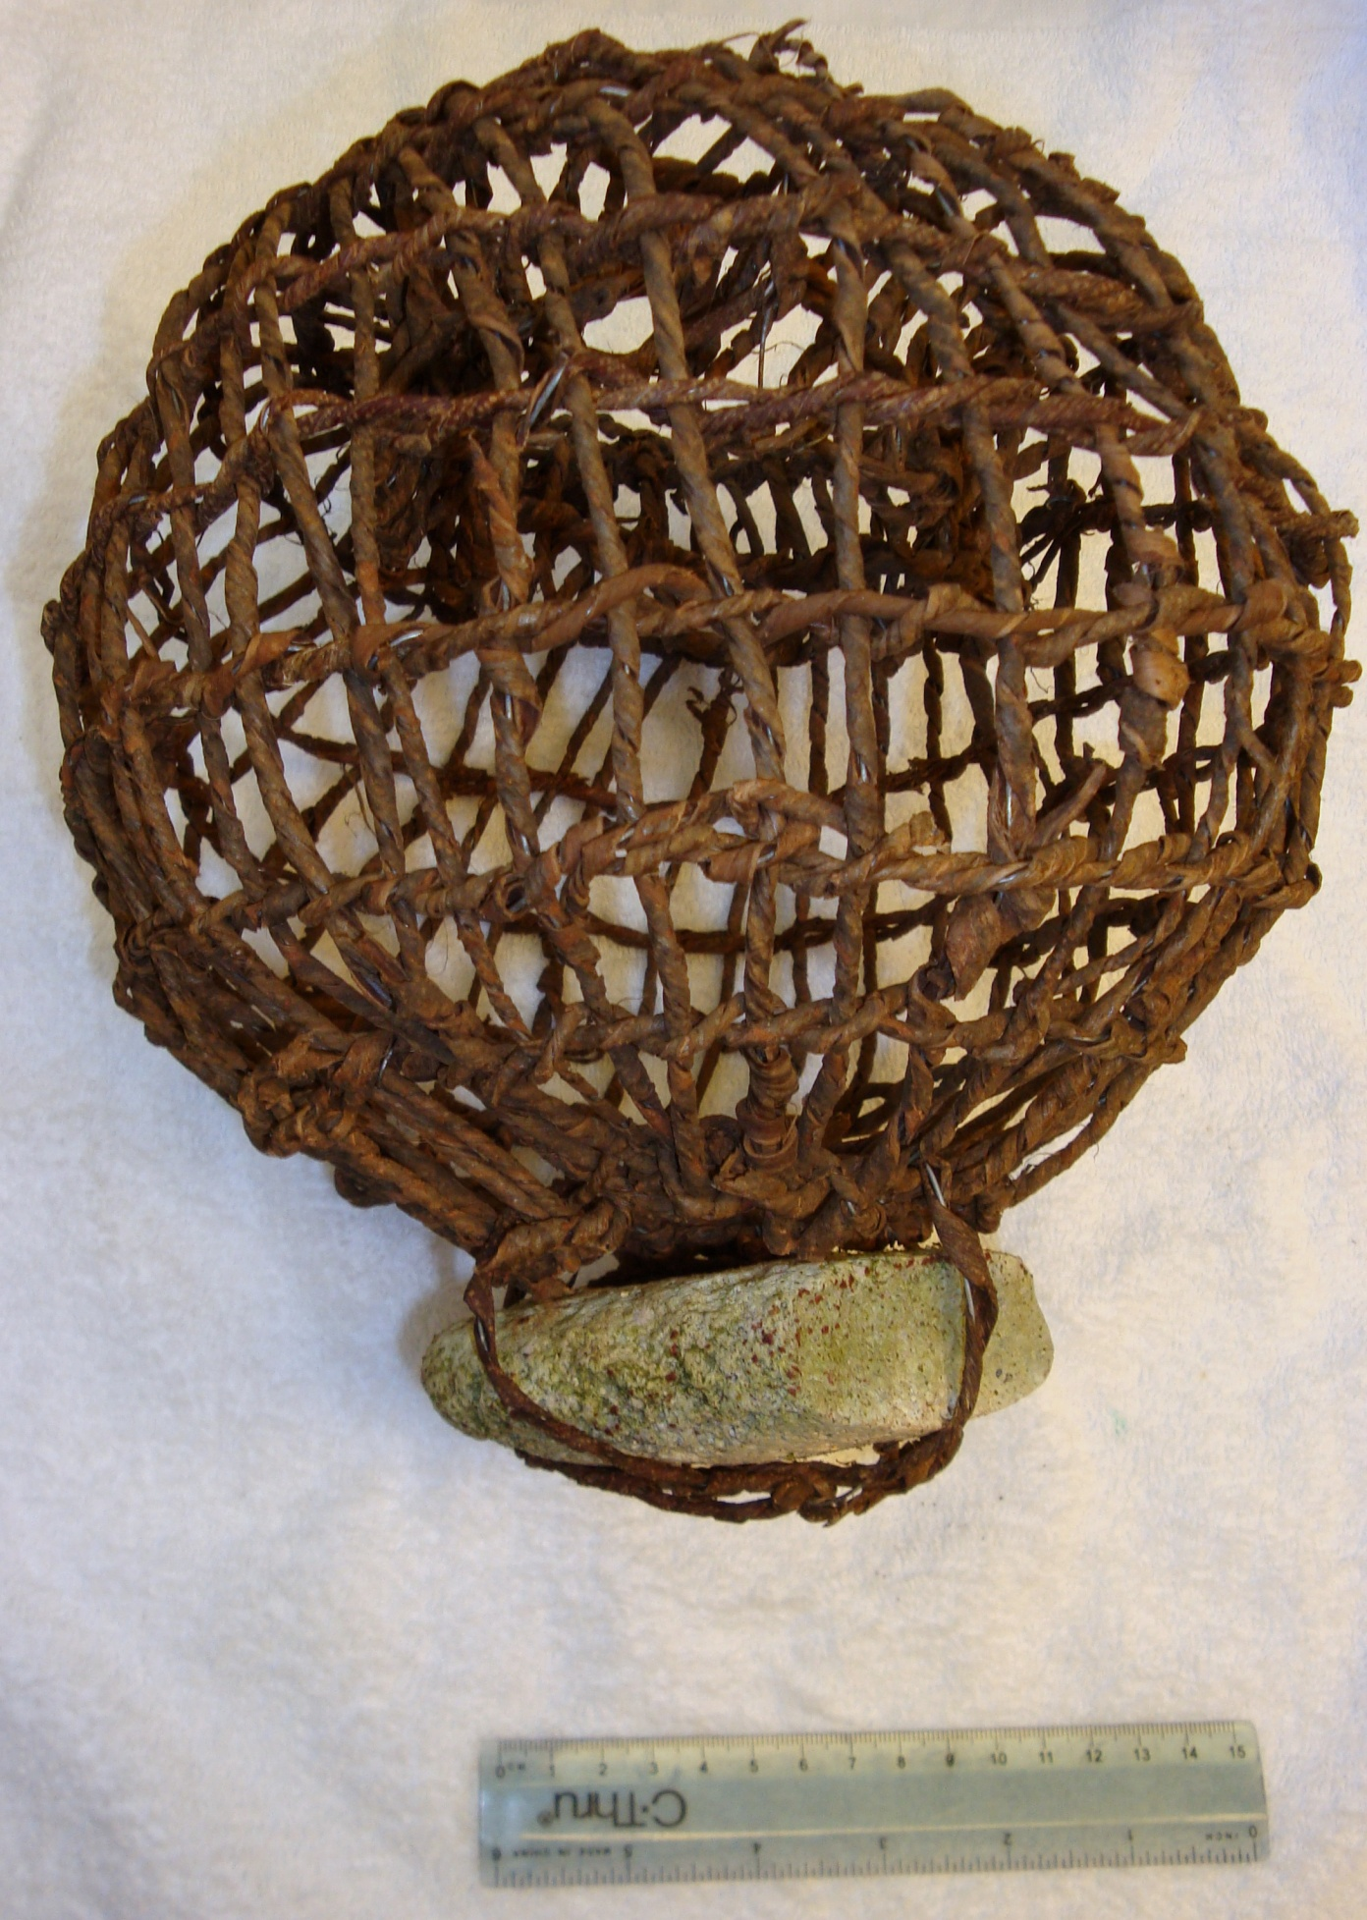
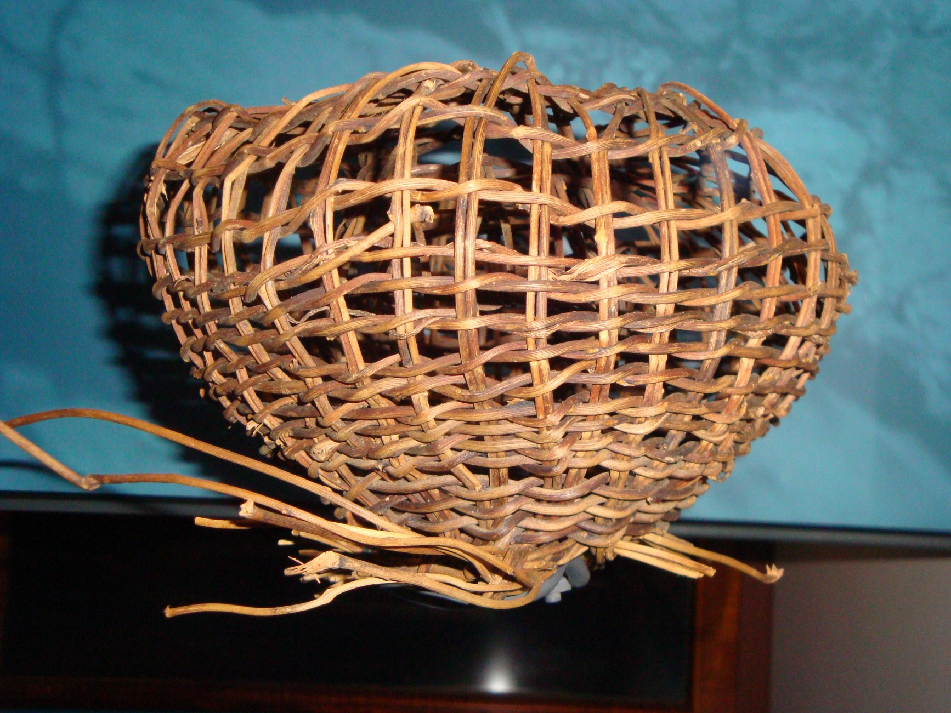
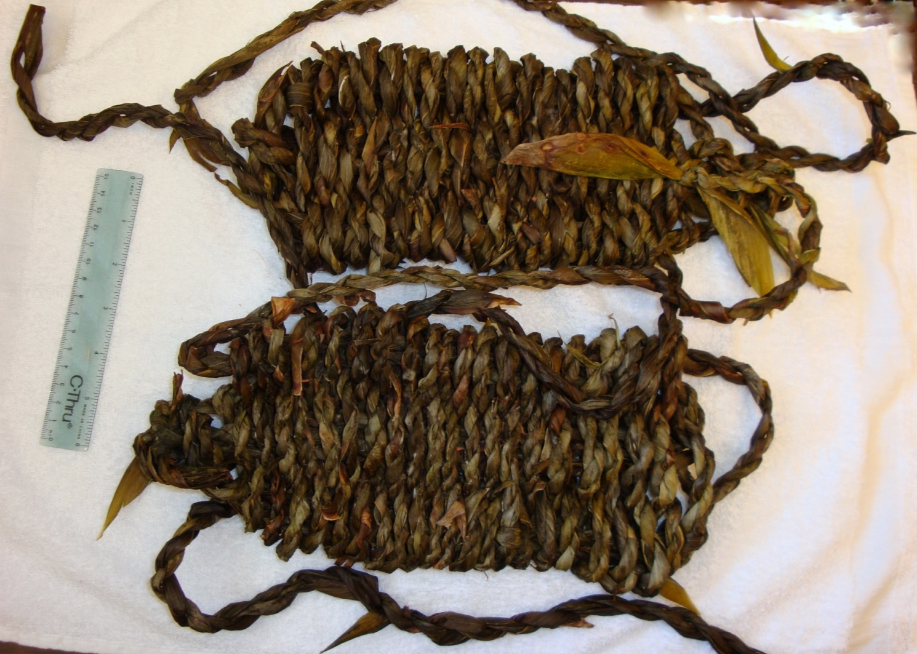
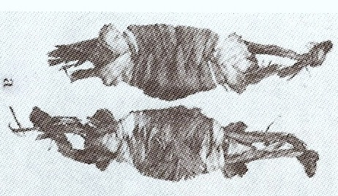

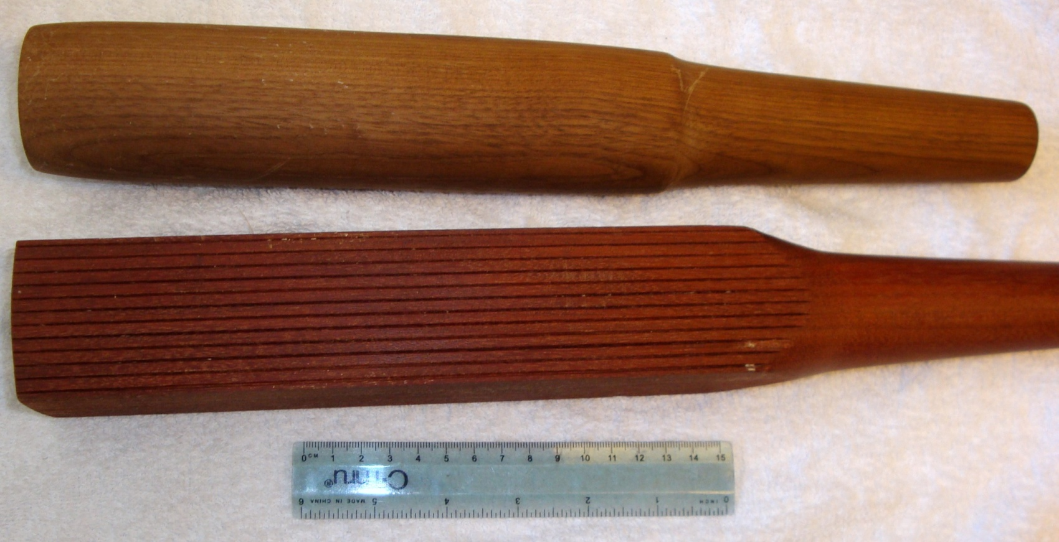
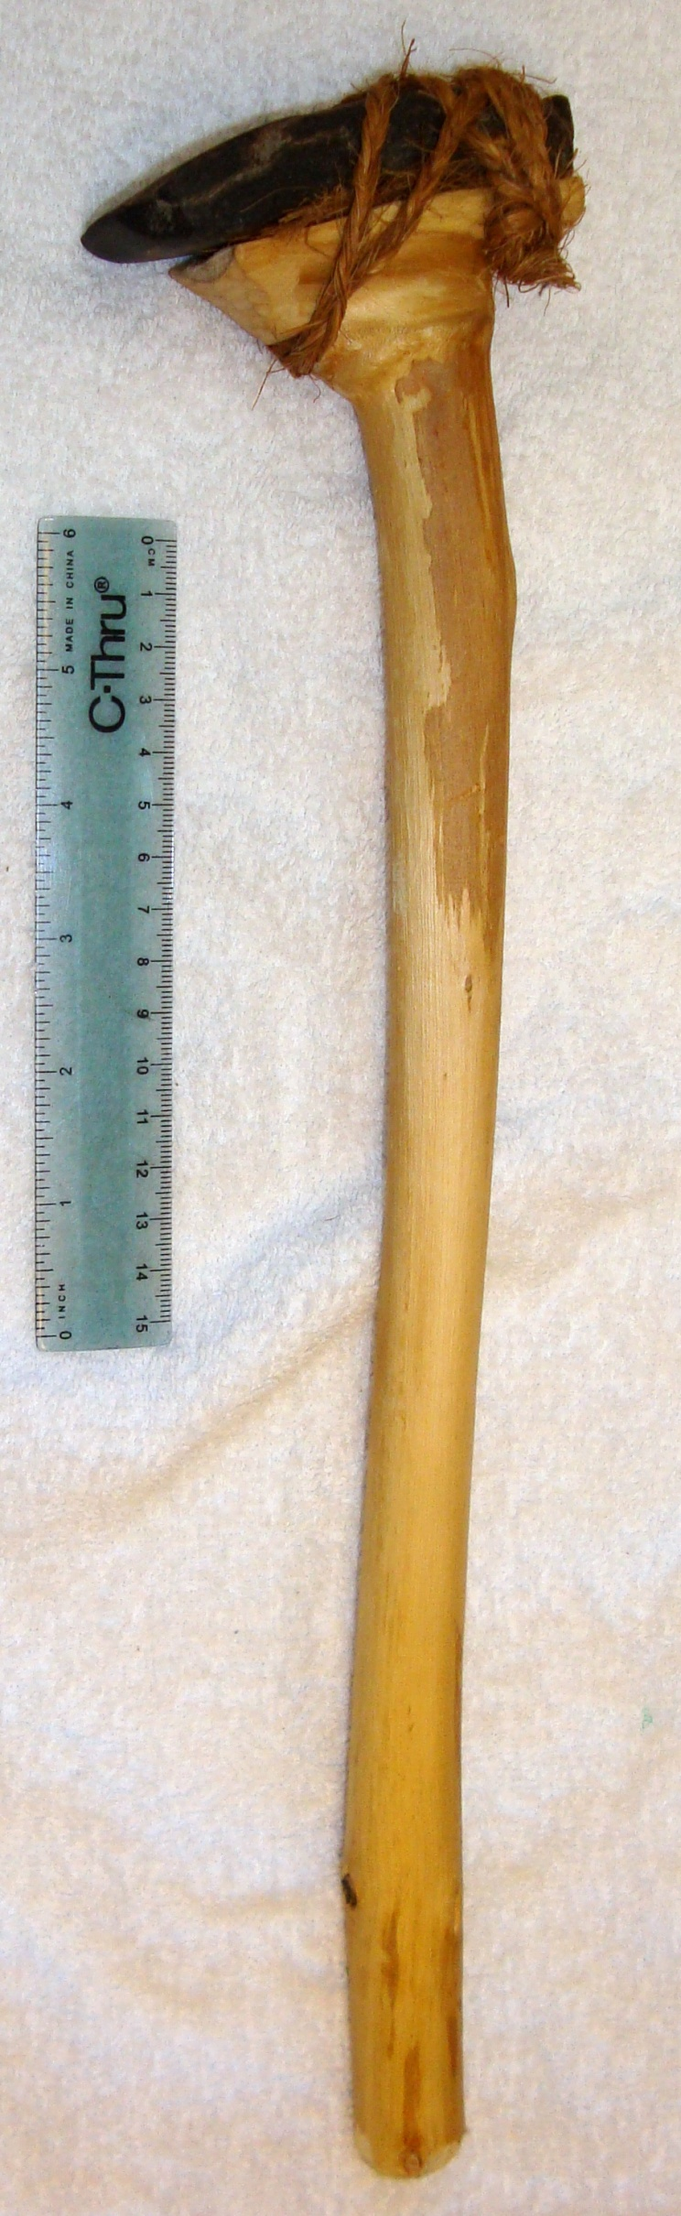
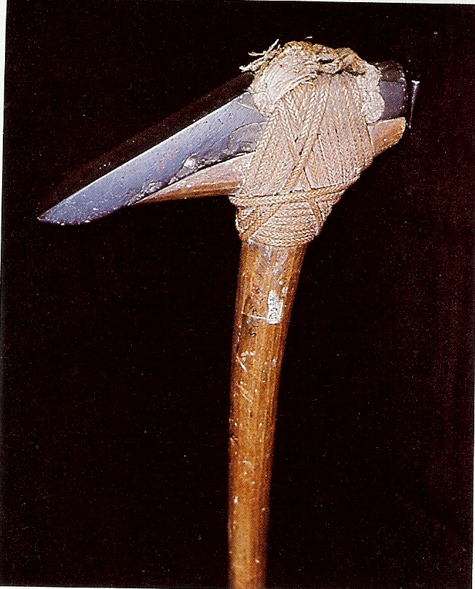
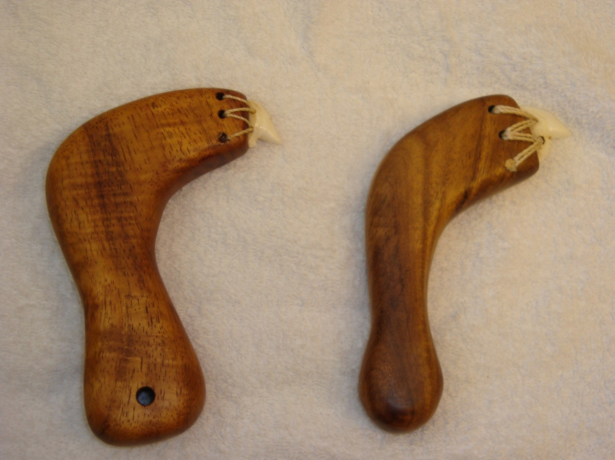
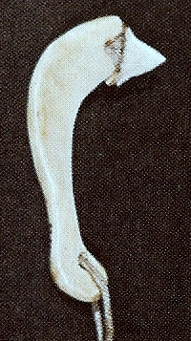
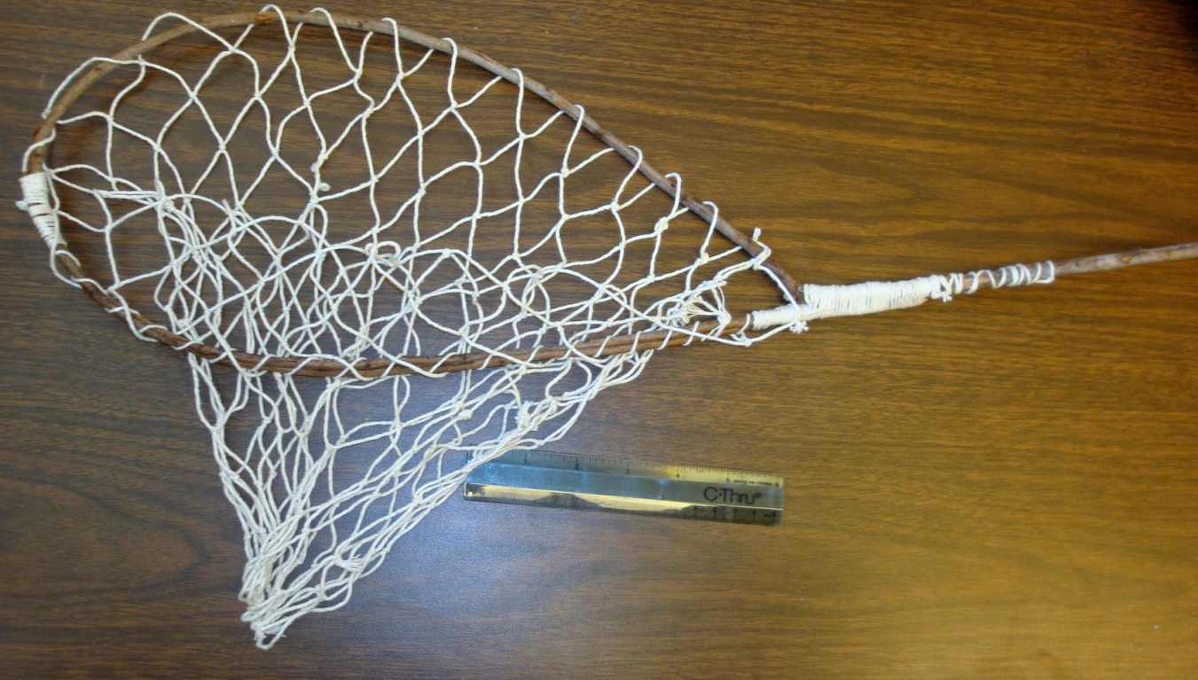
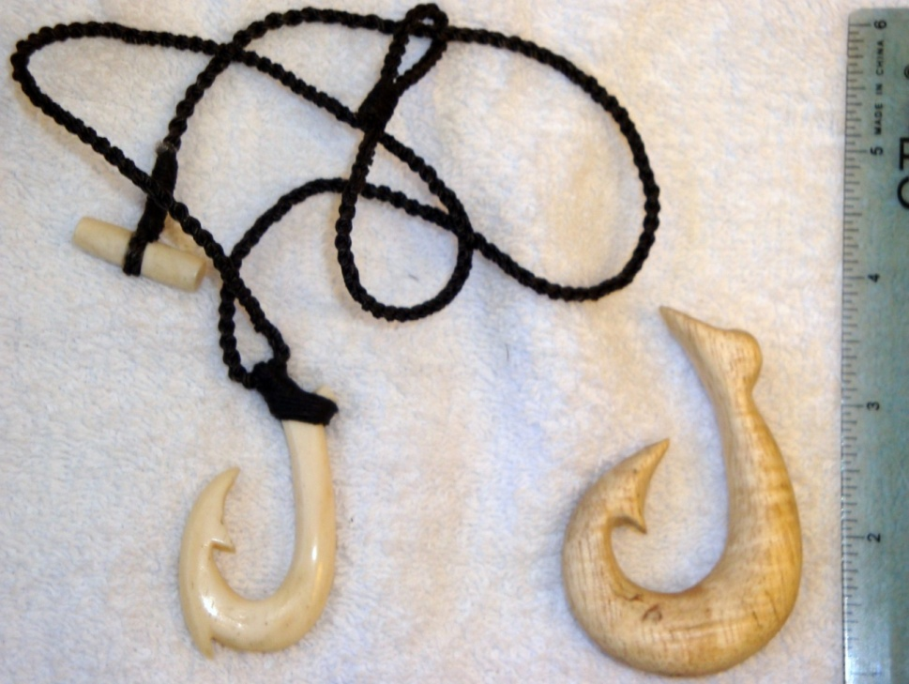
Education: Reproducing Cultural Artifacts
Al Keali‘i Chock & Katie L. Kamelamela
Department of Botany, University of Hawai‘i at Mānoa , Honolulu HI 96822-2279
Botany 446, Hawaiian Ethnobotany, is an upper division ethnobotany course open to undergraduates and graduates at the University of Hawai‘i at Mānoa (UHM). The curriculum was revised this Spring to present the course contents in a different sequence, first by cultural use, followed by multi-purpose plants and food plants, both Polynesian introduced and native (https://sites.google.com/site/hawaiianethnobotany/course-schedule).
There were two course projects: (1) reproducing a cultural artifact, using modern tools and materials, and (2) library research on a Hawaiian plant, using manuscript and Hawaiian or English language newspaper (1800's) sources. Students visited the public galleries of the Bernice Pauahi Bishop Museum (the premier natural and cultural history institution in the Pacific), the first week of class; the research cultural collections the second week; and the library, archives, and herbarium, the fifth week.
‘ulī ulī - a musical instrument (rattle), made from niu, coconut (Cocos nucifera) or ipu, gourd (Lagenaria siceraria) fruit, with seeds or small pebbles inserted to make the rattling sound. The early forms were made with only a handle of ‘ie‘ie (Freycinetia arborea) adventitious roots and leaf strips. They evolved later to form ornamental tops of tapa (bark cloth) or colored feathers. The coconut artifact on the left was made by student Gabrielle Roback, using an electric drill as a tool, and hand sandpaper. She purchased raffia (Raffia farinifera) and bamboo (Bambusa vulgaris) from a craft store to form the handle and top, It took her five sessions totaling 12.5 hours to complete the project. The picture on the right is from the Bishop Museum (Buck 1957:412, fig. 267a)
For the first project the students chose a wide variety of projects, including an adz, basket, knives, fish hooks, fish net, fish trap, mat, musical instruments, sandals, and tapa beaters. They were able to duplicate their artifacts by using the detailed information in Peter Buck’s Arts and Crafts of Hawai‘i (1957) as a reference, the Bishop Museum exhibits, various individuals (family members, friends, and cultural teachers), and internet videos. Using modern tools and materials, each student spent, on the average in six or more separate sessions, a total of 12-21, or more accumulated hours. The term paper, which accompanied the artifact, outlined what they did, when they did it, and how much time it took for each step of replicating the article. They were able to envisage the length of time and the difficulties of pre-contact Hawaiians to construct their original objects using stone, wood, and bone tools.
Maeghan Castillo reproduced a fish trap (hina ‘i), using wire with wrapped bark (from the paper bark tea tree, (Melaleuca quinquenervia). She sought the assistance of a Hawaiian Studies teacher, and used Buck (1957:312-319) as a reference.
She used a bowl to form the globular shape, and pliers to put the material together. She added as a sinker stone on the bottom, which was not present in the museum exhibit (right) made from ‘awikiwiki (Canavalia spp.) vines [other materials used were huehue (Coccolus trilobus, family Menisperaceae) stems, ‘ie ie (Freycinetia arborea) adventitious roots].
Other
Sandals (kama a) were made of leaves of kī, tī (Cordyline fruticosa), or banana, mai‘a (Musa acuminata X M. balbisiana); or the bark of hau (Hibiscus tiliaceus) or paper mulberry, wauke (Broussonetia papyrifera) which were woven together to form protection when walking over rough lava. John Dobbs made the sandals from tī leaves, first removing the petiole and upper midrib, and freezing them .It took five sessions for a total of 12.5 hours. They were subsequently dried in the plant dryer for four days and then frozen for three weeks because of a mold infestation. The student product is on the left, and the right is from Buck 1957:249 (fig. 178a), which contains a detailed description of how to make a sandal.
Ben Wadman made tapa beaters (above photo), both the preparatory (hohoa) and finishing (i‘e kuku) ones from kauila (Colubrina oppositifolia), and used kukui oil (Aleurites moluccana) for polishing; Carden Vincent a dip net (‘upena ‘āki‘iki‘i) (left bottom photo) with a single branch of ‘ūlei (Osteomeles anthyllidifolia) for the net hoop-handle, and made a traditional bamboo netting needle to construct the net from contemporary cotton cordage; while Nathaniel Soriano and Marcia Wriston made fish hooks (right bottom photo), from cow bone and koa (Acacia koa) wood, respectively.
Benjamin Field chose to make a ko‘i kalai or finishing adze. He obtained the stone from an old adze quarry between Waihe‘e and Waikane, and spent time in Mānoa stream (adjacent to the university campus) patiently flaking off the stone to form the correct dimensions, and polishing it with the slurry from his work. He added the branch from a hau (Hibiscus tiliaceus) for the handle, and added a piece of pine wood as a pad between the wood and stone. He lashed the pieces together using sennit which he prepared from coconut husk (soaking it in sea water, drying it, soaking it again, and separating the fibers which he wove into a two foot rope. The entire project took a total of 21 hours, in 16 separate sessions. The photo on the right is from the Leningrad Museum (Kaeppler 1978:113, fig. 187).
Niho ‘oki or a cutter, which was used in pre-contact times to cut hair, make wood carvings, clean and cut fish, and strip bark for cordage and bark cloth was chosen as projects by Koa Matsuoka (left) and Virginia Guevara Olvera, who were advised by their cultural teacher and wood carver, Solomon Apio. The handles are made of koa (Acacia koa) wood, with a tiger shark tooth as the cutter, and banana fiber from the petiole sheath for the cordage. While modern tools were used, the only contemporary substance added was glue mixed with sawdust. Elapsed time for both was 21.5 hours, in 11 sessions for one, and 4 for the other. The figure on the right is from a collection at Cambridge (Kaeppler 1978:108, fig. 177).
References: Buck, Peter. 1957. Arts & Crafts of Hawaii. Honolulu, Bishop Museum Press.
Kaeppler, Adrienne. L. 1978. “Artificial Curiosities” an exposition of native manufacturers collected on the three Pacific voyages of Captain James Cook, R.N. Honolulu, Bishop Museum Press.
Acknowledgements: This poster would not have been made without the valuable assistance of Betty Lou Kam, Vice-President for Cultural Resources, Bernice P. Bishop Museum, who made available the ethnology collections available for photographing, and Stephanie Saephan, Researcher/GIS Manager, Botany Department, who assisted in the poster preparation.
Photos by Al Keali‘i Chock unless otherwise indicated.
Botany 2011, Session P: Recent Topics Poster Presentation, Chase Park Plaza, St. Louis MO – July 10-13, 2011

