Slide 1


Action Research on Flipped Robotics Instruction
TCC 2018
Erik Okamura
University of Hawaii
at Manoa

Slide 2
Project Description
The purpose of this action research project is to assess the effectiveness of a flipped classroom setting on the robotics team at a public middle school in Hawaii.

Slide 3
Project Overview
Action Research on Flipped Robotics Instruction
Background
Goals
Previously…
Instruction was done in class
Minimal documentation
Students come unprepared for the robotics competition
Lack of time led to sub par robots and late or extended work days
1
Increase student engagement
2
Prepare students with the skills and knowledge necessary to compete competitively
3
Maximize class time to improve overall quality of the robot

Slide 4

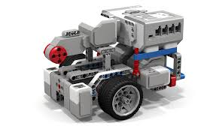

Audience
Research Participants
10 Students
Mix of 7th & 8th Graders
Interest, Skills & Prior Knowledge or Experience

Slide 5
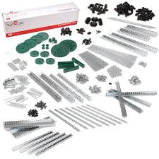
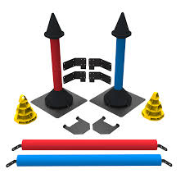
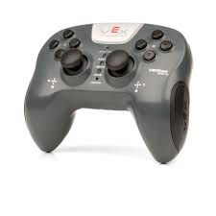
Project Plan
Action Research on Flipped Robotics Instruction
Unit 1
Unit 2
Unit 3
Unit 4
Unit 5
Unit 6
Preparing for the Season
Planning & Strategy
Drivetrain
Lifting Mechanism
Field Interfacing Device
Driving & Improving

Slide 6


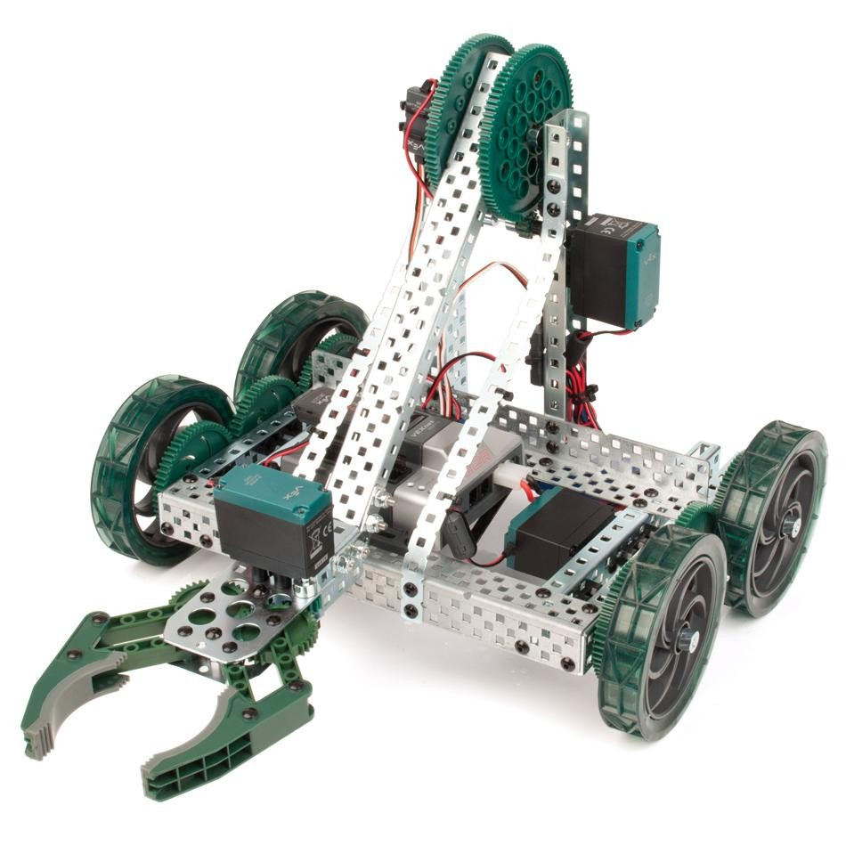

Project Parts
Action Research on Flipped Robotics Instruction
Learning Management System
1. Online Learning Modules
2. In Class Activities
3. Documentation

Slide 7
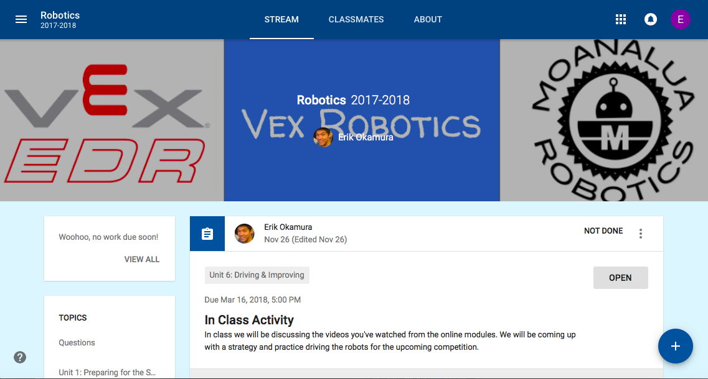
Learning Management System

Slide 8
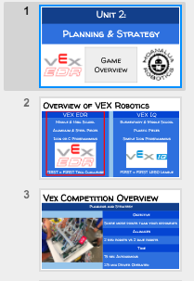
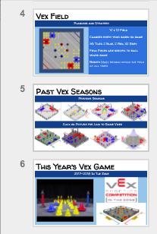
Online Modules
Read Information
Watch Videos
Look for and Think About Ideas
Completed Prior to Class

Slide 9
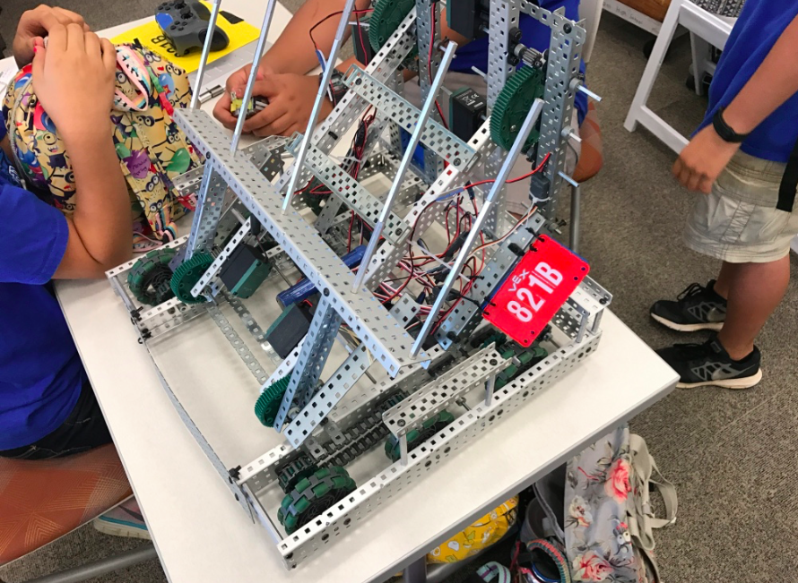
In Class Activities
Completed In Class With Team
Planning & Collaborating
Building
Problem Solving

Slide 10




Assessment Tools
Action Research on Flipped Robotics Instruction
In Class Observations
Interviews
Reflections
Final Product

Slide 11
Benefits for Students
Action Research on Flipped Robotics Instruction
Structured resources and information
Accessible collaboratively in school and at home
Documentation is completed along the way
Personalized feedback and support from teacher

Slide 12
Benefits for Teachers
Action Research on Flipped Robotics Instruction
Activities and lessons are prepared ahead of time
Lessons can be modified to better meet the needs of the students
More time available in class to review, instruct, or provide personalized assistance

Slide 13
Action Research on Flipped Robotics Instruction
Questions?
Thank you

