Slide 1

Images of Generations Past
Retell Stories for Future Generations:
University of Hawaii at Manoa Library
Genealogy of a Scroll and an Old Book, 1710-2010 – Paula Mochida
Discovery, Preservation, and Access to the Past: Magic Lantern Slides at the UHM Library – Tokiko Bazzell
Crowd-Sourcing Our Sea of Islands: Enhancing Online Collections by Enabling Community Feedback – Stu Dawrs

Slide 2
"Genealogy of a Scroll and an Old Book, 1710-2010"
Paula Mochida
University Librarian
University of Hawai'i at Manoa Library
Slides prepared by Tokiko Y. Bazzell
Japan Studies Librarian
"Libraries and Discovery in the Pacific Century" PRDLA 2011

Slide 3
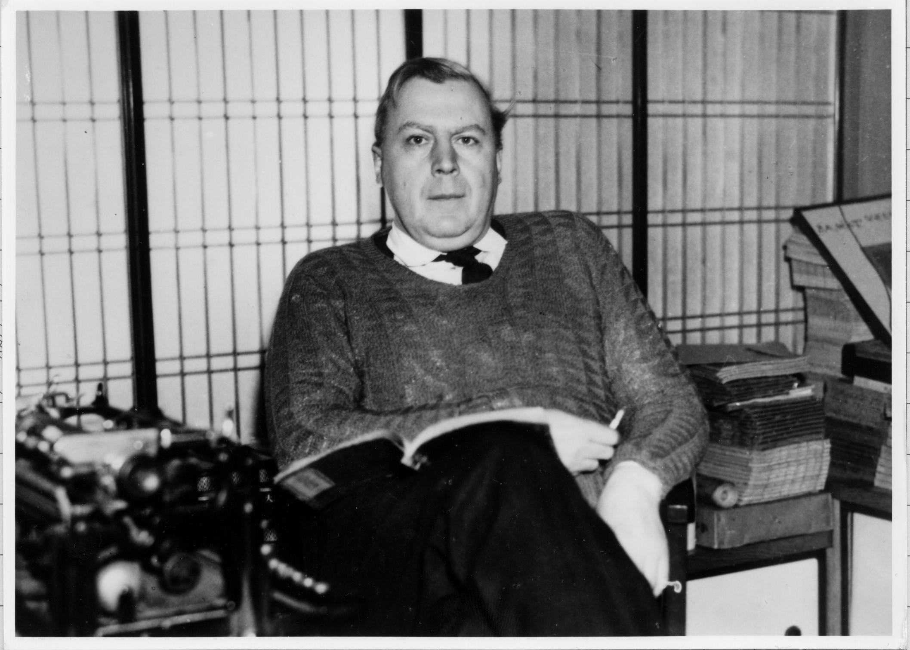
Frank Hawley
フランク・ホーレー
Born in 1906, England 英国で誕生
Came to Japan in 1931 as an English teacher
Imprisoned in 1945, back in England during World War II
Back in Japan in 1946
Worked for the Times, British newspaper, 1946-1952
Died on January 10, 1961, Kyoto, Japan 京都没

Slide 4

Frank Hawley Collection

Slide 5
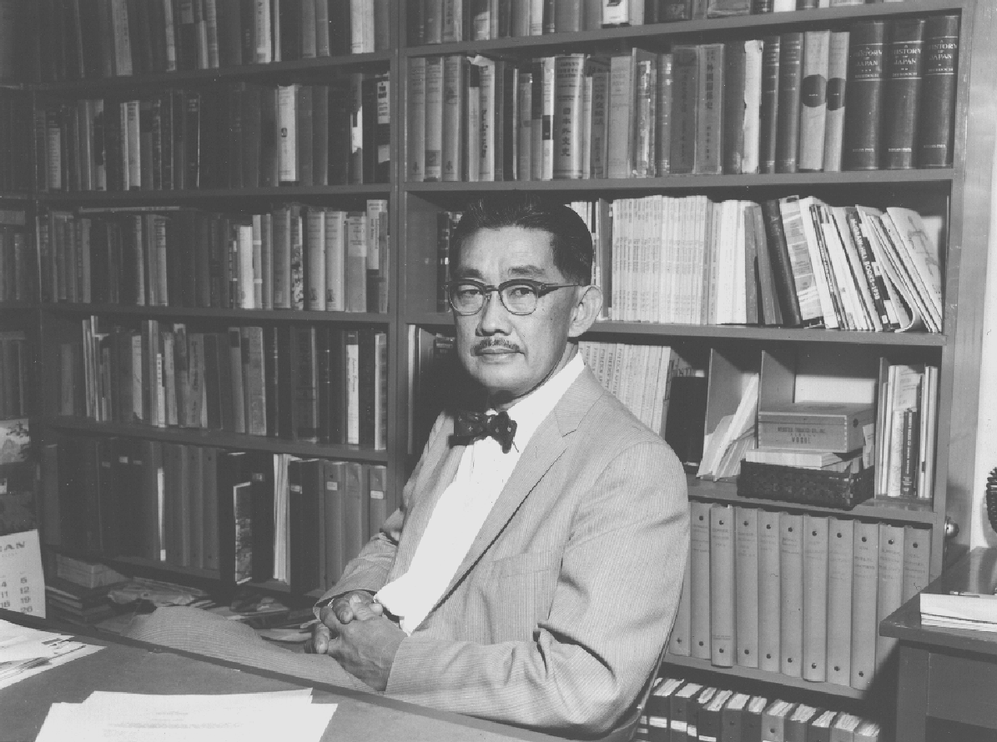
Shunzo Sakamaki 1906-1973 坂巻駿三
  History professor at UHM ハワイ大学歴史学
  Dean of Summer School
  1955-1971

Slide 6

Jan. 10, 1961 Sakamaki left for Japan
“to arrange for the purchase of written materials on Ryukyu, so that a good library collection may be acquired, for study and research.”
(Memorandum to the Governor 1/5/61)
研究に役立つ文献収集を目指し日本へ出立

Slide 7
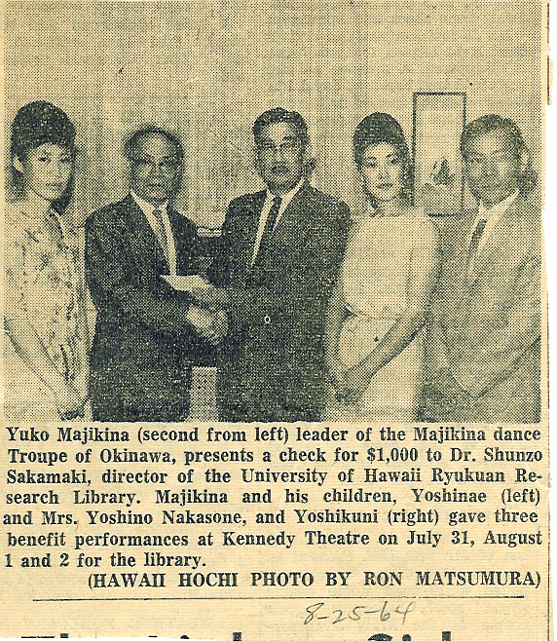

Slide 8
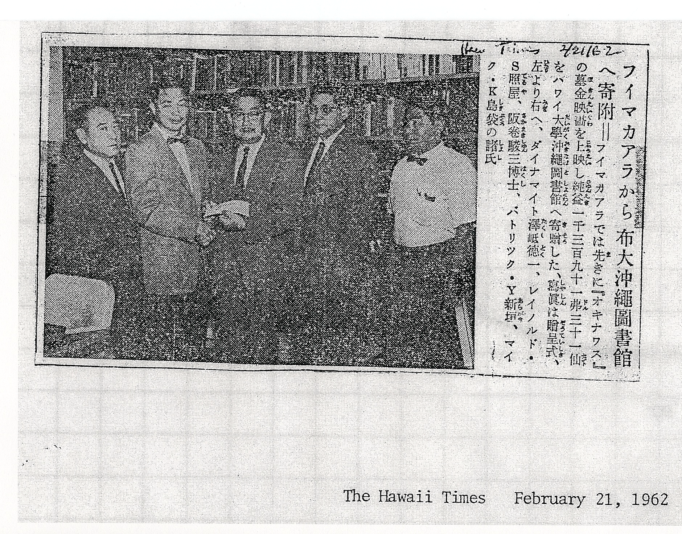

Slide 9
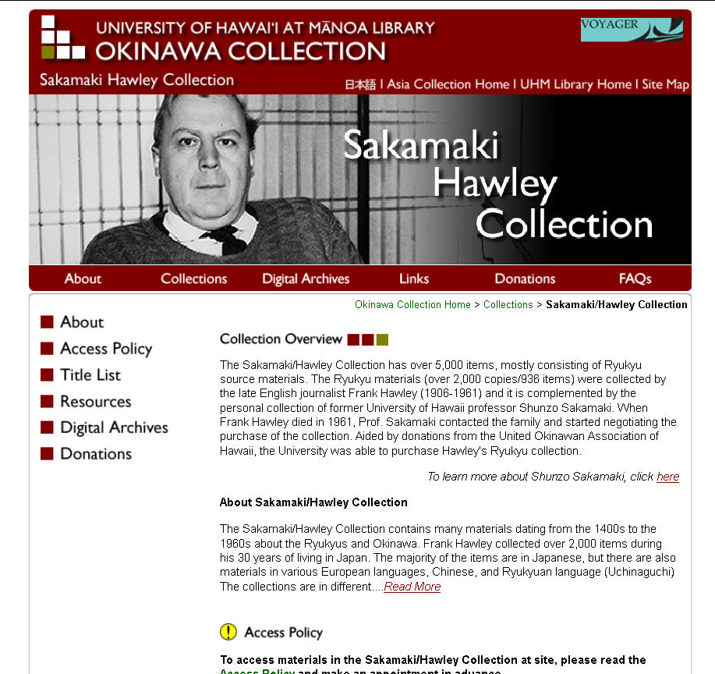
ハワイ大学マノア校図書館
沖縄コレクション
サカマキ・ホーレーコレクション

Slide 10
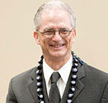
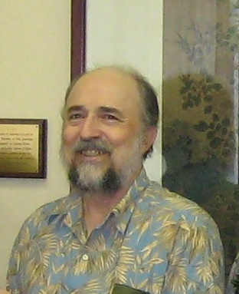
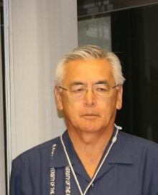
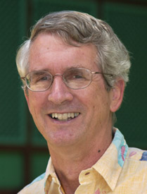
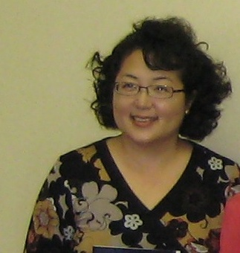
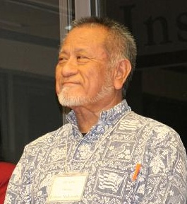
ハワイ大学沖縄研究所設立への貢献者たち
Robert Huey
Leon Serafim
Ed Kuba
Gay Satsuma
Robert Nakasone
Ned Schultz

Slide 11
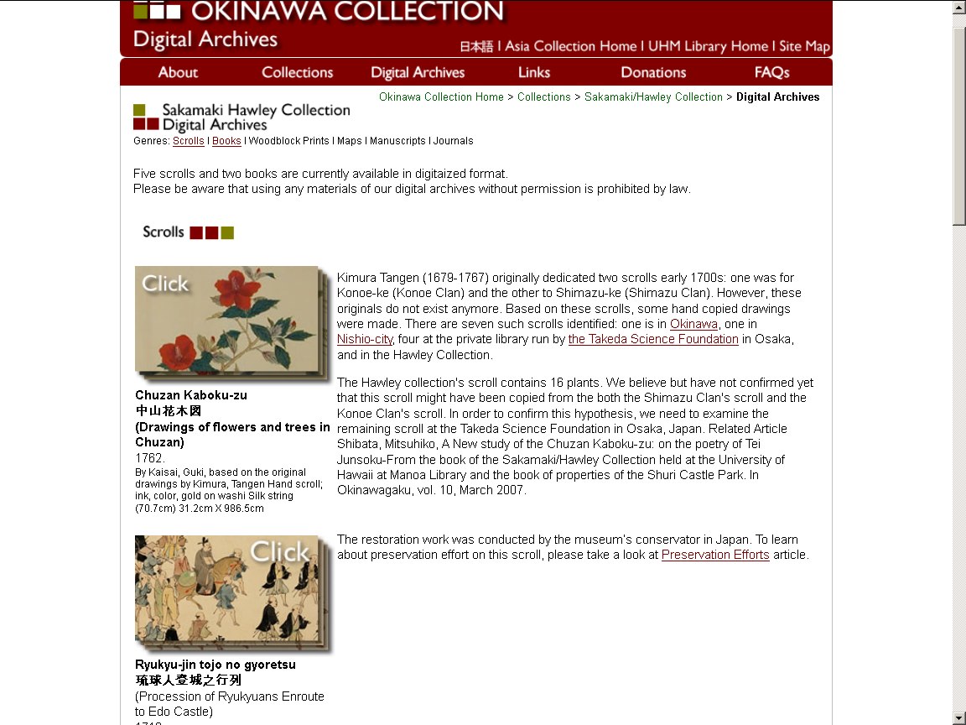

Slide 12
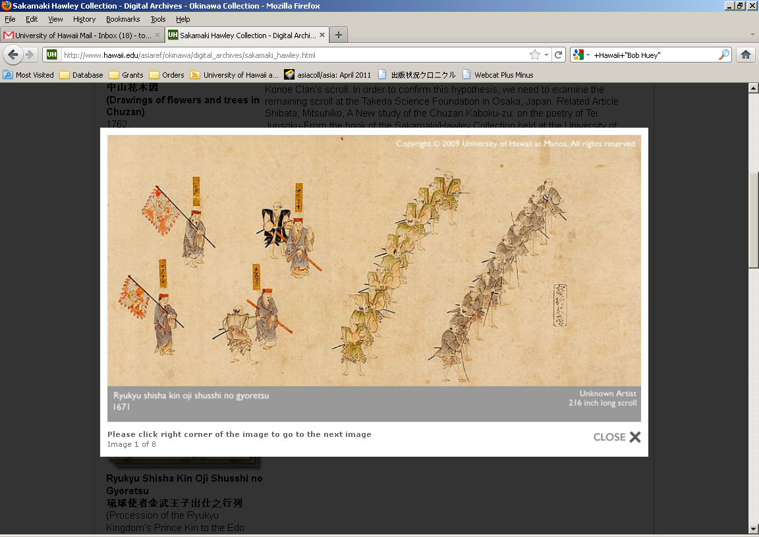

Slide 13
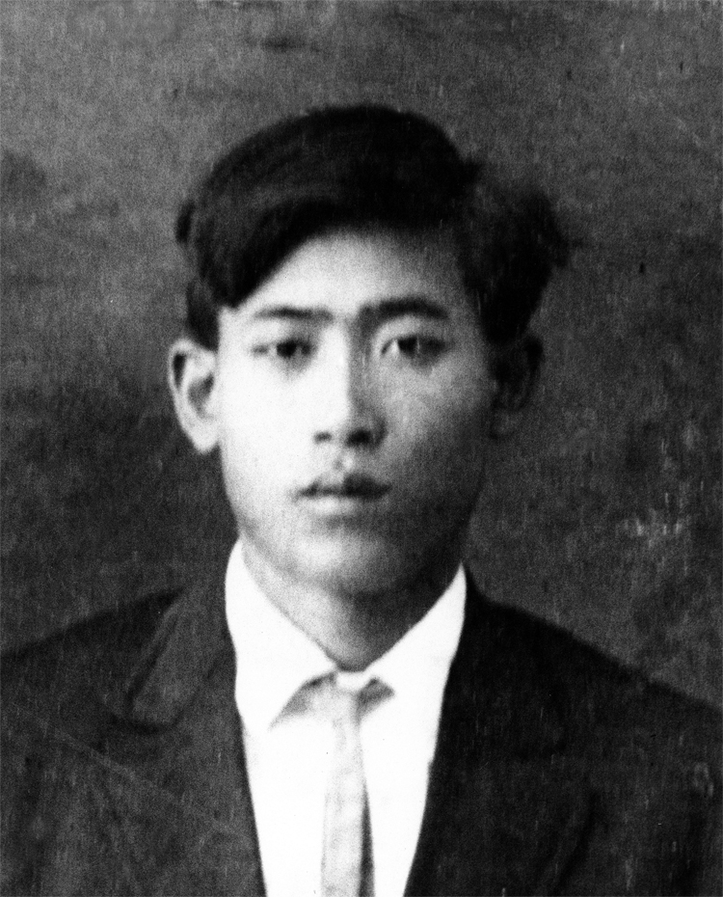
Uchima Ansho, the 1st Uchima to Hawaii一世
1891 Born in Misato-son 美里村生
1906 Moved to Hawaii (Big Island)
1913 Married Kamado Kina
1923 Relocated to Oahu
1934 Died at 43 years old

Slide 14
Ansho (1st son)
Anko (2nd son)
2 sisters (Ushi & Makatei)
1906 Moved to Hawaii
1913 Married & 9 children
1934 Passed away
Safe keeping of the document

Slide 15
Ansho (1st son)
Anko (2nd son)
2 sisters (Ushi & Makatei)
1906 Moved to Hawaii
1913 Married & 9 children
1934 Passed away
Safe keeping of the document
1961 the doc to Hawaii along with okotsu, the doc was left with his daughter while okotsu was interred to Moiliili
1993 the doc was left with Roy (Ansho’s 1st son)
2007 met Prof. Yamazato (distant relative in Okinawa), who introduced the Uchimas to Bazzell
2000 handed over to Jessie (Ansho’s daughter), then to Lucie (Jessie’s daughter

Slide 16
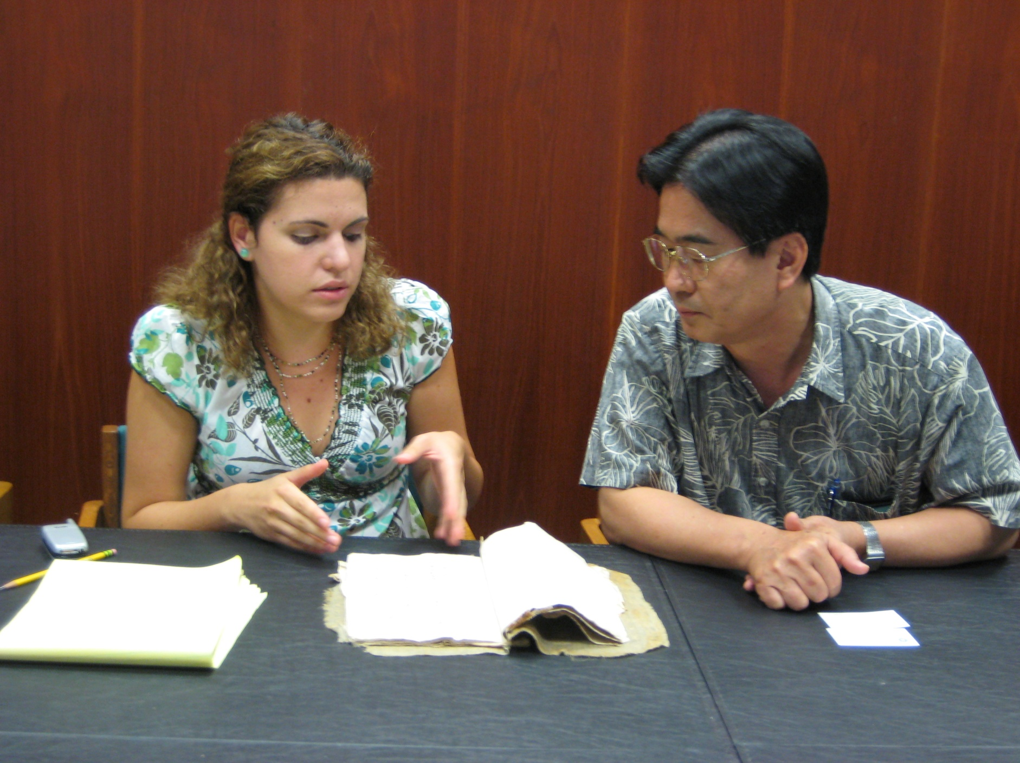
山里琉球大学教授とハワイ大学図書館スペシャリスト

Slide 17
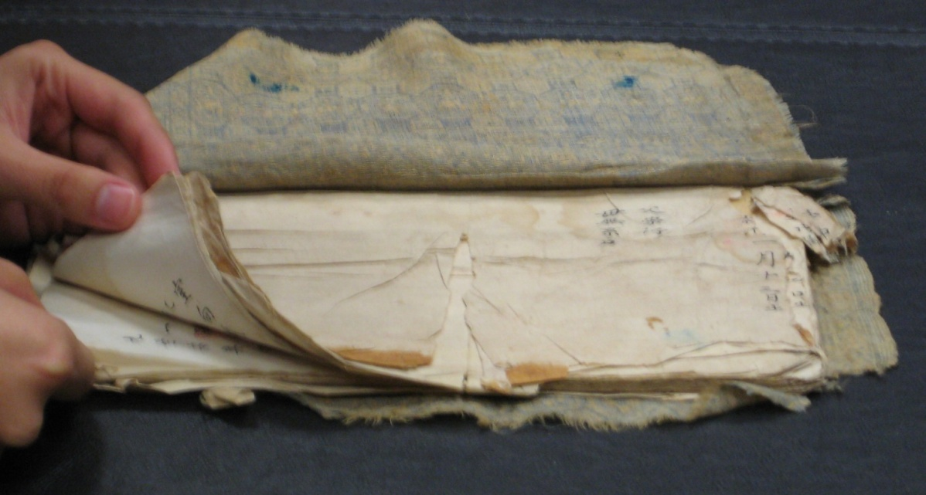
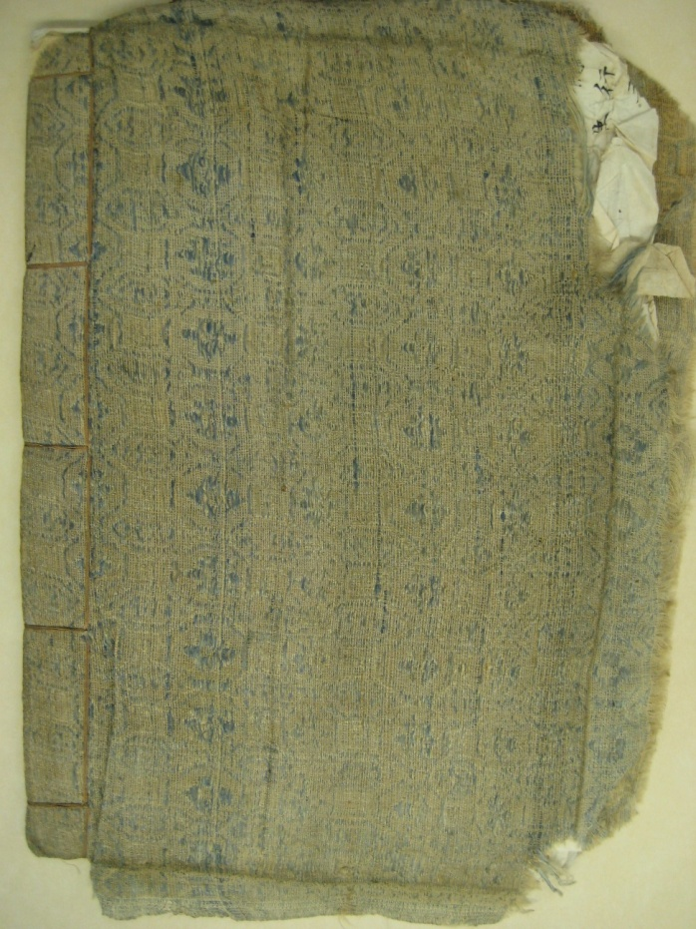

Slide 18
Ansho (1st son)
Anko (2nd son)
2 sisters (Ushi & Makatei)
1906 Moved to Hawaii
1913 Married & 9 children
1934 Passed away
Safe keeping of the document
1961 the doc to Hawaii along with okotsu, the doc was left with his daughter while okotsu was interred to Moiliili
1993 the doc was left with Roy (Ansho’s 1st son)
2007 met Prof. Yamazato (distant relative in Okinawa), who introduced the Uchima to Bazzell
2000 handed over to Jessie (Ansho’s daughter), then to Lucie (Jessie’s daughter)
2010 donated to the UHM Library 図書館へ寄贈

Slide 19
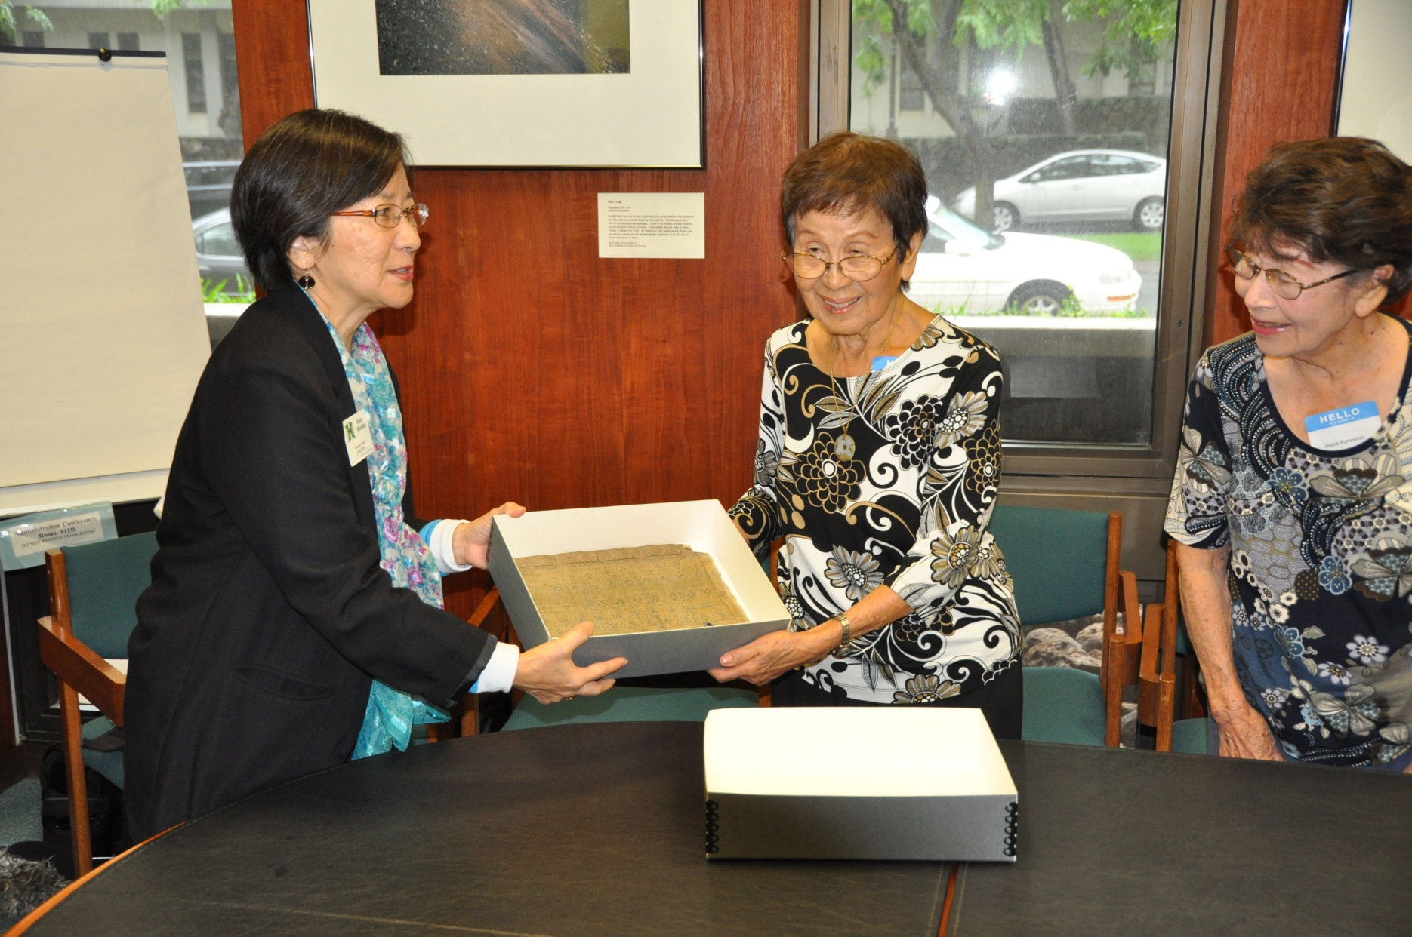
Uchima Document 内間家譜

Slide 20
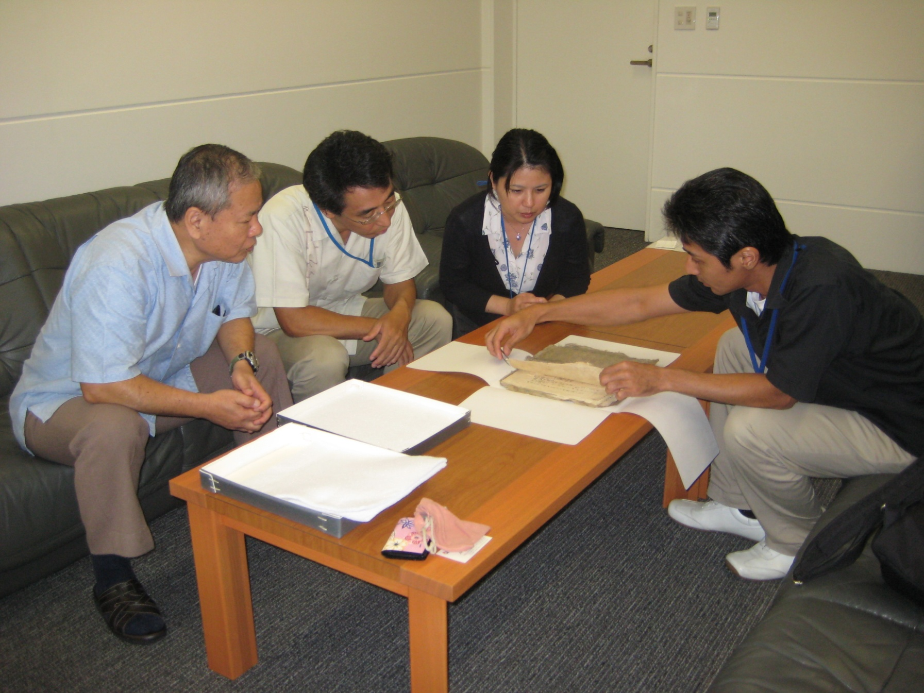
県立沖縄博物館関係者・修復師へ家譜修復を託す

Slide 21
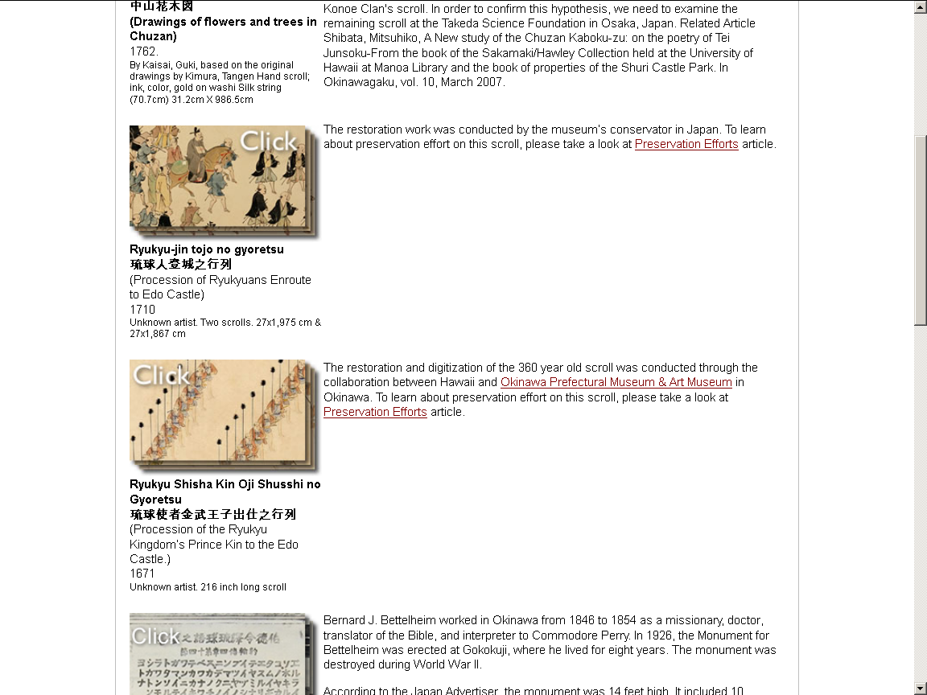

Slide 22
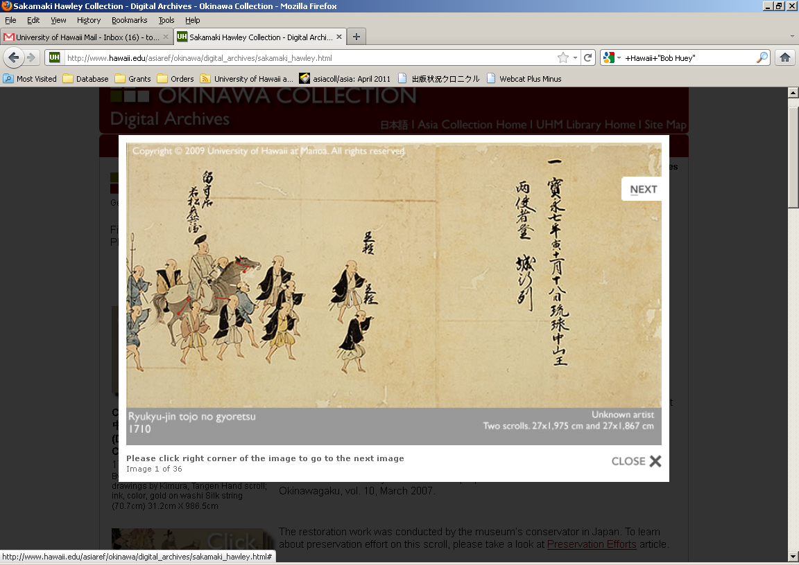

Slide 23
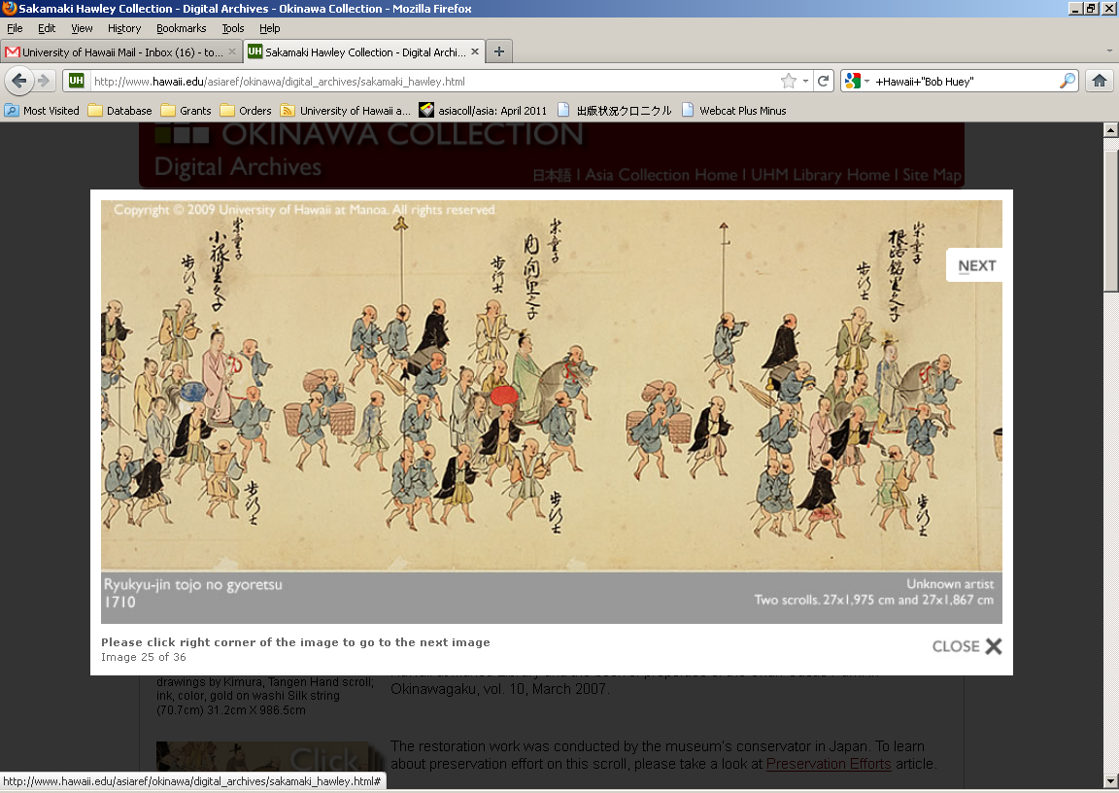

Slide 24
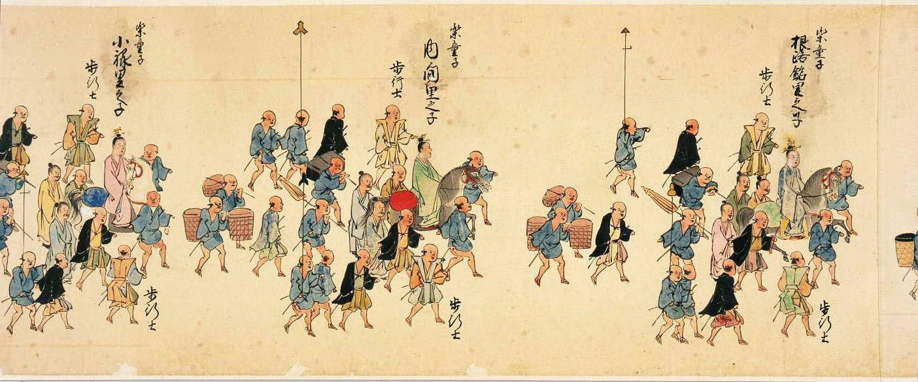

Slide 26
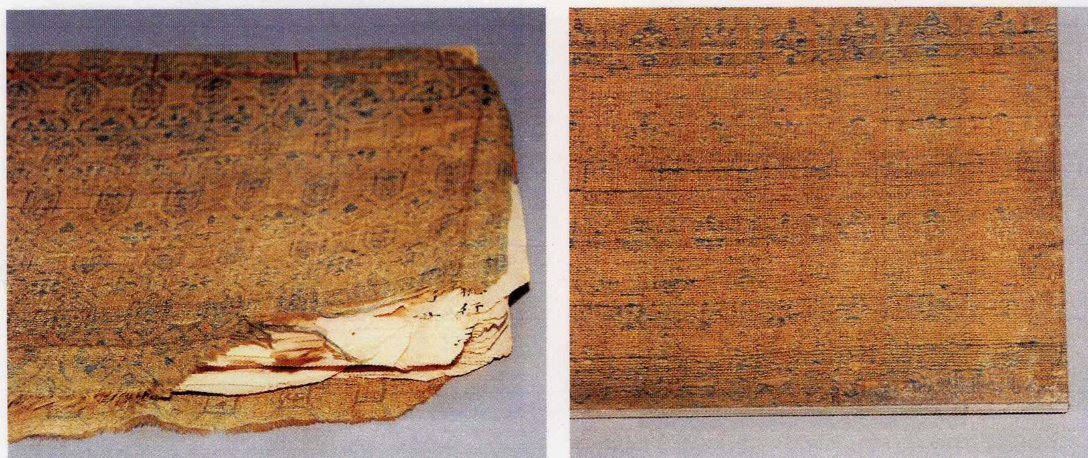
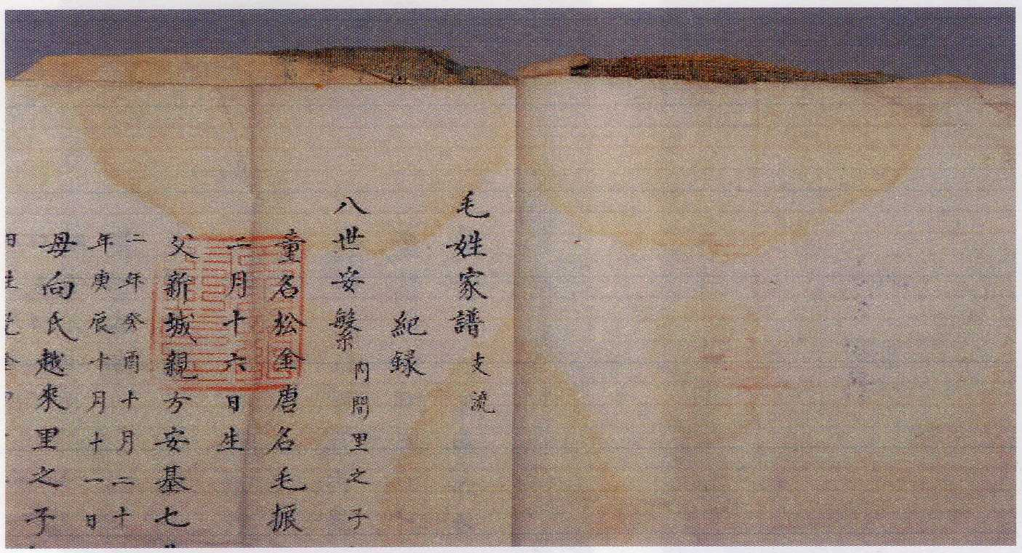
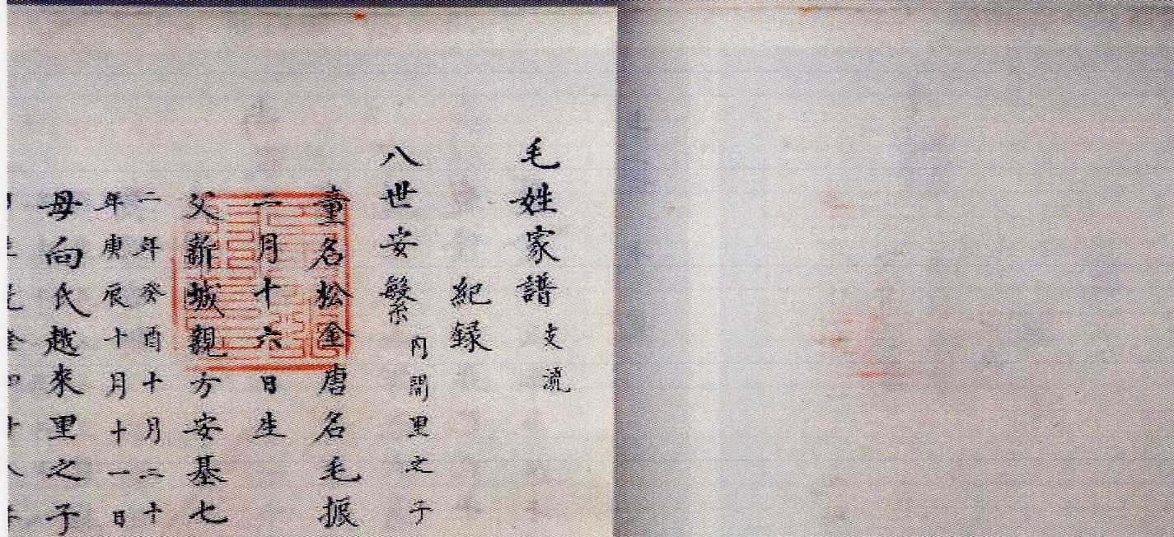

Slide 27
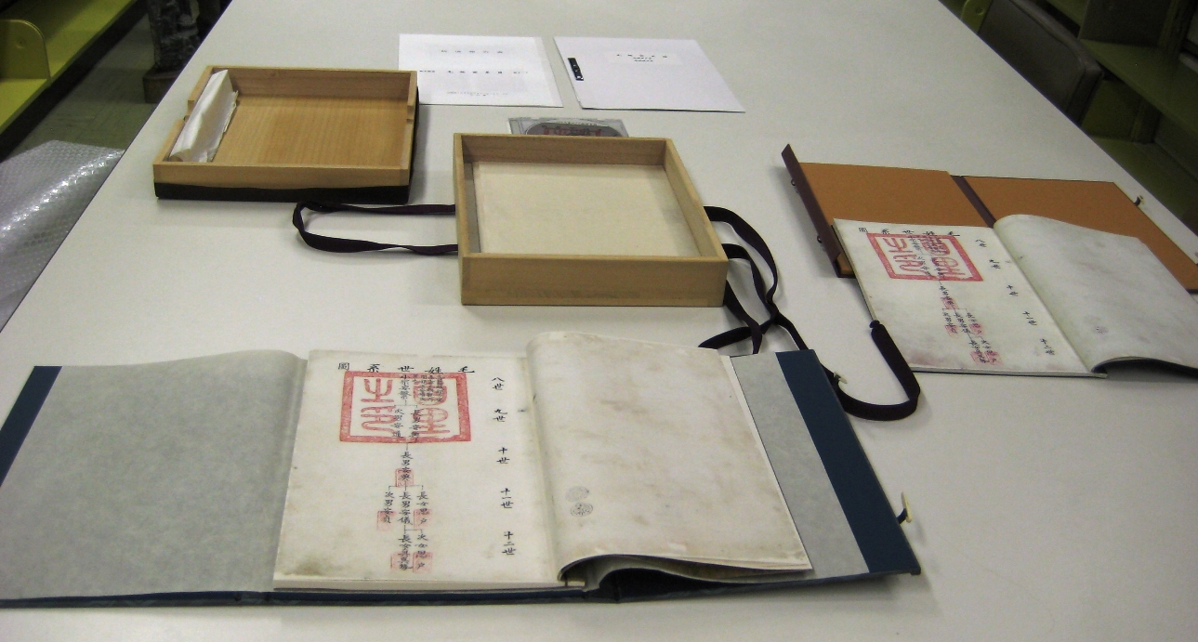

Slide 28
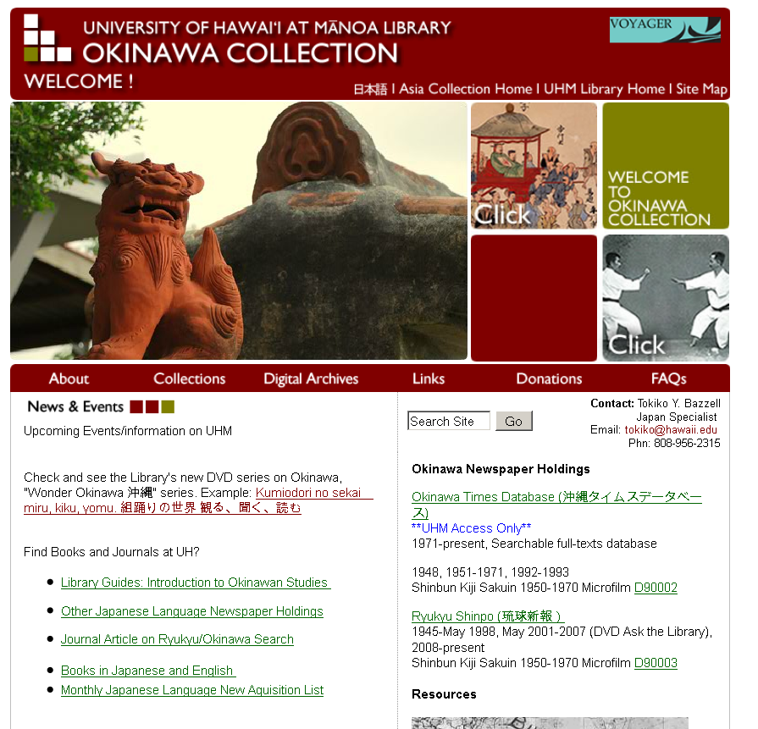
イッペー ニフェーデービル
Mahalo マハロ
有難うございました
Thank you very much

