Slide 1

Learning About Online Geometry Resources
Usability Study
Shuko Matsubara – LTEC 690, Spring 2021
University of Hawaii at Manoa
President William McKinley High School

Slide 2
Tell me about your experience in your high school Geometry class!

Slide 3
Problem
1
2
3
Lack of visual aid
Limited dynamic visual aid on tools
Limited time for searching resources

Slide 4

Problem
Solution
Today’s math teachers rely heavily on technology for teaching their class, but MHS geometry teachers need more guidance on how to use digital mathematical resources to demonstrate mathematical concepts to the students.
Make a website for teachers where they could access tutorials, examples and lists of activities to use during class.

Slide 6
Purpose
The purpose of this usability study is to design an informational website that introduces and shows how to use two online geometry resources and evaluate the navigability and the impact on MHS math teachers’ interests in incorporating the tools in their geometry lessons.

Slide 7
Past Literature
It is critical that we encourage and stimulate young people in mathematics classes through technology.
(Furner and Marinas, 2016)

Slide 8
Past Literature
It is critical that we encourage and stimulate young people in mathematics classes through technology.
Visual mathematics is very important for the learning and the brain.
(Boaler, 2016)
(Furner and Marinas, 2016)

Slide 9
Past Literature
It is critical that we encourage and stimulate young people in mathematics classes through technology.
Visual mathematics is very important for the learning and the brain.
Van Hiele’s theory shows the difficulty of some concepts in geometry.
(Boaler, 2016)
(Vojkuvkova, 2012)
(Furner and Marinas, 2016)

Slide 10
Design and Development

Slide 11

Target Audience
High school geometry teachers at McKinley High School

Slide 12



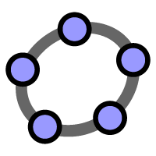
Tools Used
Google Site
Screen Cast-o-Matic
Desmos
Geogebra

Slide 13
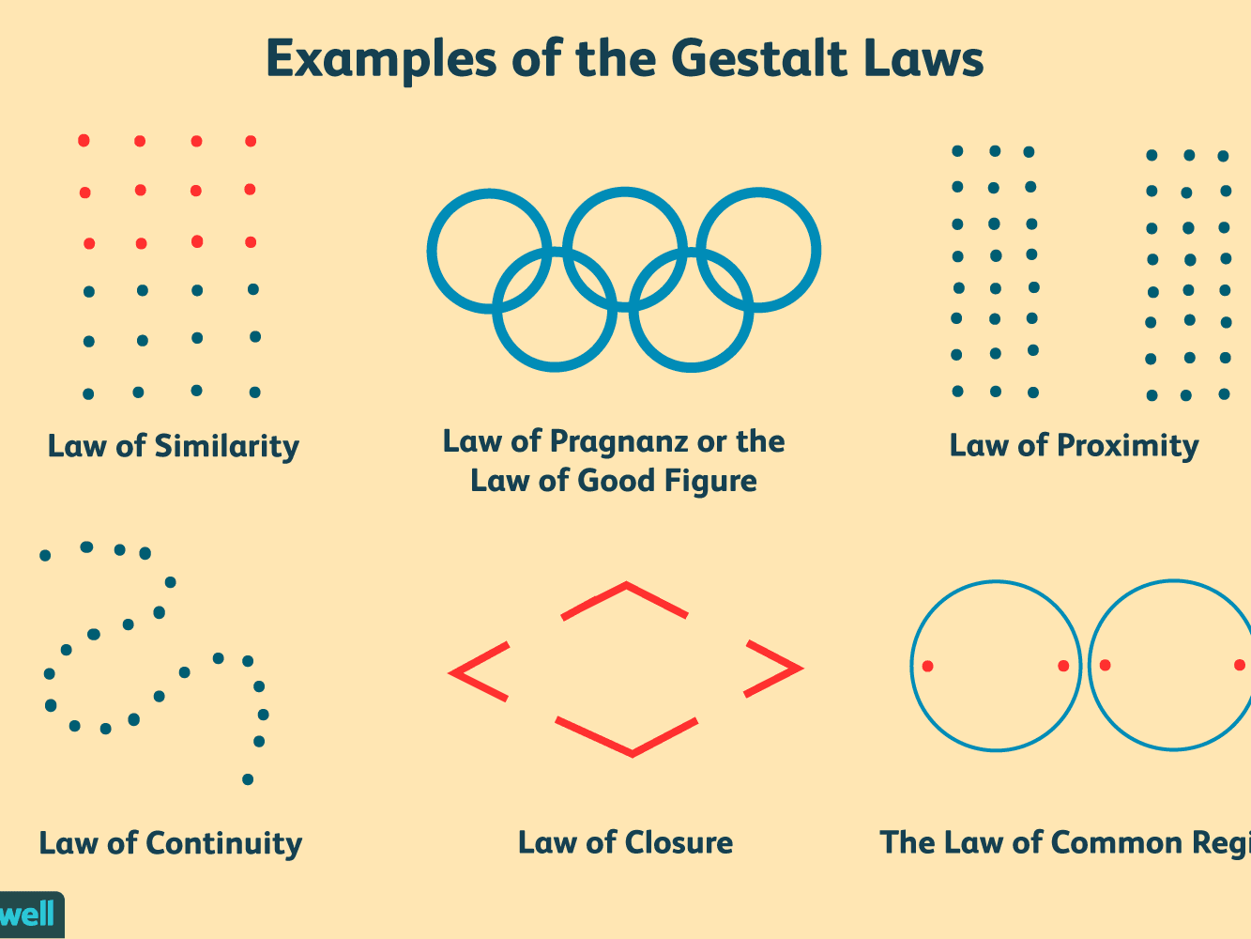
Design
Gestalt’s Principles of Design
Multimedia Design Studies
pictures and animations is remembered more easily than text (Costa, 2004)

Slide 14
Learning Objectives
1. Understand the purpose of this website.
2. Know how beneficial the online tools are.
3. What kind of online activities could be used for lessons modified for MHS geometry pacing.

Slide 15
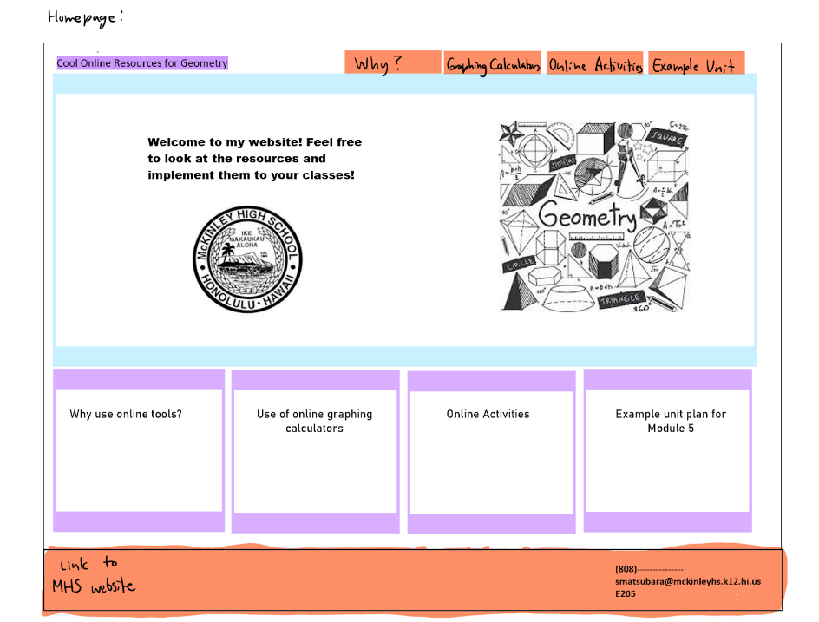
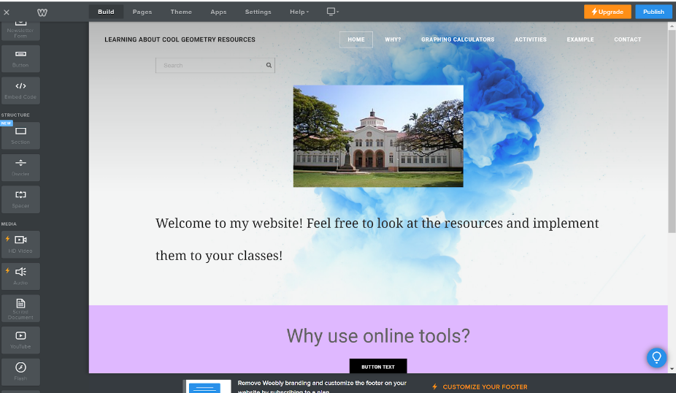
Prototype

Slide 16
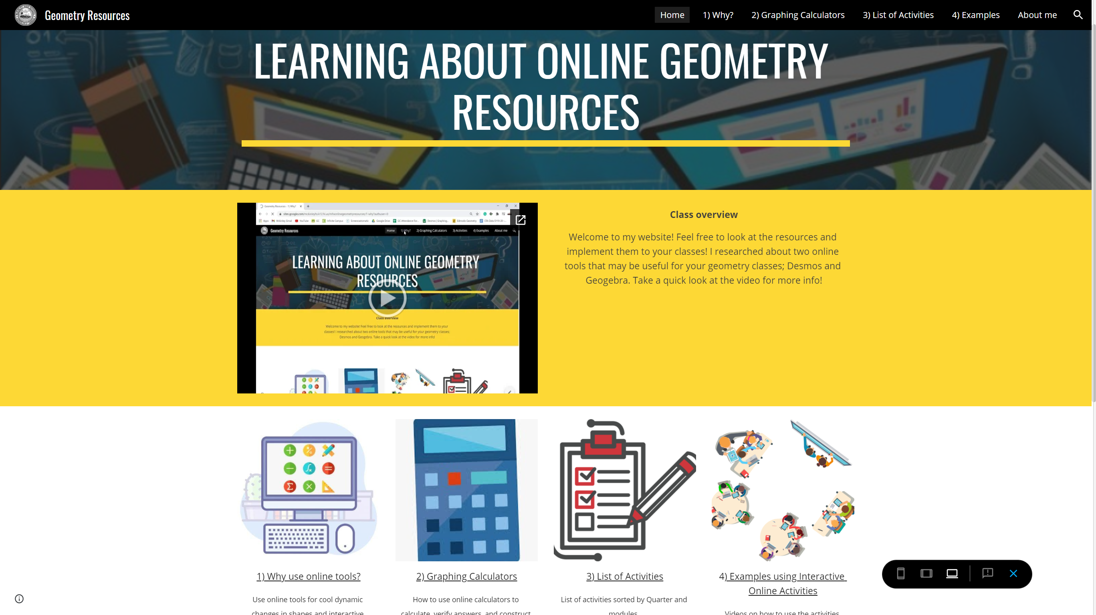
Final Draft: First Version

Slide 17
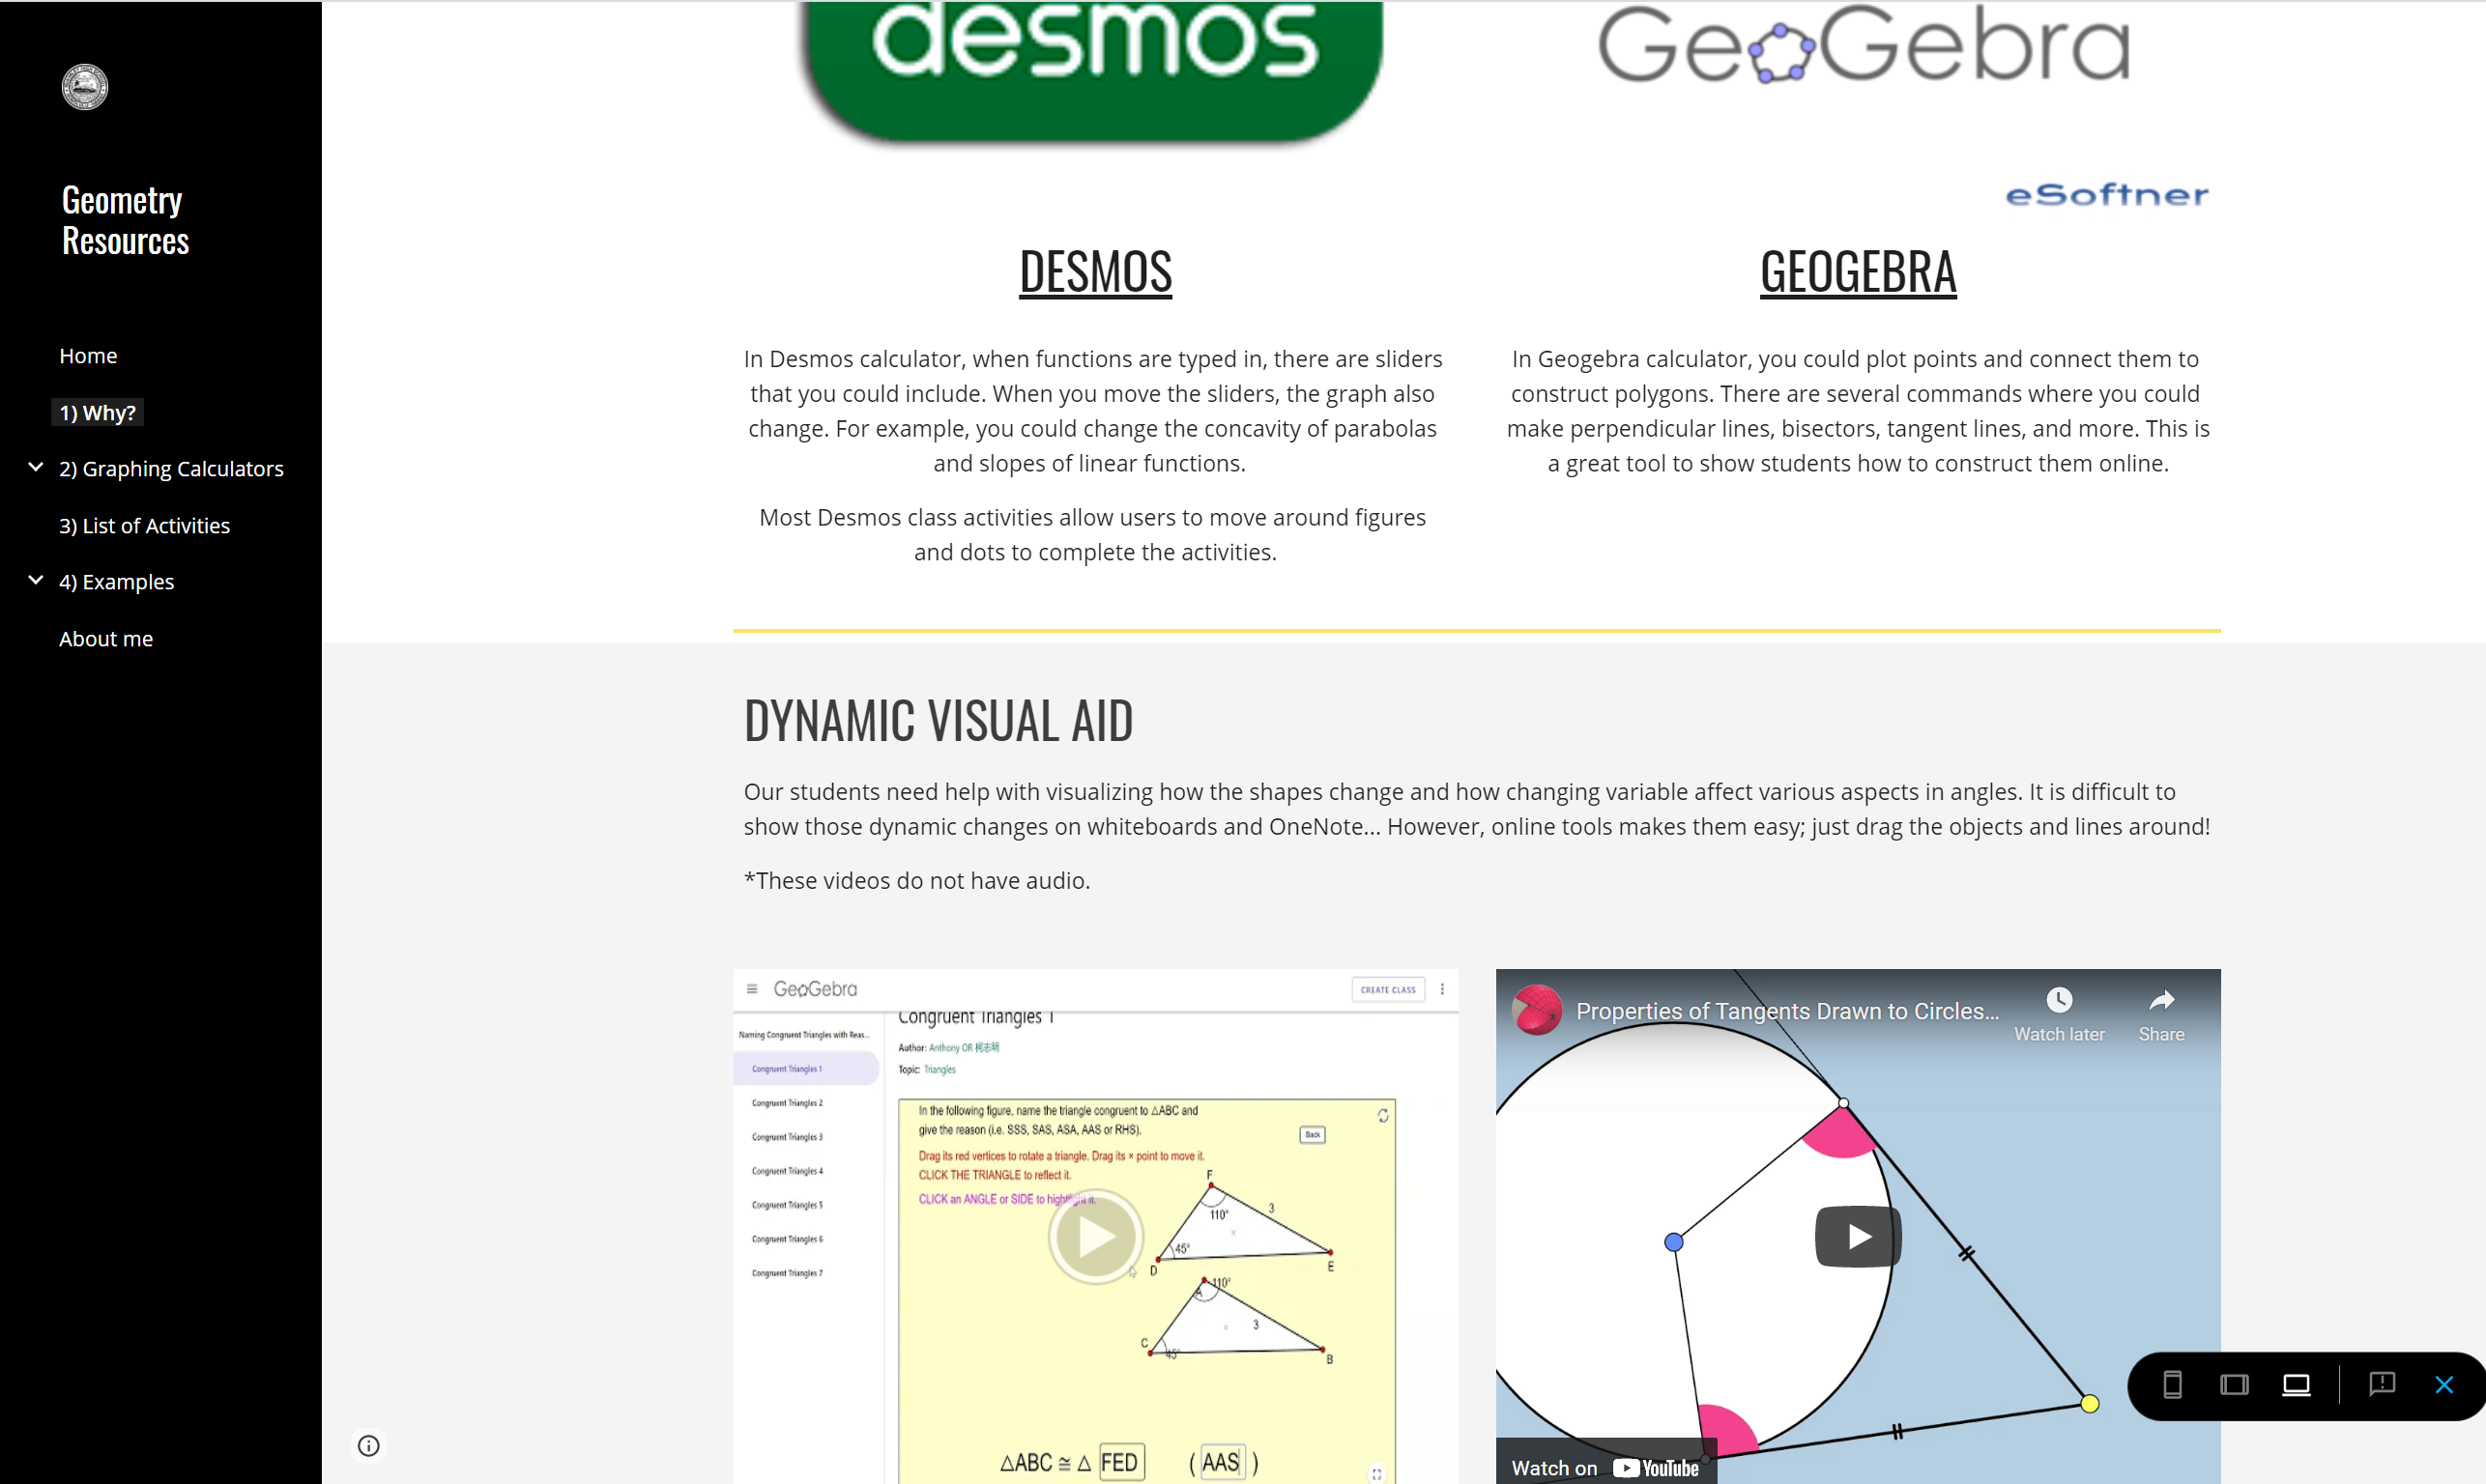
Why Use Online Tools?

Slide 18
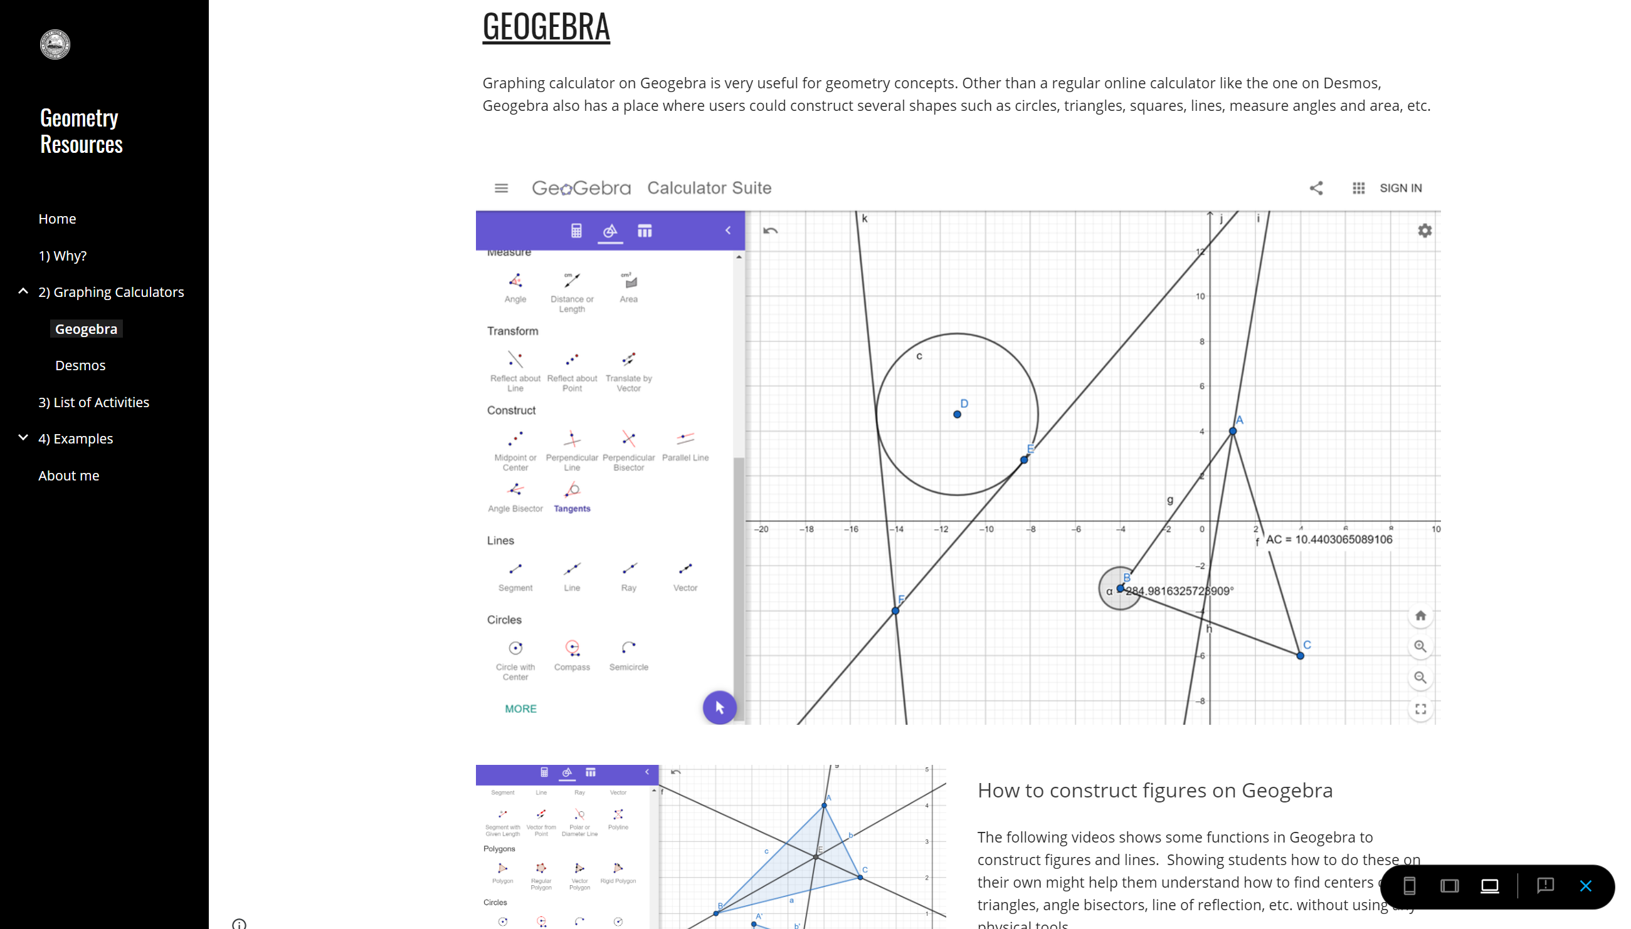
Online Graphing Calculators

Slide 19
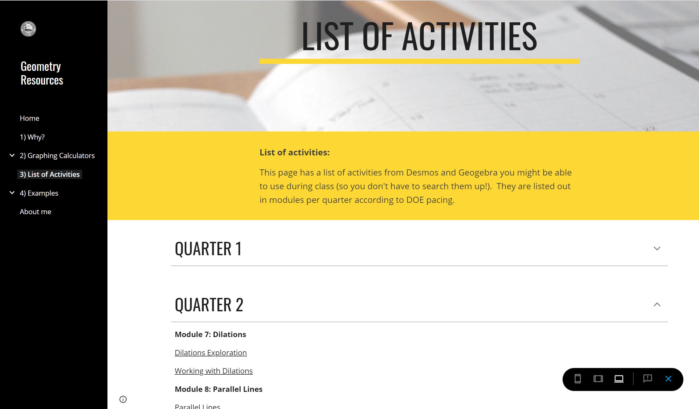

Slide 20
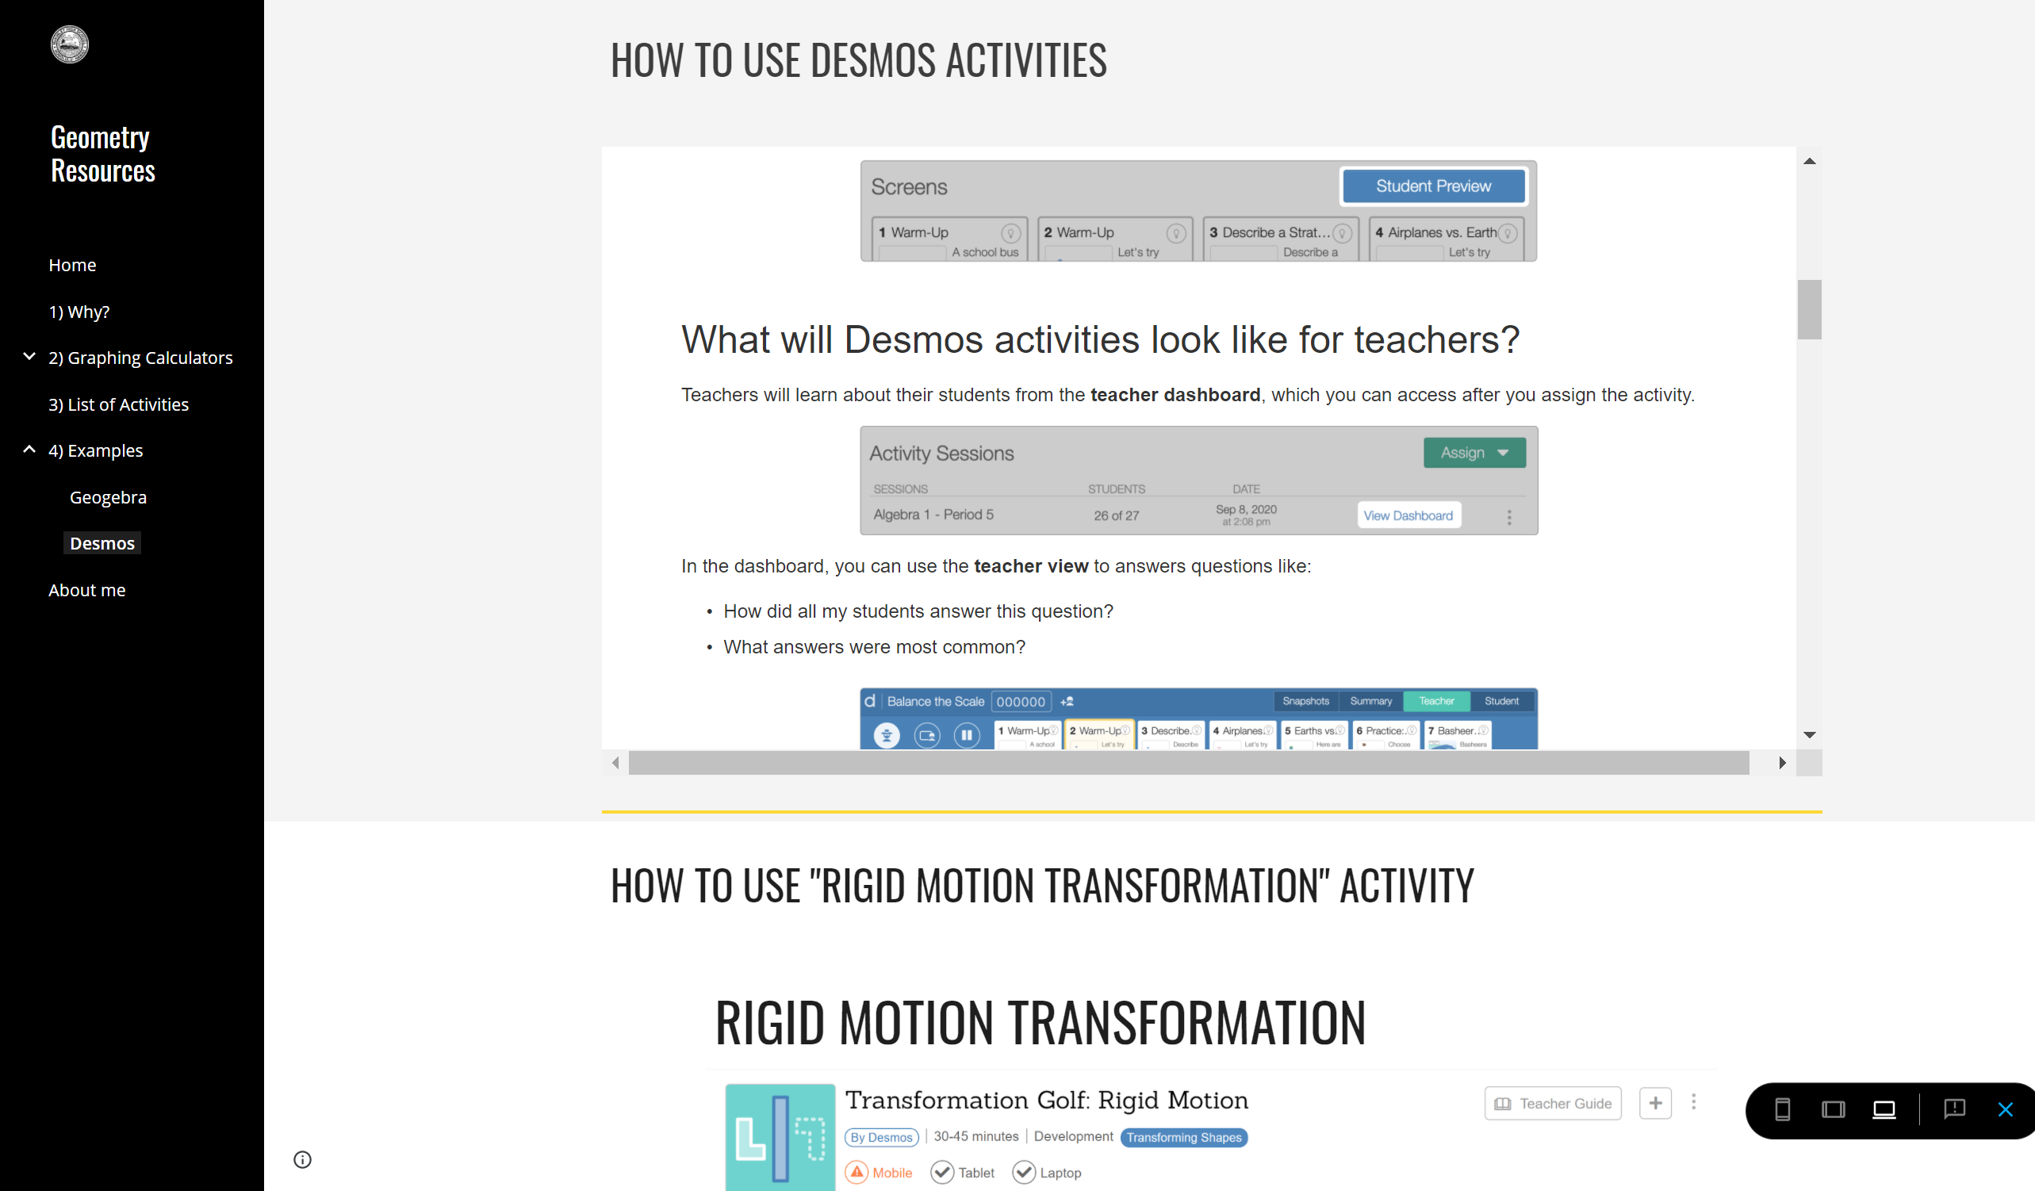
Examples of Activities

Slide 21
Evaluation

Slide 22
Research Questions
1
2
How did the design of the website affect the participants’ interests in using these tools for their students?
How easy is it for participants to navigate the website?

Slide 23
Data Collection Process
Step 2
Step 1
45 min Interview: Usability
Step 3
Pre-Survey
Post-Survey
3 rounds

Slide 24
Participants
n=13

Slide 25
Demographic Data (n=13)
Geometry:
n =7 (53.8%)
Other math:
n =3 (23.1%)
Other subject:
n =3 (23.1%)

Slide 26
Use of 2 Tools
Desmos:
n =9 (69.2%)
Geogebra:
n =1 (7.7%)
n=13

Slide 27
Interest Ratings

Slide 28
Interest Ratings

Slide 29
Interest Ratings
Not Likely

Slide 30
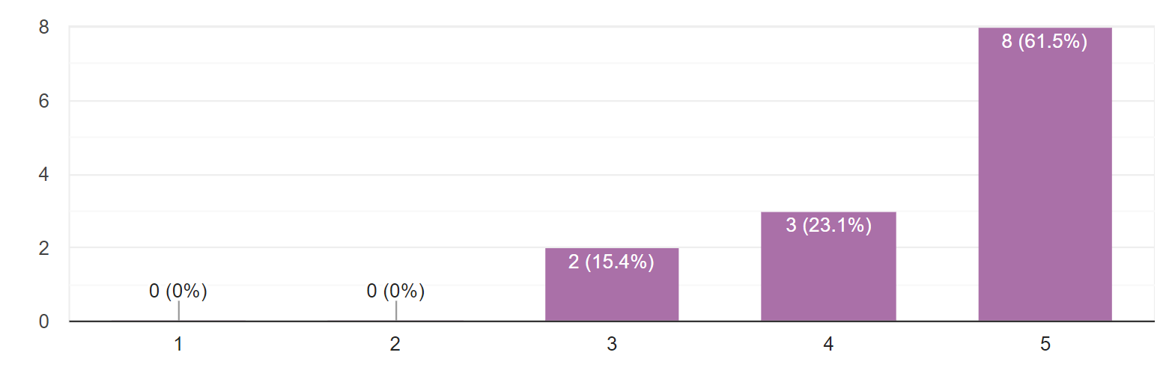
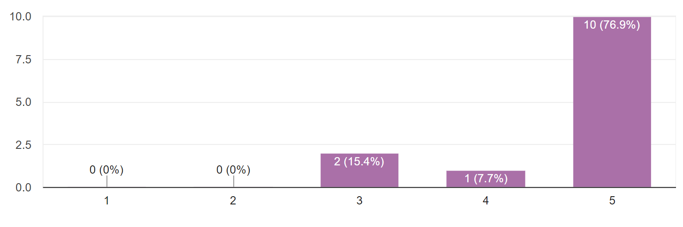
Navigability Ratings
I thought the website was easy to use (n=13)
I think most people would learn to use this site quickly (n=13)
Number of Responses
1: Strongly Disagree
5: Strongly Agree
Likert Scale Rating
Number of Responses
Likert Scale Rating

Slide 31
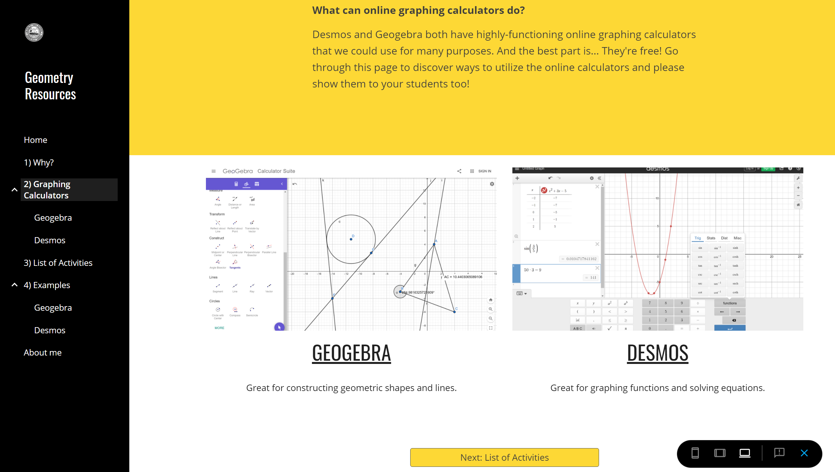
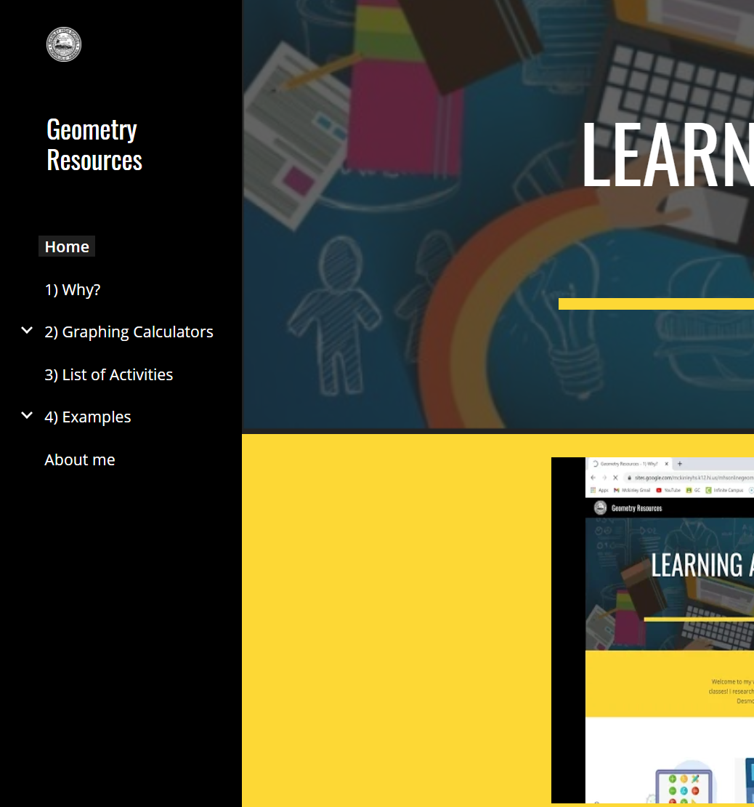
V1 to V2 Revisions
Separated pages for Geogebra and Desmos
Top to Side menu bars
Add “next” buttons

Slide 32
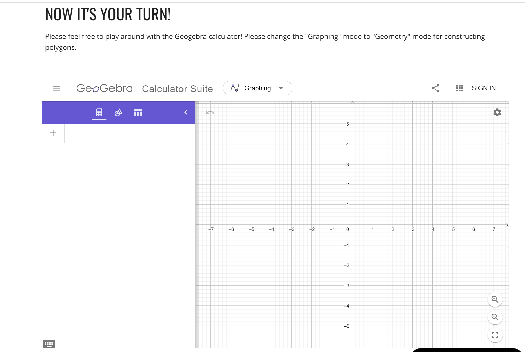
V2 to V3 Revisions
Embedded calculators
Added more info on some pages and fixed grammar.

Slide 33
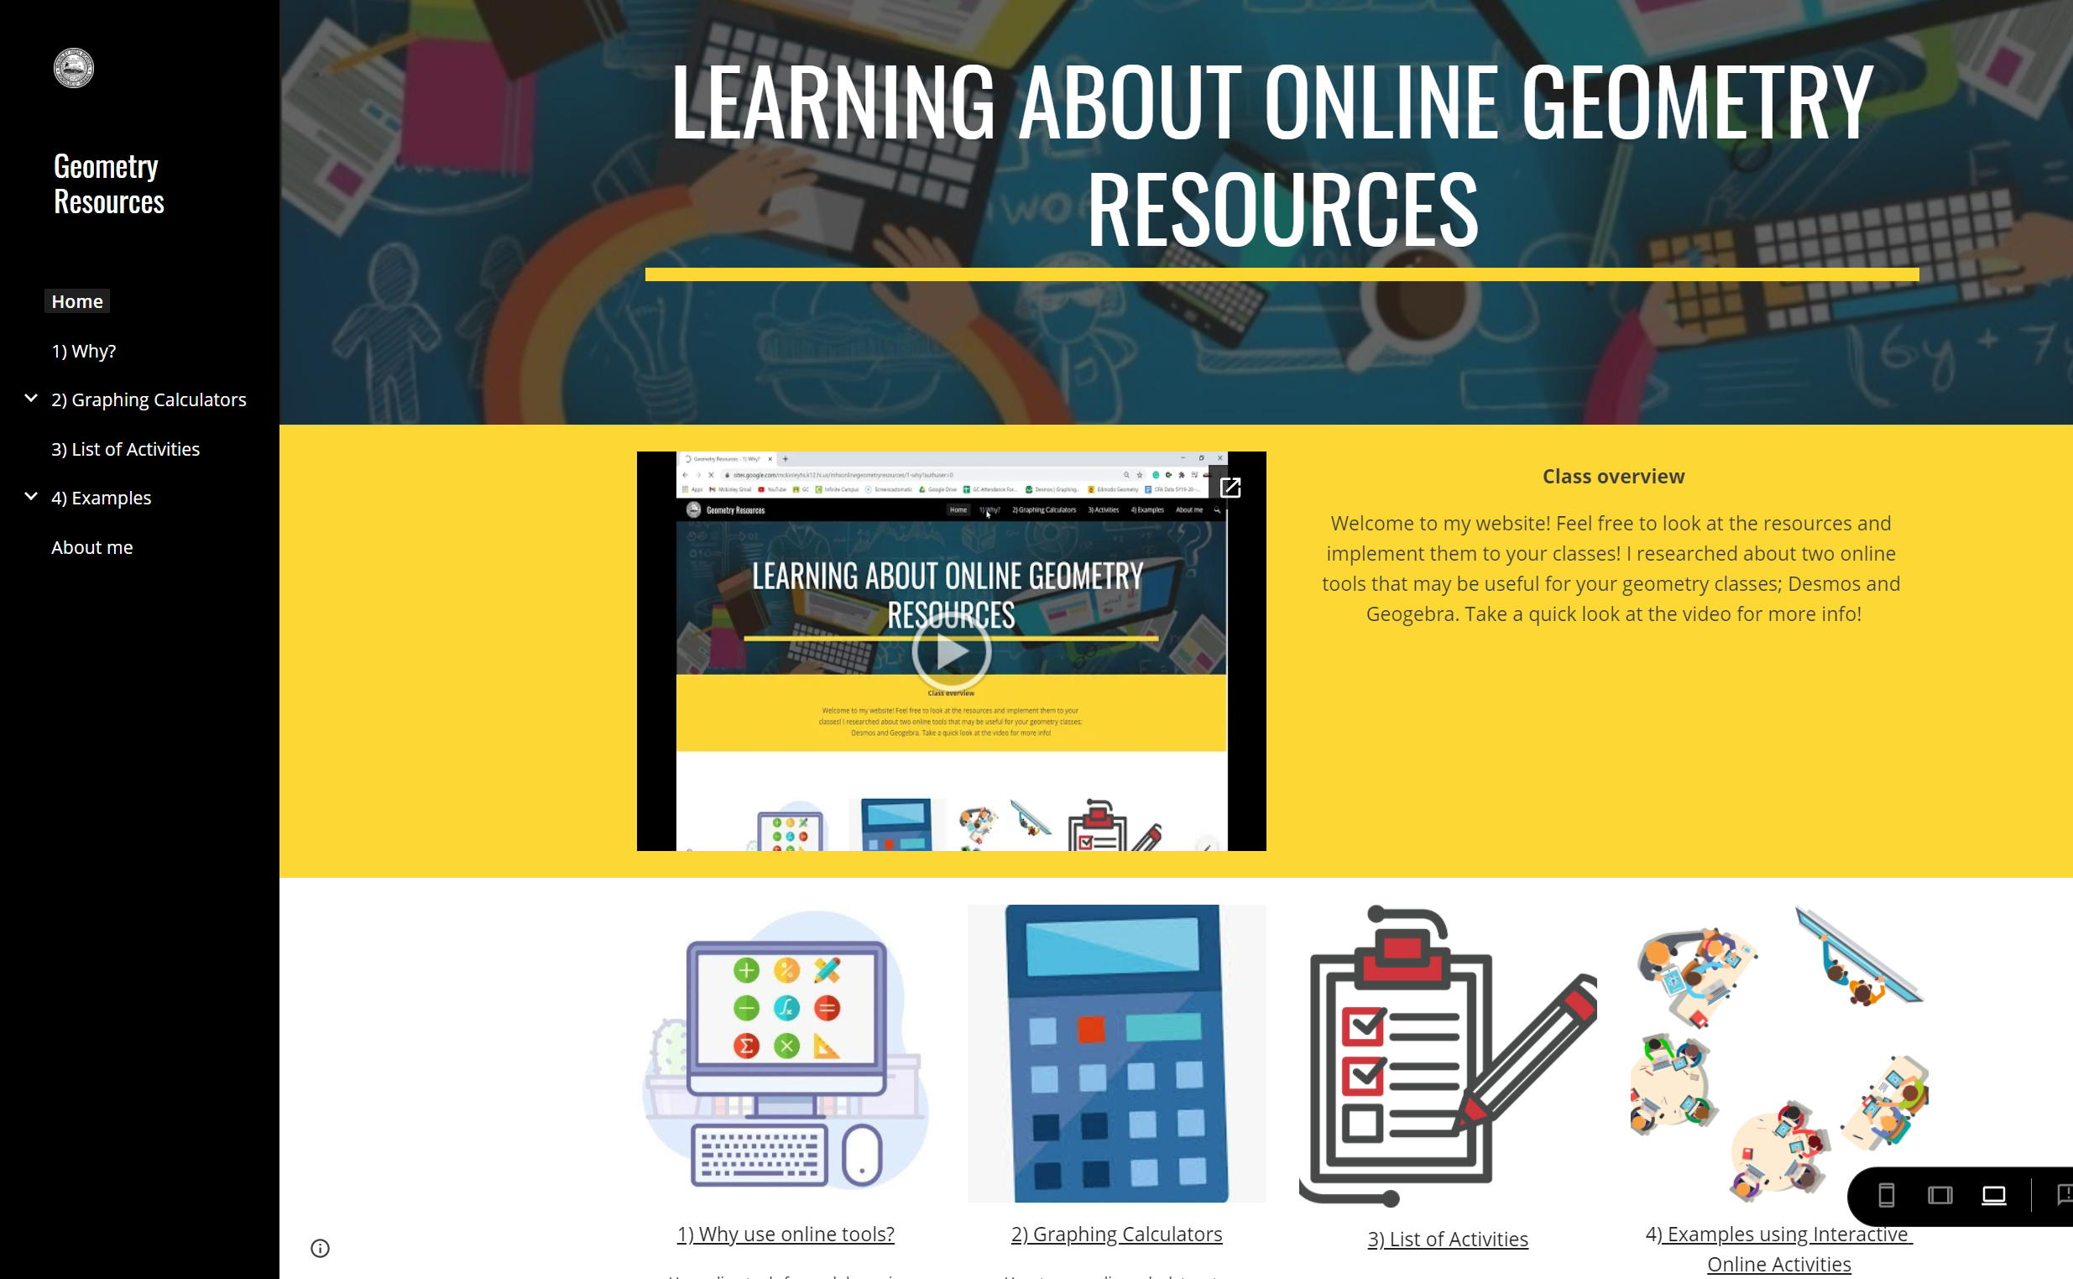
Positive Comments (n≥7)
Simple layout and pretty images

Slide 34
Positive Comments (n≥7)
Simple layout and pretty images
Geogebra videos interesting

Slide 35
Positive Comments (n≥7)
Simple layout and pretty images
Geogebra videos interesting
List of activities; don’t have to spend time searching from scratch

Slide 36
Positive Comments (n≥7)
Simple layout and pretty images
Geogebra videos interesting
List of activities; don’t have to spend time searching from scratch
Agree with reasons why online resources are useful

Slide 37
Negative Comments (n≤2)
Still lecture-based (watch video, read texts, etc.)
Still reluctant to use unless they use resources themselves
Fix grammar/layout (bullet points/blank spaces)

Slide 38
Negative Comments (n≤2)
Still lecture-based (watch video, read texts, etc.)
Still reluctant to use unless they use resources themselves
Fix grammar/layout (bullet points/blank spaces)
Solution: Add “Let’s try it together!” page

Slide 39
Discussion

Slide 40


Challenges
Content Layout/Navigation
Participants not watching video
Deciding amount of text

Slide 41
Challenges (con.)
Plan ahead
Sharing options
Organization

Slide 42
Success
Positive results overall
Gained more knowledge
Usable website for future!

Slide 43
Future Thoughts
Other math courses?
For students?

Slide 44
Thank you!

