Slide 1
FROM OBLIVION
TO HOSTS TO THE WORLD
IN 20 YEARS:
KOREAN SIGN LANGUAGE AND ITS SPEAKERS
~ ~ ~ ~
Kang-Suk Byun & Marilyn Plumlee
ICLDC-7
“Recognizing Relationships”
University of Hawai`i – Honolulu, HI
[virtual conference]
~ ~ ~
March 5, 2021 -- 8:45-9:15 pm (HST)

Slide 2
Overview of Presentation
1. Introduction: Role of serendipitous encounters
2. Chronological stages in the KSL story 2000-2019 [see handout for more detailed account]
3. Factors driving evolution 2000-2019
Linguistic research & insights nurtured community activism
Community supported & embraced linguistic activities that fostered pride and Deaf identity
4. Current status/current issues
5. 2020-2023 New Wave in lead-up to WFD 2023 in Korea
Reflections & future perspectives for KSL and the Korean Deaf community: hopes & challenges
6. Selected references by Koreans on KSL/Sign language linguistics

Slide 3
Serendipitous Encounters → Relationships
The KSL story and the story of the Korean Deaf community 2000-2019
illustrates:
  the RANDOMNESS of historical development
  the IMPORTANCE of “seeding” & incremental change
  Each RELATIONSHIP adds a DIFFERENT ELEMENT
  to the direction of change
  → RELATIONSHIPS as the DRIVERS of EVOLUTION

Slide 4
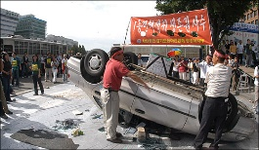
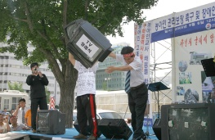
Milestones in KSL Research & Status
1983 1990s // 1999 2002 2004 2006 2007
Kim Kim SL Interpretation Naz.U – SL ITP dept. Daum Deaf TV Natl certification KAD protests for
Seung-suk Chil-Gwan Center estb KNUW – SL ITP dept KS to MPI KSL interpreters full TV captions
KS meets M & news interpreters
KEY: BLUE = personal network of relations BLACK = institutional developments
KAD = Korean Assoc. of the Deaf; KSL=Korean Sign Language;
KNUW=Korean National University of Welfare
ITP = Interpreter,
MPI= Max Planck Insitute for Psycholinguistics (Nijmegen, NL)
UZ = Ulrike Zeshan (SL linguist/researcher)

Slide 5
Initial Serendipitous Encounters
1998: Germany/Korea
Sung-Eun Hong (Hamburg) – Kang-Suk Byun data
2002: Korea/USA
Kang-Suk – Marilyn (Deaf student retreat)
Koreans to Deaf Way II in D.C.
Se-Kyung Kim (ABD-Rutgers U.) – Kang Suk & Marilyn
SK/KS/M: KSL Linguistics group (weekly)

Slide 6

THE CIRCLE EXPANDS→ Europe (NL)
Spring 2003. Ulrike Zeshan posts on LinguistList: searching for native signers of under-researched SLs to join in a research project at the Max-Planck-Institute for Psycholinguistics in Nijmegen, NL.
M sees the post & nominates KS;
Ulrike contracts KS for 1 year as a collaborator on her project at MPI
Jan. 2004. KS moves to Nijmegen to join MPI & the int’l SL research team on typology under the direction of Ulrike (team consists of native signers of German, Russian, Turkish, Ind0-Pakistani SLs)

Slide 7
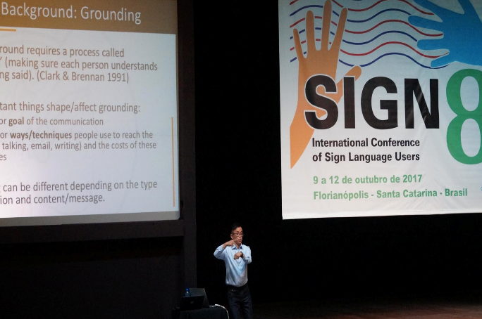
Korean Deaf linguist (KS) linguistic training & int’l contacts expand
  2008 SIL-Univ. North Dakota (Albert Bickford)
  2012 MA Linguistics (Korea)
  2014 MPI PhD Research student (cross-signing fieldwork)
  Publications (cross signing, w/de Vos, Bradford, Zeshan, Levinson)
  Speaker at international conferences
    2013-17 SIGN 6, 7, 8 in India, China & Brazil
    2015 Deaf Academics Symposium in Belgium
    2016 TISLR-12, Australia (poster presentation)
    2019 Paris WFD (2 poster presentations)
  2008 Teaching at KNUW & since 2018 at Kangnam University
  2019 Dandelion Co. estb. (Deaf culture & KSL digital events, blogs &
  offline publishing)

Slide 8

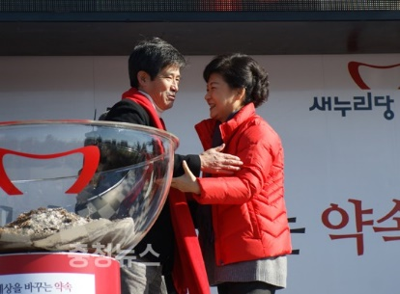
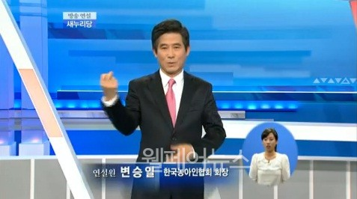
Meanwhile, back in Korea…
RELATIONSHIP MILESTONES 2008-2023
2008 2012 2013 2015 2016 2019 2021 2023
KAD 1st initiative KAD pres. meets Park Park becomes Start Corpus KSL Law WFD votes KSL Day WFD
to draft KSL Law presidential candidate Korea president at NIKL Feb.. 3 Korea to host Feb. 3 estb. Congress
2023 Congress [Naver meme]
-KSLIA Assoc.
-Dandelion estb.

Slide 9
→Expansion of Interpreting Services for Deaf Koreans
From 2006: National interpreter certification
(1,817 certified, of which 784 Deaf)
Ministry of Health & Welfare funded expanded
interpreter services, creating a strong network
  220 interpreter service locations in 2021
  Staff of 5 at each center (more staff for larger cities)
    1 Deaf director
    3 hearing interpreters
    1 Deaf interpreter

Slide 10
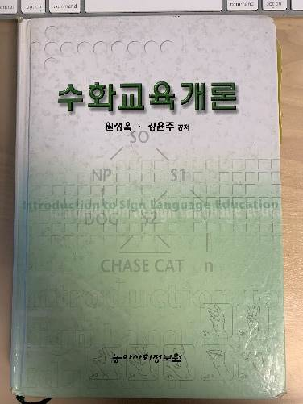
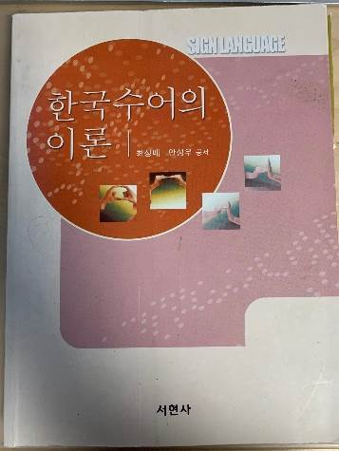
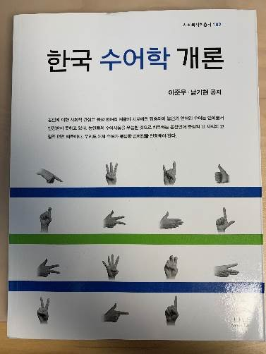
→ Books on KSL Published
2002 Introduction to Sign Language Education
2003 Theory of Korean Sign Language
2014 Introduction to Korean Sign Language Linguistics

Slide 11
→ Linguists & community actors mutually supportive
Korean Deaf Community
Linguistic KSL Research
DOMESTIC
2014 Deaf online media: Daum-1 café anchor woman Eunyoung Lee helps in recruitment of Deaf participants for KSL corpus project
KAD pres. convinces pres. candidate
Park Geun-Hye to support KSL Law
INTERNATIONALLY
6 Korean Deaf women go to
Denmark for 1 year int’l Deaf youth
leadership program (Frontrunners)
DOMESTIC
KS completes MA, KSL morphology
KSL Corpus work begins (2015)
KNUW faculty Won S-O & Heo Il active KSL research & corpus work
3-version dictionary project (Heo Il)
INTERNATIONALLY
Hong S-E completes Ph.D. in Hamburg, Germany on KSL
agreement verbs (2013)

Slide 12
KOREAN SIGN LANGUAGE ACT, 2016
KSL obtains co-equal status to Korean language (Hong et al. 2019)
Ministry of Culture, Sports & Tourism responsible for implementation
  KSL projects administered & supervised by National Institute of Korean Language (pre-existing institution)
Provides substantial budget increase in support of KSL
  KSL classes for the general public
  KSL linguistic research
  KSL-Korean dictionary project (pre-existing project)
  KSL corpus project (expansion of pre-existing project)

Slide 13
After-effects of 2016 KSL ACT
EMPHASIS on EXPANDED TEACHING of KSL
Target: general public & potential interpreters
Regional branches of Korean Assoc. of the Deaf (KAD) teach KSL
Seoul KAD branch registered 68,445 enrolled learners from 2009-2019
3 regional branches provide 4-month training & certification of KSL teachers (Deaf, CODA & proficient hearing signers)
  Gangwon-do, Chungcheong-do, Gyeongi-do
  Seoul Metropolitan gov’t supports Seoul Assoc. of Deaf to teach KSL
University KSL interpreting programs re-configured to train teachers of
KSL:
Nazareth Univ: retained SL interpreting BA;
new SL teacher training MA
KNUW: [interpreting BA dropped]
converted to SL teacher training BA
Kangnam Univ.: SL Interpreting & SL Teaching MA (est. 2017)

Slide 14
KSL ACT 2016 after-effects… (2)
All KSL projects under authority of pre-existing National Institute of Korean Language, Special Languages Department
  One CODA* as manager
  Deaf members of advisory board
  BUT→ No Deaf people in positions of authority
  *CODA = Child of Deaf Adult (hearing person, native signer from
  childhood)

Slide 15
KSL ACT 2016 after-effects…(3)
Positive views in Deaf community
Negative views in Deaf community
Pride of Deaf community increased
KSL research increased (more funding)
More opportunities to discuss KSL
2021 Korea declared an annual national Sign Language Day (February 3)
[Hangeul Day already exists]
Ministry of Culture, Sports & Tourism wields control →
Ministry has limited understanding of SL, SL linguistics or Deaf culture
Definition of “KSL”: “Signed Korean” vs. natural sign language→ Conflict between “official” signing & community’s natural signing
Limited opportunities for Deaf to contribute to KSL research & initiatives
No substantial change in life of Deaf Koreans (Lee M-H. 2020)

Slide 16
REFLECTIONS FOR THE FUTURE:
2021 – 2023 Challenges & New Wave
Deaf linguist with PhD→empowered to have bigger impact on hearing interlocutors
Interpreter certification test still strongly under influence of “signed Korean” due to non-linguist board members (government reps; Deaf people; hearing people with special ed & social work background)
WFD Congress in Korea anticipated impact:
  raise prestige & awareness of Asian Deaf accomplishments among world Deaf
  strengthen working relationship between KAD & WFD & int’l Deaf leaders
  increase Deaf Koreans’ awareness of int’l. discussions on Deaf rights, education, linguistic research, Deaf performing artists, etc.

Slide 17
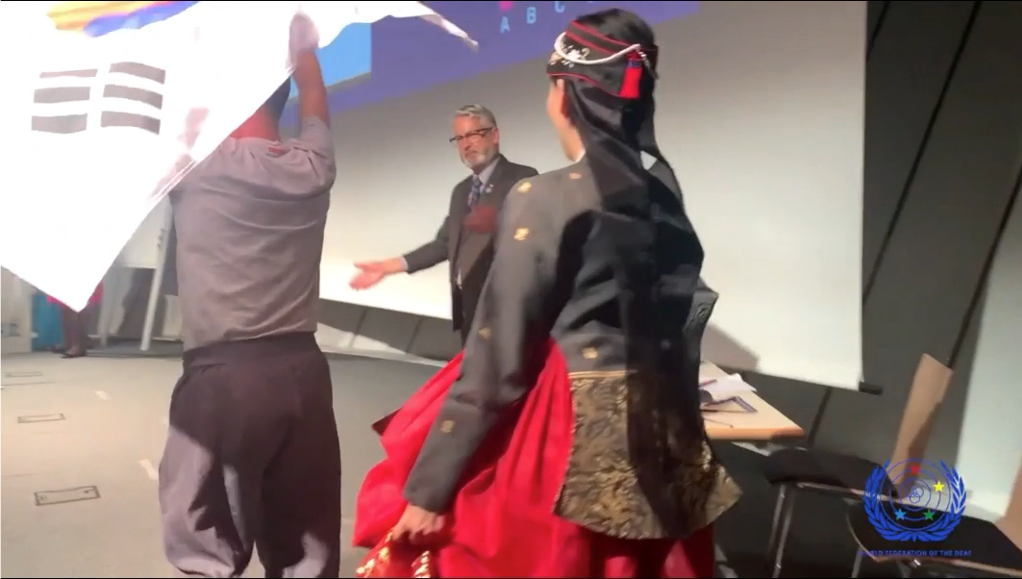
At WFD XVIII in Paris in 2019,
KOREA selected as host of next
WFD World Congress XIX in 2023

Slide 18
Serendipitous Encounters→Relationships→Evolution
“HISTORY” appears as “destiny”, a tale of inevitable
development over time when looking back from the
present.
But the “KSL STORY” is the story of many chance encounters & synergies engendered over the past 20 years.
What grew out of these chance encounters reveals that history is shaped by “working our relationships” rather than “destiny”.
WELCOME TO WFD in KOREA - 2023!

Slide 19
SELECTED REFERENCES by Koreans, about KSL/Sign Language Linguistics
Byun, K-S. [2021, anticipated]. Establishing intersubjectivity in cross-signing. [Doctoral thesis]. Radboud University/MPI. Nijmegen, The Netherlands.
Byun, K-S. 2012. The grammaticality of the A-handshape & the I-handshape in KSL: Regarding gender realization & verb classification. [MA thesis]. Chungnam University, Daejeon, South Korea.
Byun, K-S. 2007. Becoming friends with Korean Sign Language. Cheonan: Chungnam Assoc. of the Deaf. http://hdl.handle.net/11858/00-001M-0000-0029-3308.5
Byun, K-S., C. de Vos, A. Bradford, U. Zeshen, S.C. Levinson. 2018. First encounters: Repair sequences in cross-signing. TopiCS:10,2. 314-334. doi.org/10.1111/tops12303.
Choi, SB & SW Ahn. 2003. Theory of Korean Sign Language. Goyang: Seohyunsa.
Hong, S-E. 2008. Eine empirische Untersuchung zu Kongruenzverben in der Koreanischen Gebaerdensprache [An empirical investigation of agreement verbs in Korean Sign Language] [Doctoral thesis.] Univ. of Hamburg.
Hong, S-E. 2003. Empirical survey of animal classifiers in Korean Sign Language (KSL) [based on MA thesis]. Sign Language & Linguistics 6:1, 77-99.

Slide 20
REFERENCES cont’d.-2
Hong, S-E, H. Lee, M-H. Lee, & S-I Byun. 2019. The Korean Sign Language Act. In M. DeMeulder, J.J. Murray, & R.L. McKee, eds. The legal recognition of sign languages. Multilingual Matters, ch. 2.
Hong, S-E. S. Won, I. Heo, & H. Lee. 2018. Development of an integrative system for Korean Sign Language resources (ISKSLR). IREC 2018. www.sign-lang.uni-hamburg.de/lrec2018
Hong, S-E., S. Won, I. Heo, H. Lee. 2015. Raising awareness for a KSL corpus among the Deaf community. lrec-conf.org/workshops/lrec2018/W1/pdf/18008_W1.pdf
Lee, S.W. & K.H. Nam. 2014. Introduction to KSL Linguistics. Paju: Nanam.
Lee, M-H. 2020. A research on the enactment of the Korean Sign Language Act & the guarantee of language rights of the Deaf: Focusing on the perception of the affected Deaf people and the remaining tasks of the law. [PhD thesis]. Seoul: Kangnam University.
Republic of Korea[ROK]. Ministry of Culture, Sports & Tourism. Korean Sign Language Act. 2016. https://www.law.go.kr
Won, S-O. & Y-J. Kang. 2002. Introduction to Sign Language Education. Seoul: Deaf Info. Service
World Federation of the Deaf. 2019. Announcement: Countries which will be considered to host the XIX World Congress of the World Federation of the Deaf (2023). www.wfd.org

Slide 21
THANK YOU!! MAHALO!
감사합니다
~ ~ ~
Kang-Suk Byun
ithinkksl@gmail.com
Marilyn Plumlee
marilyn.plumlee@nu.edu.kz

