Slide 1

Fieldwork via mobile interviewing during
Covid-19: a case study of Kanauji
Anu Pandey
PhD student
Indian Institute of Technology Kanpur
ICLDC -7

Slide 2
ROADMAP
1. Effect of Covid-19 on fieldwork
2. Advantages & Disadvantages of telephonic interviews
3. Ethics & Dynamics of mobile interviews
4. Mobile Interview fieldwork: case study of Kanauji
5. Methodology
6. Informed consent, Details of Interview
Dynamics of smooth mobile interviews
Collaborations, Podcasts & revitalization
9. Challenges & tackling
10. Conclusion

Slide 3
Effect of Covid-19 on fieldwork
Research involving fieldwork got delayed due to the enforcement of nationwide lockdown measures, and isolation policies.
Field research through human surveys was not possible, this led to revision in methodologies for field research for many graduates.
Various kinds of virtual modes of data collection started being employed, like- skype interviews, zoom conferencing and interviews, telephonic and WhatsApp interviews.
These digital modes served as an efficient alternative mode of data collection through informants who had access to mobiles or computers.

Slide 4
Advantages of Telephonic Interviews
Telephonic interviewing has been popular in healthcare research for several decades.
Robinson (1993) points out that telephonic interviews share with face-to-face interviews: high response rate, opportunities to correct misunderstandings etc.
He also talks about added benefits provided by such interviews- lower cost ( time, effort and money), low tendency to fabricate responses, the neutralization of observer’s paradox etc.
It has also been discussed that telephonic surveys/ interviews offer a higher sense of personal security and safety among the interviewer and the interviewees. Thus, this justifies the efficacy of such interviews in nursing and healthcare research ( Marcus & curie (1986)).

Slide 5
Disadvantages of Telephonic interviews:
Engaging a participant in a telephonic interview for longer duration may cause fatigue to either parties. Such burden is profound especially at the old age.
(Herzog & Rodgers, 1988; Werth & Trenery 1993).
The role of imbalance of power in a telephonic interview may create anxiety in the interviewees, this can be normalized by letting the interviewee’s set the pace of the interview and not asking over-complex questions. (Hopper 1992; Werth & Trenery 1993)
Nowadays, people have shifted to mobiles for long distance-communication replacing telephones owing to their mobility and applications. With mobiles, it is important to have good network connections, to achieve clarity in exchange of information throughout the interview.

Slide 6
Ethics in
Cold calling i.e calling as a stranger has been extensively used for commercial purposes in UK, which raised concerns regarding the intuitiveness of the telephonic interview method. (Smith,2005) It is unethical way of infringing upon someone’s privacy.
Mobile contacts of the concerned informants are procured, necessary documents are prepared and sent in advance to the informant via WhatsApp or Gmail. These documents include :
(a) Informed consent sheet (b) Details of the interview sheet
(c) Sample of the Interview Questionnaire
Detailed guidelines should be given in the documents regarding the type of research.
A pre-call should also be made before the main interview to check the participants’ agreeableness for the proposed participation to the interviews.
Mobile
Interviewing

Slide 7
Dynamics of smooth mobile interviews
Before the telephonic interview, it is important to charge our mobiles in advance lest the call is interrupted due to insufficient battery causing embarrassment to the researcher.
Each interview should be made at scheduled time and start with some ice-beakers by the interviewer to make the informant/participants comfortable. Certain general greetings can be used for the same as in – How are you ? , How is it going ? etc.
The interviewer should keep track of the mood of the consultant. If it appears that the informant is getting bored or tired, one can digress from the interview topic and have informal chat for a while. Sometimes it is best to postpone the interview session.

Slide 8
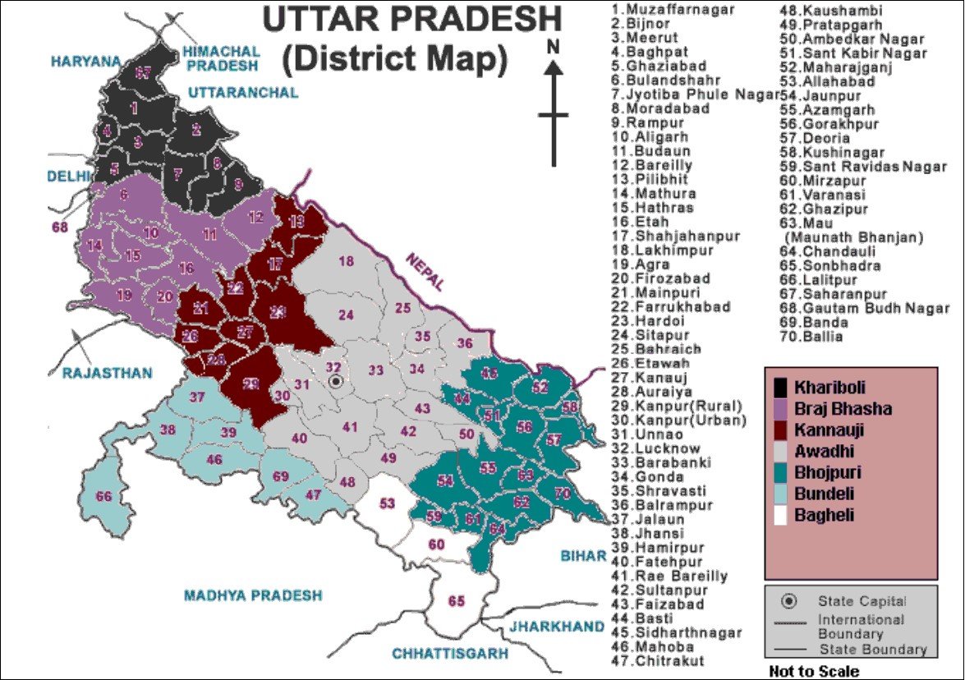
KANAUJI
Kanauji is a dialect of western Hindi spoken by around 9.5 million people presently, still it remains a sparsely documented variety.
Kanauji is spoken in districts of Kanpur, Farrukhabad, Etawah, Hardoi, Shahjahanpur, Pilibhit, Mainpuri and Auraiya districts of Uttar Pradesh (Ethnologue (2018)).

Slide 9
Mobile-interview-fieldwork: case study of Kanauji
METHODOLOGY
Step1: Informants belonging to different Kanauji speaking regions like- Kanpur, Kanauj, Farukkhabad, Mainpuri, Itawa, Auraiya etc. informants from each place, their mobile numbers were collected through known sources.
Regions | Kanpur | Kanauj | Farukkhabad | Itawa | Auraiya
Gender | Male | Male | Female | Female | Female
Age | 19 | 26 | 32 | 45 | 39
Name | Sanjay Mishra | Alok Trivedi | Rani Katiyar | Kalpana Dwivedi | Shivani Gupta
Step 2: These documents were sent to the informants- informed consent, details of the interview sheet, questionnaire prior to the main interview.
Step 3: Many participants had queries regarding the purpose and mode of research which were resolved subsequently. Confirmation of interview slots over WhatsApp or calls were done.

Slide 10
Step 4: The interviews begin with informal-greetings and explaining the informant what to expect from the questionnaire. A questionnaire consisting of 45 sentences in Standard Hindi was asked to each of the informants and elicitation of sentences in Kanauji was made over mobile calls.
Step 5:During the course of the interview, whenever there were discrepancies in interviewee’s understanding, the interviewer had to reexplain and give suggestive examples. Grammaticality judgements were also taken at various times.
Step 6: The interviews ended with an expression of gratitude via giving money or gifts as a way of expressing thankyou to the informant. Gifts were delivered either directly or through people who were acquainted to both informant and researcher.

Slide 11
Informed Consent
I volunteer to participate in a research project conducted by Anu Pandey from Indian Institute of Technology, Kanpur, UP.
As a part of this project, the researcher will document Kanauji in as many genres and domains of the language as possible. She will study the phenomena of interrogatives/questions in Kanauji through the data she will collect. She will document this data through questionnaires via mobile interviews.
I understand that the project is designed to gather information about a research topic of a PhD student on campus. I will be one of approximately 10 people being interviewed for this research.
My participation in this project is voluntary. I understand that I will be paid money or given a gift as compensation . I may withdraw and discontinue participation at any time without penalty. If I decline to participate or withdraw from the study, no one in my village/city will be told. If I feel uncomfortable in any way during the interview session, I have the right to decline to answer any question or to end the interview.
Participation involves being interviewed by a researcher from Indian Institute of Technology, Kanpur. The interview may last approximately 45 minutes to 1 hour. The researcher may take notes or make recordings.
If I want, I may become an anonymous consultant of the project. The data stored by the research will not contain my identity. But she may use a direct quote from my recordings without revealing my identity. I have read and understand the explanation provided to me. I have had all my questions answered to my satisfaction, and I voluntarily agree to participate in this study. I have been given a copy of this consent form.
____________________________ ________________________
My Signature Date
____________________________ ________________________
My Printed Name Signature of the Investigator

Slide 12
Details of the interview
I am willing to participate in mobile-interview-sessions with Anu Pandey related to her PhD research project.
I have received the documents pertaining to the interview from her and agreed upon the same.
I am available on the following dates and time for interviewing -
Date 1 : Time slots:
Date 2: Time slots:
The finalized date and timeslots will be confirmed with her via WhatsApp. I have been given a copy of this details of interview sheet.
____________________________ ________________________
My Signature Date
____________________________ ________________________
My Printed Name Signature of the Investigator

Slide 13
Collaborations
Fostering multi-party relationships is the need of the hour to fight the critical challenges of the “endangered language crisis”. Certain collaborations involved with documenting and doing fieldwork on Kanauji include:
Group 1: Linguists who want to learn structures of Indo-Aryan languages.
Group 2: Linguists specifically working on Kanauji as part of research projects or Phd Scholars.
Group 3: People interested in promoting Kanauji culture and folksongs. These are mostly native speakers who upload their videos on social media as well.
Group 4: Native speakers of Kanauji who are interested in helping with the Kanauji language documentation work.

Slide 14

7. Podcasts and revitalization
The focus of our research is ‘interrogatives’ in Kanauji. Kanauji speakers had Hindi as their second language and contact language with the researcher
Texts were designed as ‘Scripted Conversations’ where two or more native Kanauji speakers were asked to interact and record their conversations in Kanauji by giving them scripts that involved question-answer exchanges on various topics in Hindi.
These recordings were then used to make Podcasts via Android application-‘Anchor’ and distributed over podcasting applications. Thus, giving back to community and assisting in revitalization.
Podcasts is called “Rituals of Kanauji speakers”, which features questions-answers regarding some festivals -Guriya, Govardhan pooja, chahht pooja etc. among two Kanauji native speakers in kanauji followed by English translations .
The link to the podcast: anchor.fm/anu-pandey2

Slide 15
Challenges & tackling
a) Interruptions during the call:
Interruption during the interview-calls occurred due to network connectivity issues. It was found that some informants that resided in interior regions of rural areas did not have good network coverage. Secondly, in some cases the interruption was also caused by other family members of the informant, who might come to talk to him while ongoing session.
b) Disturbances during the interview:
Often there is a lot of background noise which makes it difficult in hearing the responses of the informant. Secondly, network connection problems also surface many times during the interview when connectivity line breaks and voice of the informant is unclear on several occasions, in such cases a request for repetition has to be made.

Slide 16
c) Feeling of fatigue and boredom:
It was important to keep the informant motivated by initiating short 1-2 mins informal-talks in between to relax the informant. Secondly, it was important for the researcher to keep on telling the interviewee in between time left , like 10 more minutes etc. to keep him motivated till the end.
e) Switching to mobile speaker:
One practical problem faced during mobile interviewing was that the informant and researcher felt tired of holding the mobile , so it switching to Speaker mode was feasible. Speaker mode had some more benefits as one could get grammaticality judgements from other family-members of the interviewee at the sometime.

Slide 17
Conclusion
The above case study demonstrates an alternative way of collecting language data apart from face-to-face-interviews in era of Covid-19. The advantages of this mode of data collection were that data was collected from faraway regions, without taking the pains to travel there, saving time, money and effort.
Secondly, it ensured social distancing of both the researcher and informants averts risks of catching Covid-19. More importantly, it rendered as good results as any face-to-face fieldwork interview.
Podcasts as teaching aids can bring a new change in field of adult education for endangered communities and might educate them on many day-to-day issues. It can surpass the barriers of literacy.

Slide 18
References
Block, Emily S. & Laura, Erskine. (2012). Interviewing by Telephone: Specific Considerations, Opportunities, and Challenges. In International Journal of Qualitative methods. 11(4)
Carr, C.J. Eloise & Worth, Alison. (2001). The use of telephonic interview for research. In Nursing Times Research. Vol 6, No.1. Pg. 511-524.
Hopper, R. (1992) Telephonic Conversation. Bloomington, Indiana: Indiana University Press.
Herzog, A; Rodgers, W.(1998) Interviewing older adults : Mode comparison using data from a face-to-face survey and a telephone survey. Public Opinion Quarterly 52. 84-99
Marcus, A., Crave L. (1986) Telephone surveys in public health research. Medical Care 24:2, 97-112
Robson, C. (1973) Real World Research. Oxford: Blackwell.
Smith, E. (2005). Telephone interviewing in healthcare research: A summary of the evidence. Nurse researcher. 12(3), 32-41
Thomas, R., & Purdon, S. (1994) Telephone methods for social surveys. Social research update issue 8. Retrieved June 20,2007, from the University of Surrey. Website: www.soc.survey.ac.uk/sru/SRU8.html
Worth, A; Tiernery, A.J. (1993) Conducting research interviews with elderly people by telephone. Journal of Advanced Nursing 18. 1077-1084

