Slide 1
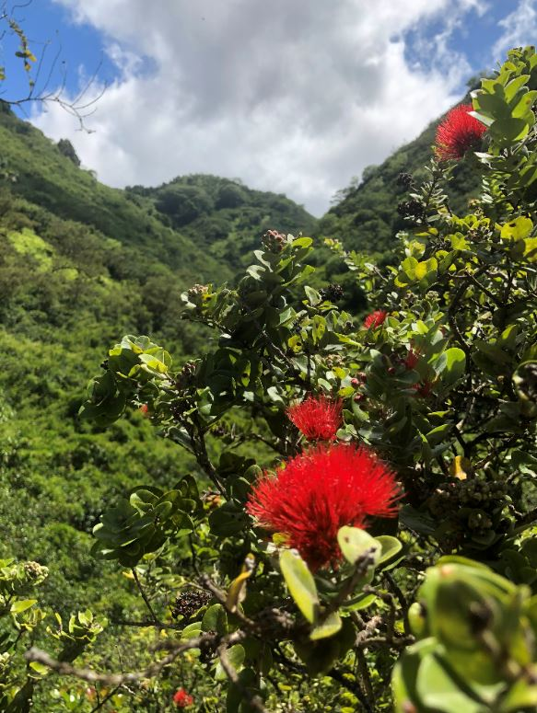
Maunalua Urban Forestry Stakeholder and Land Assessment for Tree Planting Initiatives
By Allyson Earl, Kilikina Luebbe, and Jessica Idle

Slide 2
Motivation
Deforestation and development in Hawai`i
Social and ecological benefits of trees and urban forestry
Malama Maunalua (MM) mission
  Conservation and restoration of Maunalua Bay
  Tree planting initiatives
Many urban forestry/conservation stakeholders
  Which are the best fit for MM?

Slide 3
Expected Results
Communicate with key stakeholders to understand individual stakeholders’ goals that can be combined to form a collective goal for Maunalua Bay
Create a table of stakeholder responses that can be used to identify key intervention points that align Malama Maunalua and collaborating organizations to where they will be most effective
Develop a map that highlights optimal areas for tree planting initiatives based on the priority social and ecological concerns of stakeholders
Identify specific land types and property where organizations can work together to achieve successful tree planting initiatives.

Slide 4
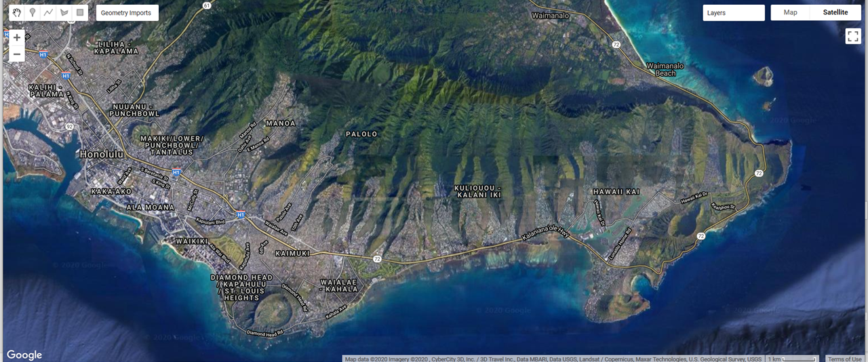
Methods: Mapping to Develop Priorities (3)

Slide 5
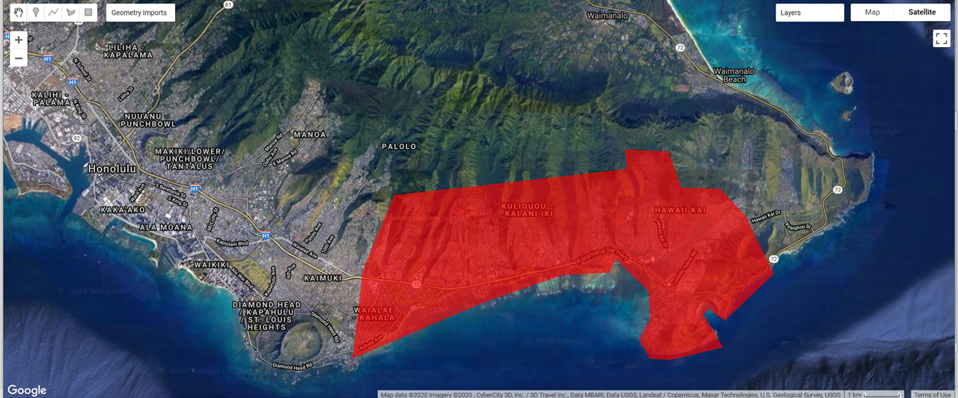
Methods: Mapping Extent

Slide 6
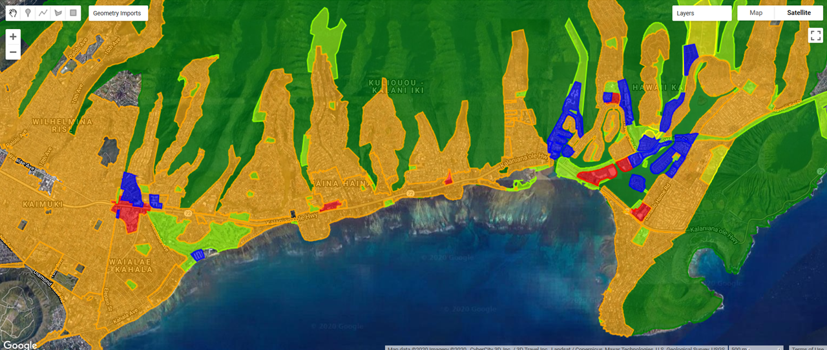
Mapping: Zonation

Slide 7
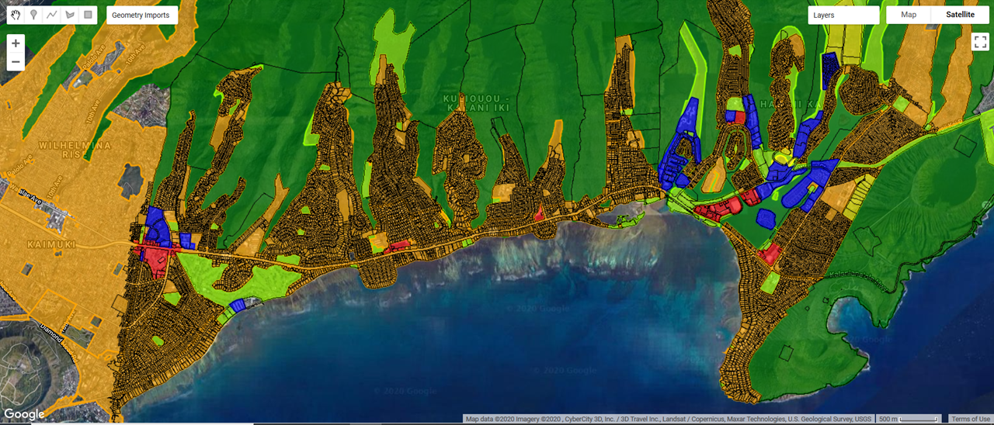
Mapping: Zonation + TMKs

Slide 8
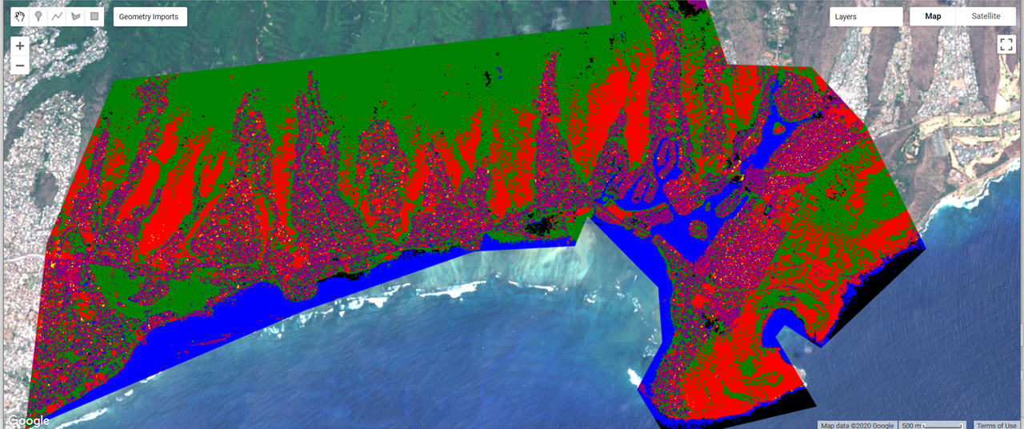
Mapping: Image Classifier
Red = Dry Vegetation
Green = Green Vegetation
Purple = Roads
Yellow = Houses
Blue = Water
Black = Shadow

Slide 9
Methods: Stakeholder Goals (1) and Responses (2)
Elicited organizations from MM, meetings with Heather (DOFAW) and Terri (CCH)
  STEW-Map
Found contact info for all identified organizations
Developed survey questions
Administered Google Forms survey
  First round on April 6, 2020
  Second round on April 23, 2020
Notes:
Once we could see the general areas that have little to no canopy coverage, we wanted to overlay that information with stakeholder and landowner information. In meetings with MM, Heather from DOFAW, and Terri with City and County of Honolulu, we elicited organizations that are either geographically located in Maunalua, or have a vested interest in urban forestry projects across the islands. The STEW-Map Heather showed us was particularly helpful, as a student had generated connectivity maps of organizations in the Maunalua area and improved our awareness of organizations we had not considered on our own. We then generated a list of many organizations and found their contact information. We also developed survey questions based on these meetings. We administered the survey via Google Forms for a first group of organizations on April 6th, and then a second group and a reminder for the first group on April 23rd.

Slide 10
Methods: Identify specific land types and property where organizations can work together to achieve successful tree planting initiatives (4)
Selected from organizations that participated in survey
Selected based on mapping that identified the property had low canopy coverage
Determined starting canopy cover (iTree)
Identified potential partners and planting considerations
Notes:
Lastly, we used the survey and mapping results to select a specific property that could greatly benefit from having a tree-planting initiative run on site and with the land occupant. We then used the iTree-Canopy tool to determine the starting canopy cover of the site, and the current environmental benefits of having such a canopy cover. Based on survey responses, we identified the organizations that may be the best fit for partners and certain considerations that would need to be included in a tree planting initiative at this site.

Slide 11
Results: Stakeholder Goals (1) and Responses (2)
Notes:
First, we will dive into the survey results.

Slide 12
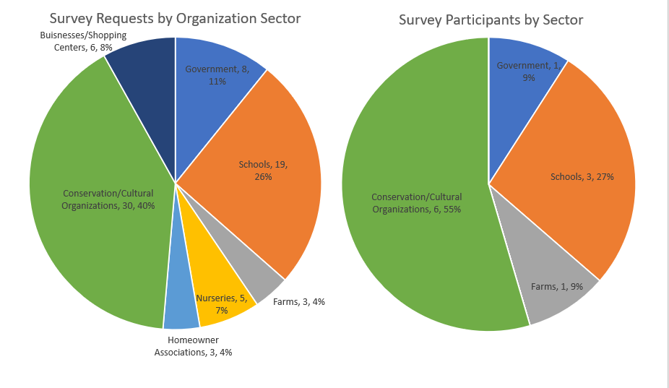
74 Survey Requests
11 Survey Participants
Notes:
Seventy-four organizations representing seven different sectors were contacted via email to complete our Urban Forestry Stakeholder survey. Eleven organizations from five different sectors responded to our survey. The bulk of our survey recipients and participants were from schools and conservation/cultural organizations. Survey recipients, survey respondents, and survey respondent responses are highlighted in the subsequent tables and figures.

Slide 13
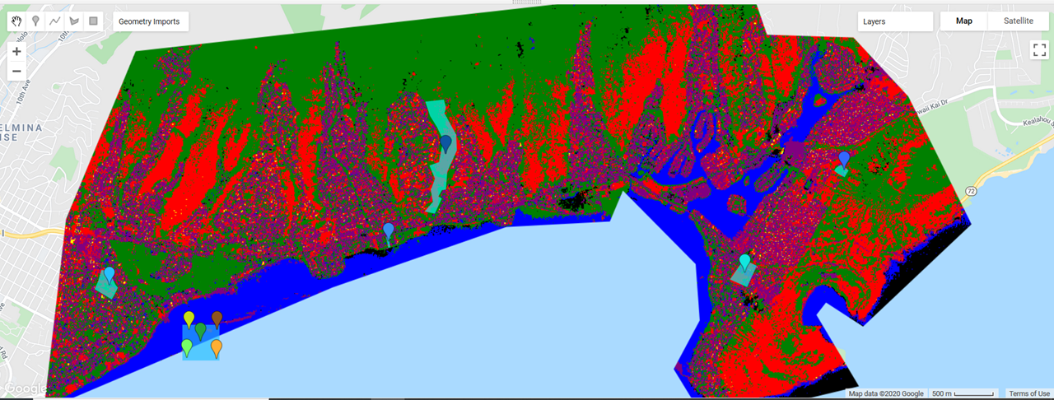
Mapping: Survey Responses
Pia Valley
Keki and Plow
Calvary by the Sea Montessori School
Kahala Elementary
Koko Head Elementary
Sierra Club
KMWP
Smart Trees Pacific
Hawaiian Islands Land Trust
DLNR/DOFAW
Notes:
The 11 survey participants were Kahala elementary, Protect and preserve Hawaii, Calvary by the Sea Montessori school, Keiki and Plow, Koko Head Elementary, Sierra club Oahu group and Sierra club, Koolau mountains watershed partnership, Smart trees pacific, Hawaiian Islands land trust, and DOFAW. Each organization were asked what their geographical extent was, and half of the organizations were limited to their property of occupancy, and the other half are island or state wide.

Slide 14
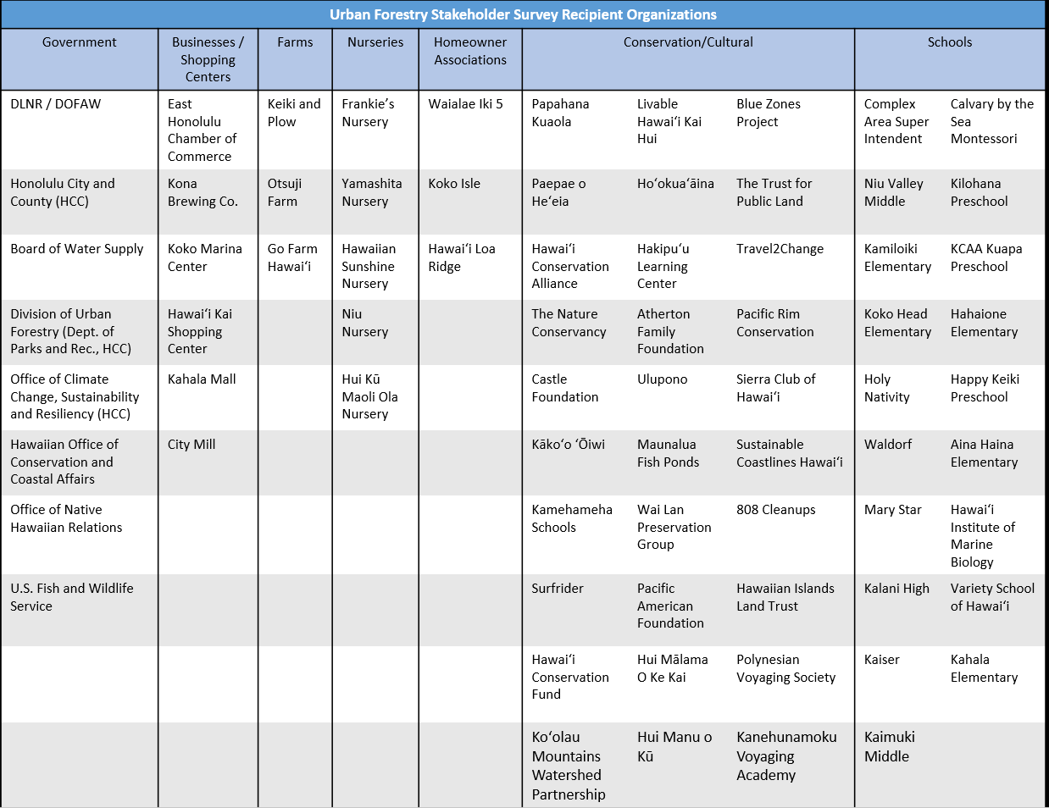
Notes:
This is a comprehensive list of all 74 organizations that we contacted organized by sector.

Slide 15
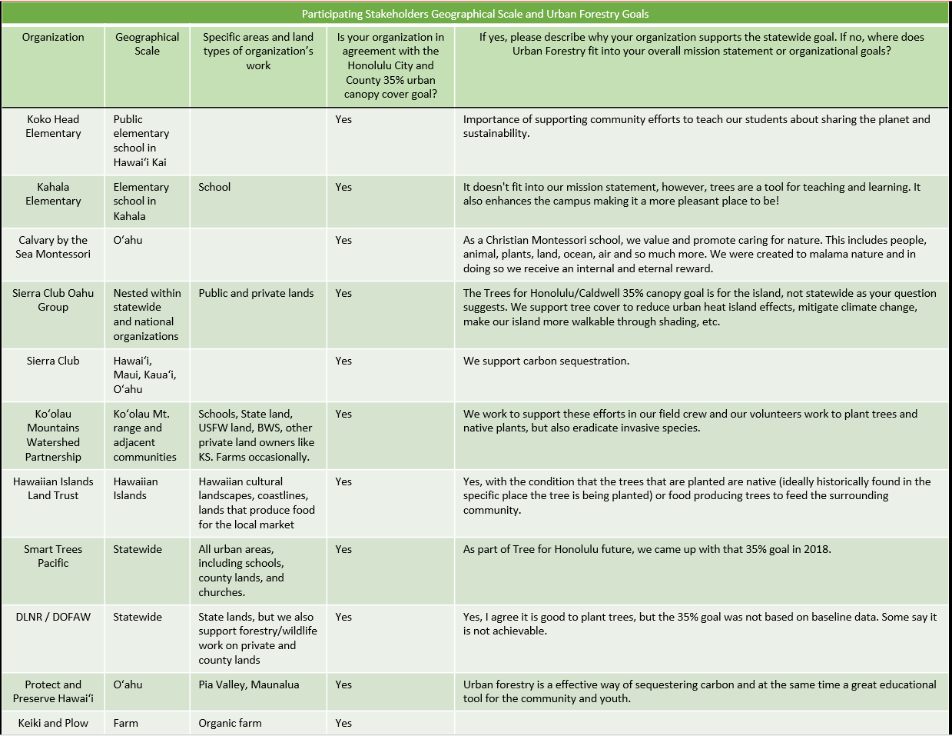
Notes:
We asked organizations about their geographical scale, and their urban forestry goals, to see if common goals for the maunalua area could be determined in the future. Their geographical scale ranged from state and island wide, to restricted to the property of the organization itself.
We also asked if organizations were in agreement with the CCH 35% canopy cover goal, and all organizations are in agreement with it. Most also have other adjoining goals that may align with MM, and can be seen more clearly in their responses.

Slide 16
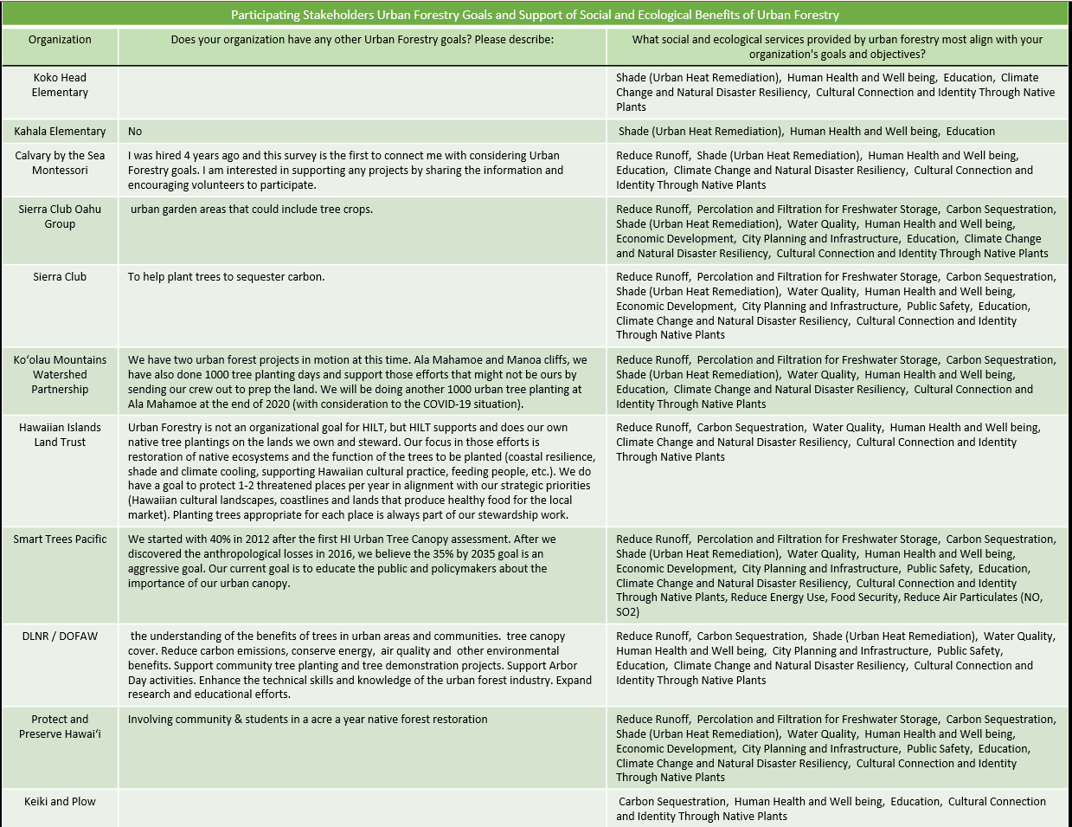
Notes:
We then asked if there were additional urban forestry goals for their organization, and most had additional or complimentary goals that expand or restrict their interest in tree planting initiative. We also prompted survey participants to select all that apply from a list of social and ecological benefits produced from increasing urban forestry. The list of services selected by each organization are included in the table, I will also summarize the responses more clearly in subsequent figures.

Slide 17
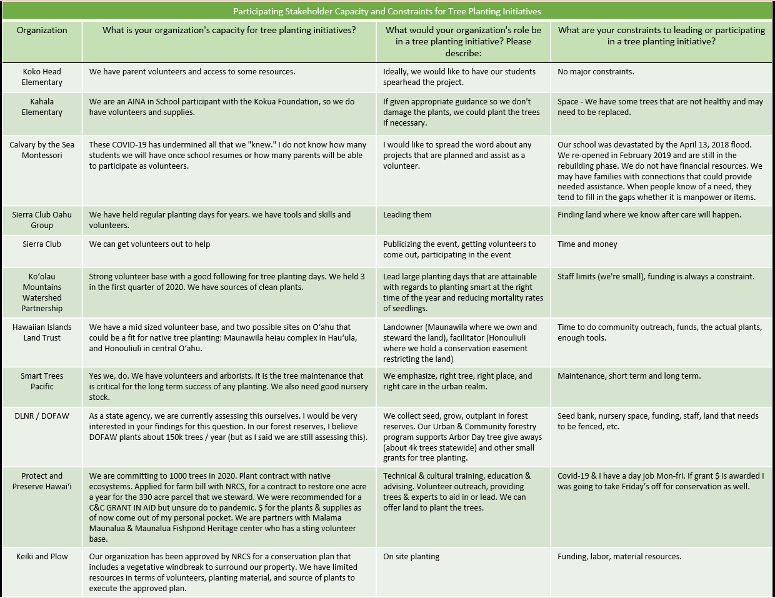
Notes:
Then we asked questions organizations about their capacity for tree planting initiatives, what their role would be in tree planting initiatives, and what their constraints to leading or joining a tree planting initiative would be.
Most organizations are very clear in what their strengths and limitations are, and MM can use this information to compile a team of partners that compliment each other in their strengths and weaknesses. As expected, funding and maintenance were the primary two constraints.

Slide 18
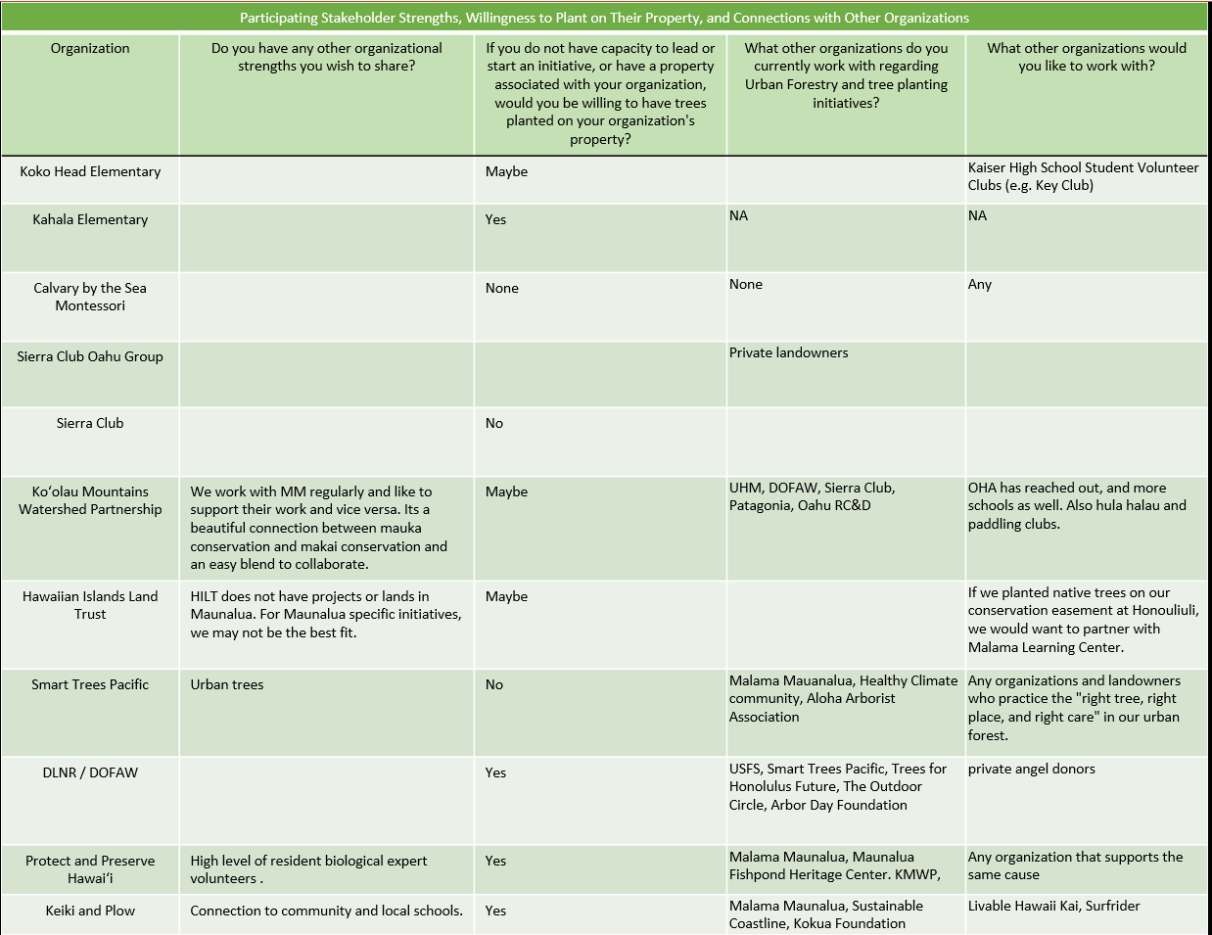
Notes:
Lastly, we asked organizations whether or not they would want trees planted on their property, and their current relationships with other organizations as well as future relationships they would like to have with other organizations. In our meeting with Heather at DOFAW she highlighted the importance of the STEW-map, which identifies the connections between organizations, and also helped us find organizations to send the survey to. Current relationships between organizations are important to integrate, as that can bring more resources and expertise to the table.

Slide 19
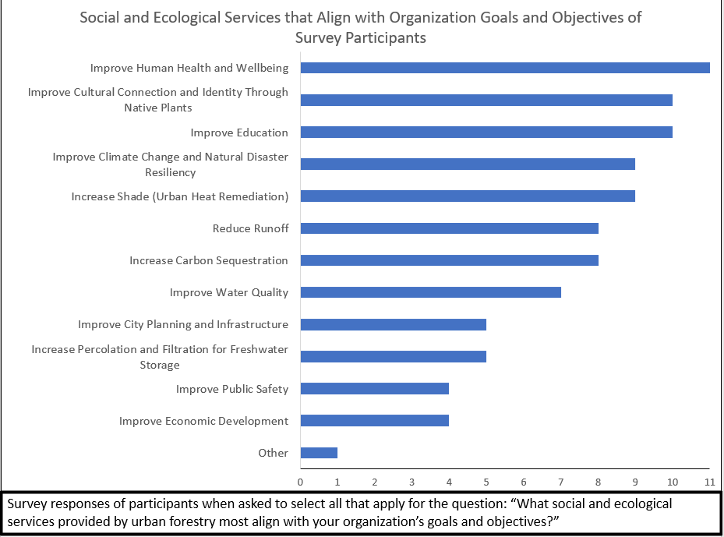
Notes:
Survey responses of participants when asked to select all that apply for the question: “What social and ecological services provided by urban forestry most align with your organization’s goals and objectives?”
The intent of this question was primarily to better understand each organization’s values as far as urban forestry goals, but when we look at the responses collectively like this with each service getting a number of “votes”, we can also see the general importance of these services across organizations and sectors, which could even be generalized to represent the primary values of the public in Maunalua. Here we found that improving human health and wellbeing, improving cultural connection and identity through native plants, and improving education were the top three services most voted by participating organizations. This does not necessarily mean that these services are most important, as we did not ask organizations to rank the services in order of importance, but it does show that these top services are collectively important to most or all of the participating organizations.
Services with the most votes are different than what we expect Malama Maunalua’s primary ecosystem service benefits are, which highlight a need to integrate these benefits into coordinating partnerships and marketing/advertising to the public for their participation.

Slide 20
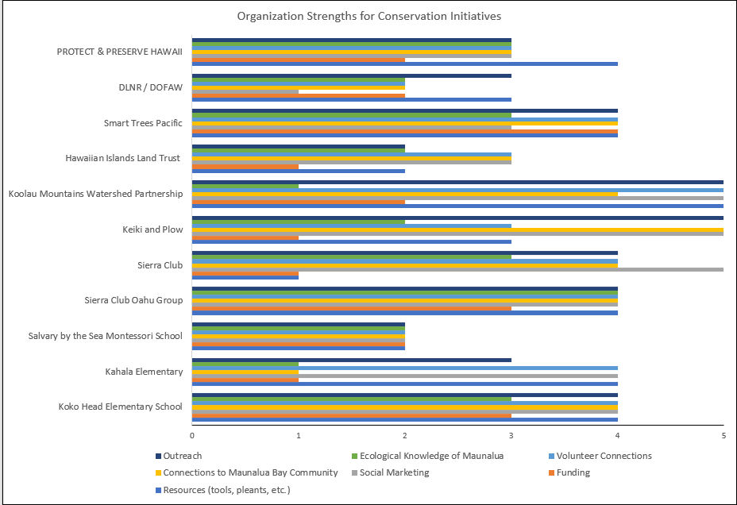
Notes:
Survey responses of participants when asked to rate the strengths of their organization on a rate of 1 (Unable to provide/Not applicable) to 5 (Our organization’s best component!) of various components that are essential to successful tree planting initiatives.
While a bit of an overload, this graphic highlights the strengths of each organization, and if you focus on one particular color, you can determine which organizations have the greatest strength in that particular component that is essential to tree planting initiatives

Slide 21
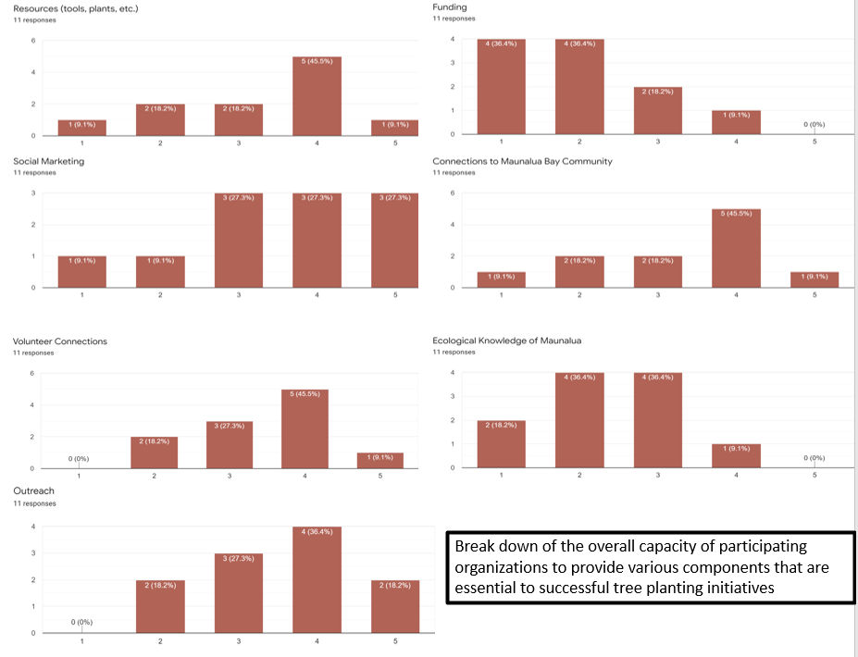
Notes:
Here we divided the responses for strengths by component, and this highlights the overall constraints and strengths for conservation initiatives in general, but also for urban forestry initiatives. As expected, funding is largely the limiting factor for almost all organizations, however, there are many organizations that have strong outreach, social marketing, and volunteer connections that could be essential partners or fill niches within tree planting initiatives.

Slide 22
Results: Identify specific land types and property where organizations can work together to achieve successful tree planting initiatives. (4)
Koko Head Elementary Pilot Project
iTree canopy cover: 11.8%
Public accessed, DOE maintained
Koko Head Elementary, Ko’olau Mountains Watershed Partnership, Smart Trees Pacific, Malama Maunalua
Specific planting considerations
Notes:
These organizations compliment each other in that they all are interested in native plants, and fill gaps in each other's strengths.

Slide 23
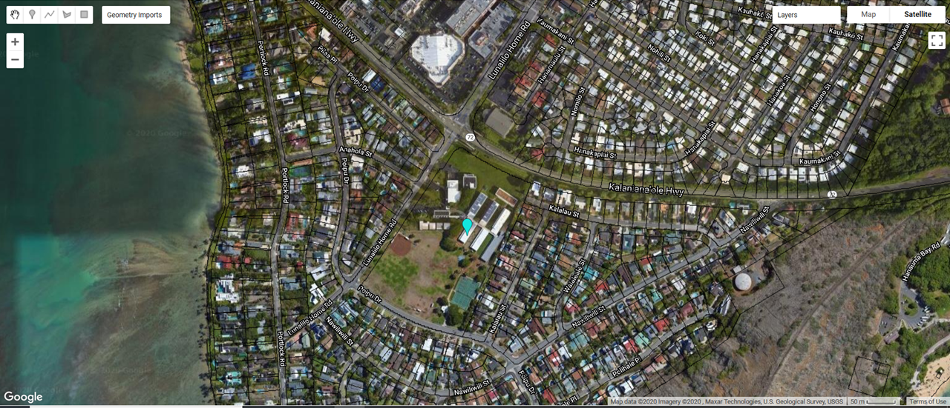
Mapping: Koko Head Elementary
Koko Head Elementary

Slide 24
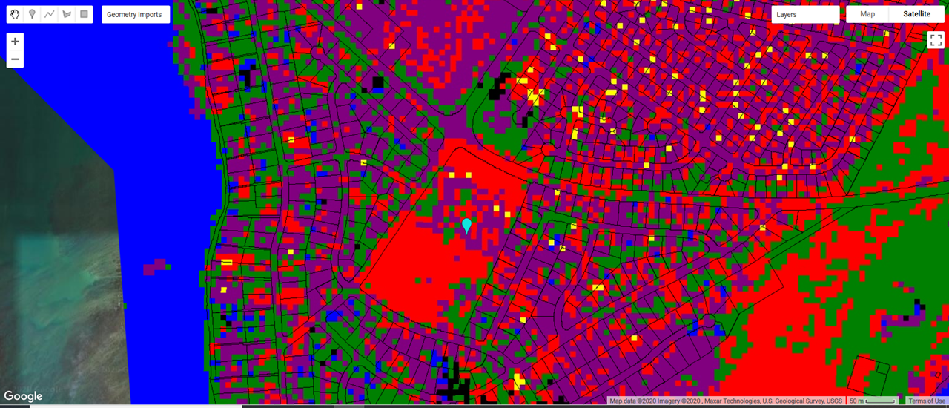
Mapping: Koko Head Elementary
Koko Head Elementary

Slide 25
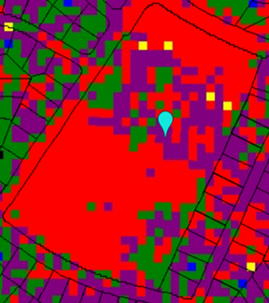
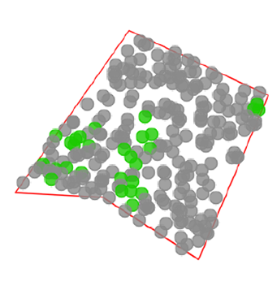
Mapping: Comparison of Classifier with I-Tree
Notes:
Slide is a little plain but gets the point across, if anyone has any other additions, by all means.

Slide 26
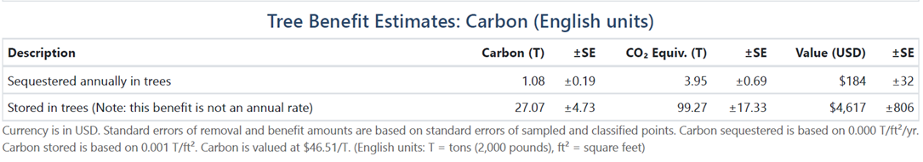
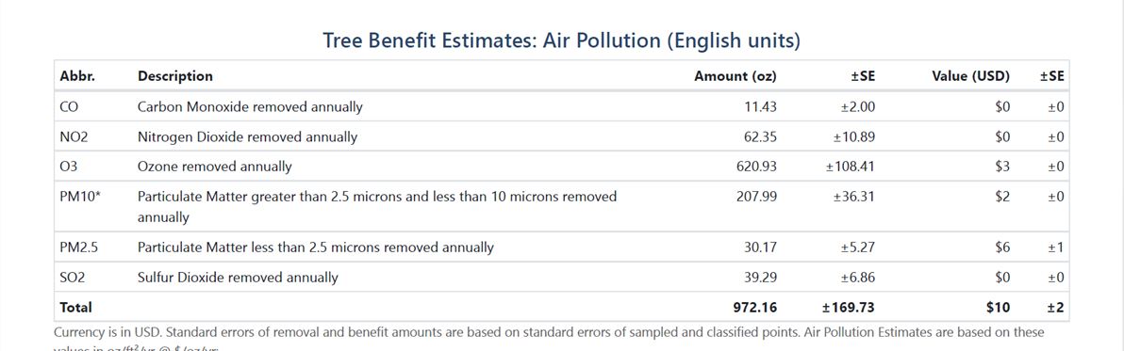
iTree-Canopy Metrics
Notes:
I- Tree Metrics

Slide 27
Conclusions: Stakeholder Goals (1) and Responses (2)
There are many potential partners
A different survey method could be used to gain more responses
Some organizations (Schools, CCH) are limited to participating only on their properties
Human health and wellbeing was the most highly-voted service provided by increasing urban forestry
Funding and ecological knowledge of Maunalua are the two main limitations for participating organizations
Notes:
There are many potential partners - not all responded, but there are interested parties across sectors
A different survey method could be used to gain more responses - We intended to call people, but due to COVID decided to try an email survey. The survey will remain open and the link provided on the one pager if any other organizations wish to participate.
Some organizations (Schools, CCH) are limited to participating only on their properties.
Human health and wellbeing was the most highly-voted service provided by increasing urban forestry - followed by improving cultural connection and education. These responses directly assist MM with framing their tree planting initiatives to appeal to partnering organizations, but also to the public even if they are not MM’s primary services they are interested in.
Funding and ecological knowledge of Maunalua are the two main limitations for participating organizations - but many organizations have strengths in social marketing, outreach, and providing volunteers. MM could fill this niche by providing the ecological knowledge of Maunalua and securing the funding to conduct the tree planting initiatives.

Slide 28
Conclusions: Identify specific land types and property where organizations can work together to achieve successful tree planting initiatives. (4)
Smart Trees Pacific and Ko’olau Mountain Watershed are the most viable partners for this project
For every 10 mid-sized native trees planted on this site, there is a potential net benefit of 972 gallons of rainfall intercepted and 254 lbs. Of CO2 sequestered
Potential grant funding from Kaulunai Urban and Community Forestry Program Community Grants
Notes:
-When determining where MM has the greatest capacity to engage in tree planting initiatives, it was important to find partners

Slide 29
Final Outputs
All tables and figures produced from survey responses
GeoTIFF files of mapping tools and descriptions of their use
iTree-Canopy output for Koko Head Elementary
Planting logistics and organizational capacity by land type outline
Example of MOU for planting partnership
Infographic describing project for use as a “one-pager” in MM newsletter

Slide 30
Thank You!
Questions?

